Slide 1


Spring 2013 Student Performance Analysis with Instructional Guidance
Grade 8 Science
Standards of Learning
Presentation may be paused and resumed using the arrow keys or the mouse.
Notes:
In order to support instruction of students in the science Standards of Learning (SOL), this PowerPoint presentation has been developed to provide information about the content for which student performance was weak or inconsistent during the spring 2013 test administration. In collaboration with the Division of Student Assessment and School Improvement, the Division of Instruction has provided instructional information for teachers and school divisions for the content areas highlighted in this presentation.
It is important to note that the SOL, examples, and instructional information highlighted in this presentation should not be the sole focus of instruction in the classroom, nor should these suggestions replace the data that teachers or school divisions have collected on student performance. Rather, this PowerPoint presentation contains information that supports the instruction of the Science Standards of Learning for which statewide student performance showed the need for improvement.

Slide 2
Earth’s Energy Budget
6.3 The student will investigate and understand the role of solar energy in driving most natural processes within the atmosphere, the hydrosphere, and on Earth’s surface. Key concepts include
a) Earth’s energy budget;
b) the role of radiation and convection in the distribution of energy;
the motion of the atmosphere and the oceans;
Students need additional experiences analyzing the significance of solar energy and the role of absorption, reflection, and radiation.
Notes:
The first standard highlighted is SOL 6.3a. Throughout this presentation, the areas in which overall student performance was weak or inconsistent will be highlighted in blue.
This standard reads: The student will investigate and understand the role of solar energy in driving most natural processes within the atmosphere, the hydrosphere, and on Earth’s surface. Key concepts include bullet a) Earth’s energy budget.
Students need additional experiences analyzing the significance of solar energy and the role of absorption, reflection, and radiation.

Slide 3
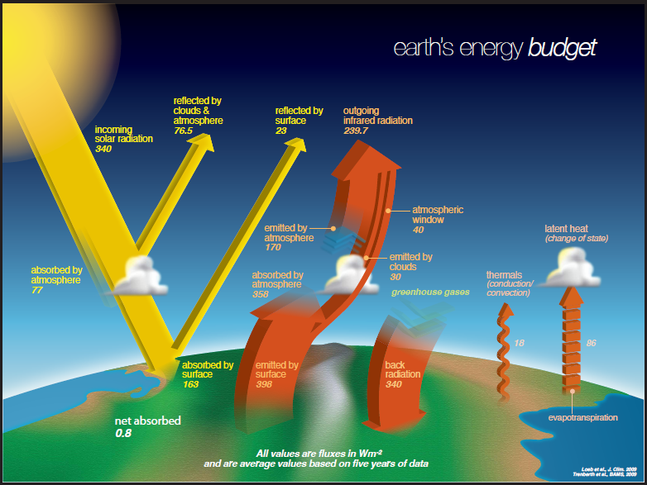
Instructional Guidance 6.3a
Earth’s Energy Budget
http://science-edu.larc.nasa.gov/energy_budget/
Notes:
Earth’s energy budget can be accounted for by determining the pathways that solar energy can travel through as it enters the atmosphere and is either reflected, absorbed, or radiated. The diagram on the screen was produced by NASA and is available for use by educators. The essential notion of this diagram is that Earth absorbs, reflects, and radiates heat and that we can account for the energy that strikes Earth.
Students should plan and conduct investigations that allow them to better understand energy transfer and heat movement. This may help students make an abstract concept like Earth’s energy budget more concrete.

Slide 4
Use of Chemical Formulas
6.4 The student will investigate and understand that all matter is made up of atoms. Key concepts include
a) atoms consist of particles, including electrons, protons, and neutrons;
b) atoms of a particular element are alike but are different from atoms of other elements;
c) elements may be represented by chemical symbols;
d) two or more atoms interact to form new substances, which are held together by electrical forces (bonds);
e) compounds may be represented by chemical formulas;
Students need additional practice interpreting the components of compounds through the expression of chemical formulas.
Notes:
The next standard highlighted is SOL 6.4e. The student will investigate and understand that all matter is made up of atoms. Key concepts include bullet
e) compounds may be represented by chemical formulas.
Students need additional practice interpreting the components of compounds through the expression of chemical formulas.

Slide 5
Instructional Guidance 6.4e
Use of Chemical Formulas
In the chemical formula for ammonia NH₃, what does the subscript 3 represent?
The number of nitrogen and hydrogen atoms in each molecule of ammonia
The number of hydrogen atoms in each molecule of ammonia
The number of ammonia molecules that will bond together
The number of nitrogen atoms in each molecule of ammonia
Notes:
In the example shown on the screen, students must recognize the subscript and identify what it means. Students found items such as this challenging. Chemical symbols, coefficients, and subscripts are used to represent various components of elements, molecules and compounds in chemical reactions. An essential concept of this SOL is that mass is conserved.
The answer to the example is shown on the screen.

Slide 6
Solar System Organization
6.8 The student will investigate and understand the organization of the solar system and the interactions among the various bodies that comprise it. Key concepts include
the sun, moon, Earth, other planets and their moons, dwarf planets, meteors, asteroids, and comets;
relative size of and distance between planets;
Students need additional experiences analyzing solar system organization and comparing various solar system bodies.
Notes:
The next standard highlighted is SOL 6.8a. This standard reads: The student will investigate and understand the organization of the solar system and the interactions among the various bodies that comprise it. Key concepts include bullet a) the sun, moon, Earth, other planets and their moons, dwarf planets, meteors, asteroids, and comets.
Students need additional experiences analyzing solar system organization and comparing various solar system bodies.

Slide 7
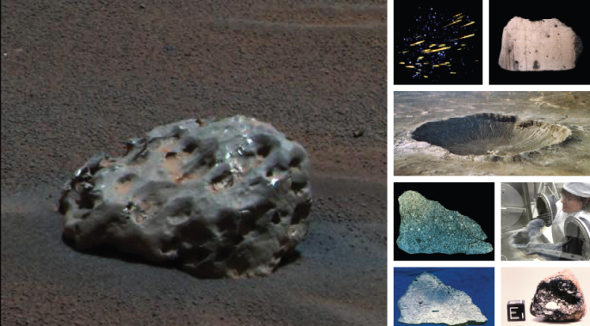
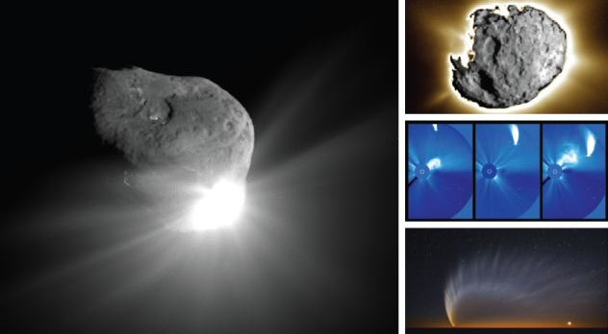
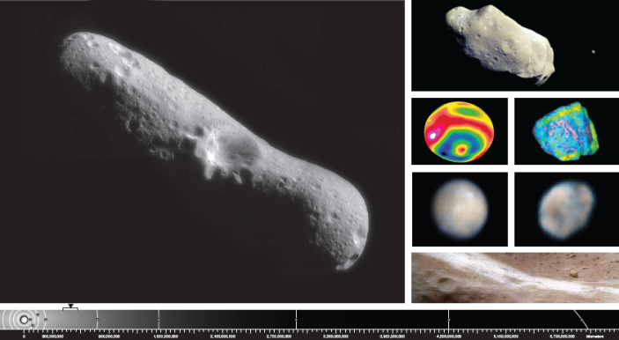
Instructional Guidance for 6.8a
Solar System Organization
Meteor
Comet
Asteroid
*Images are Public Domain: http://www.nasa.gov/audience/foreducators/
Notes:
This new standard encompasses a great deal of information. When asked to apply specific information, such as the location of non-planetary objects in a technology-enhanced item format, some students showed weaker performance than on other test items. Experiential activities pertaining to structure and location of non-planetary objects might benefit students. NASA has many resources for educators that can help.

Slide 8
Structures of Cells
LS.2 The student will investigate and understand that all living things are composed of cells. Key concepts include
cell structure and organelles;
b) similarities and differences between plant and animal cells;
c) development of cell theory; and
cell division.
Students need additional experience investigating cellular structures using microscopes or models and simulations.
Notes:
The next standard highlighted is SOL LS.2a. This standard reads: The student will investigate and understand that all living things are composed of cells. Key concepts include bullet a) cell structure and organelles.
Students need additional experience investigating cellular structures using microscopes or models and simulations.

Slide 9
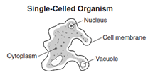
Instructional Guidance for LS.2a
Structures of Cells
In this diagram of a single-celled organism, which organelle functions as a place to store extra water?
Cell membrane
Vacuole
Cytoplasm
Nucleus
2. A plant’s green color is due to the
presence of which organelle?
Chloroplast
Nucleus
Mitochondria
Vacuole
Virginia Science Activities, Models, and Simulations (SAMS)
Notes:
The examples shown on the screen are typical SOL questions students might encounter on the Grade 8 Science test. The answers to these two questions are shown on the screen.
Students will also encounter technology enhanced items in which they might have to identify several cellular structures and their functions. Students that have already been exposed to a microscope will certainly have an advantage when exploring SOL LS.2a, structure of cells. Continuing to use a microscope through the delivery of LS.2 content will be of great help to students as they progress trough their studies. When microscopes are not available, models and simulations of cell and cell processes can assist in delivery of LS.2 content.
There is a link to the Virginia Science Activities, Models, and Simulations on this page.

Slide 10
Response to Environmental Change
LS.10 The student will investigate and understand that ecosystems, communities, populations, and organisms are dynamic, change over time, and respond to daily, seasonal, and long-term changes in their environment. Key concepts include
a) phototropism, hibernation, and dormancy;
b) factors that increase or decrease population size; and
eutrophication, climate changes, and catastrophic disturbances.
Students need additional experience analyzing phototropism,
hibernation, and dormancy in respect to changes in the
environment.
Notes:
The next standard highlighted is SOL LS.10a. This standard reads: The student will investigate and understand that ecosystems, communities, populations, and organisms are dynamic, change over time, and respond to daily, seasonal, and long-term changes in their environment. Key concepts include bullet a) phototropism, hibernation, and dormancy.
Students need additional experience analyzing phototropism, hibernation, and dormancy in respect to changes in the environment.

Slide 11
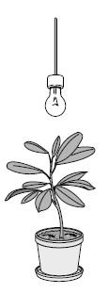
Instructional Guidance for 7.10a
Response to Environmental Change
This plant has been growing in a closet with the light bulb as it only source of light. As a result of the light bulb being moved to the location of the arrow, the plant would-
bend toward the new location of the light bulb and continue to grow.
begin to wilt, and drop its leaves.
grow very slowly with no change in appearance.
form buds and flower.
Notes:
This example requires students to identify phototropism in a plant. Items where students needed to distinguish between phototropism, hibernation, and dormancy showed weaker performance. Students should be exposed to real-life examples of phototropism, hibernation, and dormancy at school and at home. Students should investigate what advantages each response could provide and what factors could have contributed to the response expression in populations.
The answer to the example is shown on the screen.

Slide 12
Changes in Populations over Time
LS.13 The student will investigate and understand that populations of organisms change over time. Key concepts include
a) the relationships of mutation, adaptation, natural selection, and extinction;
evidence of evolution of different species in the fossil record; and
how environmental influences, as well as genetic variation, can lead to diversity of organisms.
Students need additional practice interpreting and analyzing changes in populations over time through processes such as mutation, adaptation, natural selection, and extinction.
Notes:
The next standard highlighted is SOL LS.13a. This standard reads: The student will investigate and understand that populations of organisms change over time. Key concepts include bullet a) the relationships of mutation, adaptation, natural selection, and extinction.
Students need additional practice interpreting and analyzing changes in populations over time through processes such as mutation, adaptation, natural selection, and extinction.

Slide 13
Instructional Guidance for LS.13
Changes in Populations over Time
Which process is the original source of genetic variation that allows for natural selection?
Pollination
Binary Fission
Mutation
Replication
Notes:
The item shown asks students to identify a mutation as an original source of genetic variation that allows for natural selection. Changes in populations over time may be difficult for students to understand due, in part, to the length of time involved. When possible, relate time scale to change by using organisms such as yeast algae that have short lifespans. In this instance, models and simulations are very helpful in showing changes through time.

Slide 14
Measurement Concepts
PS.1 The student will demonstrate an understanding of scientific reasoning, logic, and the nature of science by planning and conducting investigations in which
chemicals and equipment are used safely;
length, mass, volume, density, temperature, weight, and force are accurately measured;
Students need extra practice obtaining and properly recording measurements through laboratory experience.
Notes:
The next standard highlighted is SOL PS.1b. This standard reads: The student will demonstrate an understanding of scientific reasoning, logic, and the nature of science by planning and conducting investigations in which bullet b) length, mass, volume, density, temperature, weight, and force are accurately measured.
Students need extra practice obtaining and properly recording measurements through laboratory experience.

Slide 15
Instructional Guidance PS.1
Measurement Concepts
Which is a metric unit of measurement that is used to record the heat transfer of a solution in a classroom investigation?
Liter
Newton
Volt
Degree Celsius
Notes:
This example requires students to select the metric unit for a given task. Students scored lower on items that required them to select the most appropriate unit of measurement. Students need practice planning and conducting investigations in which they make and record various measurements in appropriate units. These efforts reinforce work done in earlier grades and provide a strong foundation for future development of science skills.
The answer to this example is shown on the screen.

Slide 16
Periodic Table
PS.4 The student will investigate and understand the organization and use of the periodic table of elements to obtain information. Key concepts include
a) symbols, atomic numbers, atomic mass, chemical families (groups), and periods;
b) classification of elements as metals, metalloids, and nonmetals; and
c) formation of compounds through ionic and covalent bonding.
Students need additional practice using a periodic table, including the use of a table for classification of elements.
Notes:
The next standard highlighted is SOL PS.4b. It reads: The student will investigate and understand the organization and use of the periodic table of elements to obtain information. Key concepts include bullet b) classification of elements as metals, metalloids, and nonmetals.
Students need additional practice using a periodic table, including the use of a table for classification of elements.

Slide 17
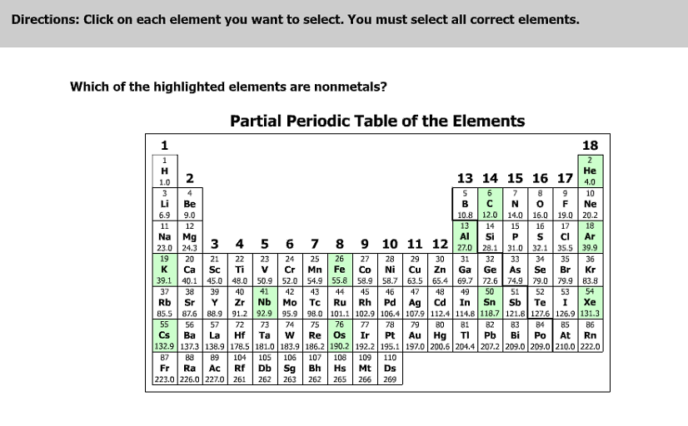
Instructional Guidance PS.4b
Periodic Table
Notes:
Students need as much exposure to laboratory settings as is practical. The more time students spend investigating the properties used to classify elements as metals, metalloids, and nonmetals they are better able to understand more complex ideas such as chemical bonding. When exploring PS.4, models and simulations are especially useful, as well as the use of video segments.
The question on the screen asks which of the highlighted elements are nonmetals. The answer is shown on the screen.

Slide 18
Chemical Changes
PS.5 The student will investigate and understand changes in matter and the relationship of these changes to the Law of Conservation of Matter and Energy. Key concepts include
physical changes;
chemical changes; and
nuclear reactions.
Students need additional practice investigating and properly representing chemical changes.
Notes:
The last standard highlighted is SOL PS.5b. It reads: The student will investigate and understand changes in matter and the
relationship of these changes to the Law of Conservation of Matter and Energy. Key concepts include bullet b) chemical changes.
Students need additional practice investigating and properly representing chemical changes.

Slide 19
Chemical Changes (PS.5b)
__CO + __NO __N₂ + __CO₂
Which set of coefficients will balance this equation?
1, 4, 2, 1
1, 2, 1, 1
2, 2, 1, 2
4, 3, 2, 4
Notes:
This slide shows a multiple choice item that assesses the skills associated with PS.5b. Students found items like these challenging. The answer to the example is shown on the screen.

Slide 20
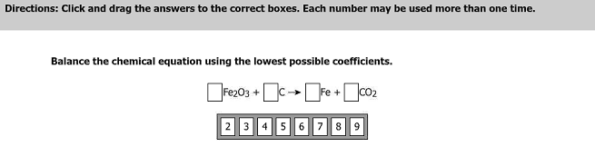
Instructional Guidance PS.5b
Chemical Changes
Answer: correct coefficients are 2, 3, 4, and 3.
Students need additional practice calculating the lowest possible coefficients for a balanced chemical reaction.
Notes:
This example shows a drag-and-drop technology enhanced item. In this case, the student must drag and drop the correct coefficient into each box until the entire reaction is balanced. Examples such as this, where students need to calculate the lowest possible coefficients to balance an equation, are more rigorous and difficult for some students. In addition, more exposure to models and simulations may help with conceptual understanding of how to balance a chemical equation.

Slide 21
Practice Items
This concludes the student performance information for the spring 2013 Grade 8 Science SOL test.
Additionally, test preparation practice items for grade 6 science, life science, and physical science can be found on the Virginia Department of Education Web site at:
http://www.doe.virginia.gov/testing/sol/practice_items/index.shtml#science
21
Notes:
This concludes the student performance information for the spring 2013 Grade 8 Science SOL test.
Additionally, test preparation practice items for Grade 6 science, life science, and physical science can be found on the Virginia Department of Education Web site at the URL shown on the screen.

Slide 22
Contact Information
For questions regarding assessment, please contact
Student_assessment@doe.virginia.gov
For questions regarding instruction, please contact
Instruction@doe.virginia.gov
Notes:
No audio.

