Slide 1


Spring 2013 Student Performance Analysis with Instructional Guidance
Earth Science
Standards of Learning
Presentation may be paused and resumed using the arrow keys or the mouse.
Notes:
In order to support instruction of students in the science Standards of Learning (SOL), this PowerPoint presentation has been developed to provide information about the content for which student performance was weak or inconsistent during the spring 2013 test administration. In collaboration with the Division of Student Assessment and School Improvement, the Division of Instruction has provided instructional information for teachers and school divisions for the content areas highlighted in this presentation.
It is important to note that the SOL, examples, and instructional information highlighted in this presentation should not be the sole focus of instruction in the classroom, nor should these suggestions replace the data that teachers or school divisions have collected on student performance. Rather, this PowerPoint presentation contains information that supports the instruction of the Science Standards of Learning for which statewide student performance showed the need for improvement.

Slide 2

Measurements and calculation using the most appropriate tools
SOL ES.1
The student will plan and conduct investigations in which
a) volume, area, mass, elapsed time, direction, temperature, pressure, distance, density, and changes in elevation/depth are calculated utilizing the most appropriate tools;
Notes:
The first standard highlighted is SOL ES.1a. This standard reads: The student will plan and conduct investigations in which bullet a) volume, area, mass, elapsed time, direction, temperature, pressure, distance, density, and changes in elevation/depth are calculated utilizing the most appropriate tools.

Slide 3
Instructional Guidance ES.1a
Measurements and Calculation Using the Most Appropriate Tools
Enhanced Scope and Sequence Lesson: “Analyzing Your School’s Quadrangle”
http://www.doe.virginia.gov/testing/sol/standards_docs/science/2010/lesson_plans/earth_sci/sci_investigation/sess_ES-1acd_1.pdf
Notes:
The Enhanced Scope and Sequence activities on the Virginia Department of Education Web site help teachers align instruction with the 2010 Science Standards of Learning (SOL) by providing examples of how the knowledge, skills and processes found in the SOL and curriculum framework can be presented to students in the classroom.
The Enhanced Scope and Sequence activity “Analyzing your Schools Quadrangle” shown on the screen will give students the opportunity to apply ES.1a skills in measuring, direction, distance, and changes in elevation calculated utilizing the most appropriate tools while engaging other SOL as well.

Slide 4
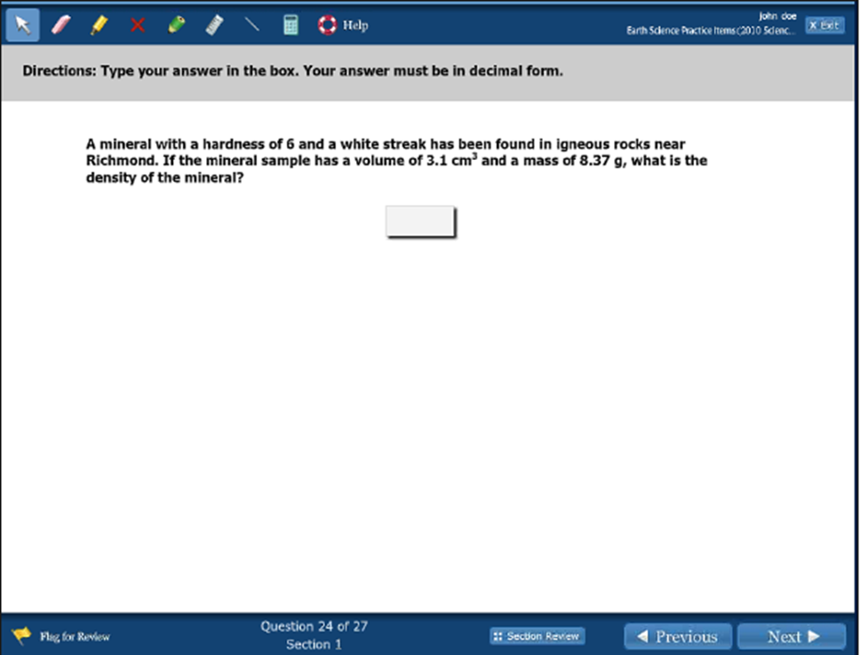

Instructional Guidance for ES.1a Measurements and Calculation Using
the Most Appropriate Tools
Notes:
This technology enhanced item requires students to calculate density. If asked to calculate density given mass and volume, most students can determine the answer. However, if given extraneous information, or asked to calculate mass when given volume and density, students do not perform as well.
The answer to the example is shown on the screen.
Teaching the skills and content associated with SOL ES.4a provides an opportunity to investigate density. Hefting a range of hand samples (e.g., minerals such as hematite, pyrite, pyroxene, quartz, calcite) reinforces the concept of density. Density, both as a computed mathematical ratio and as the more abstract conceptual understanding, is key across Earth systems content (e.g., convection in the atmosphere, ocean, and solid Earth).

Slide 5
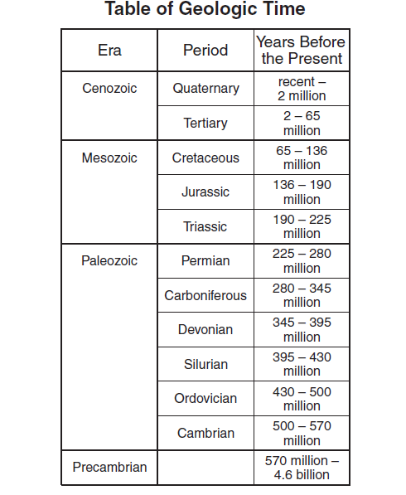
Measurements and calculation using
the most appropriate tools (ES 1.a)
Rocks found on land are up to 3.8 billion years old, but those in the ocean are no more than 180 million years old. Using the information shown, during which era could parts of the ocean floor have formed?
Triassic
Paleozoic
Precambrian
Mesozoic
Notes:
This item connects multiple concepts and requires an understanding of several areas of Earth Science (rock formation, plate tectonics, geologic time, interpreting a table, and reasoning). In certain examples with similar construction, students had difficulty when asked to apply both knowledge and specific science skills.
The answer to this example is shown on the screen.

Slide 6
The Rock Cycle ES.5
SOL ES.5
The student will investigate and understand the rock cycle as it relates to the origin and transformation of rock types and how to identify common rock types based on mineral composition and textures. Key concepts include
igneous rocks;
sedimentary rocks; and
metamorphic rocks.
Notes:
The next standard highlighted is ES.5, which relates to the rock cycle. SOL ES.5 reads: The student will investigate and understand the rock cycle as it relates to the origin and transformation of rock types and how to identify common rock types based on mineral composition and textures. Key concepts include bullet a) igneous rocks, bullet b) sedimentary rocks, and bullet c) metamorphic rocks.

Slide 7
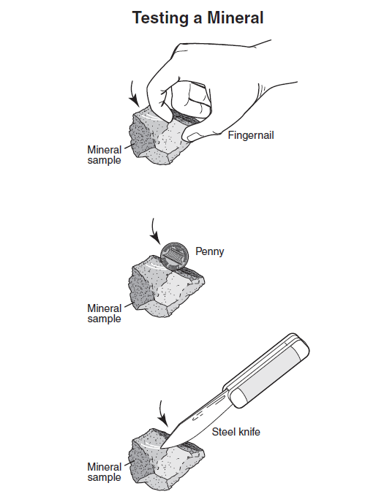
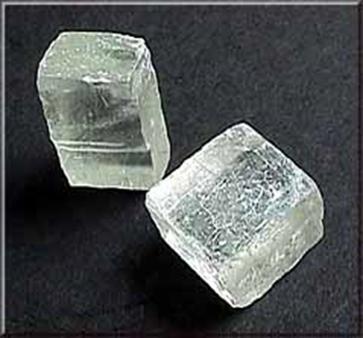
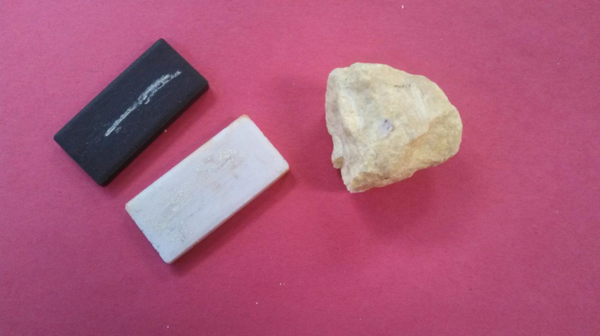
Instructional Guidance for ES.4a
Mineral Identification (in support of rock cycle ES.5)
SOL ES.4a
The student will investigate and understand how to identify major rock-forming and ore minerals based on physical and chemical properties. Key concepts include-
a) hardness, color and streak, luster, cleavage, fracture, and unique properties.
Streak Test
Calcite
Photo by: Amelia Nuckolls, Galax VA
Public Domain:
http://geomaps.wr.usgs.gov/parks/rxmin/mineral.html
The diagram shows a test for which mineral property?
Hardness
Notes:
In support of SOL ES.5, students would benefit from opportunities to practice using scientific tools and technique while investigating the concepts associated with SOL ES.4. Cleaving halite, or calcite, and looking at the resulting fragments, both with the naked eye and under a magnification, strongly reinforces the concept of mineral cleavage. Similarly, conducting streak tests conveys the idea of what streak is, especially when the mineral’s streak is not what was anticipated, as in, for example, amethyst, pyrite, and specular hematite.

Slide 8
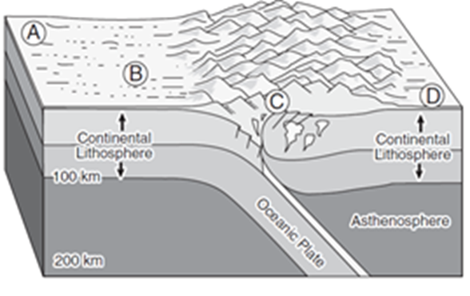
The Rock Cycle (ES.5)
Students need additional practice with items that assess the composition of Earth materials.
At which location are metamorphic rocks most likely to be found?
A. Location A
B. Location B
C. Location C
D. Location D
Notes:
Analyzing rock samples for individual minerals whether by in-hand sample or by viewing and sorting crushed rock fragments and recording compositional data, builds the idea of constituent mineralogy and texture. This example demonstrates an aspect of metamorphic rock formation. Students must understand what is happening in the cross section, differentiate the various rock forming processes underway, and choose the best matching location for metamorphism.
The answer to the question is shown on the screen.

Slide 9
The Rock Cycle (ES.5)
1. Heat and pressure can transform igneous rock into metamorphic rock. What processes can transform igneous rock into sedimentary rock?
Heat and pressure
Rifting and subduction
Erosion and sedimentation
Evaporation and condensation
2. Igneous rocks are formed by-
A. heat and pressure on existing rocks
B. evaporation of water, leaving solids behind
C. cooling and hardening of molten rock
D. layers of mud on the bottom of a lake
Notes:
Here are two more examples for ES.5. Example number one demonstrates aspects of sedimentary rock formation. Students may encounter items that differentiate between types of sedimentary rocks such as clastic and non-clastic. Example number two demonstrates aspects of igneous rock formation. Students may encounter items that differentiate between types of igneous rocks such as intrusive and extrusive.
The answers to the two questions are shown on the screen.

Slide 10
Instructional Guidance for ES.5
The Rock Cycle
See the Enhances Scope and Sequence Lesson titled, “Three Types of Rocks.”
http://www.doe.virginia.gov/testing/sol/standards_docs/science/2010/lesson_plans/earth_sci/earth_materials_processes/sess_ES-5abc.pdf
Notes:
In support of ES.5, the Enhanced Scope and Sequence lesson “Three Types of Rocks” gives students the opportunity to relate the origin and transformation of rock types, and how to identify common rock types, based on mineral composition and textures. The URL for this lesson is shown on the screen.

Slide 11
Plate Tectonics
SOL ES.7
The student will investigate and understand geologic processes including plate tectonics. Key concepts include:
geologic processes and their resulting features; and
tectonic processes.
Notes:
The next standard highlighted is ES.7. This standard reads: The student will investigate and understand geologic processes including plate tectonics. Key concepts include bullet a) geologic processes and their resulting features; and bullet b) tectonic processes.
When concepts related to the formation of Earth materials cannot be presented in a hands-on way easily in the classroom, students should have opportunities in other instructional contexts that promote inquiry.
For example, computer simulations, static and working models, and video segments, along with more abstract mathematical representations provide reinforcing pathways.

Slide 12
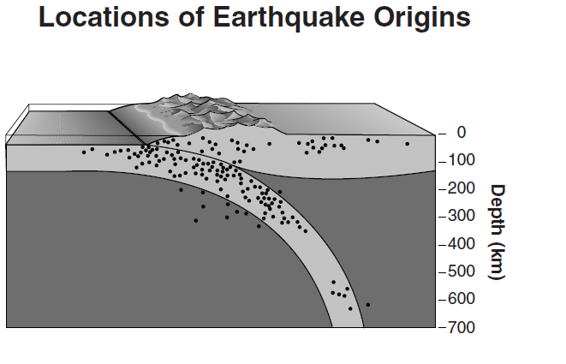
Plate Tectonics (ES.7b)
Each dot on the diagram marks the origin of an earthquake. The area with the highest concentration of earthquake origins marks-
a line of Earth’s magnetic field
a seam of soft rock, such as limestone
the path of the subducting tectonic plate
the location of a developing igneous intrusion
Notes:
For this item, it is important for students to recognize that high concentrations of earthquakes show evidence for plate boundaries.
Test questions applying Earth-science concepts in the context of scientific investigation skills showed lower overall performance. Previous information provided for ES.1a indicated that students had trouble with slightly more abstract applications of density. In this example, students need to understand the role of density in convection currents in the mantel, or subduction of oceanic crust, or the formation and movement of continental crust.
The answer to the example is shown on the screen.

Slide 13
Evidence for Changes in
Atmospheric Composition Over Time
SOL ES.11
The student will investigate and understand the origin and evolution of the atmosphere and the interrelationship of geologic processes, biologic processes, and human activities on its composition and dynamics. Key concepts include
scientific evidence for atmospheric composition changes over geologic time;
Notes:
The next standard highlighted is ES.11a. This standard reads: The student will investigate and understand the origin and evolution of the atmosphere and the interrelationship of geologic processes, biologic processes, and human activities on its composition and dynamics. Key concepts include bullet a) scientific evidence for atmospheric composition changes over geologic time.

Slide 14
Instructional Guidance for ES.11a
Evidence for Changes in
Atmospheric Composition Over Time
Students need additional practice identifying biosphere and atmosphere system interactions and the origins of the atmosphere.
Which element in Earths atmosphere is essential for human life and is extremely rare or nonexistent in the atmospheres of other planets in our solar system?
Carbon dioxide
Hydrogen
Nitrogen
Oxygen
A volcanic eruption can affect the atmosphere by-
reducing the amount of water vapor in the atmosphere
adding large quantities of several gases, such as sulfur dioxide, to the atmosphere
clearing away nearby clouds, increasing the amount of sunshine
increasing the amount of oxygen due to escaping gases
Notes:
Students need more practice identifying biosphere and atmosphere system interactions and origins of the atmosphere. It is important to connect previously taught concepts with new information. This will help avoid a discrete or compartmentalized view of the material.
For example, for some students, what was learned about the atmosphere may not always have been integrated with ideas about Earth history and Earth materials, and may not be well connected with standards-related concepts involving planetary science.
These examples on the screen illustrate the importance of assimilating the knowledge and skills of learned concepts across standards to build scientific expertise.
The answers are shown on the screen.

Slide 15
Practice Items
This concludes the student performance information for the spring 2013 Earth Science SOL test.
Additionally, test preparation practice items for Earth Science can be found on the Virginia Department of Education Web site at:
http://www.doe.virginia.gov/testing/sol/practice_items/index.shtml#science
15
Notes:
This concludes the student performance information for the spring 2013 Earth Science SOL test.
Additionally, test preparation practice items for Earth Science can be found on the Virginia Department of Education Web site at the URL shown on the screen.

Slide 16
Contact Information
For questions regarding assessment, please contact
Student_assessment@doe.virginia.gov
For questions regarding instruction, please contact Instruction@doe.virginia.gov
Notes:
No audio.

