Slide 1


Spring 2013 Student Performance Analysis with Instructional Guidance
Chemistry
Standards of Learning
Presentation may be paused and resumed using the arrow keys or the mouse.
Notes:
In order to support instruction of students in the science Standards of Learning (SOL), this PowerPoint presentation has been developed to provide information about the content for which student performance was weak or inconsistent during the spring 2013 test administration. In collaboration with the Division of Student Assessment and School Improvement, the Division of Instruction has provided instructional information for teachers and school divisions for the content areas highlighted in this presentation.
It is important to note that the SOL, examples, and instructional information highlighted in this presentation should not be the sole focus of instruction in the classroom, nor should these suggestions replace the data that teachers or school divisions have collected on student performance. Rather, this PowerPoint presentation contains information that supports the instruction of the Science Standards of Learning for which statewide student performance showed the need for improvement.

Slide 2

Mass and Charge of Subatomic Particles
SOL CH.2
The student will investigate and understand that the placement of elements on the periodic table is a function of their atomic structure. The periodic table is a tool used for the investigations of
mass and charge characteristics of subatomic particles;
Notes:
The first standard highlighted is CH.2c. It reads: The student will investigate and understand that the placement of elements on the periodic table is a function of the elements’ atomic structures. The periodic table is a tool used for the investigations of bullet c) mass and charge characteristics of subatomic particles.
Students are expected to differentiate between alpha, beta, and gamma radiation with respect to penetrating power, shielding, and composition; and differentiate between the major atom components (proton, neutron and electron) in terms of location, mass and size, as well as charge.
Teachers should begin the discussion of mass and charge characteristics of subatomic particles by helping students understand the unique properties of elements and how they are related to their atomic structure using the periodic table of elements and other tools.

Slide 3
Mass and Charge of Subatomic Particles (CH.2c)
Students need additional practice with abstract science concepts at the atomic and subatomic levels.
1. The net charge on an aluminum ion is +3 because there are-
10 protons and 13 electrons in the atom
13 protons and 10 neutrons in the nucleus
10 neutrons and 13 electrons in the atom
13 protons and 10 electrons in the atom
2. An atom contains 70 protons, 70 electrons, and 99 neutrons. What is the mass number?
A) 239
B) 169
C) 140
D) 70
Notes:
For SOL CH.2c, students need additional practice with abstract science concepts at the atomic and subatomic levels. In the first example item students are asked to provide a reason, based on the number of subatomic particles, why an aluminum ion has a plus 3 charge. Students should be given the opportunity to use a Periodic Table of Elements to determine the number of protons for an Aluminum atom that has a neutral net charge. In the second item students can use and apply the information found in a Periodic Table of Elements to determine the mass of subatomic particles.
The answers to the two questions are shown on the screen.

Slide 4
Instructional Guidance CH.2c
Mass and Charge of Subatomic Particles
Students need more experiential opportunities as well as models and simulations while engaging in the historical development of quantum theory.
Suggested laboratory investigation from the Enhanced Scope and Sequence Activity:
“Atomic Structure: Periodic Table”
http://www.doe.virginia.gov/testing/sol/standards_docs/science/2010/lesson_plans/chemistry/atomic_structure_periodic_relationships/sess_CH-2defg1h.pdf
Notes:
A hallmark of science is that it generates theories and laws that must be consistent with observations. Much of the evidence from these observations is collected during laboratory investigations. A school laboratory investigation (also referred to as a lab) is defined as an experience in the laboratory, classroom, or the field that provides students with opportunities to interact directly with natural phenomena or with data collected by others using tools, materials, data collection techniques, and models (National Research Council (NRC). 2006. America’s lab report: Investigations in high school science. Washington, DC: National Academy Press). Throughout the process, students should have opportunities to design investigations, engage in scientific reasoning, manipulate equipment, record data, analyze results, and discuss their findings. These skills and knowledge, fostered by laboratory investigations, are an important part of inquiry—the process of asking questions and conducting experiments as a way to understand the natural world (National Science Teachers Association (NSTA). 2004. NSTA Position Statement: Scientific Inquiry). While reading about science, using computer simulations, and observing teacher demonstrations may be valuable, they are not a substitute for laboratory investigations by students (NRC 2006, p. 3).
The Enhanced Scope and Sequence activities on the Virginia Department of Education Web site help teachers align instruction with the 2010 Science Standards of Learning (SOL) by providing examples of how the knowledge, skills and processes found in the SOL and curriculum framework can be presented to students in the classroom. For this particular SOL, the activity “Atomic Structure: Periodic Table” will give students the opportunities to investigate electron configurations and the Periodic Table of Elements.

Slide 5
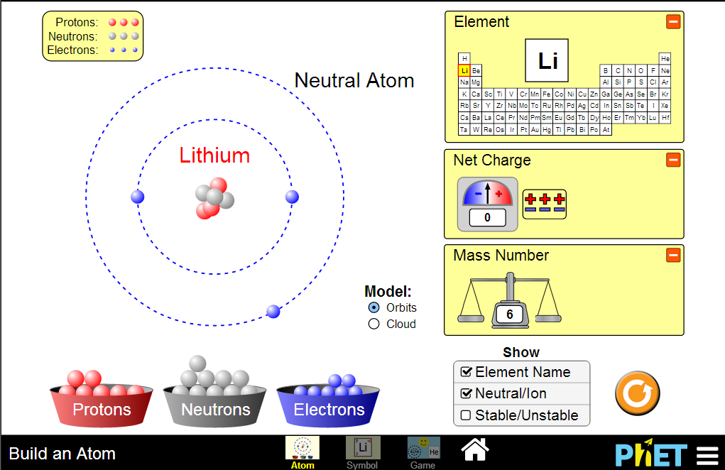
Instructional Guidance CH.2c
Mass and Charge of Subatomic Particles
Virginia Science Activities, Models, and Simulations (SAMS)
http://www.doe.virginia.gov/instruction/science/resources/sams/chemistry.docx
Notes:
Students will benefit from instructional time and meaningful contexts with real materials to reinforce fundamental concepts.
However, in some instances when objects are so small that it is impossible to make direct observations without special tools, models and simulations help students understand concepts like mass number and net charge. These tools, with their quick repetitive nature, help students achieve understanding.
The example shown allows students to manipulate the number of protons, neutrons, and electrons to observe the resulting change in net charge and mass number.
The Science Instruction staff worked with teachers to identify and correlate activities, models, and simulations to the middle and high school Science Standards. This is an example of one of the models. There is a link to the Virginia Science Activities, Models, and Simulations on this page.

Slide 6
Types of Chemical Bonds
SOL CH.3
The student will investigate and understand how conservation of energy and matter is expressed in chemical formulas and balanced equations. Key concepts include
d) bonding types;
Notes:
The next standard highlighted is SOL CH.3d. This standard reads: The student will investigate and understand how conservation of energy and matter is expressed in chemical formulas and balanced equations. Key concepts include bullet d) bonding types.

Slide 7
Types of Chemical Bonds (CH.3d)
Which of these compounds is most likely to contain a nonpolar covalent bond?
H₂
SO₂
CH₄
CaCl₂
Notes:
In this example item involving chemical bonds, the student must use the notion of bond polarity to differentiate between types of covalent bonds, which represents a slightly more complex example of bond type.
The answer to the example is shown on the screen.

Slide 8
Instructional Guidance CH.3d
Types of Chemical Bonds
Students would benefit from more opportunities to explore the nature of different chemical bond types.
Making observations between ionic and covalent compounds: investigate properties and their interactions with other substances.
Enhanced Scope and Sequence Lessons: “Aspirin Lab” and “A Crystal Lab”
Models and Simulations:
http://www.doe.virginia.gov/instruction/science/resources/sams/index.shtml
http://concord.org/stem-resources/chemical-bonds
Notes:
Instructionally, students would benefit from more opportunities to explore the nature of different chemical bonds in a laboratory setting or through the use of models and simulations.
Ionic compounds such as sodium chloride and covalent compounds such as sucrose may be used to investigate properties such as melting point, boiling point, solubility, electrical conductivity, color, and odor to help distinguish ionic from covalent compounds. As in many areas of chemistry, the distinctions are not always clear, nor do the distinctions apply to all compounds. However, carefully selected compounds allow students to make relevant observations and distinctions between ionic and covalent compounds. (reference source: http://www.mtlsd.org/teachers/smeer/stuff/lab%20differences%20between%20ionic%20and%20covalent%20compounds.pdf )
In addition to the lab investigations, students can learn about the difference between ionic and covalent bonds through a variety of models and simulations. These models and simulations can help students embed the concepts and terminology allow students to apply knowledge in various contexts, and help strengthen the specific learning objectives. Please reference the Virginia Science Activities, Models, and Simulations Web page, which may accessed by using the first URL shown on the screen for a variety of models and simulations that engage students in practices that are essential for learning science through inquiry. The second URL listed on the screen is a specific activity titled “Chemical Bonds,” which correlates to this standard.

Slide 9
Organic Chemistry
SOL CH.6
The student will investigate and understand how basic chemical properties relate to organic chemistry and biochemistry. Key concepts include
a) unique properties of carbon that allow multi-carbon compounds; and
b) uses in pharmaceuticals and genetics, petrochemicals, plastics, and food.
Notes:
The next standard highlighted is SOL CH.6a and b. This standard reads: The student will investigate and understand how basic chemical properties relate to organic chemistry and biochemistry. Key concepts include bullet a) unique properties of carbon that allow multi-carbon compounds; and bullet b) uses in pharmaceuticals and genetics, petrochemicals, plastics, and food.

Slide 10
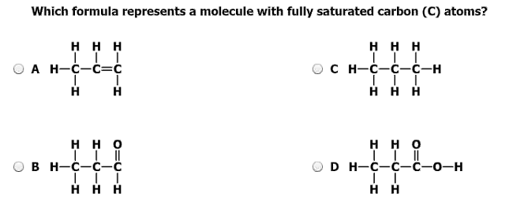
Organic Chemistry (CH.6a)
Students need additional practice investigating attributes of organic compounds.
Which formula represents a molecule with fully saturated carbon (C) atoms?
a) c)
b) d)
Notes:
For SOL CH.6a, students need additional practice investigating attributes of organic compounds. This example demonstrates carbon saturation by hydrogen and is commensurate with the items students may find on any given chemistry assessment. This content is easy for students to navigate and apply during classroom discussion.
The answer is shown on the screen.

Slide 11
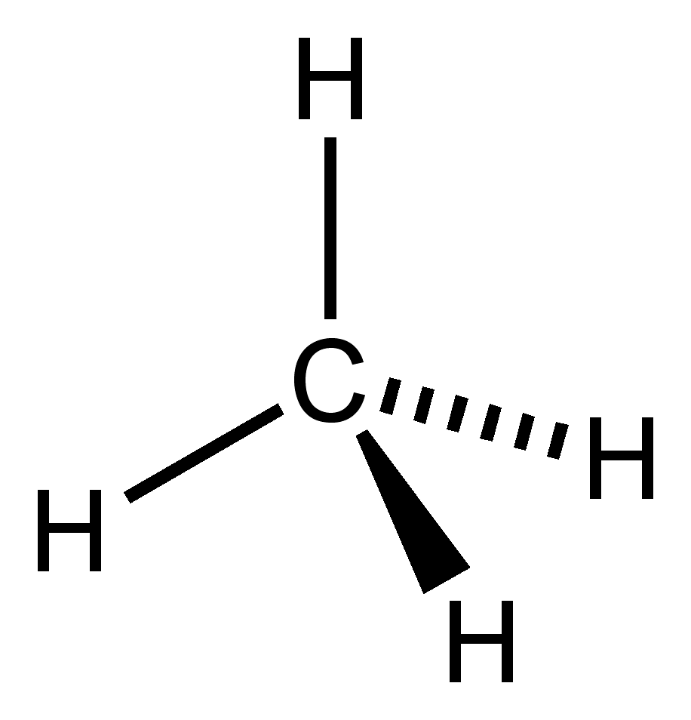
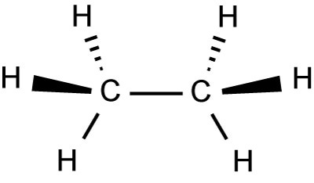
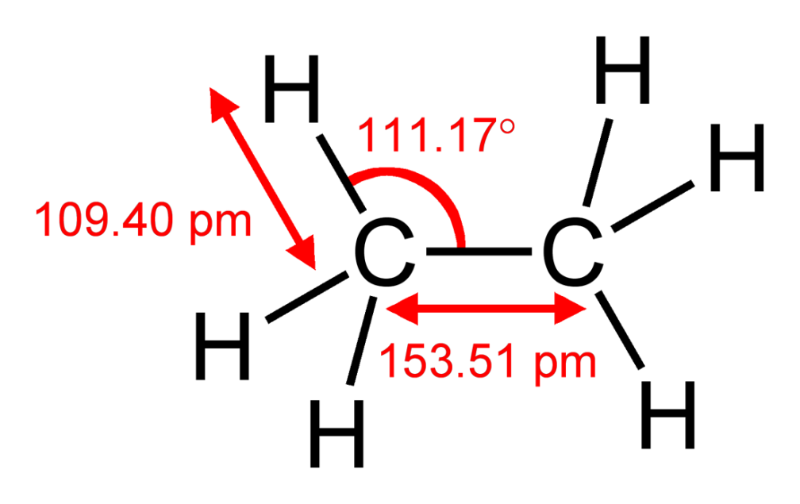
Instructional Guidance CH.6
Organic Chemistry
1)
2)
3)
Notes:
Carbon has properties that enable it to form an extensive range of compounds. Two of these properties are the ability to form chains of atoms and the ability to form multiple bonds.
Students benefit from drawing Lewis dot structures, identifying geometries, and describing polarities of certain molecules as well as describing how saturation affects shape and reactivity of carbon compounds.
Molecule #1 methane and molecule #2 ethane, show that carbon has made four covalent bonds and illustrates their respective three dimensional structures.
Molecule #3 details more information about bond lengths and bond angles.
Students should be able to recognize some common organic polymers such as polyester, DNA, glycogen and cellulose.

Slide 12
Stoichiometry
SOL CH.4
The student will investigate and understand that chemical quantities are based on molar relationships. Key concepts include
stoichiometric relationships;
solution concentrations;
Notes:
The next standard highlighted is SOL CH.4, particularly bullets b and c. This standard reads: The student will investigate and understand that chemical quantities are based on molar relationships. Key concepts include bullet b) stoichiometric relationships, and bullet c) solution concentrations.

Slide 13
Stoichiometry (CH.4b)
Students need additional practice with items that require the application of mathematical relationships and calculations.
N₂ + 3H₂ 2NH₃
If 6 liters of hydrogen gas are used, how many liters of nitrogen gas will be needed for the above reaction at STP?
2 liters
3 liters
4 liters
12 liters
Notes:
For this standard, students need additional practice with items that require the application of mathematical relationships and calculations. Stoichiometry is often incorporated into many other discussions in chemistry and teachers find many opportunities to deliver this content. However, stoichiometry of molecules remains challenging for general chemistry students in Virginia.
The answer to the question is shown on the screen.

Slide 14
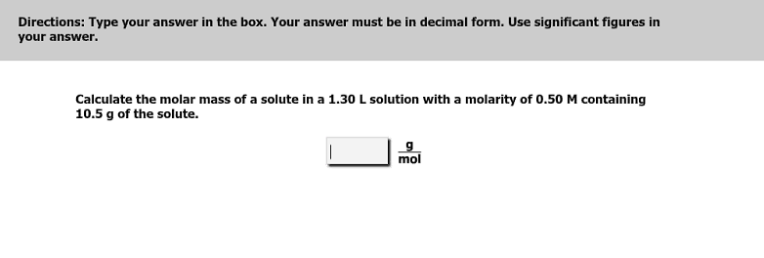
Solution Concentrations (CH.4c)
Students need additional practice calculating answers using significant digits.
Correct answers: 16 OR 16.
Technical assistance with significant digits:
http://www.doe.virginia.gov/instruction/science/resources/tech_assistance_significant_digits.pdf
Notes:
This is another example in which students struggled with the calculations that are necessary to correctly answer the question. This particular item requires students to calculate molar mass.
The student performance data also indicate that students struggled with fill in the blank items that required students to use significant digits. This particular item does not contain multiple steps; therefore the student must find the answer and then determine the lowest number of significant digits used in the stem. The answer must be displayed with two significant digits. Acceptable answers are: 16 or 16. It is important to note that fill in the blank test questions that require calculations, but are NOT assessing CH.1g, have a range of acceptable answers. Teachers are encouraged to have students express the result of any calculations using significant digits as much as is practical.
There is a technical assistance document available on the Virginia Department of Education Web site which will assist with the use of significant digits in calculations. The URL is shown on the screen.

Slide 15
Instructional Guidance CH.4b and CH.4c
Stoichiometry and Solution Concentrations
Suggested laboratory investigations using the Enhanced Scope and Sequence Lessons:
For opportunities to use stoichiometric relationships:
“Predicting products and writing equations”
http://www.doe.virginia.gov/testing/sol/standards_docs/science/2010/lesson_plans/chemistry/chemical_formulas_reactions/sess_CH-3b1abc.pdf
“Moles Lab Activities”
http://www.doe.virginia.gov/testing/sol/standards_docs/science/2010/lesson_plans/chemistry/molar_relationships/sess_CH-4abcd1abcg.pdf
For opportunities to use solutions and perform calculations of
solution concentrations:
“Solution Concentrations”
http://www.doe.virginia.gov/testing/sol/standards_docs/science/2010/lesson_plans/chemistry/molar_relationships/sess_CH-4c1bfgh2h3abd.pdf
Notes:
The Enhanced Scope and Sequence activities shown on the screen will give students opportunities to experience the use of stoichiometric relationships and perform calculations of solution concentrations. The title of these activities and the URLs are shown on the screen.

Slide 16
Practice Items
This concludes the student performance information for the spring 2013 Chemistry SOL test.
Additionally, test preparation practice items for Chemistry can be found on the Virginia Department of Education Web site at:
http://www.doe.virginia.gov/testing/sol/practice_items/index.shtml#science
Notes:
This concludes the student performance information for the spring 2013 Chemistry SOL test.
Additionally, test preparation practice items for Chemistry can be found on the Virginia Department of Education Web site at the URL shown on the screen.

Slide 17
Contact Information
For questions regarding assessment, please contact
Student_assessment@doe.virginia.gov
For questions regarding instruction, please contact
Instruction@doe.virginia.gov
Notes:
No audio.

