Slide 1


Instructional Guidance based on Student Performance on the
Spring 2014 Science Tests
Science
Standards of Learning
Grade 8 Science
Presentation may be paused and resumed using the arrow keys or the mouse.
Notes:
Statewide results for the spring 2014 Standards of Learning Grade 8 Science assessment have been analyzed to determine specific concepts that may have challenged students. This PowerPoint presentation has been developed to provide insight into the concepts that challenged students statewide. In collaboration with the Division of Student Assessment and School Improvement, the Division of Instruction has provided guidance for teachers and school divisions as they implement science curricula in the middle grades.
It is important to keep the content of this statewide analysis in perspective. The information provided here should be used as a supplemental resource, and the instructional focus should remain on the standards as a whole.
The analysis will consist of some general observations on student performance that appear to indicate the need for improvement, some specific released Standards of Learning (SOL) assessment items from the 2014 assessment, and some example items that are representative of the observations and the standards. Please note that the items in this presentation are representative of the concepts that students had the most difficulty with on the Grade 8 SOL Science assessment.

Slide 2
Grade 8 Science: Areas Needing Improvement
Students had difficulty with items related to –
weather and atmosphere;
genetics; and
basic chemical equations.
Notes:
In Grade 8 science, statewide SOL assessment data indicate that there were three areas where students had particular difficulty with middle grades science content.
These were items related to certain weather and atmosphere concepts; certain concepts and background in genetics; and concepts involved in basic chemical equations.

Slide 3
Grade 8 Science: Areas Needing Improvement
Weather and Atmosphere
(SOL 6.3, 6.5, 6.6.)
air masses;
characteristics and composition of the atmosphere;
weather maps;
air pressure; and
water vapor
Notes:
The first area where students showed the need for improvement was with items related to weather and atmosphere concepts. These concepts predominantly occur in the Grade 6 science standards, but they also relate to content found in the Physical Science standards. The nature of the items and the level of analysis required by the student varied across items, but the topics with which students had some difficulty included air masses, characteristics and composition of the atmosphere, weather maps, air pressure, and water vapor.

Slide 4
Grade 8 Science Example Item
In Earth’s atmosphere, as altitude increases –
A air temperature remains relatively constant
B the number of gas molecules per unit volume increases
C air density increases
D air pressure decreases
Notes:
Throughout this presentation, you may use the back arrow to pause the presentation while you read an item on the screen. When you are finished reading, you can use the forward arrow to resume the presentation.
In this item, concepts from standard 6.6 are the central focus. The standard states:
The student will investigate and understand the properties of air and the structure and dynamics of Earth’s atmosphere.
The key concept measured in this item is bullet c) atmospheric changes with altitude. Concepts from bullet b) pressure, temperature, and humidity are supporting concepts.
The correct answer for this example item is “D.”

Slide 5
Grade 8 Science Example Item
Water vapor in the atmosphere will form tiny droplets when the air –
A reaches 100 percent relative humidity
B warms above 10 degrees Celsius
C descends below an altitude of 1 kilometer (1000 meters)
D pressure increases by 10 percent
Notes:
In this example item, concepts from standard 6.6 are also the central focus. Standards 6.3 and 6.5 are related. Depending on how the local science curriculum is organized and sequenced, those concepts should further reinforce learning about water in the atmosphere and foundational ideas about Earth’s environment.
Bullet b of standard 6.6 relates to “pressure, temperature, and humidity.” Please note that standard 6.5 b states, “the properties of water in all three phases,” and 6.3 d is “cloud formation.” All are highly related ideas.
The correct answer for this example item is “A.”

Slide 6
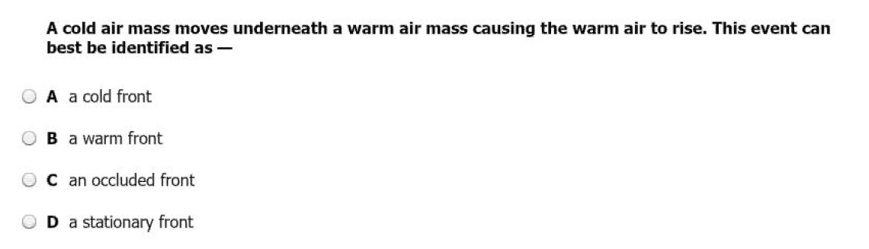
Grade 8 Science Released Item
Notes:
This released item from the 2014 SOL assessment measures standard 6.6 and focuses on types of fronts. Note that density is an embedded concept. Also, note that the item relates to concepts in standard 6.3 including cloud formation and thunderstorms.
The critically important property of “density” will continue to play a key role in all sciences that come during and after middle school.
The correct answer for this released item is “A.”

Slide 7
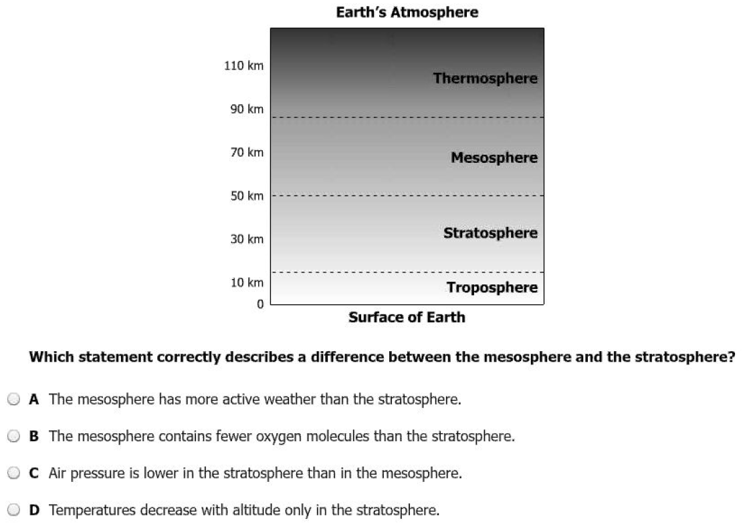
Grade 8 Science Released Item
Notes:
This released item from the 2014 assessment measures standard 6.6. It applies basic concepts of matter, pressure, and density to the structure of the atmosphere. The foundations of these ideas are introduced in the elementary grades, are broadly applied to the environment concepts in grade six, and are more deeply developed in Physical Science standards.
In this example, students can reason a correct answer by applying their knowledge of decreasing density of atmospheric gases with altitude.
The correct answer for this released item is “B.”

Slide 8
Grade 8 Science: Areas Needing Improvement
Genetics
(SOL LS.12 )
elements of historical development; and
key terminology
Notes:
The second area in which students had difficulty was with items that were related to genetics content, including elements of historical development.
Standard LS.12 states: “The student will investigate and understand that organisms reproduce and transmit genetic information to new generations.”
In some items, it appeared that students had difficulty discriminating among certain key terminology.

Slide 9
Grade 8 Science Example Item
The way a living organism appears as a result of its genetic expression is its –
A genome
B incomplete dominance
C recessive allele
D phenotype
Notes:
In this example item, students must distinguish among related terminology and find the best answer for the specific context. The item measures comprehension of the key vocabulary, but students must discriminate what is pertinent to the question.
The correct answer for this example item is “D.”

Slide 10
Grade 8 Science Example Item
The work of Franklin, Watson, and Crick contributed most to which of the following areas in the field of genetics?
A the idea of recessive traits
B selective breeding of hybrid plants
C the structure of the DNA molecule
D the discovery of the role of chromosome pairs
Notes:
Students had difficulty with comprehension of certain background information related to key historical development in genetics.
The correct answer for this example item is “C.”

Slide 11
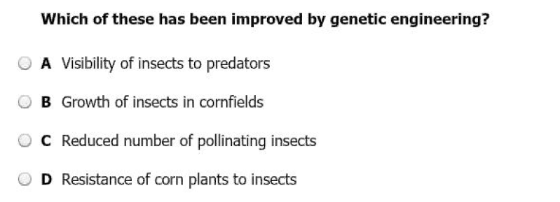
Grade 8 Science Released Item
Notes:
This released item from the 2014 SOL assessment looks at genetic engineering, a significant contribution of understanding gained by the field of genetics. Students should experience a range of rich and engaging instructional activities related to these important and current topics.
The correct answer for this released item is “D.”

Slide 12
Grade 8 Science: Areas Needing Improvement
Basic Chemistry
(SOL PS.4, concepts introduced in SOL 6.4)
balancing chemical equations (conservation of matter)
Notes:
The third area in which students had difficulty was with items that required balancing simple chemical equations.

Slide 13
Grade 8 Science Example Item
What number is needed to balance the following equation?
CH₄ + 20₂ → CO₂ + ___ H₂O
2
Notes:
This example item measures Physical Science standard PS.4. The example involves a limited number of elements.
Note that foundational concepts about chemical equations are included in the Grade 6 standards. The critical concepts are found in standard 6.4, which states in part:
The student will investigate and understand that all matter is made up of atoms. Key concepts include: bullet e) compounds may be represented by chemical formulas; and bullet f) chemical equations can be used to model chemical changes.
Simple chemical equations can be reinforced in numerous places across the middle grades, including the Life Science standards. For example, LS.5, which includes the raw materials and products of photosynthesis, is a universal and useful example.
The correct answer for this example item is “2.”

Slide 14
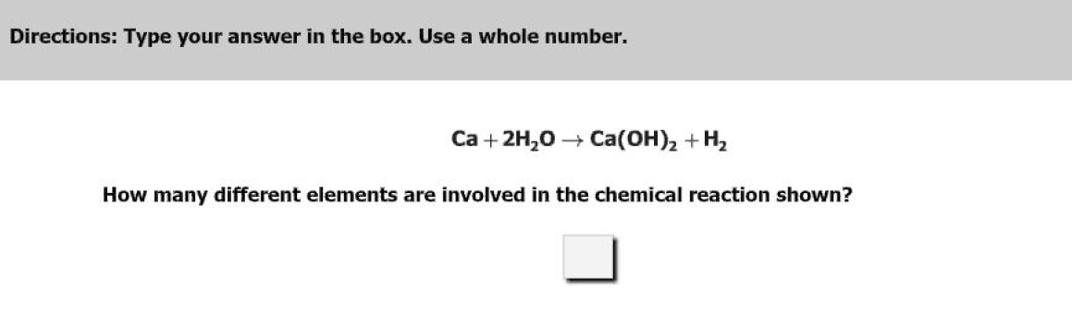
Grade 8 Science Released Item
3
Notes:
This released item from the 2014 SOL assessment also measures PS.4 and focuses on using a periodic table to identify elements of compounds. Applying the law of conservation of matter applies the mathematical concept of equality. The correct answer for this example item is “3.”
Enhanced connections among a school’s mathematics and science teachers and their respective middle curricula could further reinforce the “real-world” applications of this basic algebraic idea.
At the same time, an articulated middle-science program that weaves the common elements of the three sets of middle science standards could improve student mastery of all of these key ideas.
In conclusion:
It is important to state that there is a clear need to reinforce the critical concepts presented in the three sets of middle-level science standards. The local curriculum should deliberately “spiral” when developing this content, especially those concepts and ideas with which students have had notable difficulty. Sixth-grade, life science and physical science teachers, along with middle mathematics teachers, should plan together closely and map out the middle curriculum to ensure that there is a meaningfully connected sixth through eighth grade instructional program.

Slide 15
Practice Items
This concludes the student performance information for the spring 2014 Grade 8 Science test.
Additionally, test preparation practice items for
this test can be found on the Virginia Department of Education Web site at:
https://www.doe.virginia.gov/teaching-learning-assessment/student-assessment/sol-practice-items-all-subjects
Notes:
This concludes the student performance information for the spring 2014 Grade 8 Science test.
Additionally, test preparation practice items for this test can be found on the Virginia Department of Education Web site at the URL shown on the screen.

Slide 16
Contact Information
For questions regarding assessment, please contact
Student_assessment@doe.virginia.gov
For questions regarding instruction, please contact Instruction@doe.virginia.gov
Notes:
For questions regarding assessment, please contact student_assessment@doe.virginia.gov.
For questions regarding instruction, please contact instruction@doe.virginia.gov.

