Slide 1
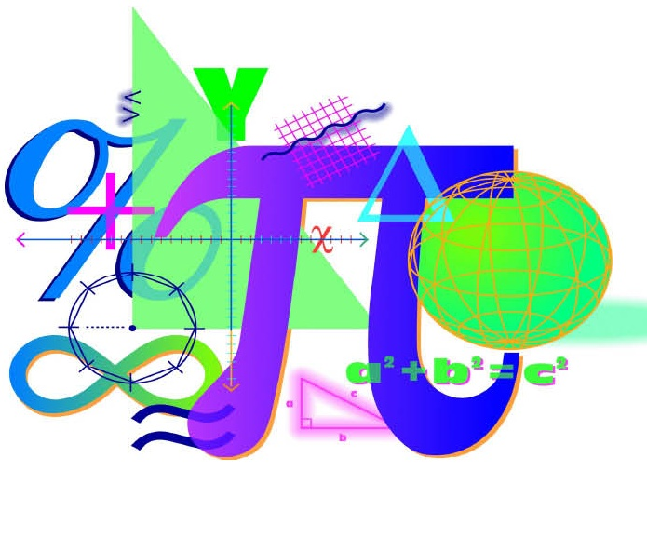


Spring 2012 Student Performance Analysis
Algebra II
Standards of Learning
Presentation may be paused and resumed using the arrow keys or the mouse.

Slide 2

Simplify Rational Expressions
SOL AII.1
The student, given rational, radical, or polynomial expressions,
will
add, subtract, multiply, divide, and simplify rational algebraic expressions;
add, subtract, multiply, divide, and simplify radical expressions containing rational numbers and variables, and expressions containing rational exponents;
write radical expressions as expressions containing rational
exponents and vice versa; and
d) factor polynomials completely.

Slide 3








Suggested Practice for SOL AII.1
Students need additional practice simplifying algebraic
expressions, in particular, when the process includes factoring
the numerator and/or denominator.
Simplify each expression:
a) c)
d)
a) b) c) d)

Slide 4









Suggested Practice for SOL AII.1
Students need additional practice factoring polynomials
completely.
Simplify each expression:
a) c)
d)

Slide 5
Identify Field Properties
SOL AII.3
The student will perform operations on complex
numbers, express the results in simplest form using
patterns of the powers of i, and identify field
properties that are valid for the complex numbers.

Slide 6




Suggested Practice for SOL AII.3
Students need additional practice identifying the field
properties that are valid for complex numbers.
Identify the property used in each of the following:
a)
b)
c)
d)
e)
Identity Property of Multiplication
Distributive Property
Associative Property of Addition
Symmetric Property
Transitive Property

Slide 7
Solving Quadratic Equations
SOL AII.4
The student will solve, algebraically and graphically,
absolute value equations and inequalities;
quadratic equations over the set of complex numbers;
equations containing rational algebraic expressions; and
equations containing radical expressions.

Slide 8






Suggested Practice for SOL AII.4
Students need additional practice solving quadratics over the
set of complex numbers.
Solve these quadratic equations, and name both roots:
a)
b)
c)

Slide 9
Analyzing Functions
SOL AII.7
The student will investigate and analyze functions algebraically
and graphically. Key concepts include
domain and range, including limited and discontinuous domains and ranges;
zeros;
x- and y-intercepts;
intervals in which a function is increasing or decreasing;
asymptotes;
end behavior;
inverse of a function; and
composition of multiple functions.

Slide 10




Suggested Practice for SOL AII.7
Students need additional practice determining domain and
range, finding asymptotes, and determining end behavior.
Given the function:
a) What is the domain and range of this function?
b) What are the horizontal and vertical asymptotes of this
function?
c) As x approaches positive infinity, what is the end behavior of this function?

Slide 11



Suggested Practice for SOL AII.7
Students need additional practice determining domain and
range, finding asymptotes, and determining end behavior.
Given the function:
What is the domain of this function?
What is the vertical asymptote of this function?

Slide 12





Suggested Practice for SOL AII.7
.
.
Students need additional practice determining domain and
range, finding asymptotes, and determining end behavior.
Given the function:
What are the asymptotes of this function?
What is the domain and range of this function?
What is the x-intercept and y-intercept of this function?
As x approaches negative infinity, what is the end behavior
of this function?
.

Slide 13


Suggested Practice for SOL AII.7
Students need additional practice determining domain and
range, finding asymptotes, and determining end behavior.
Given the function:
What is the domain and range of this function?
What are the horizontal and vertical asymptotes of this
function?
c) As x approaches positive infinity, what is the end behavior of this function?

Slide 14




Suggested Practice for SOL AII.7
Students need additional practice finding asymptotes.
For each function, determine all asymptotes.
a) c)
b)

Slide 15




Suggested Practice for SOL AII.7
Students need additional practice finding asymptotes.
Select the function(s) that have an asymptote at x =3.

Slide 16








Suggested Practice for SOL AII.7
Students need additional practice finding the inverse of a
function.
Find the inverse of each function:
a)
b)
c)
d)

Slide 17
Describing the Solutions to a Polynomial Equation
SOL AII.8
The student will investigate and describe the
relationships among solutions of an equation, zeros of
a function, x-intercepts of a graph, and factors of a
polynomial expression.

Slide 18



Suggested Practice for SOL AII.8
Students need additional practice describing the roots of an
equation.
Choose one of these phrases to describe the roots of the
equations shown:
Exactly 2 distinct real roots
Exactly 2 distinct imaginary roots
Exactly 3 distinct real roots
Exactly 1 real root and 2 distinct imaginary roots
a)
b)
c)
Exactly 2 distinct real roots
Exactly 2 distinct imaginary roots
Exactly 3 distinct real roots

Slide 19
Determining Curve of Best Fit
SOL AII.9
The student will collect and analyze data, determine
the equation of the curve of best fit, make
predictions, and solve real-world problems, using
mathematical models. Mathematical models will
include polynomial, exponential and logarithmic
functions.

Slide 20

Suggested Practice for SOL AII.9
Students need additional practice identifying the equation for
the curve of best fit and making predictions using the curve of
best fit.
A data set is displayed in this table. Using the exponential
curve of best, what is the value of y, rounded to the nearest
hundredth, when x = 5?
x | -3 | -2 | -1 | 0
y | 3.375 | 2.25 | 1.5 | 1

Slide 21
Solving Problems Involving Variation
SOL AII.10
The student will identify, create, and solve real-world
problems involving inverse variation, joint variation,
and a combination of direct and inverse variations.

Slide 22
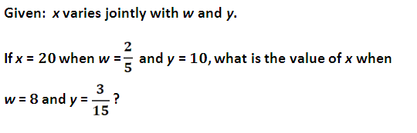

Suggested Practice for SOL AII.10
Students need additional practice identifying a variation
equation that models a situation, and solving problems
involving variation.

Slide 23






Suggested Practice for SOL AII.10
Which equations represent this situation?
A car's stopping distance, d, varies directly with the speed it
travels, s, and inversely with the friction value of the road
surface, f.

Slide 24

Suggested Practice for SOL AII.10
The amount of time required to stack boxes varies
directly with the number of boxes and inversely with the
number of people who are stacking them. If 2 people can stack
60 boxes in 10 minutes, how many minutes will be required for
6 people to stack 120 boxes?

Slide 25
Using Properties of the Normal Curve
SOL AII.11
The student will identify properties of a normal
distribution and apply those properties to determine
probabilities associated with areas under the
standard normal curve.

Slide 26


Suggested Practice for SOL AII.11
Students need additional practice using mean and standard
deviation to find the area under a normal curve and apply
properties of the normal distribution to solve problems.
The running times for a group of 200 runners to complete a one
mile run are normally distributed with a mean of 6.5 minutes
and a standard deviation of 1.5 minutes.
a) Approximately how many of the runners have a time greater
than 8 minutes?
b) What percentage, rounded to the nearest tenth, of these runners can complete this run in less than 3.5 minutes?

Slide 27
Distinguishing Between Permutations and Combinations
SOL AII.12
The student will compute and distinguish between
permutations and combinations and use technology
for applications.

Slide 28


Suggested Practice for SOL AII.12
Decide whether each of these can be answered using a
permutation or a combination and then determine the answer.
a) Twenty horses competed in a race. In how many ways could
the horses have finished in first place through third place?
b) A 10 person student council will be selected from 18 students at a school. How many possibilities are there for this student council?

Slide 29

Practice Items
This concludes the student performance information for the
spring 2012 Algebra II SOL test.
Additionally, test preparation practice items for Algebra II can be
found on the Virginia Department of Education Web site at:
https://www.doe.virginia.gov/teaching-learning-assessment/student-assessment/sol-practice-items-all-subjects

