Slide 1



Spring 2014 Student Performance Analysis
Algebra I
Standards of Learning
Presentation may be paused and resumed using the arrow keys or the mouse.
Notes:
Statewide results for the spring 2014 mathematics SOL tests have been analyzed to determine specific content that may have challenged students. In order to support preparation of students for the Algebra I test, this PowerPoint presentation has been developed to provide examples of SOL content identified by this analysis. It should be noted that these items are not SOL test questions and are not meant to mimic SOL test questions. Instead, they are intended to provide mathematics educators with further insight into the concepts that challenged students statewide.
It is important to keep the content of this statewide analysis in perspective. The information provided here should be used as supplemental information. Instructional focus should remain on the standards as a whole, with school or division level data being used as the focal guiding resource to help improve instruction.

Slide 2
Performing Operations on Polynomials
SOL A.2
The student will perform operations on polynomials, including
applying the laws of exponents to perform operations on expressions;
adding, subtracting, multiplying, and dividing polynomials; and
factoring completely first- and second-degree binomials and trinomials in one or two variables. Graphing calculators will be used as a tool for factoring and for confirming algebraic factorizations.
2
Notes:
The first standard highlighted is SOL A.2. For this standard students need additional practice performing operations on polynomials including: a) applying the laws of exponents to perform operations on expressions, b) dividing polynomials, and c) factoring completely first- and second-degree binomials and trinomials in one or two variables.

Slide 3





Suggested Practice for SOL A.2a
Students need additional practice applying the laws of exponents when multiplying expressions.
Simplify:
Most common error
3
Notes:
For SOL A.2a, students need additional practice applying the laws of exponents when multiplying expressions. The answer to the question is shown on the screen.
For items similar to this example, the most common error is shown on the screen. The most common error students make when determining the coefficient of this product is to multiply the coefficients in the expression, without applying the exponent. This error results in a coefficient of 8. The most common error students make when determining the exponent of the product is to add all of the exponential numbers in the expression. Therefore, in this item, this error would result in an exponent of nine.

Slide 4













Suggested Practice for SOL A.2b
Students need additional practice dividing polynomials.
1. If , find the quotient of and .
Simplify, if :
Which polynomial is equivalent to this expression if ?
a. b. c. d.
4
Slide revised 1/27/2015
Notes:
For SOL A.2b, students need additional practice dividing polynomials. It would benefit students to practice this skill in both open-response and multiple choice formats.
The answers to the questions are shown on the screen.

Slide 5









Suggested Practice for SOL A.2c
Students need additional practice identifying one of the factors of the completely factored form of a polynomial.
Identify one of the factors of when it is
completely factored.
a. b. c. d.
Identify one of the factors of when it is
completely factored.
a. b. c. d.
5
Notes:
For SOL A.2c, students need additional practice identifying one of the factors of the completely factored form of a polynomial. Students typically perform better on a multiple choice item that asks for the factored form of a polynomial, rather than an item which asks for one of the factors. When an item asks for the factored form of a polynomial, students could work backwards from each answer option by multiplying the factors to determine if the product is the given polynomial. When an item only asks for one factor, it requires students to be able to perform the skill of factoring on the given polynomial.
The answers to the examples are shown on the screen.

Slide 6






Suggested Practice for SOL A.2c
Students need additional practice identifying a factored form of a polynomial function when given the zeros.
A polynomial function has zeros at and . Which function could be this polynomial function?
Most common error
6
Notes:
For SOL A.2c, students need additional practice identifying a factored form of a polynomial function given the zeros. The answer to the example is shown on the screen. The most common error is to use the zero and its sign (positive or negative) in the factored form. For the example shown, the zeros are positive two and positive six, so this common error would result in choosing option C rather than the correct answer, which is option D.

Slide 7
Express Square Roots and Cube Roots in Simplest Radical Form
SOL A.3
The student will express the square roots and cube roots of
whole numbers and the square root of a monomial algebraic
expression in simplest radical form.
7
Notes:
The next standard highlighted is SOL A.3. This standard reads: The student will express the square roots and cube roots of whole numbers and the square root of a monomial algebraic expression in simplest radical form.
Performance on simplifying the square root of a monomial algebraic expression and expressing the result in simplest radical form was inconsistent.

Slide 8





Suggested Practice for SOL A.3
Students need additional practice identifying expressions that are in simplest radical form.
Identify each expression that is in simplest radical form.
8
Notes:
For SOL A.3, students need additional practice identifying expressions that are in simplest radical form, when given a list of expressions. When presented an expression, students should focus on the radicand to make sure that it cannot be further simplified rather than focusing on the term that precedes the radical expression.
The answer to the example is shown on the screen.

Slide 9
Solving Linear and Quadratic Equations
SOL A.4
The student will solve multistep linear and quadratic equations in two variables, including
solving literal equations (formulas) for a given variable;
justifying steps used in simplifying expressions and solving equations, using field properties and axioms of equality that are valid for the set of real numbers and its subsets;
solving quadratic equations algebraically and graphically;
solving multistep linear equations algebraically and graphically;
solving systems of two linear equations in two variables algebraically and graphically; and
solving real-world problems involving equations and systems of equations.
Graphing calculators will be used both as a primary tool in solving problems and to
verify algebraic solutions.
9
Notes:
The next standard highlighted is SOL A.4. See the bullets highlighted in green for the parts of this standard for which students need additional practice.

Slide 10
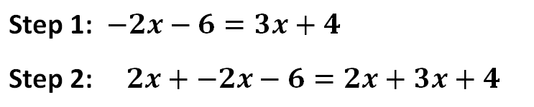
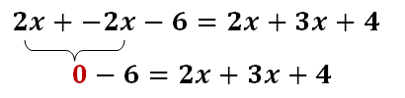
Suggested Practice for SOL A.4b
Students need additional practice justifying steps used to solve an equation using the axioms of equality.
What property justifies the work between step 1 and step 2?
Commutative property of addition
Inverse property of addition
Addition property of equality
Associative property of addition
10
Notes:
For SOL A.4b, students need additional practice justifying steps used to solve an equation using the axioms of equality.
The answer to the question shown on the screen is the Addition Property of Equality because between step 1 and step 2 “2x” is added to both sides of the equation. A common error is to label this as the Inverse Property of Addition, presumably because step 2 shows 2x + -2x. However, the Inverse Property of Addition states that a number a plus its opposite equals 0. That property would be applied in a later step when 2x plus -2x is shown to equal zero.

Slide 11





Suggested Practice for SOL A.4c
Students need additional practice finding solutions to quadratic equations presented algebraically.
Identify the solutions to the equation:
a.
b.
c.
d.
11
Notes:
For SOL A.4c, students need additional practice finding solutions to quadratic equations presented algebraically.
Students would benefit from practice with quadratic equations that are not in standard form, such as in the example provided.
The answer is shown on the screen.

Slide 12

Suggested Practice for SOL A.4d
Students need additional practice determining solutions to equations that have the following solutions: x=0, an infinite number of real solutions, and no real solutions.
1. What is the solution to ?
2. What describes the solution to ?
a. There is an infinite number of real solutions.
b. There are no real solutions.
c. The only solution is 0.
d. The only solution is 5.
There are an infinite number of real solutions.
12
Notes:
For SOL A.4d, students need additional practice determining solutions to equations that have the following solutions: x =0, an infinite number of real solutions, and no real solutions.
The answers to the examples are shown on the screen.

Slide 13





Suggested Practice for SOL A.4d
Students need additional practice finding solutions to equations that contain rational expressions.
Find the solution to the equation shown:
a.
b.
c.
d.
13
Notes:
For SOL A.4d, students need additional practice finding solutions to equations that contain rational expressions, such as the example shown.
The answer to the example is shown on the screen.

Slide 14


Suggested Practice for SOL A.4d
Students need additional practice finding solutions to equations that require computation with positive and negative rational numbers.
Find the solution to the equation shown.
14
Notes:
Students also need additional practice finding solutions to equations that require computation with positive and negative rational numbers.
The answer to the example is shown on the screen.

Slide 15


Suggested Practice for SOL A.4e
Students need additional practice finding the x-value of the solution of a system of equations presented both algebraically and graphically.
What is the x-value of the solution to this system of equations?
15
Notes:
For SOL A.4e, students need additional practice finding the x-value of the solution of a system of equations presented both algebraically and graphically.
The example on the screen presents a system algebraically and asks for the x-value of the solution to the system. The example on the next screen presents a system graphically and asks the same question.
The answer to this example is shown on the screen.

Slide 16
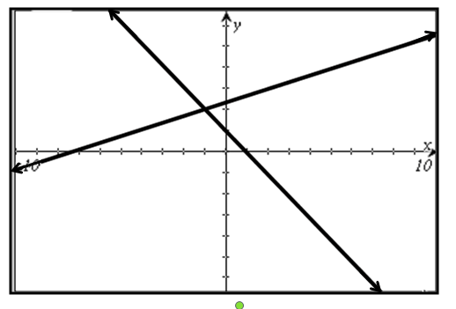



Suggested Practice for SOL A.4e
What appears to be closest to the x-value of the solution to this system of equations?
a. c.
b. d.
16
Notes:
When a system of equations is presented graphically, as in this example, students tend to choose the x-value of an x-intercept of one of the lines as the answer, rather than the x-value of the intersection.
The correct answer is shown on the screen.

Slide 17

Suggested Practice for SOL A.4f
Students need additional practice finding solutions to systems of equations presented in a real-world situation.
James bought a total of 15 bottles of drinks for his team.
Each drink was either a bottle of water or a bottle of juice.
He spent $1.50 on each bottle of water.
He spent $3.00 on each bottle of juice.
James spent a total of $28.50.
How many bottles of juice did James buy?
17
Notes:
For SOL A.4f, students need additional practice finding solutions to systems of equations presented in a real-world situation. Students had a difficult time finding solutions when they had to write the system from given information and then find the solution.
The answer to the example is shown on the screen.

Slide 18
Solving Multistep Inequalities and
Systems of Inequalities
SOL A.5
The student will solve multistep linear inequalities in two
variables, including
solving multistep linear inequalities algebraically and graphically;
justifying steps used in solving inequalities, using axioms of inequality and properties of order that are valid for the set of real numbers and its subsets;
solving real-world problems involving inequalities; and
solving systems of inequalities.
18
Notes:
The next standard highlighted is SOL A.5. This standard requires students to solve multistep linear inequalities in two variables. Specifically, students had difficulty with bullet d) solving systems of inequalities.

Slide 19






Suggested Practice for SOL A.5d
Students need additional practice identifying ordered pairs that are solutions to a system of inequalities.
1. Which ordered pairs are solutions to this system of inequalities?
Which ordered pair is a solution to this system of inequalities?
a. b. c. d.
19
Notes:
For SOL A.5d, students need additional practice identifying ordered pairs that are solutions to a system of inequalities.
When providing practice, students should be given the opportunity to work with inequalities that are presented in multiple formats, including standard form.
The answers to the examples are shown on the screen.

Slide 20
Determining Slope of a Line
SOL A.6
The student will graph linear equations and linear inequalities
in two variables, including
determining the slope of a line when given an equation of the line, the graph of the line, or two points on the line. Slope will be described as rate of change and will be positive, negative, zero, or undefined; and
writing the equation of a line when given the graph of the line, two points on the line, or the slope and a point on the line.
20
Notes:
The next standard highlighted is SOL A.6. For this standard, students need additional practice determining the slope of a line when given two points on the line.

Slide 21




Suggested Practice for SOL A.6a
Students need additional practice finding slope.
Find the slope of the line passing through the points (8,1) and
(6,9).
Line p line has an x-intercept of 5 and a y-intercept of 3. Find the
slope of line p.
Extension: What is an equation for line p?
Two possible answers:
21
Notes:
For SOL A.6a, students need additional practice finding slope. As an extension to example #2, ask students to determine an equation for line p.
The answers are shown on the screen.

Slide 22
Investigating and Analyzing Functions
SOL A.7
The student will investigate and analyze function (linear and
quadratic) families and their characteristics both algebraically
and graphically, including
determining whether a relation is a function;
domain and range;
zeros of a function;
x- and y-intercepts;
finding the values of a function for elements in its domain; and
making connections between and among multiple representations of functions including concrete, verbal, numeric, graphic, and algebraic.
22
Notes:
The next standard highlighted is SOL A.7. In particular, students need additional practice finding the zeros of a function and finding the values of a function for elements in its domain.

Slide 23






Suggested Practice for SOL A.7c
Students need additional practice identifying the zeros of a function.
1. Which function appears to have two distinct zeros?
a.
b.
c.
d.
2. What are all the zeros of the function ?
23
Notes:
For SOL A.7c, students need additional practice identifying the zeros of a function presented algebraically.
The answers to the two examples are shown on the screen.

Slide 24





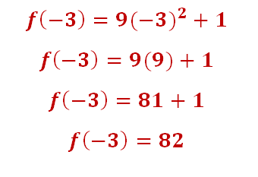
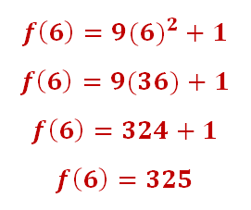
Suggested Practice for SOL A.7e
Students need additional practice identifying the values of a function for given domain values.
Find the values of for the domain values of .
24
Notes:
For SOL A.7e, students need additional practice identifying the values of a function for given domain values. For this standard, students would benefit from varied presentations of this concept.
Using the example on the screen, students would typically perform very well on an alternate version of this item such as: “Evaluate f(-3) for the function f(x)=9x^2+1,” or “Evaluate f(6) for the function f(x)=9x^2+1.” Presenting the domain in set notation and/or specifically using the word “domain” in the question helps students make the connection that the values they are calculating using -3 and 6, respectively, are the corresponding range values for the specific domain values. Examples such as this help make the connection that the ordered pairs (-3,82) and (6,325) lie on the function.
The answers to this question are shown on the screen.

Slide 25
Analyzing Direct and Inverse Variations
SOL A.8
The student, given a situation in a real-world context, will analyze a relation to determine whether a direct or inverse variation exists, and represent a direct variation algebraically and graphically and an inverse variation algebraically.
25
Notes:
The next standard highlighted is SOL A.8. In particular, students need additional practice representing direct and inverse variations algebraically and direct variations graphically.

Slide 26




Suggested Practice for SOL A.8
Students need additional practice identifying a direct variation equation that represents a real-world situation.
The number of calories, c, burned while walking is directly proportional to the distance, d, a person walks. Tom burned 180 calories walking a distance of 2 miles. Which equation represents this relationship?
a.
b.
c.
d.
26
Notes:
For SOL A.8, students need additional practice identifying a direct variation equation algebraically and graphically. Students did well when they had to identify a direct variation from a table of values. However, they had a more difficult time identifying the equation that represented a direct variation described in a practical application.
The answer to the example is shown on the screen.

Slide 27

Suggested Practice for SOL A.8
Students need additional practice creating a direct variation from a set of ordered pairs.
Create a direct variation using two of the ordered pairs from those shown.
27
Notes:
For SOL A.8, students need additional practice creating a direct variation from a set of ordered pairs. Students should realize that every direct variation passes through the origin. Using the origin and the given point (-5,-2), students should be able to determine the equation of the direct variation, which in this example, is y=(2/5)x. Once they have the equation of the direct variation, they should be able to select the points from the list that lie on the line. There are other strategies which can be used to solve this problem and a discussion with your students of various strategies is encouraged.
The answers to the example are shown on the screen.

Slide 28
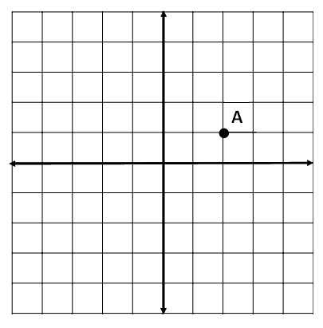
Suggested Practice for SOL A.8
Students need additional practice identifying a direct variation graphically.
Point A lies on the graph of a direct variation. Identify two other points with integral coordinates that lie on the graph of the direct variation.
y
Any two of the points shown on the graph in red are correct responses.
x
28
Notes:
For SOL A.8, students also need additional practice identifying a direct variation graphically.
Using their knowledge of slope and that every direct variation passes through the origin, students should be able to identify additional points that lie on the graph of the direct variation.
The answers to the example are shown on the screen.

Slide 29
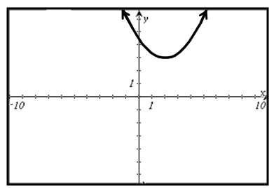
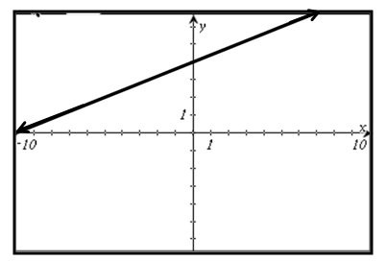
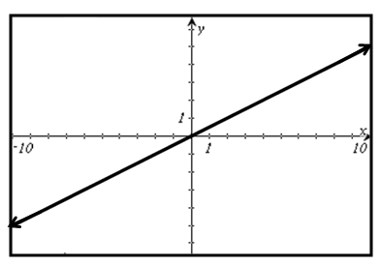
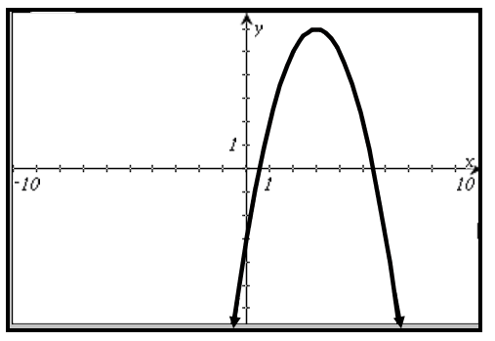
Suggested Practice for SOL A.8
Identify the graph that represents a direct variation.
29
Notes:
When presented a variety of graphs, students had difficulty identifying the graph that represents a direct variation. The answer is shown on the screen.

Slide 30





Suggested Practice for SOL A.8
Students need additional practice identifying an inverse variation equation that represents a real-world situation.
  The number of days, d, it takes workers to set-up for the Summer Music Festival varies inversely as the number of workers, w. The Summer Music Festival was set-up in 2 days by 50 workers. Which equation represents this situation?
  a.
  b.
  c.
  d.
Extension: How many days would it take 60 workers to set up for the Summer Music Festival?
Answer: It would take days or 1 day and 16 hours.
30
Notes:
For SOL A.8, students also need additional practice identifying an inverse variation equation that represents a real-world situation.
The answer to the example is shown on the screen.
As an extension, ask students how many days it would take 60 workers to set-up for the Summer Music Festival. The answer is shown on the screen.

Slide 31
Interpret Standard Deviation
SOL A.9
The student, given a set of data, will interpret variation in
real-world contexts and calculate and interpret mean absolute
deviation, standard deviation, and z-scores.
31
Notes:
The next standard highlighted is SOL A.9. This standard reads: The student, given a set of data, will interpret variation in real-world contexts and calculate and interpret mean absolute deviation, standard deviation, and z-scores.
In particular, students need practice calculating and interpreting standard deviation.

Slide 32



Suggested Practice for SOL A.9
Students need additional practice solving problems involving standard deviation.
A data set is shown.
If the standard deviation of the data set is approximately 1.25, how many of these elements are within one standard deviation of the mean?
32
Notes:
For SOL A.9, students need additional practice performing calculations with statistical information.
For the data set shown, the mean is 4.2. In order to determine how many elements are within one standard deviation of the mean, subtract the standard deviation from the mean, and add the standard deviation to the mean to find the interval in which values within one standard deviation lie. For the example on the screen, any data elements that are greater than or equal to 2.95 and less than or equal to 5.45 are within one standard deviation of the mean. The answer is shown on the screen.

Slide 33

Suggested Practice for SOL A.9
Students need additional practice solving problems involving standard deviation.
A data set has a mean of 45. An element of this data set
has a value of 50 and a z-score of 0.75. What is the
standard deviation for this data set, rounded to the nearest
hundredth?
Use two of the three numbers shown in the list to
complete this sentence.
A data set could have a variance of and a standard
deviation of .
81
9
9 40.5 81
33
Notes:
For SOL A.9, students need additional practice performing calculations with statistical information and understanding the relationship between variance and standard deviation.
The answers to the two examples are shown on the screen.
As an extension to example #2, ask students to give other numbers that would accurately complete the sentence. Students should realize that the standard deviation of a data set is the square root of the variance.

Slide 34
Analyzing Box-and-Whisker Plots
SOL A.10
The student will compare and contrast multiple univariate data
sets, using box-and-whisker plots.
34
Notes:
The next standard highlighted is SOL A.10. This standard reads: The student will compare and contrast multiple univariate data sets, using box-and-whisker plots.

Slide 35
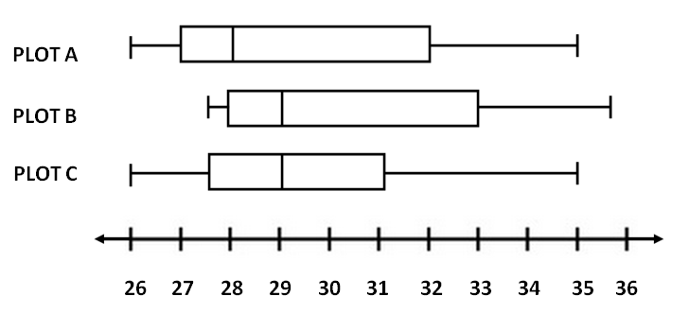
Suggested Practice for SOL A.10
Students need additional practice identifying and comparing the ranges, interquartile ranges, and medians of box-and-whisker plots.
Which two plots appear to have the same value for the range?
Which two plots appear to have the same value for the interquartile range?
Which two plots appear to have the same value for the median?
Plots A and C
Plots A and B
Plots B and C
35
Notes:
For this standard, students need additional practice identifying and comparing basic values associated with box-and-whisker plots: the range, interquartile range, and median. The range is the difference between the upper and lower extremes. The interquartile range is the difference between the upper quartile (Q3) and the lower quartile (Q1). The median value (Q2) can be found by locating the vertical line in the box, between Q1 and Q3.
The answers to the questions are shown on the screen. The next slide shows these same box-and-whisker plots with a different question format.

Slide 36
Suggested Practice for SOL A.10
Which statement appears to be true regarding the box-and-whisker plots shown?
The interquartile range of the data for plot A is greater than the interquartile range of the data for plot B.
The upper extreme of the data for plot A is greater than the upper extreme of the data for plot C.
The range of the data in plot A is the same as the range of the data in plot C.
The median of the data in plot A is greater than the median of the data in plot B.
36
Notes:
This question asks students to identify the true statement about these box-and-whisker plots. Again, students are comparing the basic values associated with the plots: range, interquartile range, and median. This item also has a statement about the upper extreme that needs to be evaluated.
The answer to the question is shown on the screen.

Slide 37
Using the Curve of Best Fit
SOL A.11
The student will collect and analyze data, determine the
equation of the curve of best fit in order to make predictions,
and solve real-world problems, using mathematical models.
Mathematical models will include linear and quadratic
functions.
37
Notes:
The next standard highlighted is SOL A.11. In particular, student performance was inconsistent when making predictions using the curve of best fit.

Slide 38




Suggested Practice for SOL A.11
Students need additional practice determining the linear or quadratic curve of best fit.
This set of ordered pairs shows a relationship between x and y.
Which equation best represents this relationship?
a.
b.
c.
d.
Extension: Using the curve of best fit, what is the value of y, rounded to the nearest whole number, when the value of x is 8?
Answers will vary depending on how the numbers in the curve of best fit are rounded. Using the equation in option d, y = 186.
38
Notes:
For SOL A.11, students need additional practice determining the linear or quadratic curve of best fit for a set of data. Students should be able to determine whether the curve of best fit is linear or quadratic, and then choose the equation which best models the data.
The answer to the question is shown on the screen.
As an extension, have students predict the value of y, rounded to the nearest whole number, when the value of x is 8.
The answer is shown on the screen.

Slide 39




Suggested Practice for SOL A.11
Students need additional practice determining the
linear or quadratic curve of best fit and making predictions.
This set of ordered pairs shows a relationship between x and y.
Using the line of best fit, which is closest to the output when the input is 5?
a.
b.
c.
d.
39
Notes:
For SOL A.11, students need additional practice making predictions using the curve of best fit.
Students should be familiar with different ways to describe the x- and y-values, including input, output, independent variable, and dependent variable.
The answer to the question is shown on the screen.

Slide 40
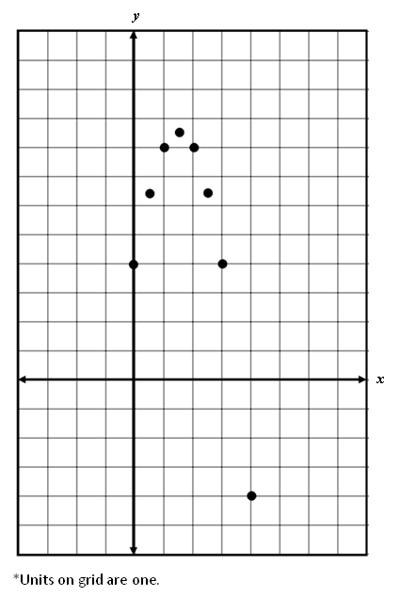




Suggested Practice for SOL A.11
Which equation best models the relationship shown on the grid?
a.
b.
c.
d.
40
Notes:
Here is another example that asks students to select the curve of best fit given data on a grid. Students should recognize the shape as quadratic and be able to eliminate choices a and b. They should also recognize that since the curve opens downward, the coefficient on the first term will be negative. This eliminates option c and leaves the student with the correct answer, which is option d. Alternately, a less efficient strategy for this particular example is to enter the points into the graphing calculator, and then find the quadratic curve of best fit.

Slide 41
Practice Items
This concludes the student performance information for the spring 2014 Algebra I SOL test.
Additionally, test preparation practice items for
Algebra I can be found on the Virginia Department of Education Web site at:
https://www.doe.virginia.gov/teaching-learning-assessment/student-assessment/sol-practice-items-all-subjects
41
Notes:
This concludes the student performance information for the spring 2014 Algebra I SOL test.
Additionally, test preparation practice items for Algebra I can be found on the Virginia Department of Education Web site at the URL shown on the screen.

Slide 42
Contact Information
For questions regarding assessment, please contact
Student_assessment@doe.virginia.gov
For questions regarding instruction, please contact Michael.Bolling@doe.virginia.gov
42
Notes:
For questions regarding assessment, please contact student_assessment@doe.virginia.gov.
For questions regarding instruction, please contact Michael.Bolling@doe.virginia.gov.

