Slide 1
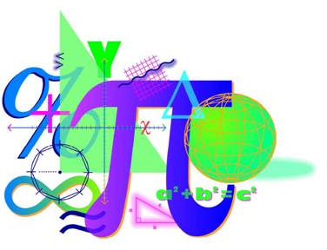


Spring 2013 Student Performance Analysis
Geometry
Standards of Learning
Presentation may be paused and resumed using the arrow keys or the mouse.
Notes:
This is the spring 2013 student performance analysis for the Geometry Standards of Learning test. Statewide results for the spring 2013 mathematics SOL tests have been analyzed to determine specific content that may have challenged students. In order to support preparation of students for the Geometry test, this PowerPoint presentation has been developed to provide examples of SOL content identified by this analysis.
While some of this content was first introduced in the 2009 mathematics SOL, other content is included in both the 2001 and 2009 mathematics SOL. There are also many similarities between the content identified during this analysis and the content identified during the spring 2012 student performance analysis.
This PowerPoint presentation contains concrete examples of the content for which student performance was weak or inconsistent. These items are not SOL test questions and are not meant to mimic SOL test questions. Instead, they are intended to provide mathematics educators with further insight into the concepts that challenged students statewide.
It is important to note that the SOL and examples highlighted in this presentation should not be the sole focus of instruction, nor should these suggestions replace the data that teachers or school divisions have collected on student performance. Rather, this information provides supplemental instructional information based on student performance across the Commonwealth of Virginia.

Slide 2
Judging the Validity of a Logical Argument
SOL G.1
The student will construct and judge the validity of a logical
argument consisting of a set of premises and a conclusion. This
will include:
identifying the converse, inverse, and contrapositive of a conditional statement;
translating a short verbal argument into symbolic form;
using Venn diagrams to represent set relationships; and
using deductive reasoning.
Notes:
The first standard being highlighted is SOL G.1 This standard requires students to construct and judge the validity of a logical argument. In particular, students had difficulty with bullet d. Bullet d states that students will construct and judge the validity of a logical argument consisting of a set of premises and a conclusion using deductive reasoning.

Slide 3
Suggested Practice for SOL G.1
Students need additional practice judging the validity of a logical argument and using valid forms of deductive reasoning, including the law of syllogism, the law of contrapositive, the law of detachment, and counterexamples.
Example of the law of detachment:
Let p = “a dog eats bread”
Let q = “the dog gains weight”
p → q, “If a dog eats bread, then the dog gains weight” is a true statement.
John’s dog eats bread. What can be concluded?
John’s dog gains weight.
Notes:
For SOL G.1, students need additional practice judging the validity of a logical argument and using valid forms of deductive reasoning, including the law of syllogism, the law of contrapositive, the law of detachment, and counterexamples.
Deductive reasoning uses facts, rules, definitions, or properties to reach logical conclusions. The example shown uses the law of detachment, which states: If p then q is true, and p is true, then q must be true. In this case, the logical conclusion is that John’s dog gains weight.

Slide 4
Suggested Practice for SOL G.1
Example of the law of contrapositive:
Let p = “a dog eats bread”
Let q = “the dog gains weight”
p → q means “If a dog eats bread, then the dog gains weight.”
p → q is a true statement.
What is the contrapositive of this statement? Is it a true statement?
“If the dog does not gain weight, then the dog does not eat
bread” is a true statement.
Notes:
Here is an example that uses the law of contrapositive, which states that a conditional statement and its contrapositive are logically equivalent. This means, if a conditional statement is true then its contrapositive will also be true. The same cannot be said of the inverse or converse of a conditional statement. For the example shown, the contrapositive of the conditional statement is, “If the dog does not gain weight, then the dog does not eat bread.” This is a true statement.

Slide 5
Suggested Practice for SOL G.1
Example of the law of syllogism:
Let p = “a dog eats bread”
Let q = “the dog gains weight”
Let r = “the dog gets fat”
p → q means “If a dog eats bread, then the dog gains weight.”
q → r means “If the dog gains weight, then the dog gets fat.”
Using the law of syllogism, what is the logical conclusion?
The law of syllogism concludes:
p → r, which translates to: “If a dog eats bread, then the dog gets fat.”
Notes:
Here is an example that uses the law of syllogism. The law of syllogism allows students to draw conclusions from two true statements when the conclusion of one statement is the hypothesis of the other. In this case, “the dog gains weight” is the conclusion of the first conditional statement and the hypothesis of the second conditional statement. The question asks: Using the law of syllogism, what is the logical conclusion? The law of syllogism concludes: If p then r, which translates to: “If a dog eats bread, then the dog gets fat.”

Slide 6
Suggested Practice for SOL G.1
Example of a counterexample:
Let p = “n is an integer and n² is divisible by 4”
Let q = “n is divisible by 4”
p → q means “If n is an integer and n² is divisible by 4, then n is divisible by 4.”
A counterexample is any example that will prove a statement
false. In this case, a number for which p is true and q is false is
a counterexample.
What is a counterexample to p → q ?
In this case, n = 10 is a counterexample because 10² = 100 and
100 is divisible by 4, but 10 is not divisible by 4.
Other possible answers: 2, 6, 14, 18, etc.
Notes:
The last example for SOL G.1 uses a counterexample. Only one counterexample is required to prove a statement false. The counterexample makes the hypothesis of the statement true and the conclusion false.
The example on the screen reads: Let p equal n is an integer and n squared is divisible by four. Let q equal n is divisible by four. If p then q means: If n is an integer and n squared is divisible by four, then n is divisible by four. Remember, a counterexample is any example that will prove a statement false. In this case, a number for which p is true and q is false is a counterexample.
The question reads: What is a counterexample to if p then q? The answer is provided on the screen. In this case, n equals ten is a counterexample because ten squared equals one hundred and one hundred is divisible by four, but ten is not divisible by four. Other possible answers are: two, six, fourteen, eighteen, etc.

Slide 7
Determining and Verifying Parallelism
SOL G.2
The student will use the relationships between angles formed
by two lines cut by a transversal to
determine whether two lines are parallel;
verify the parallelism, using algebraic and coordinate methods as well as deductive proofs; and
solve real-world problems involving angles formed when parallel lines are cut by a transversal.
Notes:
The next standard being highlighted is SOL G.2, and specifically bullet a. This standard and bullet read: The student will use the relationships between angles formed by two lines cut by a transversal to determine whether two lines are parallel.

Slide 8
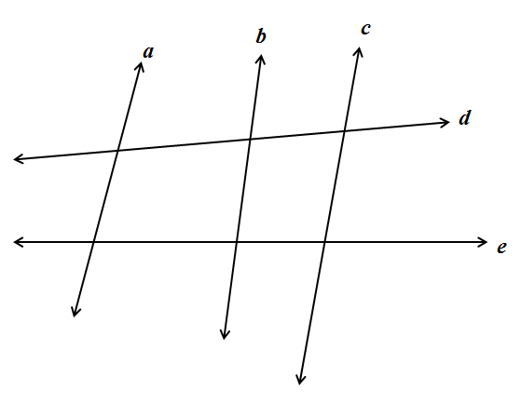
Suggested Practice for SOL G.2a
Students need additional practice determining parallelism in
complex figures.
Given information about a figure, determine parallel lines or congruent angles.
This is an example of a complex figure with more than one transversal.
Notes:
For this standard, students need additional practice determining parallelism in complex figures. This screen shows an example of a complex figure with more than one transversal. Students need practice working with figures that require them to determine parallelism of lines or congruent angles. They need to be able to identify transversals as well as corresponding, alternate interior, alternate exterior, and same-side interior angles on these figures.

Slide 9
Suggested Practice for SOL G.2a
Given: a ll c
What is the value of x ?
x = 105
Is b ll c ? Why or why not?
No, because there are no
congruent corresponding,
alternate interior, or alternate
exterior angles.
Is d ll e ? Why or why not?
No, because there are no
congruent corresponding,
alternate interior, or alternate
exterior angles.
x°
105°
85°
85°
Notes:
This example for SOL G.2a asks students to determine the measure of an angle and to determine whether certain lines are parallel. The answers to these questions are shown on the screen.
For this example, it is important for students to recognize that the two eighty five degree angles are not directly related and do not prove any pair of lines parallel.

Slide 10
Suggested Practice for SOL G.2a
Given: a ll b and d ll e
Find the values of
x, y, and z.
x = 73
y = 107
z = 63
b
c
a
d
107°
117°
x°
z°
y°
e
Notes:
Here is another example that gives parallel lines, and asks students to find angle measures. The answers are shown on the screen.

Slide 11
Identifying a Parallel or Perpendicular Line to a Given Line
SOL G.3
The student will use pictorial representations, including
computer software, constructions, and coordinate methods, to
solve problems involving symmetry and transformation. This will
include
investigating and using formulas for finding distance, midpoint, and slope;
applying slope to verify and determine whether lines are parallel or perpendicular;
investigating symmetry and determining whether a figure is symmetric with respect to a line or a point; and
determining whether a figure has been translated, reflected, rotated, or dilated, using coordinate methods.
Notes:
The next standard being highlighted is SOL G.3. For this standard students need additional practice with bullets a and b. In particular, students need more practice using coordinate methods to investigate slope and apply slope to verify and determine whether lines are parallel or perpendicular.

Slide 12
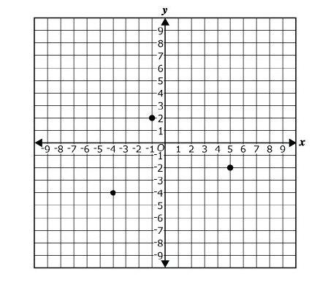
Suggested Practice for SOL G.3
Find the coordinates of a point that
lies on a line which passes through
point P and is parallel to line c.
Possible answers:
(-10,0), (-7,-2), (-1,-6), (2,-8), (5,-10)
Find the coordinates of a point that
lies on a line which passes through
point P and is perpendicular to
line c.
Possible answers:
(-6,-7), (-2,-1), (0, 2), (2, 5), (4, 8)
Students need additional practice determining parallel and
perpendicular lines on a coordinate grid.
c
P
Notes:
For SOL G.3, students need additional practice determining parallel and perpendicular lines on a coordinate grid.
The first example requires students to plot a point that lies on a line which passes through a given point, and is parallel to the given line. The second example requires students to plot a point that lies on a line which passes through a given point, and is perpendicular to the given line. Correct answers can be found by applying the relationship between the slopes of two parallel lines and the relationship between the slopes of two perpendicular lines. Students should understand that there are a number of correct answers for these problems. Possible answers are shown on the screen.

Slide 13
Justifying Constructions
SOL G.4
The student will construct and justify the constructions of
a line segment congruent to a given line segment;
the perpendicular bisector of a line segment;
a perpendicular to a given line from a point not on the line;
a perpendicular to a given line at a point on the line;
the bisector of a given angle;
a line parallel to a given line through a point not on the given line.
Notes:
The next standard being highlighted is SOL G.4. Most students demonstrated proficiency in completing constructions, but many students are not as proficient at justifying the constructions listed in the standard.

Slide 14
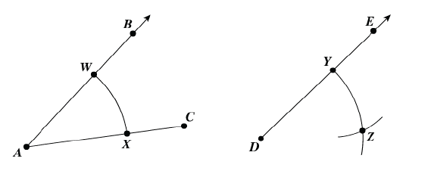
Suggested Practice for SOL G.4
Students need additional practice justifying constructions.
Arcs WX and YZ are drawn using the same radius. An arc with radius WX is centered on point Y and intersects arc YZ at point Z. A line segment will connect points D and Z.
Which statement justifies this construction?
A. ∠A ≅ ∠D because they are corresponding parts of congruent triangles.
B. ∠A ≅ ∠D because they are alternate interior angles.
C. ∠A ≅ ∠D because AB = DE.
Notes:
For SOL G.4, students need additional practice justifying constructions.
In the construction shown on the screen, line segments AW, AX, DY, and DZ are congruent because they were created using the same radius. The distance from point W to point X is the same as the distance from point Y to point Z. Since the sides of the triangles formed by points AWX and points DYZ are congruent, the triangles are congruent; therefore, angle A is congruent to angle D because they are corresponding parts of congruent triangles.

Slide 15
Proving Triangles Congruent
SOL G.6
The student, given information in the form of a figure or
statement, will prove two triangles are congruent, using
algebraic and coordinate methods as well as deductive proofs.
Notes:
The next standard being highlighted is SOL G.6. In this standard, students had difficulty proving triangles congruent using deductive proofs.

Slide 16
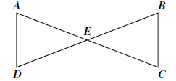


Suggested Practice for SOL G.6
Students need additional practice completing the steps and
reasons in two-column deductive proofs that prove triangles
congruent.
Given: In the figure, line segments
AC and BD bisect each other
at point E.
Prove: AED ≅ CEB
Possible Answer:
Statements | Reasons
AC and BD bisect each other at point E. AE=EC and DE=EB | 1. Given 2. Definition of bisector
3. and | 3. Definition of congruence
4. ∠AED ≅ ∠CEB | 4. Vertical angles are congruent.
5. AED ≅ CEB | 5. SAS (Side-Angle-Side) Theorem
Slide Revised 3/24/14
Notes:
For SOL G.6, Students need additional practice completing the steps and reasons in two-column deductive proofs that prove triangles congruent.
This content was also highlighted in the 2012 student performance analysis as weak or inconsistent. The example shown requires students to prove two triangles congruent. One possible answer is shown on the screen. It is important to note that steps two and three could be switched and the answer would still be correct.

Slide 17
Proving Triangles Similar
SOL G.7
The student, given information in the form of a figure or
statement, will prove two triangles are similar, using
algebraic and coordinate methods as well as deductive proofs.
Notes:
The next standard being highlighted is SOL G.7. In this standard, students need more practice proving two triangles similar using deductive proofs.

Slide 18
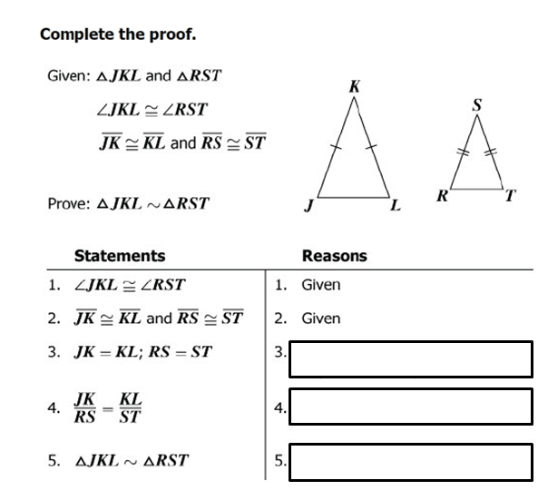
Suggested Practice for SOL G.7
Definition of congruence
Division property of equality
SAS Similarity
Notes:
Here is an example for SOL G.7. This example asks students to prove two triangles similar. The item requires that the two-column proof be completed. The answers are shown on the screen.

Slide 19
Finding Arc Lengths and Areas of Sectors
SOL G.11
The student will use angles, arcs, chords, tangents, and
secants to
investigate, verify, and apply properties of circles;
solve real-world problems involving properties of circles; and
find arc lengths and areas of sectors in circles.
Notes:
The next standard being highlighted is SOL G.11. In particular, students need additional practice with Bullet c. The standard reads: The student will use angles, arcs, chords, tangents, and secants to find arc lengths and areas of sectors in circles.

Slide 20
Suggested Practice for SOL G.11
Students need additional practice finding the area of a sector or
arc length when given the radius or diameter and a central angle
of a circle.
Find the area of the shaded
sector of Circle Q.
33.5 cm²
Find the length of arc AB.
8.4 cm
A
B
60°
8 cm
Q
Notes:
For SOL G.11, students need additional practice finding the area of a sector or arc length when given the radius or diameter and a central angle of a circle.
Students should understand the relationship between a central or inscribed angle and its intercepted arc. Another understanding is that arcs have degree measures as well as linear measurements. For the examples shown on the screen, a student must first determine the relationship between the ratio of the central angle to the whole circle, which is 60:360. Then, this ratio can be used to find the area of the sector by multiplying the area of the entire circle by this ratio. Similarly, this ratio can be used to find the arc length by multiplying the circumference of the circle by this ratio.

Slide 21
Identifying Points on a Circle
SOL G.12
The student, given the coordinates of the center of a circle and a
point on the circle, will write the equation of the circle.
Students should have experiences that require them to determine any of the following from given information:
  • the coordinates of the center;
  • the length of a radius;
  • coordinate endpoints of a radius;
  • the length of a diameter;
  • coordinate endpoints of a diameter;
  • the coordinates of a point on the circle; and/or
  • the equation of a circle.
Notes:
The next standard being highlighted is SOL G.12. This standard reads: The student, given the coordinates of the center of a circle and a point on the circle, will write the equation of the circle.
To become proficient at this standard, students should have experiences that require them to determine any of the following from given information: the coordinates of the center; the length of a radius; coordinate endpoints of a radius; the length of a diameter; coordinate endpoints of a diameter; the coordinates of a point on the circle; and/or the equation of a circle. In particular, students need additional practice finding the coordinates of a point on the circle.

Slide 22
Suggested Practice for SOL G.12
Students need additional practice identifying the coordinates of
points that lie on a circle when given sufficient information to
write the equation of the circle.
A circle has a center at (-1, 4) and a diameter of 20.
Select each pair of coordinates that represent a point on this
circle.
(-7, -4) (11, 20) (19, 16)
(5, 12) (-9, -2) (-1, 4)
Notes:
For SOL G.12, students need additional practice identifying the coordinates of points that lie on a circle when given sufficient information to write the equation of the circle.
In the example shown, the equation of the circle is the quantity x plus one squared plus the quantity y minus four squared equals one hundred. A common error for this type of problem is for students to incorrectly use the diameter, rather than the radius, when writing the equation. After writing the equation of the circle, the points listed can be tested, to determine whether they make the equation true. It is important to note that some students still erroneously believe that the center of the circle is a point on the circle. The answers to the question are shown on the screen.

Slide 23
Reasoning Using Similar Geometric Objects
SOL G.14
The student will use similar geometric objects in two- or three-
dimensions to
compare ratios between side lengths, perimeters, areas, and volumes;
determine how changes in one or more dimensions of an object affect area and/or volume of the object;
determine how changes in area and/or volume of an object affect one or more dimensions of the object; and
solve real-world problems about similar geometric objects.
Notes:
The next standard being highlighted is SOL G.14.
This standard requires students to compute, reason and solve problems using similar geometric objects. This standard continues to be difficult for many students to demonstrate proficiency. In general, many students are not making the connection between length (one dimension), area (two dimensions), and volume (three dimensions).

Slide 24
Suggested Practice for SOL G.14
Students need additional practice determining how changes in
dimensions of a geometric object affect surface area and volume,
and how changes in surface area and volume affect its
dimensions. Students also need additional practice determining
these relationships for similar geometric objects.
Example Using Ratios:
Two similar rectangular prisms have side lengths with a ratio of 1:3.
What is the ratio of their surface areas?
1:9
What is the ratio of their volumes?
1:27
Notes:
For SOL G.14, students need additional practice determining how changes in dimensions of a geometric object affect surface area and volume, and how changes in surface area and volume affect its dimensions. Students also need additional practice determining these relationships for similar geometric objects.
Most students are proficient at finding the surface area and volume of geometric objects and are able to make comparisons when they can first calculate the surface areas or volumes of each of the objects separately. Many students are not as proficient at making comparisons when figures are not provided or when specific dimensions of the objects are not given. In this example, students must find the relationships without being able to actually calculate the surface area or volume of each figure. The answers to the two questions are shown on the screen.

Slide 25
Suggested Practice for SOL G.14
Example Using Scale Factors:
The dimensions of a triangular prism with a surface area of
51.46 cm² are multiplied by a scale factor of 2.5 to create a
similar triangular prism.
What is the surface area of the new triangular prism?
Extension: What is the relationship between the volume of the original prism and the volume of the new prism?
The new volume is 15.625 times the volume of the original prism.
Notes:
Here is an example for SOL G.14 that uses scale factors.
The question reads: The dimensions of a triangular prism with a surface area of 51.46 cm² are multiplied by a scale factor of 2.5 to create a similar triangular prism. What is the surface area of the new triangular prism?
For this type of question students need to recognize that changing the linear dimensions of the triangular prism by a scale factor of 2.5 will affect the surface area by 2.5 squared, or 6.25. The new surface area will be 6.25 times larger than the original surface area. The surface area of the new triangular prism is 321.625 cm squared.
An extension of this question is: What is the relationship between the volume of the original prism and the volume of the new prism? The answer is shown on the screen. The new volume is 15.625 times the volume of the original prism.

Slide 26
Suggested Practice for SOL G.14
Relationship Between Volume and Dimensions:
Cathy has two cylinders that are the same height, but the volume of the second cylinder is 16 times the volume of the first cylinder. The radius of the second cylinder is –
2 times the radius of the first cylinder.
4 times the radius of the first cylinder.
8 times the radius of the first cylinder.
16 times the radius of the first cylinder.
Notes:
Here is another example for SOL G.14. The answer is shown on the screen. Students may benefit from comparing the answer of this question to the answer of the question that follows on the next slide.

Slide 27
Suggested Practice for SOL G.14
Relationship Between Volume and Dimensions:
Cathy has two cylinders with radii the same length, but the
volume of the second cylinder is 16 times the volume of the first
cylinder. The height of the second cylinder is –
2 times the height of the first cylinder.
4 times the height of the first cylinder.
8 times the height of the first cylinder.
16 times the height of the first cylinder.
Notes:
Here is another example for SOL G.14. The answer is shown on the screen.

Slide 28
Practice Items and Tools Practice
This concludes the student performance information for the Geometry tests administered during the spring 2013 test administration.
Additionally, test preparation practice items for Geometry can be
found on the Virginia Department of Education Web site at:
https://www.doe.virginia.gov/teaching-learning-assessment/student-assessment/sol-practice-items-all-subjects
There is also an End-of-Course Tools Practice located at the same URL that provides students the opportunity to practice with the online tools and provides an interface for students to practice constructions using the online compass.
Notes:
This concludes the student performance information for the Geometry tests administered during the spring 2013 test administration.
Additionally, test preparation practice items for Geometry can be found on the Virginia Department of Education Web site at the URL shown on the screen.
There is also an End-of-Course Tools Practice located at the same URL that provides students the opportunity to practice with the online tools and provides an interface for students to practice constructions using the online compass.

Slide 29
Contact Information
For assessment questions, please contact
Student_assessment@doe.virginia.gov
For instruction questions, please contact Michael.Bolling@doe.virginia.gov
29

