Slide 1
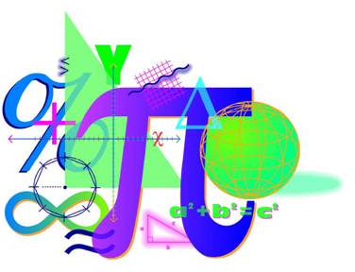


Spring 2013 Student Performance Analysis
Algebra II
Standards of Learning
Presentation may be paused and resumed using the arrow keys or the mouse.
Notes:
This is the spring 2013 student performance analysis for the Algebra II Standards of Learning test. Statewide results for the spring 2013 mathematics SOL tests have been analyzed to determine specific content that may have challenged students. In order to support preparation of students for the Algebra II test, this PowerPoint presentation has been developed to provide examples of SOL content identified by this analysis.
While some of this content was first introduced in the 2009 mathematics SOL, other content is included in both the 2001 and 2009 mathematics SOL. There are also many similarities between the content identified during this analysis and the content identified during the spring 2012 student performance analysis.
This PowerPoint presentation contains concrete examples of the content for which student performance was weak or inconsistent. These items are not SOL test questions and are not meant to mimic SOL test questions. Instead, they are intended to provide mathematics educators with further insight into the concepts that challenged students statewide.
It is important to note that the SOL and examples highlighted in this presentation should not be the sole focus of instruction, nor should these suggestions replace the data that teachers or school divisions have collected on student performance. Rather, this information provides supplemental instructional information based on student performance across the Commonwealth of Virginia.

Slide 2
Operations on Rational Expressions and
Factoring Polynomial Expressions
SOL AII.1
The student, given rational, radical, or polynomial expressions, will
a) add, subtract, multiply, divide, and simplify rational algebraic expressions;
b) add, subtract, multiply, divide, and simplify radical expressions containing rational numbers and variables, and expressions containing rational exponents;
c) write radical expressions as expressions containing rational exponents and vice versa; and
d) factor polynomials completely.
2
Notes:
The first standard being highlighted is SOL A2.1. In particular students need additional practice with bullets a and d. They read: The student, given rational, radical, or polynomial expressions will, bullet a: add, subtract, multiply, divide, and simplify rational algebraic expressions; and bullet d: factor polynomials completely.

Slide 3



Suggested Practice for SOL AII.1a
Students need additional practice performing operations on rational expressions.
Assuming no denominator equals zero, completely simplify each expression.
a.
b.
3
Notes:
For SOL A2.1a, students need additional practice performing operations on rational expressions.
In order to simplify many of the expressions, students need to be proficient at factoring polynomials. Two examples are shown on the screen. When solving example a, there is a need to factor out a negative one in order to simplify. This is a skill in which students should be proficient. The answers to the two examples are shown on the screen.

Slide 4




Suggested Practice for SOL AII.1a
Assuming no denominator equals zero, completely simplify each expression.
c.
d.
4
Notes:
Here are two more examples that require addition or subtraction with rational expressions. The most common student error is adding or subtracting the numerators and adding or subtracting the denominators, when the rational expressions do not contain like denominators. For example c, students can simplify the rational expression on the left so that it has a denominator of two x plus three. This will make it easier to simplify. Example d is shown because it is similar in rigor to items that had low student performance. The answers to the examples are shown on the screen.

Slide 5


Suggested Practice for SOL AII.1d
Students need additional practice factoring polynomials
completely.
Factor each polynomial completely.
a.
b.
5
Notes:
For SOL A2.1d, students need additional practice factoring polynomials completely.
Students should work on recognizing special patterns such as the sum or difference of cubes or the difference of squares. Possible ways students can be assessed on factoring items include: selecting the completely factored expression, selecting one factor from the choices given, and selecting all factors from a list of possible factors. When selecting all factors from a list of possible factors, students should be sure to select only the factors of the completely factored expression. The answers for these examples are shown on the screen.

Slide 6





Suggested Practice for SOL AII.1d
When completely factored, which is one factor of this polynomial?
a.
b.
c.
d.
6
Notes:
Here is an example where students are asked to select one of the factors of this polynomial when it is completely factored. Students generally have a more difficult time on items that require selecting one factor versus selecting the completely factored form.

Slide 7

Finding the n^{th} Term of a
Sequence or Series
SOL AII.2
The student will investigate and apply the properties of
arithmetic and geometric sequences and series to solve real-
world problems, including writing the first n terms, finding the
n^{th} term, and evaluating summation formulas. Notation will
include and a_{n}.
7
Notes:
The next standard being highlighted is SOL A2.2. This standard reads: The student will investigate and apply the properties of arithmetic and geometric sequences and series to solve real-world problems, including writing the first n terms, finding the n^{th} term, and evaluating summation formulas. Notation will include sigma and a subscript n.
Students did very well on most aspects of this standard but do need additional practice finding the n^{th} term and evaluating summation formulas.

Slide 8


Suggested Practice for SOL AII.2
Students need additional practice finding the n^{th} term of a sequence when a written description of the sequence is given.
What is the seventh term of the geometric sequence with a first term of 729 and a common ratio of ?
8
Notes:
For SOL A2.2, students need additional practice finding the n^{th} term of a sequence when a written description of the sequence is given.
Students performed better on items when the geometric or arithmetic sequence was written out numerically. Students may have had a more difficult time selecting the correct formula from the Algebra II formula sheet when the question was presented in the format of this example. The answer to the example is provided on the screen.

Slide 9

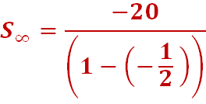

Suggested Practice for SOL AII.2
Students need additional practice finding the sum of a geometric series, particularly when the common ratio is negative.
Find the sum of this series.
9
Notes:
For SOL A2.2, students also need additional practice finding the sum of a geometric series, particularly when the common ratio is negative.
Students did well on multiple choice and fill-in-the-blank items when the ratio was positive. When the ratio of the series was negative, the most common student error was subtracting the ratio from one incorrectly in the denominator. The answer to the example is shown on the screen.

Slide 10
Identifying the Field Properties of
Complex Numbers
SOL AII.3
The student will perform operations on complex numbers,
express the results in simplest form using patterns of the
powers of i, and identify field properties that are valid for the
complex numbers.
10
Notes:
The next standard being highlighted is SOL A2.3. Students did well simplifying expressions with powers of i. They had a more difficult time identifying properties that are valid for the complex numbers.

Slide 11

Suggested Practice for SOL AII.3
Students need additional practice identifying the field
properties that are valid for complex numbers.
Identify the property represented in each example.
a.
b.
c.
d.
e.
Inverse Property of Multiplication
Commutative Property of Addition
Transitive Property
Distributive Property
Symmetric Property
11
Notes:
For SOL A2.3, students need additional practice identifying the field properties that are valid for complex numbers.
Students should be able to recognize properties when applied to complex numbers. They should also recognize the properties as they are used to solve equations or simplify expressions. The answers to the examples are shown on the screen.

Slide 12





Suggested Practice for SOL AII.3
Identify the property used between each step:
Step 1:
Step 2:
Step 3:
Step 4:
Step 5:
Given
Distributive Property
Commutative Property of Addition
Substitution Property
Substitution Property
12
Notes:
Here is an example that requires students to identify the properties used while simplifying an expression. Students did not perform as well on items like this one, when more than one property needs to be identified. The answers are shown on the screen.

Slide 13
Solving Absolute Value Equations
SOL AII.4
The student will solve, algebraically and graphically,
a) absolute value equations and inequalities;
b) quadratic equations over the set of complex numbers;
c) equations containing rational algebraic expressions; and
equations containing radical expressions.
Graphing calculators will be used for solving and confirming the algebraic solutions.
13
Notes:
The next standard being highlighted is SOL A2.4. In particular, students need additional practice solving quadratic equations over the set of complex numbers algebraically.

Slide 14




Suggested Practice for SOL AII.4b
Students need additional practice solving quadratic equations over the set of complex numbers.
What is the solution set for each equation shown?
a.
b.
c.
14
Notes:
For SOL A2.4b, students need additional practice solving quadratic equations over the set of complex numbers.
Students had difficulty on questions when the quadratic equation was not in standard form, and the solutions had imaginary roots. Note the two different formats for listing the solution set. Students should be familiar with multiple representations of solutions.

Slide 15
Determining Solutions for a System of Equations
SOL AII.5
The student will solve nonlinear systems of equations,
including linear-quadratic and quadratic-quadratic,
algebraically and graphically. Graphing calculators will be used
as a tool to visualize graphs and predict the number of
solutions.
15
Notes:
The next standard being highlighted is SOL A2.5. For this particular standard, students had difficulty solving nonlinear systems of equations, including linear-quadratic and quadratic-quadratic, algebraically and graphically.

Slide 16
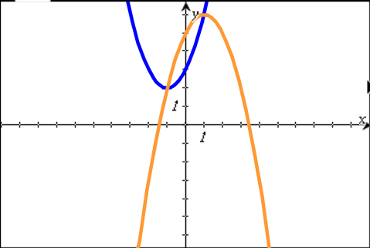

Suggested Practice for SOL AII.5
Students need additional practice plotting the solution to a system of equations graphed on the coordinate plane.
Plot the apparent solutions to the system of equations shown.
16
Notes:
For SOL A2.5, students need additional practice plotting the solution to a system of equations graphed on the coordinate plane.
When asked for the solution to a quadratic-quadratic system of equations represented on a coordinate plane in the traditional multiple choice format, students perform well. However, when they are given the system on the coordinate plane, and asked to plot the solutions, they have a more difficult time. Students tend to include additional points that are not solutions, such as the y-intercepts of the quadratics. The answers to the question are shown on the screen.

Slide 17


Suggested Practice for SOL AII.5
Students need additional practice finding the solutions of a system of linear-quadratic equations when the equations are given symbolically.
What is the value of the y-coordinate of the solution to this
system of equations?
What are the values of the x-coordinates of the solutions to
this system of equations?
17
Notes:
For SOL A2.5, students also need additional practice finding the solutions of a system of linear-quadratic equations when the equations are given symbolically. In particular, students have a more difficult time when the question is in fill-in-the-blank format, and they are asked to provide the x or y coordinate of the solution. The answers to the examples are shown on the screen. If a question similar to question two was a fill-in-the-blank item on an SOL test, the question would likely be modified to ask for one of the x-coordinates, and either answer would be scored as correct.

Slide 18
Analyzing Functions
SOL AII.7
The student will investigate and analyze functions algebraically
and graphically. Key concepts include
a) domain and range, including limited and discontinuous domains and ranges;
b) zeros;
c) x- and y-intercepts;
d) intervals in which a function is increasing or decreasing;
e) asymptotes;
f) end behavior;
g) inverse of a function; and
h) composition of multiple functions.
Graphing calculators will be used as a tool to assist in investigation of
functions.
18
Notes:
The next standard being highlighted is SOL A2.7, which requires students to analyze functions algebraically and graphically. All of the bullets are highlighted due to inconsistent student performance within each bullet. The concepts within each bullet that need improvement will be highlighted on the next several screens.

Slide 19

Suggested Practice for SOL AII.7a
Students need additional practice finding values that are not in the domain of a rational function, particularly when they have to select from a list of possible values.
Select the values that are NOT in the domain of the function shown.
19
Notes:
For SOL A2.7a students need additional practice finding values that are not in the domain of a rational function, particularly when they have to select from a list of possible values.
The example shown on the screen requires students to select all of the values that are NOT in the domain of the function shown. When presented with a list of values, there is not one common error. Students seem to have many misconceptions with this skill. The distractors in this question were created using common student errors. The answers to the question are shown on the screen.

Slide 20

Suggested Practice for SOL AII.7a
Students need additional practice finding the range of functions.
Select the best description for the range of the function shown.
All real numbers
All real numbers except for 2
All real numbers except for 2 and 5
All real numbers between 2 and 5
20
Notes:
Here is another example for SOL A2.7a. Students need additional practice finding the range of functions.
This question asks students to find the range of a rational function. The answer is shown on the screen.

Slide 21
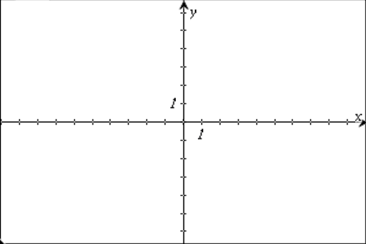





Suggested Practice for SOL AII.7a
What is the apparent range of the function shown on the coordinate plane?
a. b. c. d.
Extension: Name the apparent domain of this graph.
21
Notes:
Here is one more example for SOL A2.7a. Students should be able to find the domain and range of any function type presented graphically, including piecewise functions. The answer to this question is shown on the screen.
As an extension, ask students to define the apparent domain of this graph. The answer is shown on the screen.

Slide 22

Suggested Practice for SOL AII.7b
Students need additional practice finding the zero of a logarithmic function.
Which value is a zero of ?
a. b.
c. d.
22
Notes:
For SOL A2.7b, students need additional practice finding the zero of a logarithmic function.
An example for this skill is shown on the screen, along with its answer.

Slide 23

Suggested Practice for SOL AII.7c
Students need additional practice determining the x- and
y-intercepts of a function.
Select all of the x- and y-intercepts of the function shown by circling the x-intercept(s) and boxing the y-intercept(s).
23
Notes:
For SOL A2.7c, students need additional practice determining the x- and y-intercepts of a function.
Students need more practice selecting all of the intercepts from a list. A common student error for this type of item is interchanging the coordinates of the ordered pair and selecting, for example, (0,1) from the list, rather than the correct x-intercept of (1,0).
The answers to the question are shown on the screen.

Slide 24






Suggested Practice for SOL AII.7d
Students need additional practice identifying the intervals throughout which a function is increasing or decreasing.
Select the intervals throughout which the function shown is only increasing.
24
Notes:
For SOL A2.7d, students need additional practice identifying the intervals throughout which a function is increasing or decreasing.
An example that represents this skill is shown on the screen, along with its answers.

Slide 25





Suggested Practice for SOL AII.7e
Students need additional practice finding asymptotes when the function is represented symbolically.
What are the asymptotes of the function shown?
a.
b.
c.
d.
25
Notes:
For SOL A2.7e, students need additional practice finding asymptotes when the function is represented symbolically.
For this example, students do not recognize that x equals six is not an asymptote since there is a factor of x minus six in the numerator and denominator. The answer is shown on the screen.

Slide 26






Suggested Practice for SOL AII.7e
Name the horizontal asymptote of the function shown.
a.
b.
c.
d.
Common error
26
Notes:
Here is another example for SOL A2.7e. Students had mixed performance on items that required finding the horizontal asymptote of an exponential function. For functions such as the one shown, students need to make sure that the power is entered correctly in the graphing calculator. For instance, in this example, a common student error would be to graph the equation one eighth raised to the x power minus four, rather than one eighth raised to the quantity x minus four. The answer to the example is shown on the screen.

Slide 27

Suggested Practice for SOL AII.7f
Students need additional practice determining the end
behavior of a function.
Select two true statements about the graph of .
As x approaches positive infinity, f(x) approaches positive infinity.
As x approaches negative infinity, f(x) approaches negative infinity.
As x approaches negative infinity, f(x) approaches positive infinity.
As x approaches positive infinity, f(x) approaches negative infinity.
27
Notes:
For SOL A2.7f, students need additional practice determining the end behavior of a function.
Students had a difficult time with end behavior of varied function types. The example shown is a polynomial function, and the degree and leading coefficient determine its end behavior. Students need additional practice with both even and odd degree polynomial functions. An example like this one also asks students to pick out more than one correct answer, which mimics some technology enhanced items students may see on a test. The answers to the question are shown on the screen.

Slide 28

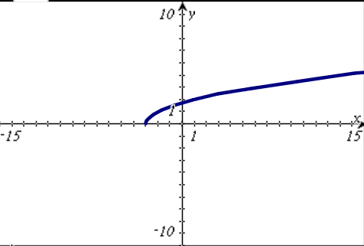
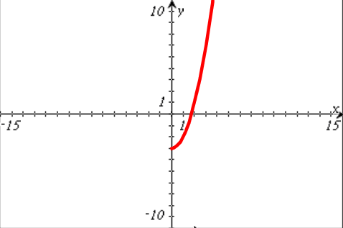
Suggested Practice for SOL AII.7g
Students need additional practice determining the inverse of a
function represented graphically.
The function is shown on the coordinate plane. Graph the inverse of this function.
28
Notes:
For SOL A2.7g, students need additional practice determining the inverse of a function represented graphically.
An example representing this skill is shown on the screen, along with its answer.

Slide 29







Suggested Practice for SOL AII.7h
Students need additional practice finding the composition of functions when both functions are quadratic.
If and , what is ?
a.
b.
c.
d.
29
Notes:
For SOL A2.7h, students need additional practice finding the composition of functions when both functions are quadratic.
An example for this skill, and its answer, are shown on the screen.

Slide 30
Recognizing the Relationship Among the
Solution, Zero, and x-Intercept of a Graph
SOL AII.8
The student will investigate and describe the relationships
among solutions of an equation, zeros of a function,
x-intercepts of a graph, and factors of a polynomial expression.
30
Notes:
The next standard being highlighted is SOL A2.8. For this standard, students need additional practice describing the relationships among solutions of an equation, zeros of a function, and the x-intercepts of a graph.

Slide 31

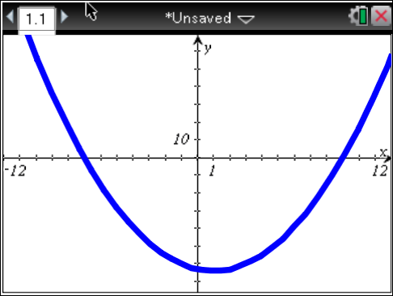


Suggested Practice for SOL AII.8
Students need additional practice making the connection
between a zero, a solution, and the graphical representation of the x-intercept.
What appear to be the zeros of the function
shown on the coordinate plane?
What appear to be the solutions to the equation represented by the graph when
f(x) = 0?
c. What are the apparent x-intercepts of the function shown on the graph?
Multiple ways that these mathematical terms can be used to ask questions
31
Notes:
For SOL A2.8, students need additional practice making the connection between a zero, a solution, and the graphical representation of the x-intercept.
This screen shows several ways in which these mathematical terms can be used to ask questions. Students do not seem to understand the meaning of these words as they relate to the graphical representation of the function.

Slide 32
Making Predictions with Curves of Best Fit
SOL AII.9
The student will collect and analyze data, determine the
equation of the curve of best fit, make predictions, and solve
real-world problems, using mathematical models.
Mathematical models will include polynomial, exponential, and
logarithmic functions.
32
Notes:
The next standard being highlighted is SOL A2.9. In this standard, students need additional practice determining the equation of the curve of best fit and making predictictions.

Slide 33
Suggested Practice for SOL AII.9
Students need additional practice finding the exponential curve of best fit for a set of data and making predictions using this curve.
The table provides the value of an account over time that earned annual compound interest. There was an initial deposit of $1,500 into the account, and no other deposits were made.
Assuming the account continues to grow in the same way, use the exponential curve of best fit to find the value of the account at the end of 40 years, rounded to the nearest dollar.
Value of Account Over Time
Time in years, x
0 | 5 | 10 | 15 | 20 | 25 | 30
1,500.00 | 1,914.42 | 2,443.34 | 3,118.39 | 3,979.95 | 5,079.53 | 6,482.91
Value in dollars
$10,560
33
Notes:
For SOL A2.9, students need additional practice finding the exponential curve of best fit for a set of data and making predictions using this curve.
When the data points are graphed, students do well on choosing the equation of the curve of best fit or predicting a value. However, students struggle with this skill when they have to determine the curve of best fit and/or make a prediction when the data is represented in a table or in a set.
An example that represents this skill, and its answer, are shown on the screen.

Slide 34
Solving Problems Involving Variation
SOL AII.10
The student will identify, create, and solve real-world problems
involving inverse variation, joint variation, and a combination
of direct and inverse variations.
34
Notes:
The next standard being highlighted is SOL A2.10. For this standard, students need additional practice solving real-world problems involving inverse variation, joint variation, and a combination of direct and inverse variations.

Slide 35
Suggested Practice for SOL AII.10
Students need additional practice finding the constant of proportionality and solving real-world problems involving a combination of direct and inverse variations.
If y varies inversely with the square of x, what is the
constant of proportionality when y = 10 and x = 5?
b. Body mass index (BMI) is directly proportional to a person’s weight in pounds and inversely proportional to the square of a person’s height in inches. A person with a BMI of 23.91 has a weight of 135 pounds and a height of 63 inches. Rounded to the nearest hundredth, what is the BMI of a person with a weight of 145 pounds and a height of 65 inches?
250
Answers may vary depending on how the constant was rounded. BMI should be approximately 24.13.
35
Notes:
For SOL A2.10, students need additional practice finding the constant of proportionality and solving real-world problems involving a combination of direct and inverse variations.
Two examples to practice these skills, and their answers, are shown on the screen.

Slide 36
Applying Properties of the Normal Distribution to Solve Problems
SOL AII.11
The student will identify properties of a normal distribution
and apply those properties to determine probabilities
associated with areas under the standard normal curve.
36
Notes:
The next standard being highlighted is SOL A2.11. This standard reads, the student will identify properties of a normal distribution and apply those properties to determine probabilities associated with areas under the standard normal curve.
This content was new to the 2009 Mathematics SOL and student performance with much of this content was weak.

Slide 37
Suggested Practice for SOL AII.11
For assistance with this content, or to find suggestions on types of questions to present to students, please refer to the Technical Assistance Document located at the Virginia Department of Education Web site at:
http://www.doe.virginia.gov/instruction/mathematics/high/technical_assistance_algebra2_aii_11.pdf
37
Notes:
For assistance with the content of SOL A2.11, or to find suggestions on types of questions to present to students, please refer to the Technical Assistance Document located at the Virginia Department of Education Web site at the URL shown on the screen
This document gives specific instructions on how to solve problems that are similar to ones on the screens that follow.

Slide 38
Suggested Practice for SOL AII.11
Students need additional practice using properties of the normal distribution curve to find the probability of an event, the percent of data that falls within a specified interval, and the number of expected values that fall within a specified interval.
A population of adult males had their heights measured. The heights were normally distributed. Approximately what percentage of the heights, rounded to the nearest whole number, are within one standard deviation of the mean?
  34 % c. 68%
  b. 95% d. 99.7%
Notes:
For this standard, students need additional practice using properties of the normal distribution curve to find the probability of an event, the percent of data that falls within a specified interval, and the number of expected values that fall within a specified interval.
Students should be familiar with using the empirical rule to determine the approximate percentage of data that falls within one, two and three standard deviations of the mean. Students should also know that the total area under the curve is one. An example and its answer are shown on the screen.

Slide 39
Suggested Practice for SOL AII.11
At a company, the data set containing the ages of applicants for a particular job was normally distributed. The mean age of the applicants was 30 years old, and the standard deviation of the data set was 3.5 years. Which is closest to the percent of applicants that were 21 years old or younger?
a. 0.5 %
b. 2.0 %
c. 2.57 %
d. 9.0 %
39
Notes:
The next few slides show examples of how this standard may be assessed.
Here is another example that asks students to find the probability of an event by performing calculations, rather than using the empirical rule as in the previous example. The answer to this question is shown on the screen.

Slide 40
Suggested Practice for SOL AII.11
A normally distributed data set of 500 values has a mean of 35 and a standard deviation of 7. Which is closest to the
probability that a value in the data set will fall between 42 and 46?
a. 0.04
b. 0.10
c. 10
d. 50
40
Notes:
This example asks students to find the probability that a value in the data set will fall between two given values. The answer is shown on the screen.

Slide 41
Suggested Practice for SOL AII.11
A normally distributed data set of 600 values has a mean of
18.5 and a standard deviation of 3.25.
1. What is the approximate number of values in the data set expected to be 22 or greater?
2. What is the approximate number of values in the data set expected to be 16 or fewer?
3. Which is closest to the expected number of values in the data set that lie between 21 and 27?
a. 6 b. 22 c. 130 d. 467
Acceptable answers: 84 or 85
Acceptable answers: 132 or 133
41
Notes:
These last examples for standard A2.11 ask for the approximate number of values in the data set that will be at or above, at or below or between two numbers in a data set. The answers to the questions are shown on the screen.

Slide 42
Practice Items
This concludes the student performance information for the spring 2013 Algebra II SOL test.
Additionally, test preparation practice items for Algebra II can be found on the Virginia Department of Education Web site at:
http://www.doe.virginia.gov/testing/sol/practice_items/index.shtml#math
42
Notes:
This concludes the student performance information for the spring 2013 Algebra II SOL test.
Additionally, test preparation practice items for Algebra II can be found on the Virginia Department of Education Web site at the URL shown on the screen.

Slide 43
Contact Information
For assessment questions, please contact
Student_assessment@doe.virginia.gov
For instruction questions, please contact Michael.Bolling@doe.virginia.gov
43

