Slide 1
Spring 2013 Student Performance Analysis
Algebra I
Standards of Learning
Presentation may be paused and resumed using the arrow keys or the mouse.
Notes:
This is the spring 2013 student performance analysis for the Algebra I Standards of Learning test. Statewide results for the spring 2013 mathematics SOL tests have been analyzed to determine specific content that may have challenged students. In order to support preparation of students for the Algebra I test, this PowerPoint presentation has been developed to provide examples of SOL content identified by this analysis.
While some of this content was first introduced in the 2009 mathematics SOL, other content is included in both the 2001 and 2009 mathematics SOL. There are also many similarities between the content identified during this analysis and the content identified during the spring 2012 student performance analysis.
This PowerPoint presentation contains concrete examples of the content for which student performance was weak or inconsistent. These items are not SOL test questions and are not meant to mimic SOL test questions. Instead, they are intended to provide mathematics educators with further insight into the concepts that challenged students statewide.
It is important to note that the SOL and examples highlighted in this presentation should not be the sole focus of instruction, nor should these suggestions replace the data that teachers or school divisions have collected on student performance. Rather, this information provides supplemental instructional information based on student performance across the Commonwealth of Virginia.

Slide 2
Representing and Evaluating Expressions
SOL A.1
The student will represent verbal quantitative situations algebraically and evaluate these expressions for given replacement values of the variables.
2
Notes:
The first standard being highlighted is SOL A.1. This standard reads: The student will represent verbal quantitative situations algebraically and evaluate these expressions for given replacement values of the variables.

Slide 3
Suggested Practice for SOL A.1
Students need additional practice translating expressions.
Select each phrase that verbally translates this algebraic expression:
One fourth times the cube root of x less five.
One fourth times the cube root of x less than five.
Five subtract one fourth times the cube root of x.
Five less than one fourth times the cube root of x.
3
Notes:
For SOL A.1 students need additional practice translating expressions. This example asks students to select each phrase that represents a verbal translation of the expression shown. Two of the answer options translate this expression and are boxed in red on the screen. If students are presented with two options similar to the options highlighted in yellow, they have difficulty recognizing how these options differ and do not recognize the last option as a correct translation.

Slide 4
Suggested Practice for SOL A.1
Students need additional practice evaluating expressions with cube roots, square roots, and the square of a number, particularly when the replacement variable has a negative value.
Evaluate the following expressions:
a.
b.
c.
4
Notes:
For SOL A.1 students also need additional practice evaluating expressions with cube roots, square roots, and the square of a number, particularly when the replacement variable has a negative value.
The answers to the examples are shown on the screen. For example a, a common student error is to add negative thirty six rather than thirty six. Similarly, a common error for example b is to subtract negative nine rather than nine. For example c, a common error would be to calculate the value under the radicand as negative thirty six plus sixty four rather than thirty six plus sixty four. It is important that students recognize the difference between squaring a negative number and squaring a number and taking its opposite.

Slide 5
Suggested Practice for SOL A.1
Students need additional practice evaluating expressions that contain an absolute value.
Evaluate the following expressions:
a.
b.
5
Notes:
For SOL A.1 students need additional practice evaluating expressions that contain an absolute value.
A common student error is not taking the absolute value of the quantity inside the absolute value sign when that value is negative. For example, in problem a, this error would result in multiplying negative two times negative five to get a value of ten, rather than multiplying negative two times five to get a value of negative ten.
The answers to the examples are shown on the screen.

Slide 6
Performing Operations on Polynomials
SOL A.2
The student will perform operations on polynomials, including
applying the laws of exponents to perform operations on expressions;
adding, subtracting, multiplying, and dividing polynomials; and
factoring completely first- and second-degree binomials and trinomials in one or two variables. Graphing calculators will be used as a tool for factoring and for confirming algebraic factorizations.
6
Notes:
The next standard being highlighted is SOL A.2. For this standard there were several areas of inconsistent performance. Students need additional practice performing operations on polynomials including: a) applying the laws of exponents to perform operations on expressions, b) dividing polynomials, and c) factoring completely first- and second-degree binomials and trinomials in one or two variables. Graphing calculators will be used as a tool for factoring and for confirming algebraic factorizations.

Slide 7
Suggested Practice for SOL A.2a
Students need additional practice applying the laws of exponents to simplify expressions.
Simplify:
a. b.
c. d.
7
Notes:
For SOL A.2a students need additional practice applying the laws of exponents to simplify expressions.
The examples on the screen show some areas of student weakness. For example a, many students will calculate the power of the variable correctly, but will incorrectly calculate the coefficient by not raising the two to the fourth power. Similarly in example b, many students will incorrectly solve this by dividing thirty by six to get five, and then not square the five. Example c is shown because students need more practice recognizing any value raised to the zero power is one. And finally, example d is shown because students need additional practice simplifying expressions with negative exponents.
Students did well on items that required applying the basic rules, such as addition or subtraction of exponents only. For example, students would perform well on example b if the question only asked students to simplify what is inside the parenthesis.
The answers to the four examples are shown on the screen.

Slide 8
Suggested Practice for SOL A.2b
Students need additional practice dividing polynomials.
a. Find the quotient of and .
b. Simplify the following expression. Assume the denominator does not equal zero.
c. Simplify :
8
Notes:
For SOL A.2b students need additional practice dividing polynomials. Students perform better on simplifying polynomial expressions that involve addition, subtraction and multiplication, but do need additional practice with dividing polynomials. It would be helpful for students to practice this skill in a non-multiple choice format.
The answers to the questions are shown on the screen.

Slide 9
Suggested Practice for SOL A.2c
Students need additional practice completely factoring polynomials, particularly when there is a greatest common factor.
Identify all of the factors of when it is completely factored.
9
Notes:
For SOL A.2c students need additional practice completely factoring polynomials, particularly when there is a greatest common factor.
For the example shown, many students would not recognize that the greatest common factor of two is indeed a factor. It is also important to note that four x squared minus nine can be factored into the quantity two x plus three times the quantity two x minus three, and is therefore not a factor of eight x squared minus eighteen when it is completely factored.
The answer to the example is shown on the screen.

Slide 10
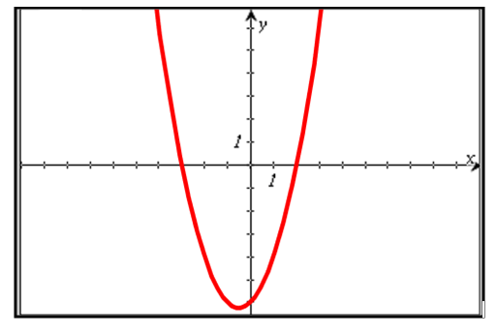
Suggested Practice for SOL A.2c
Students need additional practice using the x-intercepts from the graphical representation of the polynomial to determine and confirm its factors.
Using two of the factors shown, create a possible equation for the graphed relation.
10
Notes:
Here is another example for SOL A.2c. Students need additional practice using the x-intercepts from the graphical representation of the polynomial to determine and confirm its factors.
Most students can answer questions that require selection of a factored equation from a list of answer options to match the given graph. However, it is more difficult for them to create the equation from a list of factors.
The answer to the question is shown on the screen.

Slide 11
Express Square Roots and Cube Roots in Simplest Radical Form
SOL A.3
The student will express the square roots and cube roots of
whole numbers and the square root of a monomial algebraic
expression in simplest radical form.
11
Notes:
The next standard being highlighted is SOL A.3. This standard reads: The student will express the square roots and cube roots of whole numbers and the square root of a monomial algebraic expression in simplest radical form.
In the spring 2012 student performance analysis, students had difficulty understanding how to calculate or simplify the cube root of a whole number. Students did much better on those concepts during the spring 2013 test administration. Students are also doing very well at calculating and simplifying the square root of a whole number. However, performance on simplifying the square root of a monomial algebraic expression in simplest radical form was inconsistent.

Slide 12
Suggested Practice for SOL A.3
Students need additional practice simplifying the square root of a monomial algebraic expression.
Write each expression in simplest radical form.
a.
b.
c.
12
Notes:
For SOL A.3 students need additional practice simplifying the square root of a monomial algebraic expression.
Students would benefit from experiences that require them to simplify monomial expressions that do not have perfect square coefficients.
The answers to the examples are shown on the screen.

Slide 13
Solving Linear and Quadratic Equations
SOL A.4
The student will solve multistep linear and quadratic equations
in two variables, including
solving literal equations (formulas) for a given variable;
justifying steps used in simplifying expressions and solving equations, using field properties and axioms of equality that are valid for the set of real numbers and its subsets;
solving quadratic equations algebraically and graphically;
solving multistep linear equations algebraically and graphically;
solving systems of two linear equations in two variables algebraically and graphically; and
solving real-world problems involving equations and systems of equations.
Graphing calculators will be used both as a primary tool in solving problems and to
verify algebraic solutions.
13
Notes:
The next standard being highlighted is SOL A.4. For this standard, students need additional practice with bullet a) solving literal equations (formulas) for a given variable; bullet c) solving quadratic equations algebraically and graphically; bullet d) solving multistep linear equations algebraically; and bullet e) solving systems of two linear equations in two variables algebraically.

Slide 14
Suggested Practice for SOL A.4a
Students need additional practice solving literal equations.
The formula for the surface area (S) of a triangular prism is
where h is the height of the prism, p is the perimeter of the base, and B is the area of the base. Solve the equation for the given variable:
a. Solve for h:
b. Solve for B:
14
Notes:
For SOL A.4a students need additional practice solving literal equations.
The answers to the two questions are shown on the screen.

Slide 15
Suggested Practice for SOL A.4c
Students need additional practice finding solutions to quadratic equations presented algebraically and graphically.
Identify the solutions to the equation:
a.
b.
c.
d.
15
Notes:
For SOL A.4c students need additional practice finding solutions to quadratic equations presented algebraically and graphically.
The answer to the question is shown on the screen.

Slide 16
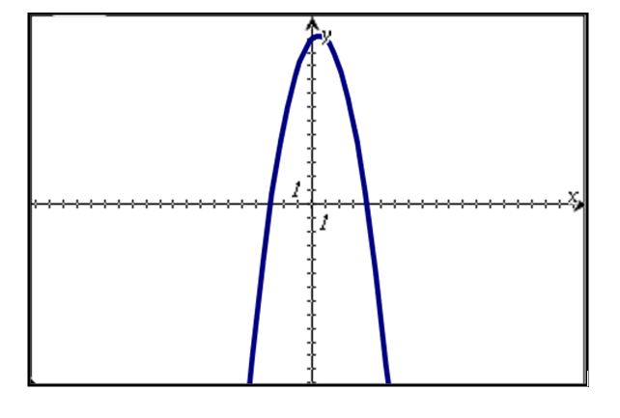
Suggested Practice for SOL A.4c
The graph of is shown.
Plot the solutions to .
16
Notes:
Here is another example for SOL A.4c. Students don’t seem to understand that the word “solution” is where the graph of the quadratic equation crosses the x-axis. Students will erroneously plot the y-intercept as a solution, and many times, they will also plot the maximum or minimum as the solution.
The answer to this question in shown on the screen.

Slide 17
Suggested Practice for SOL A.4d
Students need additional practice describing solutions to equations that have the following solutions: x=0, an infinite number of real solutions, and no real solutions.
Describe the solution to each equation.
a.
b.
c.
No real solutions
x=0
An infinite number of real solutions
17
Notes:
For SOL A.4d students need additional practice describing solutions to equations that have the following solutions: x =0, an infinite number of real solutions, and no real solutions.
The answers to the examples are shown on the screen.

Slide 18
Suggested Practice for SOL A.4e
Students need additional practice finding solutions to systems of equations presented algebraically.
1. Which system of equations has no real solution?
a. b.
c. d.
2. What is x-value of the solution to this system of equations?
x=6
18
Notes:
For SOL A.4e students need additional practice finding solutions to systems of equations presented algebraically.
Students are better at identifying the solution to a system of equations when the system is presented graphically. However, when the system is presented algebraically, students have more difficulty. In the first example, students are asked to identify a system of equations with no real solution. Students should be able to compare the slopes of the lines in each system to determine whether the lines are parallel. The second question asks students to find the x-value of the solution to the system of equations.
The answers to both questions are shown on the screen.

Slide 19
Solving Multi-Step Inequalities and Systems of Inequalities
SOL A.5
The student will solve multistep linear inequalities in two
variables, including
solving multistep linear inequalities algebraically and graphically;
justifying steps used in solving inequalities, using axioms of inequality and properties of order that are valid for the set of real numbers and its subsets;
solving real-world problems involving inequalities; and
solving systems of inequalities.
19
Notes:
The next standard being highlighted is SOL A.5. This standard requires students to solve multistep inequalities in two variables. Specifically, students had difficulty with bullet a) solving multistep linear inequalities algebraically; bullet b) justifying steps used in solving inequalities, and bullet d) solving systems of inequalities.

Slide 20
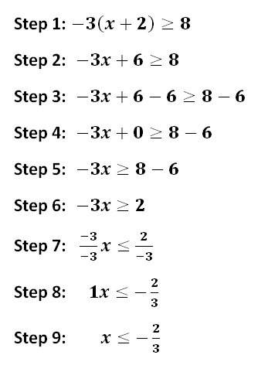
Suggested Practice for SOL A.5a
Students need additional practice solving multistep inequalities.
An inequality is solved as shown.
Between which two steps is an
error made? Explain the error.
The -3 was not distributed properly to the second term.
20
Notes:
For SOL A.5a students need additional practice solving multistep inequalities.
One way in which this standard is assessed is identifying where a mistake has been made in the steps shown for solving. The answer to this example is shown on the screen. An extension could be to incorporate practice for SOL A.5b by asking students which property justifies the work between two consecutive steps.

Slide 21
Suggested Practice for SOL A.5b
Students need additional practice identifying properties of inequality.
Given:
Using the given inequality, select all that illustrate the application of the subtraction property of inequality.
21
Notes:
For SOL A.5b students need additional practice identifying properties of inequality.
This question asks students to identify all inequalities that illustrate the subtraction property of inequality. The answers are shown on the screen.
As an extension ask students to identify the property illustrated by each of the answer options not selected.

Slide 22
Suggested Practice for SOL A.5d
Students need additional practice identifying ordered pairs that are solutions to a system of inequalities.
Which ordered pairs are solutions to this system of inequalities?
$$\left(−4,−3\right) \left(0,−4\right) \left(1,1\right) \left(1,3\right) \left(3,−1\right) \left(4,3\right) (6,0)$$
22
Notes:
For SOL A.5d students need additional practice identifying ordered pairs that are solutions to a system of inequalities.
Students do well when selecting solutions from a graph, or when asked to shade the region of the graph that is the solution to the system of inequalities. They do not do as well when they have no visual representation of the system.
The answers to the example are shown on the screen.

Slide 23
Determining Slope of a Line
SOL A.6
The student will graph linear equations and linear inequalities
in two variables, including
determining the slope of a line when given an equation of the line, the graph of the line, or two points on the line. Slope will be described as rate of change and will be positive, negative, zero, or undefined; and
writing the equation of a line when given the graph of the line, two points on the line, or the slope and a point on the line.
23
Notes:
The next standard being highlighted is SOL A.6. For this standard, students need additional practice determining the slope of a line when given an equation of the line, or two points on the line and they also need practice when writing the equation of a line when given the graph of a line.

Slide 24
Suggested Practice for SOL A.6a
Students need additional practice finding slope.
Find the slope, m, of the line represented by the given equation.
a.
b.
c.
24
Notes:
For SOL A.6a students need additional practice finding slope. Equations should be presented to students in different formats.
The answers to the questions are shown on the screen.

Slide 25
Suggested Practice for SOL A.6a
Students need additional practice finding slope.
a. Find the slope of the line passing through the points (6,3) and (4,2).
b. Find the slope of the line passing through the point (5,1) with an
x-intercept of 4.
25
Notes:
Here are two more examples for SOL A.6a. In the second example, students will need to think about the x-intercept as a point in order to find the slope of the line.
The answers are shown on the screen.

Slide 26
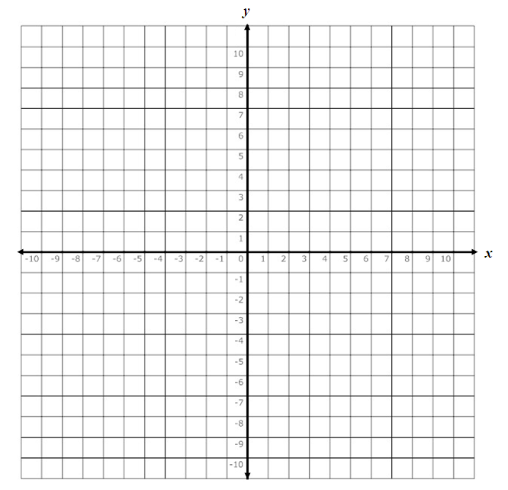
Suggested Practice for SOL A.6
Given:
a. What is the slope of the line represented by this equation?
b. What is the y-intercept of the line represented by this equation (SOL A.7)?
c. Graph the line represented by this equation.
(0,5)
26
Notes:
Here is another example that contains questions that are correlated to standards A.6 and A.7.
The answers are shown on the screen.

Slide 27
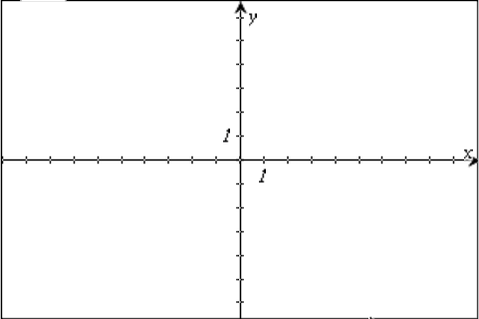
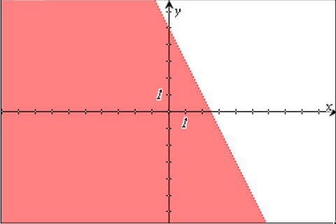
Suggested Practice for SOL A.6b
Graph the inequality .
27
Notes:
Here is another example for SOL A.6b. Students would benefit from experiences graphing an inequality presented in varied formats.
The answer is shown on the screen.

Slide 28
Investigating and Analyzing Functions
SOL A.7
The student will investigate and analyze function (linear and
quadratic) families and their characteristics both algebraically
and graphically, including
determining whether a relation is a function;
domain and range;
zeros of a function;
x- and y-intercepts;
finding the values of a function for elements in its domain; and
making connections between and among multiple representations of
functions including concrete, verbal, numeric, graphic, and algebraic.
28
Notes:
The next standard being highlighted is SOL A.7. In particular, students need additional practice finding domain and range, the zeros of a function and x- and y-intercepts of a function.

Slide 29
Suggested Practice for SOL A.7b
Students need additional practice identifying the domain and range from a graph.
What appears to be the range of the relation shown?
a.
b.
c.
d.
29
Notes:
For SOL A.7b students need additional practice identifying the domain and range from a graph.
It is important for students to recognize that the range for this set of points consists of discrete values, as indicated on the screen, and is not a range of values, as indicated in option b.

Slide 30
Suggested Practice for SOL A.7b
What appears to be the domain of the relation shown?
All real numbers greater than -1
All real numbers greater than 2
All real numbers less than 10
All real numbers
30
Notes:
Here is another example for SOL A.7b.
The answer is shown on the screen.

Slide 31
Suggested Practice for SOL A.7c
Students need additional practice finding zeros of linear functions.
Graph each function and then plot a point at the location of the zero.
a.
b.
c.
b
a
$$The zero is 2, located at \left(2,0\right).$$
$$The zero is 6, located at \left(6,0\right).$$
$$The zero is−2, located at \left(−2,0\right).$$
c
31
Notes:
For SOL A.7c students need additional practice finding zeros of linear functions. A common error is for students to substitute zero into the equation for the variable x, erroneously selecting the y-intercept as the location of the zero.
The answers to the questions are shown on the screen.

Slide 32
Suggested Practice for SOL A.7c
Students need additional practice finding zeros of quadratic functions presented algebraically.
a. What are the zeros of the function ?
b. What are the zeros of the function ?
32
Notes:
For SOL A.7c students also need additional practice finding zeros of quadratic functions presented algebraically.
The answers to the two examples are shown on the screen.

Slide 33
Suggested Practice for SOL A.7d
Students need additional practice identifying the x- and
y-intercepts of a function.
What are the x- and y- intercepts of the function ?
a. x- intercept of $\left(0,\frac{8}{3} \right)$ and y- intercept of $\left(−8,0\right)$
b. x- intercept of $\left(0,−\frac{8}{3} \right)$ and y- intercept of $\left(8,0\right)$
c. x- intercept of $\left( \frac{8}{3} ,0\right)$ and y- intercept of $\left(0,−8\right)$
d. x- intercept of $\left( −\frac{8}{3} ,0\right)$ and y- intercept of $\left(0, 8\right)$
33
Notes:
For SOL A.7d students need additional practice identifying the x- and y-intercepts of a function.
For this example, students are asked to find both the x- and y-intercepts of a linear function.
The answer is shown on the screen.

Slide 34
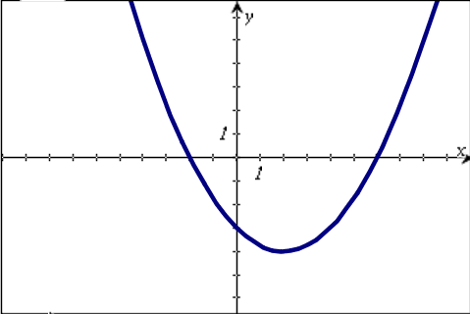
Suggested Practice for SOL A.7d
Plot the x- and y-intercepts of the relation shown on the graph.
The x-intercepts are located at (-2,0) and (6,0) and the y-intercept is located at (0,-3).
34
Notes:
Here is another example for SOL A.7d. This example asks students to plot the x- and y- intercepts of a relation presented graphically.
The answers are shown on the screen.

Slide 35
Analyzing Direct and Inverse Variations
SOL A.8
The student, given a situation, will analyze a relation to
determine whether a direct or inverse variation exists, and
represent a direct variation algebraically and graphically and an
inverse variation algebraically.
35
Notes:
The next standard being highlighted is SOL A.8. In particular, students need additional practice representing direct and inverse variations algebraically.

Slide 36
Suggested Practice for SOL A.8
Students need additional practice selecting ordered
pairs from a list to make a relation that is a direct or inverse variation.
Given this set of ordered pairs:
a. Select three points that will create a direct variation relation.
b. Select three points that will create an inverse variation relation.
36
Notes:
For SOL A.8 students need additional practice selecting ordered pairs from a list to make a relation that is a direct or inverse variation.
The answers to the examples are shown on the screen. In addition, students need to be able to identify which set of ordered pairs, when presented as answer options, represent a direct or inverse variation.

Slide 37
Suggested Practice for SOL A.8
Students need additional practice identifying a direct variation equation algebraically and graphically.
Identify the equations that represent a direct variation.
37
Notes:
For SOL A.8 students also need additional practice identifying a direct variation equation algebraically and graphically.
The answers to the example are shown on the screen.

Slide 38
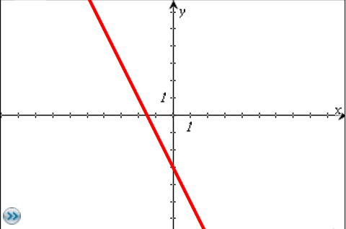
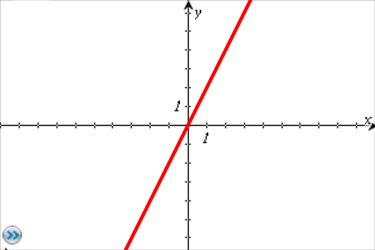
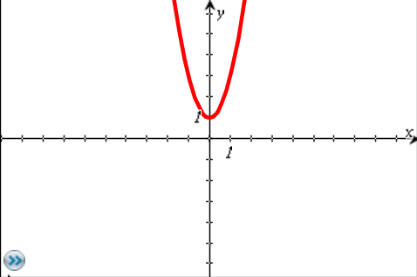
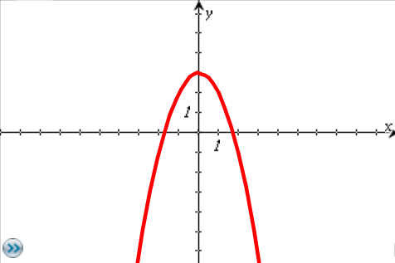
Suggested Practice for SOL A.8
Identify the graph of a direct variation.
38
Notes:
Here is an example that requires identification of a graph of a direct variation. The answer is shown on the screen.

Slide 39
Interpret Standard Deviation and Z-Scores
SOL A.9
The student, given a set of data, will interpret variation in
real-world contexts and calculate and interpret mean absolute
deviation, standard deviation, and z-scores.
39
Notes:
The next standard being highlighted is SOL A.9. This standard reads: The student, given a set of data, will interpret variation in real-world contexts and calculate and interpret mean absolute deviation, standard deviation, and z-scores.
In particular, students need practice calculating and interpreting standard deviation and z-scores.

Slide 40
Suggested Practice for SOL A.9
Students need additional practice performing calculations with statistical information.
a. A data set has a mean of 55 and a standard deviation of 3.5. The z-score for a data point is -1.2. What is the data point?
b. A data set has a standard deviation of 3. The element 16 is an element of a data set, with a z-score of 2.4. What is the mean of the data set?
50.8
8.8
40
Notes:
For SOL A.9 students need additional practice performing calculations with statistical information.
The answers to the two examples are shown on the screen.

Slide 41
Suggested Practice for SOL A.9
Students need additional practice performing calculations with statistical information.
The number of minutes book club students read on Monday night is displayed by the graph. The mean number of minutes for this data set is 21.18, and the standard deviation of the data set is 6.5. The z-score for the data point representing the number of minutes Tim read is 1.25. In which interval does this data point lie?
The interval 25 to 30 minutes.
41
Notes:
Here is another example for SOL A.9. This example asks students to identify an interval in which a data point lies. Intervals can be presented graphically, as in this example, or algebraically.
The answer to this question is shown on the screen.

Slide 42
Analyzing Box-and-Whisker Plots
SOL A.10
The student will compare and contrast multiple univariate data
sets, using box-and-whisker plots.
42
Notes:
The next standard being highlighted is SOL A.10. This standard reads: The student will compare and contrast multiple univariate data sets, using box-and-whisker plots. Students have difficulty with many aspects of this standard.

Slide 43
Suggested Practice for SOL A.10
Students need additional practice interpreting data plotted in box-and-whisker plots.
Each of these box-and-whisker plots contain 15 unique elements.
1. Write a statement comparing the range of both plots.
2. Which box-and-whisker plot has the greater interquartile range?
The value of the range for both plots is equal to 17.
Plot A. The value of the interquartile range for Plot A is 11, and the value of the interquartile range for Plot B is 10.
3. Which data set has more elements with a value of 11 or greater?
Plot B. There are 12 elements in Plot B with a value of 11 and above and 8 elements in Plot A with a value of 11 and above.
43
Notes:
For SOL A.10 students need additional practice interpreting data plotted in box-and-whisker plots.
Students struggle with vocabulary, such as range and interquartile range. They have difficulty calculating and comparing the range and interquartile range of two or more plots. Students also need practice comparing plots that have a specified number of elements. For instance, the third question requires students to sketch out Plots A and B and determine how many elements of each plot meet a given criteria.
The answers to the questions are shown on the screen.

Slide 44
Suggested Practice for SOL A.10
Plot A represents the total number of songs downloaded by each of 15 students
in Mr. Archer’s class during October. Each student in Mr. Archer’s class
downloaded a different number of songs from the others.
Plot B represents the total number of songs downloaded by each of 20 students
in Mrs. Baker’s class during October. Each student In Mrs. Baker’s class
downloaded a different number of songs from the others.
During the month of October, what is the difference between the number of students who downloaded more than 6 songs in Mrs. Baker’s class and the number of students who downloaded more than 6 songs in Mr. Archer’s class?
The difference is 4. There were 15 students who downloaded more than 6 songs in Mrs. Baker’s class, and 11 students who downloaded more than 6 songs in Mr. Archer’s class.
44
Notes:
Here is another example for SOL A.10. This question requires students to determine how many data points in each plot meet a certain criterion.
The answer is shown on the screen.

Slide 45
Suggested Practice for SOL A.10
This box-and-whisker plot summarizes the number of pieces of pizza each of ten volunteers served at a concession stand one night.
Another volunteer served 16 pieces of pizza that night, and 16 is added to the original data set. A new box-and-whisker plot is drawn. Which two statements comparing the new box-and-whisker plot to the original box-and-whisker plot must be true?
The interquartile range of the box-and-whisker plot increases.
The range of the box-and-whisker plot increases.
The value of the upper extreme increases.
The value of the median increases.
45
Notes:
Here is an example that requires students to determine the affect on a box and whisker plot when an element is added to the data set. Paying attention to the location of the new element within the original data set helps students determine whether or not certain conclusions can be drawn. It is very important for students to realize that some statements cannot be proven true using the box and whisker plot, since the elements themselves are not given. Students must draw conclusions based only on the information that is given.
For instance, the statement, “The interquartile range of the box-and-whisker plot increases,” may be true or false, depending on the data set. Likewise the location of the median of the data set will change, but the value of the median may or may not increase. The only two statements that will always be true are the ones indicated on the screen.

Slide 46
Using the Curve of Best Fit
SOL A.11
The student will collect and analyze data, determine the
equation of the curve of best fit in order to make predictions,
and solve real-world problems, using mathematical models.
Mathematical models will include linear and quadratic
functions.
46
Notes:
The next standard being highlighted is SOL A.11. In particular, students had inconsistent performance making predications using the curve of best fit.

Slide 47
Suggested Practice for SOL A.11
Students need additional practice making predictions using the
linear or quadratic curve of best fit.
This set of ordered pairs shows a relationship between x and y.
a. What is the equation for the quadratic curve of best fit for this set of data?
b. Predict the value of y when x = 8.
200
47
Notes:
For SOL A.11 students need additional practice making predictions using the linear or quadratic curve of best fit.
Students performed better when they had to predict from a graph or find the equation of a line of best fit when the data points were presented on a graph. When data was presented in set form or in a table, students had more difficulty finding the curve of best fit and making a predication.
The answers to the questions are shown on the screen.

Slide 48
Suggested Practice for SOL A.11
This table shows the value, v, of an account at the end of m months. There was an initial deposit of $50 and no other deposits were made.
If the value of the account continues to increase in the same way, predict the value of the account at the end of 13 months. Use the quadratic curve of best fit to make the prediction.
m, time in months | v, value in dollars
0 | 50
1 | 129
3 | 299
5 | 485
7 | 687
9 | 905
$1,389.00
48
Notes:
Here is another example that asks students to predict a value using the quadratic curve of best fit. Similar to the last example, students should determine the quadratic curve of best fit using the graphing calculator, and then use that curve to predict the value of the account at the end of thirteen months.
The answer to the question is shown on the screen.

Slide 49
Suggested Practice for SOL A.11
The data in the table shows the average United States farm size, in acres, for the years 2000-2007.
Average Farm Size
Using the line of best fit for the data shown in the table, what is the best prediction of the average farm size in the year 2014?
a. 437 acres b. 441 acres c. 447 acres d. 463 acres
Year | Average Acres Per Farm
2000 | 434
2001 | 437
2002 | 436
2003 | 441
2004 | 443
2005 | 444
2006 | 446
2007 | 449
49
Notes:
Here is one last example for SOL A.11. The answer is shown on the screen.

Slide 50
Practice Items
This concludes the student performance information for the spring 2013 Algebra I SOL test.
Additionally, test preparation practice items for
Algebra I can be found on the Virginia Department of Education Web site at:
http://www.doe.virginia.gov/testing/sol/practice_items/index.shtml#math
50
Notes:
This concludes the student performance information for the spring 2013 Algebra I SOL test.
Additionally, test preparation practice items for Algebra I can be found on the Virginia Department of Education Web site at the URL shown on the screen.

Slide 51
Contact Information
For assessment questions, please contact
Student_assessment@doe.virginia.gov
For instruction questions, please contact Michael.Bolling@doe.virginia.gov
51
Notes:
(No audio.)

