Slide 1
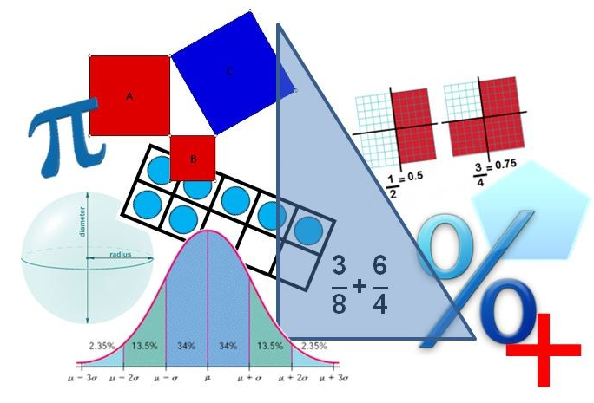
Student Performance Analysis Spring 2019
Geometry
Mathematics Standards of Learning

Slide 2
Student Performance Analysis Spring 2019 (1 of 3)
Statewide results for the spring 2019 mathematics tests based on the 2016 Mathematics Standards of Learning (SOL) have been analyzed to determine specific content that may have challenged students. In order to support preparation of students for the Geometry test, this PowerPoint presentation has been developed to provide examples of SOL content identified by this analysis.

Slide 3
Student Performance Analysis Spring 2019 (2 of 3)
It should be noted that these items are not SOL test questions and are not meant to mimic SOL test questions. Instead, they are intended to provide mathematics educators with further insight into the concepts that challenged students statewide.
Please be aware that figures/images used in these items may not be drawn to scale.

Slide 4
Student Performance Analysis Spring 2019 (3 of 3)
It is important to keep the content of this statewide analysis in perspective. The information provided here should be used as supplemental information.
Instructional focus should remain on the standards as a whole, with school- or division-level data being used as the focal guiding resource to help improve instruction.

Slide 5
Counterexamples and Validity
SOL G.1
The student will use deductive reasoning to construct and judge the validity of a logical argument consisting of a set of premises and a conclusion. This will include
identifying the converse, inverse, and contrapositive of a conditional statement;
translating a short verbal argument into symbolic form; and
determining the validity of a logical argument.

Slide 6
Counterexamples (G.1c)
When determining counterexamples, students need additional practice finding values or examples that will make the first part of a conditional statement true and the second part of the statement false.
The most common error on SOL test items occurs when students select values that make the first part of the conditional statement false.

Slide 7
Suggested Practice with Counterexamples (G.1c)
Identify three values for m that are counterexamples to this statement.
If m is a factor of 100, then m² is a factor of 100.
2 4 5 10 15 20 25

Slide 8
Answers to Practice with Counterexamples (G.1c)
Identify three values for m that are counterexamples to this statement.
If m is a factor of 100, then m² is a factor of 100.
2 4 5 10 15 20 25
Common errors on SOL test items include:
selecting numbers such as 2, 5, and 10 that make both parts of the statement true; and
selecting 15 because it makes the first part of the statement false.

Slide 9
Validity (G.1c)
When determining the validity of an argument, students need additional practice examining each statement individually and all statements together.

Slide 10
Suggested Practice with Validity of an Argument (G.1c)
Given: $\sim m→\sim p$
$\sim p→r$
Based on the given statements, identify all valid conclusions.
$m→p$ $p→m$ $r→\sim m$ $\sim m→r$
$\sim r→m$ $\sim r→p$

Slide 11
Answers to Practice with Validity of an Argument (G.1c)
Given: $\sim m→\sim p$
$\sim p→r$
Based on the given statements, identify all valid conclusions.
$m→p$ $p→m$ $r→\sim m$ $\sim m→r$
$\sim r→m$ $\sim r→p$
Common errors on SOL test items include selecting the converse or inverse of the given statements.

Slide 12
Parallel Lines and Angle Relationships
SOL G.2
The student will use the relationships between angles formed by two lines intersected by a transversal to
prove two or more lines are parallel; and
solve problems, including practical problems, involving angles formed when parallel lines are intersected by a transversal.

Slide 13
Parallel Lines (G.2a)
Students need additional practice working with figures in which the given information does not include specific angle measures. Additionally, students would benefit from additional practice applying algebraic concepts to find angle measures and to determine parallel lines.

Slide 14
Figure with Parallel Lines (G.2a)
Use this figure to answer the next three questions.

Slide 15
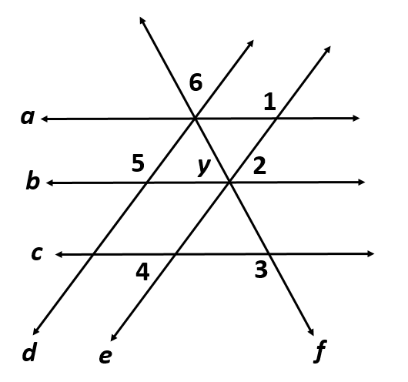
Suggested Practice #1 with Parallel Lines (G.2a)
Given: $a∥b∥c$
Select two statements
that must be true.
$∠5≅∠1$ $∠4≅∠2$ $∠6≅∠4$
$∠1 is supplementary to ∠4$ $∠5 is supplementary to ∠2$

Slide 16
Answers to Practice #1 with Parallel Lines (G.2a)
Given: $a∥b∥c$
Select two statements
that must be true.
$∠5≅∠1$ $∠4≅∠2$ $∠6≅∠4$
$∠1 is supplementary to ∠4$ $∠5 is supplementary to ∠2$

Slide 17
Suggested Practice #2 with Parallel Lines (G.2a)
Given: $d∥e$
$m∠5=(2x+10)°$
$m∠2=(x+20)°$
$m∠6=50°$
Find the value of y.

Slide 18
Answers to Practice #2 with Parallel Lines (G.2a)
Given: $d∥e$
$m∠5=(2x+10)°$
$m∠2=(x+20)°$
$m∠6=50°$
Find the value of y.
y = 60 degrees
Common errors on SOL test items include finding the value of x (instead of y) or thinking angles 2 and y are the same measure.

Slide 19
Suggested Practice with Angle Relationships (G.2b)
Given:
$$∠5≅∠1$$
$$∠4≅∠2$$
$$∠1 is supplementary to ∠2$$
Which statement
is true?
A. Only $a∥b$
B. Only $d∥e$
C. Only $a∥b∥c$
D. $a∥b∥c$ and $d∥e$

Slide 20
Answer to Practice with Angle Relationships (G.2b)
Given:
$$∠5≅∠1$$
$$∠4≅∠2$$
$$∠1 is supplementary to ∠2$$
Which statement
is true?
A. Only $a∥b$
B. Only $d∥e$
C. Only $a∥b∥c$
D. $a∥b∥c$ and $d∥e$

Slide 21
Transformations
SOL G.3
The student will solve problems involving symmetry and transformation. This will include
investigating and using formulas for determining distance, midpoint, and slope;
applying slope to verify and determine whether lines are parallel or perpendicular;
investigating symmetry and determining whether a figure is symmetric with respect to a line or a point; and
determining whether a figure has been translated, reflected, rotated, or dilated, using coordinate methods.

Slide 22
Combination of Transformations (G.3d)
Students need additional practice:
identifying the result of a combination of two transformations; and
completing a combination of two transformations to determine the new coordinates of a given figure.
Common errors on SOL test items include:
confusing the x-axis with the y-axis;
confusing clockwise and counterclockwise;
confusing horizontal with vertical; and
incorrectly locating the line $y=x$or $y=−x.$

Slide 23
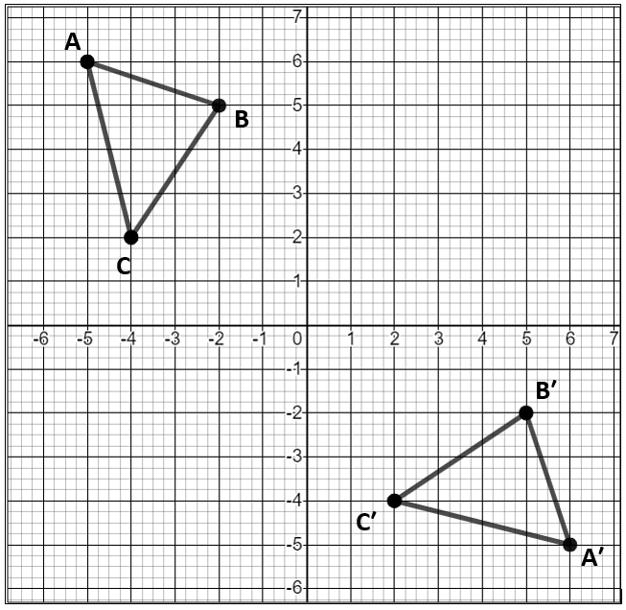
Suggested Practice #1 with Transformations (G.3d)
Which sequence of two transformations maps △ABC to △A′B′C′? (The vertices of the triangles have integral coordinates.)
A. A rotation 90° counterclockwise about the origin, then a reflection over the line $y=−x$
B. A rotation 90° clockwise about the origin, then a reflection over the x-axis
C. A translation 7 units to the right, then a reflection over the x-axis
D. A reflection over the y-axis, then a translation 8 units down

Slide 24
Answer to Practice #1 with Transformations (G.3d)
Which sequence of two transformations maps △ABC to △A′B′C′? (The vertices of the triangles have integral coordinates.)
A. A rotation 90° counterclockwise about the origin, then a reflection over the line $y=−x$
B. A rotation 90° clockwise about the origin, then a reflection over the x-axis
C. A translation 7 units to the right, then a reflection over the x-axis
D. A reflection over the y-axis, then a translation 8 units down

Slide 25
Suggested Practice #2 with Transformations (G.3d)
1. Identify other transformations that would also result in △ABC mapping to △A′B′C′.
2. Identify a combination of transformations that would result in mapping △A′B′C′ back to △ABC.

Slide 26
Answers to Practice #2 (Problem 1) with Transformations (G.3d)
Possible answers to #1:
A reflection over the line $y=x$
A reflection over the $y$-axis, then a rotation 90° clockwise or 270° counterclockwise
A rotation 90° counterclockwise, then a reflection over the $y$-axis

Slide 27
Answers to Practice #2 (Problem 2) with Transformations (G.3d)
Possible answers to #2:
A reflection over the $y$-axis, then a rotation 90° clockwise or 270° counterclockwise
A rotation 90° counterclockwise, then a reflection over the $y$-axis
A reflection over the $x$-axis, then a rotation 90° counterclockwise

Slide 28
Suggested Practice #3 with Transformations (G.3d)
Given: △XYZ
X (2, 3)
Y (-1, -1)
Z (3, -4)
The given triangle will be reflected over the line
$y=x$ and then translated 6 units to the left to form △X′Y′Z′. What are the coordinates of △X′Y′Z′ ?

Slide 29
Answers to Practice #3 with Transformations (G.3d)
Given: △XYZ
X (2, 3)
Y (-1, -1)
Z (3, -4)
The given triangle will be reflected over the line
$y=x$ and then translated 6 units to the left to form △X′Y′Z′. What are the coordinates of △X′Y′Z′ ?
The coordinates of X′ are (-3, 2).
The coordinates of Y′ are (-7, -1).
The coordinates of Z′ are (-10, 3).

Slide 30
Constructions
SOL G.4
The student will construct and justify the constructions of
a) a line segment congruent to a given line segment;
b) the perpendicular bisector of a line segment;
c) a perpendicular to a given line from a point not on the line;
d) a perpendicular to a given line at a given point on the line;
e) the bisector of a given angle;
f) an angle congruent to a given angle;
g) a line parallel to a given line through a point not on the line; and
h) an equilateral triangle, a square, and a regular hexagon inscribed in a circle.

Slide 31
Construction Steps and Justifications (G.4)
Students need additional practice with verbal descriptions related to constructions. This includes:
identification of the next step when given an initial step;
identification of the construction from a description; and
identification of justifications for steps used in a construction.
There are multiple methods to most geometric constructions and students would benefit from experiences with more than one method.

Slide 32
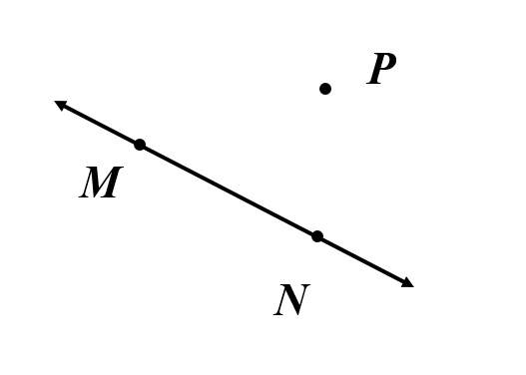
Suggested Practice #1 with Constructions (G.4b)
Given: Line MN
Point P
Juan will construct a perpendicular
bisector to $\overline{MN}$. Which of these
could be the first step for completing this construction?
Juan should place the compass point —
A. at P and draw an arc that intersects point M.
B. at M and draw an arc with a radius less than half of MN.
C. at N and draw an arc that intersects point M.
D. at N and draw an arc with a radius greater than $\frac{1}{2}$MN.

Slide 33
Answer to Practice #1 with Constructions (G.4b)
Given: Line MN
Point P
Juan will construct a perpendicular
bisector to $\overline{MN}$. Which of these
could be the first step for completing this construction?
Juan should place the compass point —
A. at P and draw an arc that intersects point M.
B. at M and draw an arc with a radius less than half of MN.
C. at N and draw an arc that intersects point M.
D. at N and draw an arc with a radius greater than $\frac{1}{2}$MN.

Slide 34
Suggested Practice #2 with Constructions (G.4c)
Given: Line MN and point P
Which of these could be the first
step for constructing a line
perpendicular to $\overset{⃡}{MN}$ that passes
through point P ?
Set the compass at P and draw an arc that intersects $\overset{⃡}{MN}$ in two places.
B. Draw a line that passes through P and intersects $\overset{⃡}{MN}$.
C. Set the compass at M and draw an arc with radius less than MP below $\overset{⃡}{MN}$.
D. Set the compass at N and draw an arc through M.

Slide 35
Answer to Practice #2 with Constructions (G.4c)
Given: Line MN and point P
Which of these could be the first
step for constructing a line
perpendicular to $\overset{⃡}{MN}$ that passes
through point P ?
Set the compass at P and draw an arc that intersects $\overset{⃡}{MN}$ in two places.
B. Draw a line that passes through P and intersects $\overset{⃡}{MN}$.
C. Set the compass at M and draw an arc with radius less than MP below $\overset{⃡}{MN}$.
D. Set the compass at N and draw an arc through M.

Slide 36
Triangle Side Lengths and Angle Measures
SOL G.5
The student, given information concerning the lengths of sides and/or measures of angles in triangles, will solve problems, including practical problems. This will include
ordering the sides by length, given angle measures;
ordering the angles by degree measure, given side lengths;
determining whether a triangle exists; and
determining the range in which the length of the third side must lie.

Slide 37
Triangle Side Lengths (G.5c)
Students need additional practice applying the Triangle Inequality Theorem to practical problems.
Common errors on SOL test items include selecting a side length that is one of the correct sides, but ignoring other criteria such as “the longest” side length or total perimeter of the triangle.

Slide 38
Suggested Practice with Triangle Side Lengths (G.5c)
Ginger will build a structure in the shape of a scalene triangle. The perimeter of the triangular structure must be 42 inches.
Select two numbers that could each represent the length of the longest side, in inches, of this structure.
10 14 15 20 21

Slide 39
Answer to Practice with Triangle Side Lengths (G.5c)
Ginger will build a structure in the shape of a scalene triangle. The perimeter of the triangular structure must be 42 inches.
Select two numbers that could each represent the length of the longest side, in inches, of this structure.
10 14 15 20 21
Common error on SOL tests:
selecting 10 or 14 inches as a side length of the triangle and
not understanding why those lengths could not be the longest side

Slide 40
Pythagorean Theorem and Special Right Triangles
SOL G.8
The student will solve problems, including practical problems, involving right triangles. This will include applying
the Pythagorean Theorem and its converse;
properties of special right triangles; and
trigonometric ratios.

Slide 41
Pythagorean Theorem (G.8a)
Students need additional practice applying the Pythagorean Theorem to triangles whose side lengths are represented by algebraic expressions.
Common errors on SOL test items include:
using the wrong side of the triangle as the hypotenuse; and
failing to square the variable when it is used in the Pythagorean Theorem.

Slide 42
Suggested Practice with the Pythagorean Theorem (G.8a)
A triangle has side lengths 10y, 6y, and 64. The longest side is 10y.
What value for y proves that this triangle is a right triangle?
A triangle has side lengths 25, 15x and 20x. The longest side is 25.
What value for x proves that this triangle is a right triangle?

Slide 43
Answers to Practice with the Pythagorean Theorem (G.8a)
A triangle has side lengths 10y, 6y, and 64. The longest side is 10y.
What value for y proves that this triangle is a right triangle?
y = 8
A triangle has side lengths 25, 15x and 20x. The longest side is 25. What value for x proves that this triangle is a right triangle? x = 1
Common errors on SOL tests include:
not squaring all side lengths; and/or
not squaring the variable.

Slide 44
Special Right Triangles (G.8b)
Students need additional practice applying properties of special right triangles to composite figures to determine unknown side lengths, particularly when radicals are used to represent the given information and/or the final answer.
Common errors on SOL test items include:
incorrect application of the rules of special right triangles; and
incorrectly multiplying, dividing, or rationalizing radicals.

Slide 45
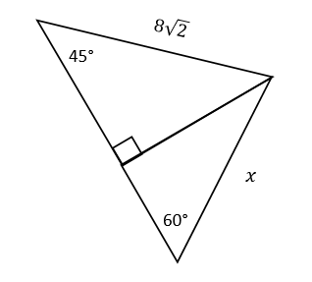
Suggested Practice #1 with Special Right Triangles (G.8b)
The figure shown is composed of two triangles that share a common side. Find the value of $x.$

Slide 46
Answer to Practice #1 with Special Right Triangles (G.8b)
The figure shown is composed of two triangles that share a common side. Find the value of $x.$
$$x=\frac{16\sqrt{3}}{3}$$
Common error: Students appear to know the side relationships but are unable to recognize the answer when the denominator has been rationalized.

Slide 47
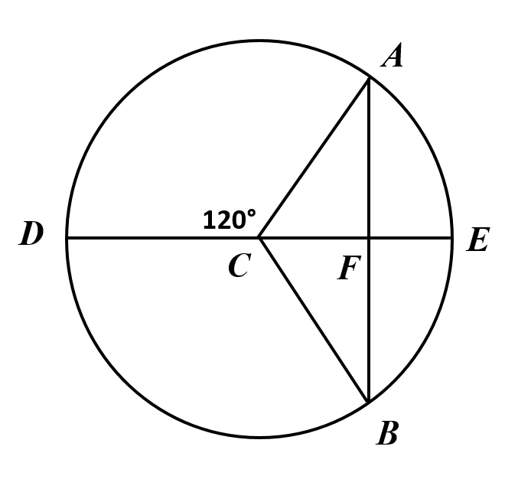
Suggested Practice #2 with Special Right Triangles (G.8b)
Given: Circle C with diameter $\overline{DE}$,
A and B on circle C, and
isosceles △ABC
If DE = 20 inches, what is AF ?
10 inches
5 inches
5$\sqrt{3}$ inches
10$\sqrt{3}$ inches

Slide 48
Answer to Practice #2 with Special Right Triangles (G.8b)
Given: Circle C with diameter $\overline{DE}$,
A and B on circle C, and
isosceles △ABC
If DE = 20 inches, what is AF ?
10 inches
5 inches
5$\sqrt{3}$ inches
10$\sqrt{3}$ inches

Slide 49
Suggested Practice #3 with Special Right Triangles (G.8b)
Given: Circle C with diameter $\overline{DE}$,
A and B on circle C, and
isosceles △ABC
If DE = 20 inches, what is FE ?
A. 10 inches
B. 5 inches
C. 5$\sqrt{3}$ inches
D. 10$\sqrt{3}$ inches

Slide 50
Answer to Practice #3 with Special Right Triangles (G.8b)
Given: Circle C with diameter $\overline{DE}$,
A and B on circle C, and
isosceles △ABC
If DE = 20 inches, what is FE ?
A. 10 inches
B. 5 inches
C. 5$\sqrt{3}$ inches
D. 10$\sqrt{3}$ inches

Slide 51
Chords, Secants, and Tangents in Circles
SOL G.11
The student will solve problems, including practical problems, by applying properties of circles. This will include determining
angle measures formed by intersecting chords, secants, and/or tangents;
lengths of segments formed by intersecting chords, secants, and/or tangents;
arc length; and
area of a sector.

Slide 52
Chords, Secants, Tangents, Angles, and Arcs (G.11)
Students need additional practice finding angle measures, lengths of line segments, and arc lengths.
Common errors on SOL test items include:
believing that a non-central angle has the same degree measure as its intercepted arc; and
using incorrect formulas when finding the measure of a line segment resulting from intersecting chords, a chord and a secant, or a tangent and a secant.

Slide 53
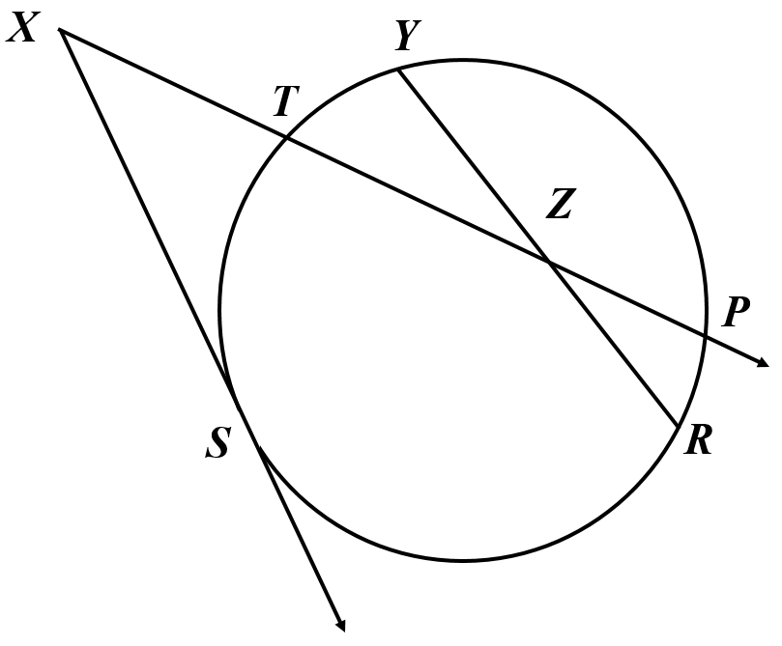
Suggested Practice #1 with Arc and Angle Measures (G.11a)
Given: A circle with SY=90°
TY=40°
SP=160°
Find $m∠X.$

Slide 54
Answer to Practice #1 with Arc and Angle Measures (G.11a)
Given: A circle with SY=90°
TY=40°
SP=160°
Find $m∠X.$
$$m∠X=55°$$
A common error is to find ST = 50$°$ and assume it is also the measure of angle X.

Slide 55
Suggested Practice #2 with Arc and Angle Measures (G.11a)
Given: A circle with
ST=70°
RS=96°
$m∠YZP$=128°
Find the measure of YP, in degrees.
90° C. 147°
128° D. 166°

Slide 56
Answer to Practice #2 with Arc and Angle Measures (G.11a)
Given: A circle with
ST=70°
RS=96°
$m∠YZP$=128°
Find the measure of YP, in degrees.
90° C. 147°
128° D. 166°
Common error: students select the measure of the angle that intercepts the arc.

Slide 57
Suggested Practice with Chords, Secants, and Tangents (G.11b)
Given:
A circle with
Tangent $\vec{XS}$
Secant $\vec{XP}$
Chord $\overline{YR}$
XT = 8 cm
TP = 16 cm
ZP = 10 cm
ZR = 12 cm
XS =
YZ =

Slide 58
Answer to Practice with Chords, Secants, and Tangents (G.11b)
Given:
A circle with
Tangent $\vec{XS}$
Secant $\vec{XP}$
Chord $\overline{YR}$
XT = 8 cm
TP = 16 cm
ZP = 10 cm
ZR = 12 cm
XS = $8\sqrt{3}$ cm
YZ = 5 cm

Slide 59
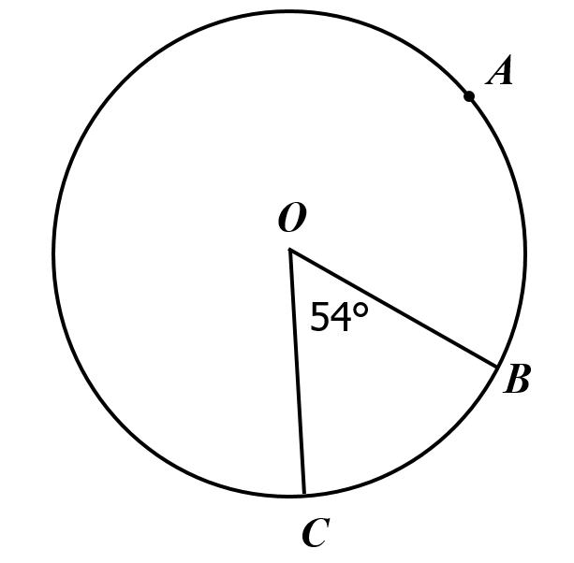
Suggested Practice with Arc Length (G.11c)
In Circle O, the length of BC is 25.4 cm.
Find the length of BAC to the nearest tenth of a centimeter.

Slide 60
Answer to Practice with Arc Length (G.11c)
In Circle O, the length of BC is 25.4 cm.
Find the length of BAC to the nearest tenth of a centimeter.
The length of arc BAC, to the nearest tenth of a centimeter, is 143.9 cm.
Common error: Students do not appear to recognize that the ratio of the central angle to the whole circle is equal to the ratio of the arc length to the circumference.

Slide 61
Equations of Circles
SOL G.12
The student will solve problems involving equations of circles.

Slide 62
Equations of Circles and Radicals (G.12)
Students need additional practice finding and using radius and diameter measurements that are expressed in radical form.
Common errors on SOL test items include:
using the diameter instead of the radius and vice versa; and
not recognizing an answer expressed in radical form.

Slide 63
Suggested Practice #1 with Equations of Circles (G.12)
Circle P is represented by this equation:
$${\left(x+5\right)}^{2}+{\left(y−3\right)}^{2}=40$$
What is the diameter of circle P ?
A. $2\sqrt{10}$
B. $4\sqrt{10}$
C. 40
D. 80

Slide 64
Answer to Practice #1 with Equations of Circles (G.12)
Circle P is represented by this equation:
$${\left(x+5\right)}^{2}+{\left(y−3\right)}^{2}=40$$
What is the diameter of circle P ?
A. $2\sqrt{10}$
B. $4\sqrt{10}$
C. 40
D. 80
Common error: Students select the radius of the circle.

Slide 65
Suggested Practice #2 with Equations of Circles (G.12)
A circle has a radius of $3\sqrt{7}$ and a center at (2, -3). Determine the equation of this circle.
+ =
$(x−2)²$ $(x+2)²$ $(y−3)²$ $(y+3)²$
$21$ $63$ $9\sqrt{7}$ $21\sqrt{7}$ $441$

Slide 66
Answer to Practice #2 with Equations of Circles (G.12)
A circle has a radius of $3\sqrt{7}$ and a center at (2, -3). Determine the equation of this circle.
$(x−2)²$ + $(y+3)²$ = $63$
$(x+2)²$ $(y−3)²$
$21$ $9\sqrt{7}$ $21\sqrt{7}$ $441$
Note: The addends can be in either order.

Slide 67
Surface Area and Volume of Objects
SOL G.13
The student will use surface area and volume of three-dimensional objects to solve practical problems.

Slide 68
Surface Area and Volume Applications (G.13)
Students need additional practice finding surface area and/or volume of three-dimensional figures when some values are not directly provided on the figure and/or when the answer is expressed in terms of pi ($π$).
Common errors on SOL test items include:
confusion between height and slant height on a pyramid;
not knowing when to apply the Pythagorean Theorem; and
confusion about when to use a radius or diameter.

Slide 69
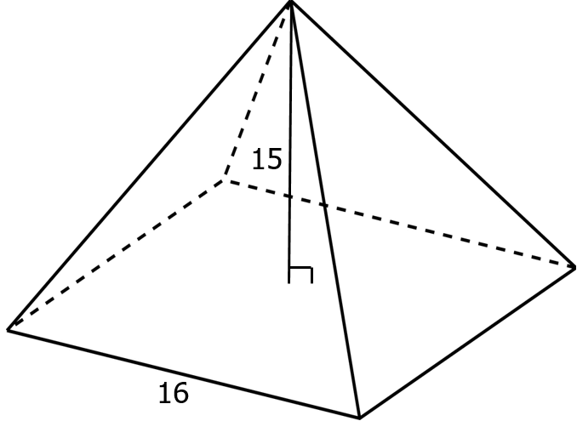
Suggested Practice #1 with Surface Area and Volume (G.13)
A square pyramid has a height of 15 cm and a base edge of 16 cm.
What is the area of one face of this pyramid?

Slide 70
Answer to Practice #1 with Surface Area and Volume (G.13)
A square pyramid has a height of 15 cm and a base edge of 16 cm.
What is the area of one face of this pyramid?
136 cm²
Common error: Students confuse the height with the slant height or they do not know how to use the Pythagorean Theorem to find the slant height.

Slide 71
Suggested Practice #2 with Surface Area and Volume (G.13)
A square pyramid has a height of 15 cm and a base edge of 16 cm.
What is the surface area of this pyramid?

Slide 72
Answer to Practice #2 with Surface Area and Volume (G.13)
A square pyramid has a height of 15 cm and a base edge of 16 cm.
What is the surface area of this pyramid?
800 cm²
Common error: Students do not include all four faces and the base.

Slide 73
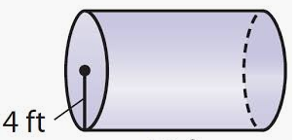
Suggested Practice #3 for Surface Area and Volume (G.13)
This cylinder has a radius of 4 feet and a volume of 208$π$ cubic feet.
What is the height of the cylinder?
52 feet
26 feet
16 feet
13 feet

Slide 74
Answer to Practice #3 for Surface Area and Volume (G.13)
This cylinder has a radius of 4 feet and a volume of 208$π$ cubic feet.
What is the height of the cylinder?
52 feet
26 feet
16 feet
13 feet
Common error: Students divide 208 by 4 (the radius) or by 8 (the diameter).

Slide 75
Suggested Practice #4 for Surface Area and Volume (G.13)
This cylinder has a radius of 4 feet and a volume of 208$π$ cubic feet.
What is the surface area of the cylinder, in terms of $π$ ?
52$π$ square feet
104$π$ square feet
136$π$ square feet
208$π$ square feet

Slide 76
Answer to Practice #4 for Surface Area and Volume (G.13)
This cylinder has a radius of 4 feet and a volume of 208$π$ cubic feet.
What is the surface area of the cylinder, in terms of $π$ ?
52$π$ square feet
104$π$ square feet
136$π$ square feet
208$π$ square feet
There are a variety of errors made when solving this type of problem. Some students use the volume and 4 to find the height. Others find the height correctly but do not add the areas of the bases.

Slide 77
Similar Geometric Figures
SOL G.14
The student will apply the concepts of similarity to two- or three-dimensional geometric figures. This will include
comparing ratios between lengths, perimeters, areas, and volumes of similar figures;
determining how changes in one or more dimensions of a figure affect area and/or volume of the figure;
determining how changes in area and/or volume of a figure affect one or more dimensions of the figure; and
solving problems, including practical problems, about similar geometric figures.

Slide 78
Similarity Comparisons with Geometric Figures (G.14a, d)
Students need additional practice comparing the ratios of lengths, areas, and volumes of similar objects and applying this information to practical problems.

Slide 79
Suggested Practice #1 with Similar Figures (G.14a, d)
The ratio of the perimeters of two regular pentagons is 2500:1.
What is the ratio of the length of one side of the larger pentagon to the length of one side of the smaller pentagon?
2500:1
500:1
50:1
25:1

Slide 80
Answer to Practice #1 with Similar Figures (G.14a, d)
The ratio of the perimeters of two regular pentagons is 2500:1.
What is the ratio of the length of one side of the larger pentagon to the length of one side of the smaller pentagon?
A. 2500:1
B. 500:1
C. 50:1
D. 25:1
Common error: Many students believe they should divide by 5 since a pentagon has 5 sides. Since perimeter and side length are both linear measurements, students should not divide.
The ratios are equal.

Slide 81
Suggested Practice #2 with Similar Figures (G.14a, d)
The ratio of the surface areas of two cubes is 900:1.
What is the ratio of the area of one face of the larger cube to one face of the smaller cube?
What is the ratio of the side length of the larger cube to the side length of the smaller cube?
What is the ratio of the volume of the larger cube to the volume of the smaller cube?

Slide 82
Answers to Practice #2 with Similar Figures (G.14a, d)
The ratio of the surface areas of two cubes is 900:1.
What is the ratio of the area of one face of the larger cube to one face of the smaller cube?
What is the ratio of the side length of the larger cube to the side length of the smaller cube?
What is the ratio of the volume of the larger cube to the volume of the smaller cube?
900: 1
30: 1
27,000: 1
Common error: Students believe they should divide by 6 because a cube has 6 faces, but they only divide the large number by 6.

Slide 83
Suggested Practice #3 with Similar Figures (G.14a, d)
The ratio of the diameters of two spheres is 3:5. The volume of the smaller sphere is 322.4 cm³.
Which is closest to the volume of the larger sphere?
193.4 cm³
537.3 cm³
895.6 cm³
1492.6 cm³

Slide 84
Answer to Practice #3 with Similar Figures (G.14a, d)
The ratio of the diameters of two spheres is 3:5. The volume of the smaller sphere is 322.4 cm³.
Which is closest to the volume of the larger sphere?
193.4 cm³
537.3 cm³
895.6 cm³
1492.6 cm³
Common error: Students create a proportion that uses the original ratio.
$\frac{3}{5}$ = $\frac{322.4}{x}$

Slide 85
Practice Items
This concludes the student performance information for the spring 2019 Geometry SOL test.
Additional information on accessing practice items and the Guided Practice Suggestions can be found on the Virginia Department of Education website.

Slide 86
Contact Information
For questions regarding assessment, please contact student_assessment@doe.virginia.gov
For questions regarding instruction, please contact vdoe.mathematics@doe.virginia.gov

