Slide 1
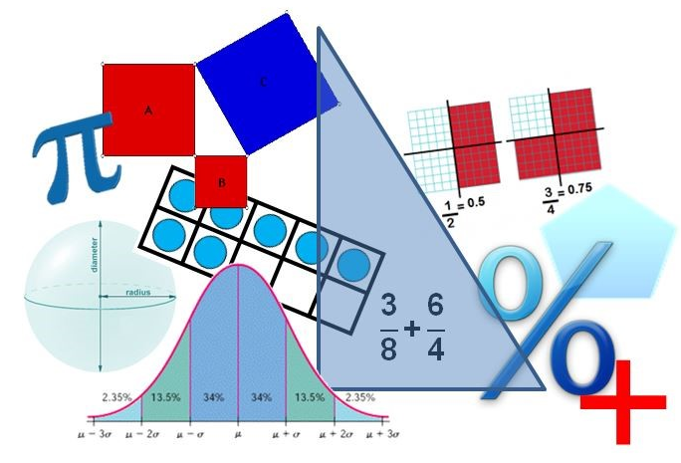
Student Performance Analysis
Spring 2019
Grade 6
Mathematics Standards of Learning

Slide 2
Student Performance Analysis Spring 2019 (1 of 3)
Statewide results for the spring 2019 mathematics tests based on the 2016 Mathematics Standards of Learning (SOL) have been analyzed to determine specific content that may have challenged students. In order to support preparation of students for the Grade 6 Mathematics test, this PowerPoint presentation has been developed to provide examples of SOL content identified by this analysis.

Slide 3
Student Performance Analysis Spring 2019 (2 of 3)
It should be noted that these items are not SOL test questions and are not meant to mimic SOL test questions. Instead, they are intended to provide mathematics educators with further insight into the concepts that challenged students statewide.

Slide 4
Student Performance Analysis Spring 2019 (3 of 3)
It is important to keep the content of this statewide analysis in perspective. The information provided here should be used as supplemental information.
Instructional focus should remain on the standards as a whole, with school- or division-level data being used as the focal guiding resource to help improve instruction.

Slide 5
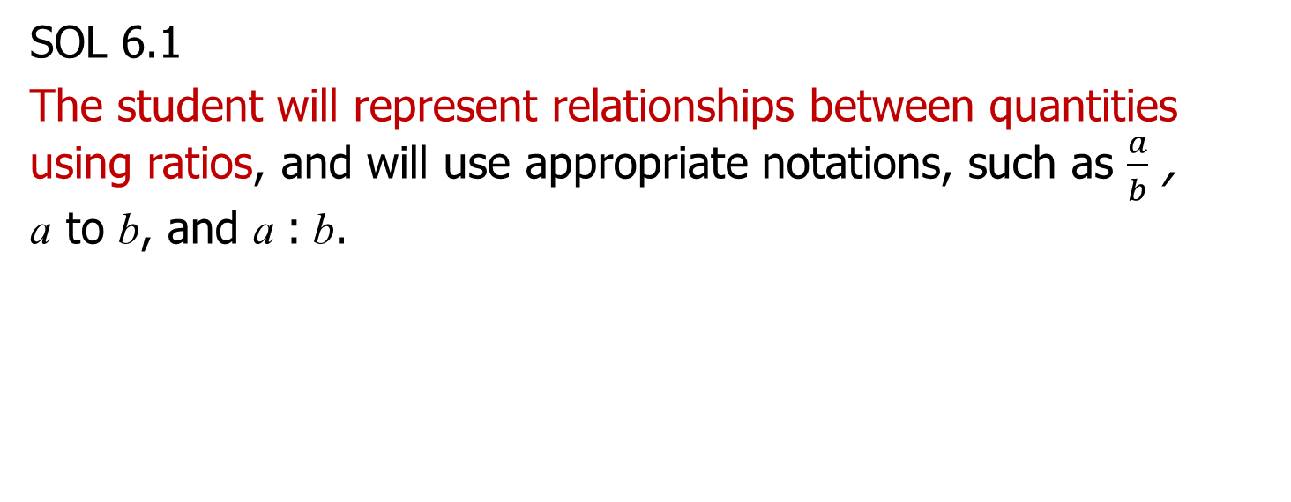
Ratios
SOL 6.1
The student will represent relationships between quantities using ratios, and will use appropriate notations, such as $\frac{a}{b}$ , a to b, and a : b.

Slide 6
Represent Relationships Using Ratios
Students would benefit from additional practice with representing relationships using ratios.
Common errors on SOL test items include:
using the sum of the numbers in the ratio to model a relationship; and
switching the order of the ratio.

Slide 7
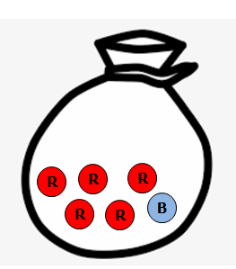


Suggested Practice #1 with Representing Relationships Using Ratios (6.1)
There are 5 red candies and 1 blue candy shown in the bag. What is the least number of red and blue candies that can be added to the bag to create a ratio of 3 to 2 for the number of red candies to the number of blue candies?
Key:
= red
= blue

Slide 8
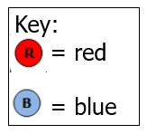


Answer to Practice #1 with Representing Relationships Using Ratios (6.1)
There are 5 red candies and 1 blue candy shown in the bag. What is the least number of red and blue candies that can be added to the bag to create a ratio of 3 to 2 for the number of red candies to the number of blue candies?
Common error: Reversing the order of the ratio and adding 1 red candy and 8 blue candies to obtain a 2:3 ratio.

Slide 9
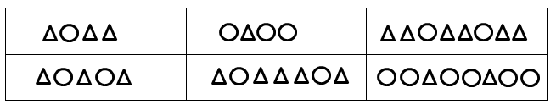
Suggested Practice #2 with Representing Relationships Using Ratios (6.1)
Identify each set that has a 1:3 ratio for the number of circles to the number of triangles.

Slide 10
Answer to Practice #2 with Representing Relationships Using Ratios (6.1)
Identify each set that has a 1:3 ratio for the number of circles to the number of triangles.
Common error: Selecting a model that represents the ratio values but it is a 3:1 ratio.

Slide 11
Representing and Determining Equivalencies
SOL 6.2
The student will
represent and determine equivalencies among fractions, mixed numbers, decimals, and percents; and
b) compare and order positive rational numbers.

Slide 12
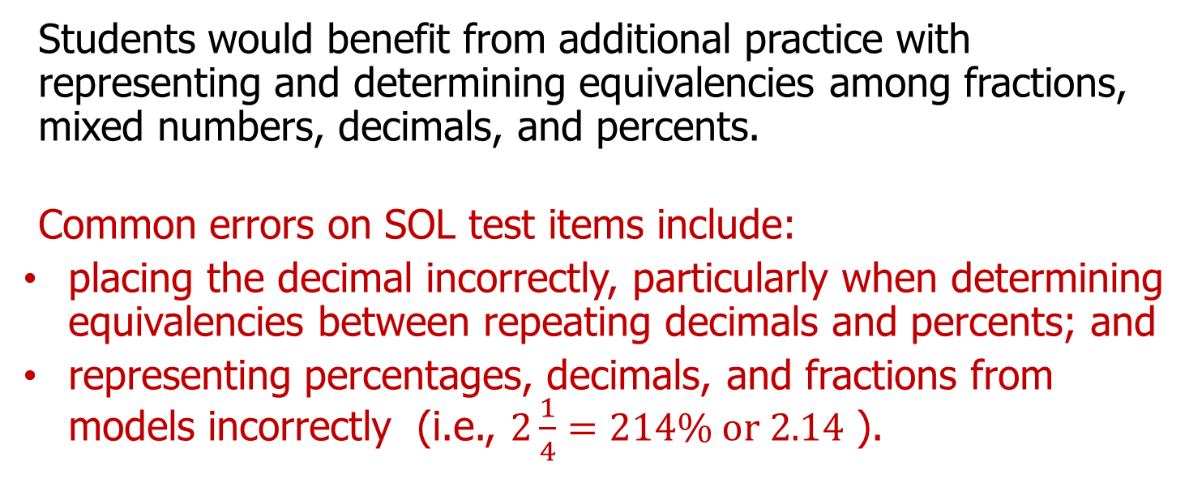
Representing and Determining Equivalencies (6.2)
Students would benefit from additional practice with representing and determining equivalencies among fractions, mixed numbers, decimals, and percents.
Common errors on SOL test items include:
placing the decimal incorrectly, particularly when determining equivalencies between repeating decimals and percents; and
representing percentages, decimals, and fractions from models incorrectly (i.e., $2\frac{1}{4}=214\% or 2.14$ ).

Slide 13
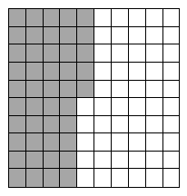
Suggested Practice #1 with Representing and Determining Equivalencies (6.2a)
This square has been divided into equal parts. Which pair of numbers are equivalent to the shaded portion of the square?
A. $45\% , \frac{45}{10}$ B. $4.5\% , \frac{45}{100}$ C. $45\% , \frac{45}{100}$ D. $4.5\% , \frac{45}{10}$

Slide 14
Answer to Practice #1 with Representing and Determining Equivalencies (6.2a)
This square has been divided into equal parts. Which pair of numbers are equivalent to the shaded portion of the square?
A. $45\% , \frac{45}{10}$ B. $4.5\% , \frac{45}{100}$ C. $45\% , \frac{45}{100}$D. $4.5\% , \frac{45}{10}$
Common error: representing 45%, but the incorrect fraction.

Slide 15
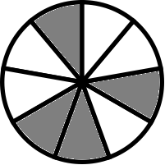
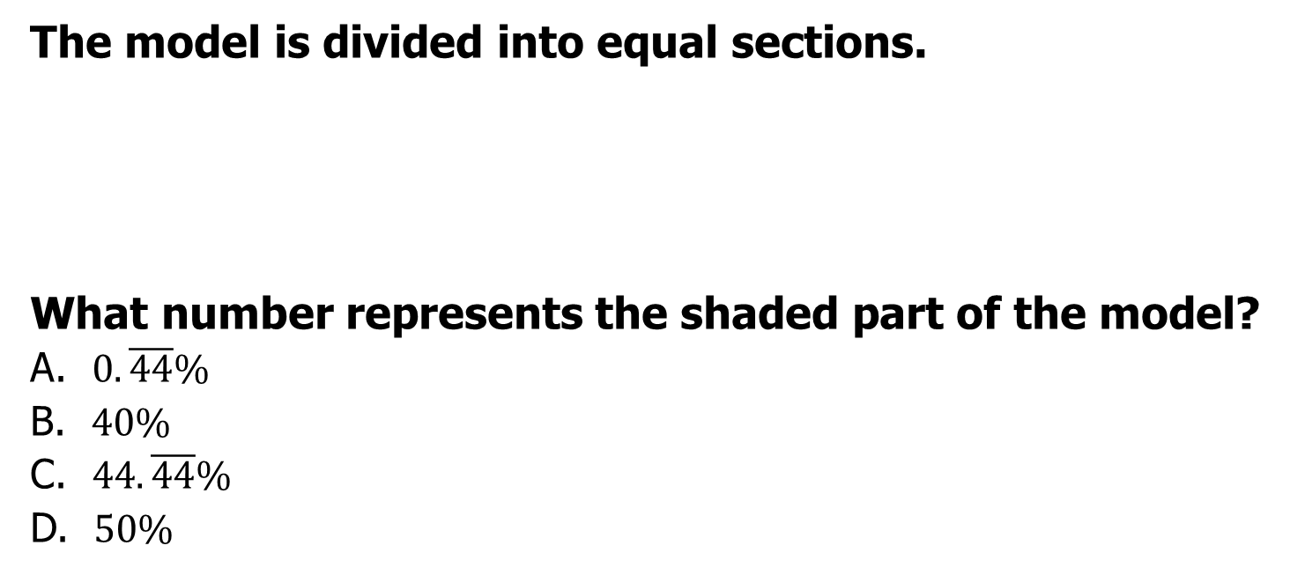
Suggested Practice #2 with Representing and Determining Equivalencies (6.2a)
The model is divided into equal sections.
What number represents the shaded part of the model?
A. $0.\overline{44}\%$
B. $40\%$
C. $44.\overline{44}\%$
D. $50\%$

Slide 16
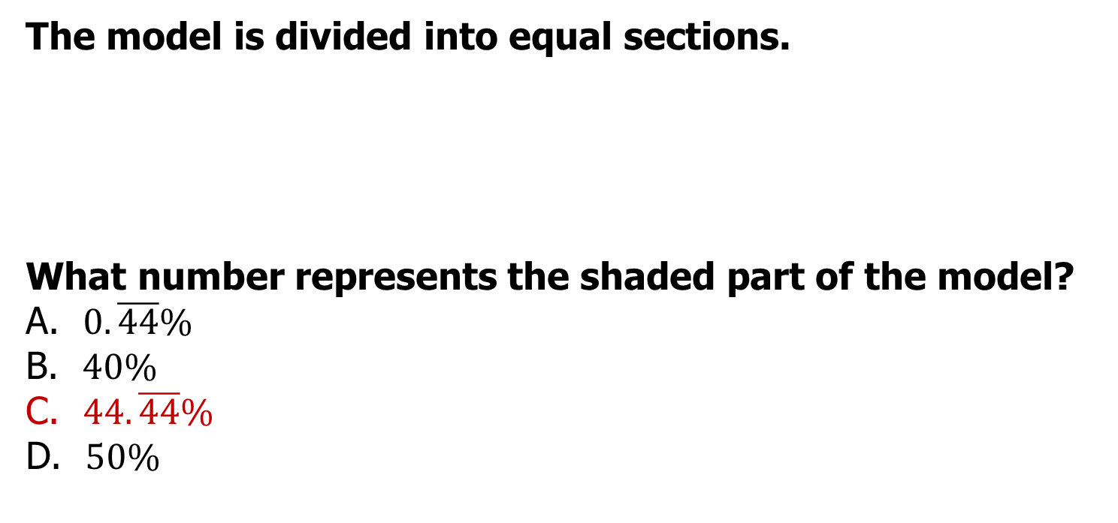
Answer to Practice #2 with Representing and Determining Equivalencies (6.2a)
The model is divided into equal sections.
What number represents the shaded part of the model?
A. $0.\overline{44}\%$
B. $40\%$
C. $44.\overline{44}\%$
D. $50\%$
Common error: Placing the decimal point incorrectly when converting a decimal to a percent.

Slide 17
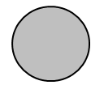
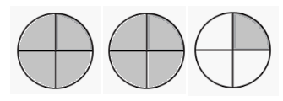
Suggested Practice #3 with Representing and Determining Equivalencies (6.2a)
This model is shaded to represent one whole.
What percent is represented by the shaded part of this model?

Slide 18
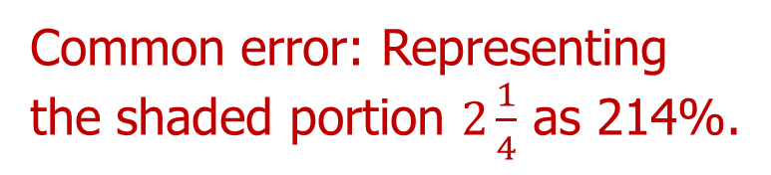
Answer to Practice #3 with Representing and Determining Equivalencies (6.2a)
This model is shaded to represent one whole.
What percent is represented by the shaded part of this model?
225%
Common error: Representing the shaded portion $2\frac{1}{4}$ as 214%.

Slide 19
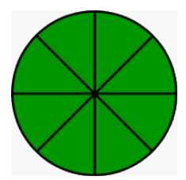
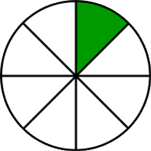
Suggested Practice #4 with Representing and Determining Equivalencies (6.2a)
This model is shaded to represent one whole.
What equivalent improper fraction, percent, and decimal are represented by the shaded part of this model?

Slide 20
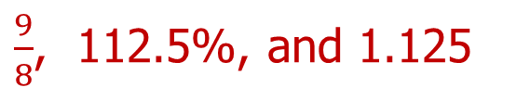
Answer to Practice #4 with Representing and Determining Equivalencies (6.2a)
This model is shaded to represent one whole.
What equivalent improper fraction, percent, and decimal are represented by the shaded part of this model?
$\frac{9}{8}$, 112.5%, and 1.125
Common error: Representing the shaded part as 118% and 1.18.

Slide 21
Fractions and Mixed Numbers
SOL 6.5
The student will
multiply and divide fractions and mixed numbers;
solve single-step and multistep practical problems involving addition, subtraction, multiplication, and division of fractions and mixed numbers; and
c) solve multistep practical problems involving addition, subtraction, multiplication, and division of decimals.

Slide 22
Modeling Division of Fractions
Students would benefit from additional practice with modeling multiplication and division of fractions and mixed numbers.
Common errors on SOL test items include:
multiplying the numerator of a fraction (the part) by the whole number to get the number of fractional parts. (See practice problem for example.)

Slide 23
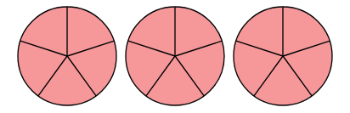

Suggested Practice with Modeling Division of Fractions (6.5a)
Exactly how many $\frac{3}{5}$ are in 3?
A. 3 B. 5 C. 9 D. 10

Slide 24

Answer to Practice with Modeling Division of Fractions (6.5a)
Exactly how many $\frac{3}{5}$ are in 3?
A. 3 B. 5 C. 9 D. 10
Common error: some students appear to multiply the numerator (3) by the whole number (3).

Slide 25
Practical Problems Involving Operations with Fractions and Mixed Numbers (6.5b)
Students would benefit from additional practice with solving practical problems involving operations of fractions and mixed numbers.
Common errors on SOL test items include:
solving problems where the object(s) used in the model change dimensions.

Slide 26
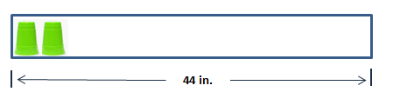
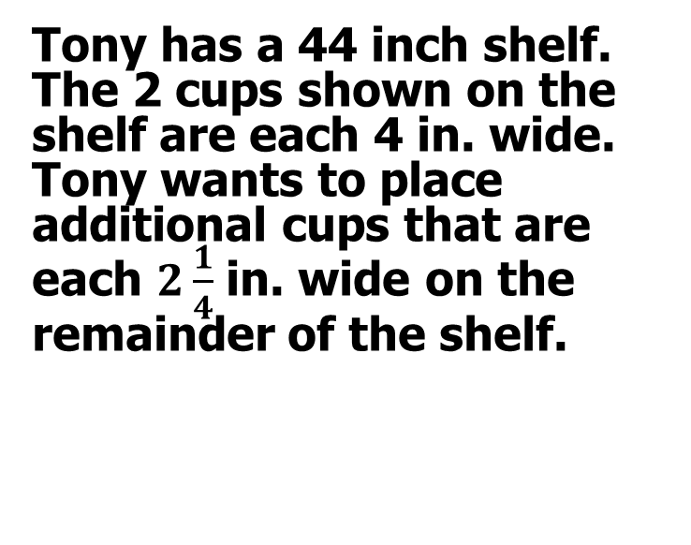
Suggested Practice with Practical Problems Involving Operations with Fractions and Mixed Numbers (6.5b)
Tony has a 44 inch shelf. The 2 cups shown on the shelf are each 4 in. wide. Tony wants to place additional cups that are each $2\frac{1}{4}$ in. wide on the remainder of the shelf.
Approximately how many more cups can Tony place on the remainder of the shelf?
A. 9 B. 11 C. 16 D. 19

Slide 27
Answer to Practice with Practical Problems Involving Operations with Fractions and Mixed Numbers (6.5b)
Tony has a 44 inch shelf. The 2 cups shown on the shelf are each 4 in. wide. Tony wants to place additional cups that are each $2\frac{1}{4}$ in. wide on the remainder of the shelf.
Approximately how many more cups can Tony place on the remainder of the shelf?
A. 9 B. 11 C. 16 D. 19
Common error: used the original width to determine the number of additional cups.

Slide 28
Operations with Integers and Practical Problems Involving Integers
SOL 6.6
The student will
add, subtract, multiply, and divide integers;
solve practical problems involving operations with integers; and
c) simplify numerical expressions involving integers.

Slide 29
Operations with Integers and Practical Problems Involving Integers (6.6)
Students would benefit from additional practice modeling operations with integers and solving practical problems involving integers.
Common errors on SOL test items include:
representing the number of groups as a negative value when using a pictorial model; and
applying vocabulary inaccurately, such as deposit and withdrawal.

Slide 30
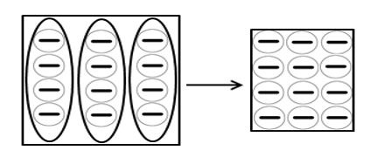

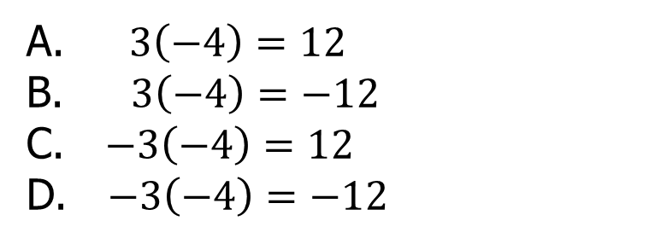
Suggested Practice #1 with Modeling Operations of Integers (6.6a)
Which equation is best represented by this model?
A. $3\left(−4\right)=12$
B. $3\left(−4\right)=−12$
C. $−3\left(−4\right)=12$
D. $−3\left(−4\right)=−12$

Slide 31
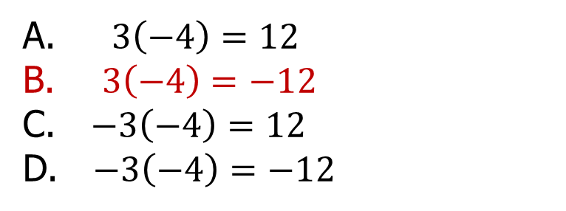
Answer to Practice #1 with Modeling Operations of Integers (6.6a)
Which equation is best represented by this model?
Common error: assuming that the counters and the number of groups are represented by a negative number.
A. $3\left(−4\right)=12$
B. $3\left(−4\right)=−12$
C. $−3\left(−4\right)=12$
D. $−3\left(−4\right)=−12$

Slide 32
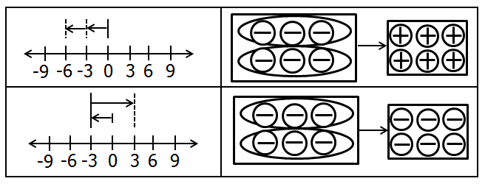
Suggested Practice #2 with Modeling Operations of Integers (6.6a)
Directions: Select all the correct answers.
Identify each model that best represents the number sentence -3 x 2 = -6.

Slide 33
Answer to Practice #2 with Modeling Operations of Integers (6.6a)
Directions: Select all the correct answers.
Identify each model that best represents the number sentence -3 x 2 = -6.
Common error: some students believe the number of groups and counters are both negative.

Slide 34
Suggested Practice #1 with Practical Problems Involving Integers (6.6b)
A bank account statement shows these withdrawals and deposits.
  Withdrawal, -$58
  Deposit, $140
  Withdrawal, -$72
  Deposit, $65
What is the total amount of these withdrawals and deposits?

Slide 35
Answer to Practice #1 with Practical Problems Involving Integers (6.6b)
A bank statement shows these withdrawals and deposits.
  Withdrawal, -$58
  Deposit, $140
  Withdrawal, -$72
  Deposit, $65
What is the total amount of these withdrawals and deposits?
$75
Common error: assumed all transactions were withdrawals and obtained -$335

Slide 36
Suggested Practice #2 with Practical Problems Involving Integers (6.6b)
Chris had $2,145 in his bank account. He made withdrawals and deposits as shown in the table.
Chris’s Bank Account
Exactly how much money was in Chris’s bank account after these withdrawals and deposits?
A. $203 B. $902 C. $1,397 D. $2,893
Activity | Amount (dollars)
Withdrawal | 682
Deposit | 348
Withdrawal | 147
Deposit | 249
Withdrawal | 516

Slide 37
Answer to Practice #2 with Practical Problems Involving Integers (6.6b)
Chris had $2,145 in his bank account. He made some withdrawals and deposits, as shown in the table.
Chris’s Bank Account
Exactly how much money was in Chris’s bank account after these withdrawals and deposits?
A. $203 B. $902 C. $1,397 D. $2,893
Common error: assumed all values were withdrawals to obtain $203
Activity | Amount (dollars)
Withdrawal | 682
Deposit | 348
Withdrawal | 147
Deposit | 249
Withdrawal | 516

Slide 38
Suggested Practice #3 with Practical Problems Involving Integers (6.6b)
Kenya hiked on a trail.
  She started her hike at an elevation of -60 feet.
  She ascended to an elevation of 965 feet.
  Then she descended 250 feet and stopped for lunch.
What is the change in elevation from where Kenya started her hike to where she stopped for lunch?
A. 655 ft
B. 775 ft
C. 1,155 ft
D. 1,275 ft

Slide 39
Answer to Practice #3 with Practical Problems Involving Integers (6.6b)
Kenya hiked on a trail.
  She started her hike at an elevation of -60 feet.
  She ascended to an elevation of 965 feet.
  Then she descended 250 feet and stopped for lunch.
What is the change in elevation from where Kenya started her hike to where she stopped for lunch?
A. 655 ft
B. 775 ft
C. 1,155 ft
D. 1,275 ft
Common error: subtracted 60 and 250 from 965 to obtain 655 feet

Slide 40
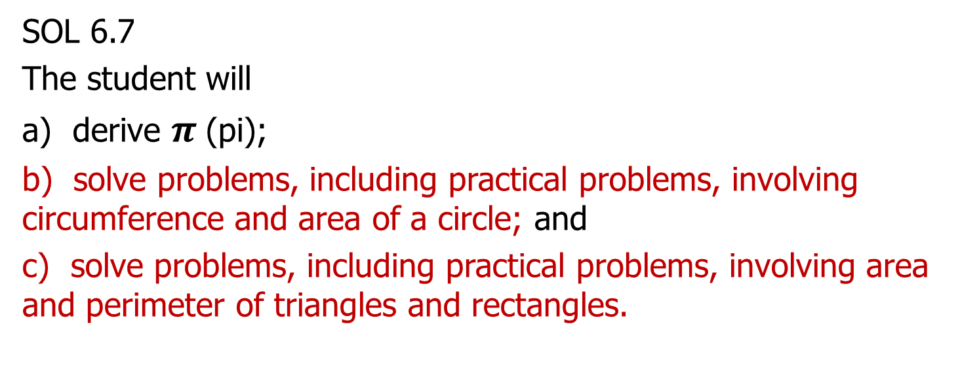
Area of a Circle and
Area and Perimeter of Rectangles
SOL 6.7
The student will
a) derive $π$(pi);
b) solve problems, including practical problems, involving circumference and area of a circle; and
c) solve problems, including practical problems, involving area and perimeter of triangles and rectangles.

Slide 41
Area of a Circle and
Area and Perimeter of Rectangles (6.7)
Students would benefit from additional practice with solving problems involving the area of a circle and area and perimeter of triangles and rectangles.
Common errors on SOL test items include:
using the value of the diameter to find the area of a circle; and
using incorrect units for perimeter and area.

Slide 42
Suggested Practice with Finding the Area of a Circle (6.7b)
The diameter of a circular tabletop is 6 feet. Which of the following is closest to the area of the tabletop?
A. 113.04 square feet
B. 28.26 square feet
C. 18.84 square feet
D. 9.42 square feet

Slide 43
Answer to Practice with Finding the Area of a Circle (6.7b)
The diameter of a circular tabletop is 6 feet. Which of the following is closest to the area of the tabletop?
A. 113.04 square feet
B. 28.26 square feet
C. 18.84 square feet
D. 9.42 square feet
Common error: used 6 feet as the radius value in the formula

Slide 44
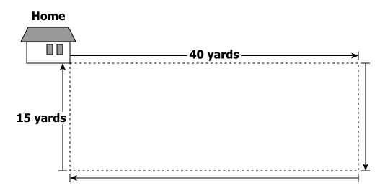
Suggested Practice #1 with Finding the Area and Perimeter of Rectangles (6.7c)
The drawing shows the rectangular yard adjacent to a house.
What is the distance around the yard?
What is the area of the yard?

Slide 45
Answer to Practice #1 with Finding the Area and Perimeter of Rectangles (6.7c)
The drawing shows the rectangular yard adjacent to a house.
What is the distance around the yard?
What is the area of the yard?
110 yards
600 square yards
Common error: Students confuse area and perimeter and answer 110 square yards and 600 yards.

Slide 46
Suggested Practice #2 with Finding the Area and Perimeter of Rectangles (6.7c)
Jaquan is buying a rectangular rug that is 4.5 feet wide and 8 feet long. What is the total area of the rug?
A. 25 feet
B. 25 square feet
C. 36 feet
D. 36 square feet

Slide 47
Answer to Practice #2 with Finding the Area and Perimeter of Rectangles (6.7c)
Jaquan is buying a rectangular rug that is 4.5 feet wide and 8 feet long. What is the total area of the rug?
A. 25 feet
B. 25 square feet
C. 36 feet
D. 36 square feet
Common error: used linear feet

Slide 48
Suggested Practice #3 with Finding the Area and Perimeter of Rectangles (6.7c)
Celie is making rectangular place mats that are 10 inches wide and 14 inches long. What is the least amount of ribbon that she will need to create a ribbon border around 1 place mat?
A. 48 inches
B. 48 square inches
C. 140 inches
D. 140 square inches

Slide 49
Answer to Practice #3 with Finding the Area and Perimeter of Rectangles (6.7c)
Celie is making rectangular place mats that are 10 inches wide and 14 inches long. What is the least amount of ribbon that she will need to create a ribbon border around 1 place mat?
A. 48 inches
B. 48 square inches
C. 140 inches
D. 140 square inches
Common error: used square inches

Slide 50
Circle Graphs
SOL 6.10
The student, given a practical situation, will
represent data in a circle graph;
b) make observations and inferences about data represented in a circle graph; and
c) compare circle graphs with the same data represented in bar graphs, pictographs, and line plots.

Slide 51
Circle Graphs (6.10)
Students would benefit from additional practice using rational numbers to represent data in a circle graph.
Common errors on SOL test items include:
calculating percentages of data values incorrectly when the data represents more than one whole.

Slide 52
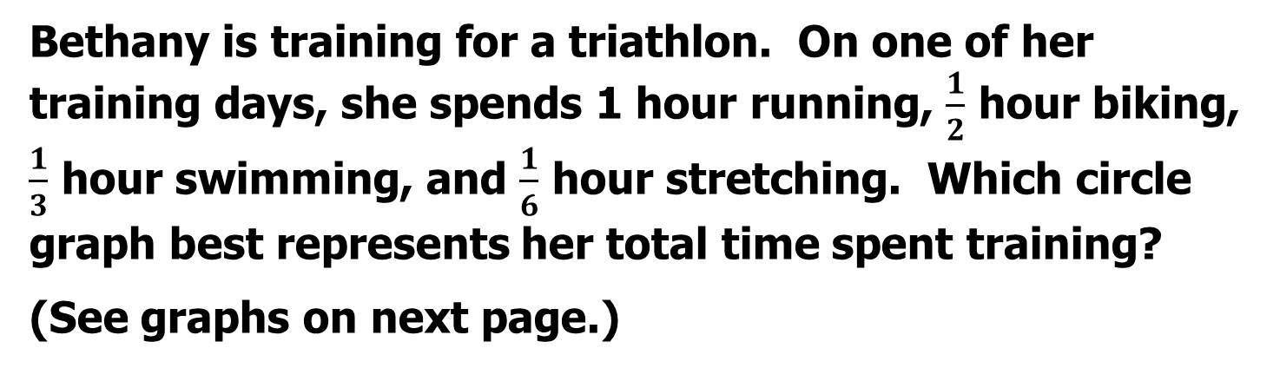
Suggested Practice with Representing Data in a Circle Graph (6.10a) 1 of 2
Bethany is training for a triathlon. On one of her training days, she spends 1 hour running, $\frac{1}{2}$ hour biking, $\frac{1}{3}$ hour swimming, and $\frac{1}{6}$ hour stretching. Which circle graph best represents her total time spent training?
(See graphs on next page.)

Slide 53
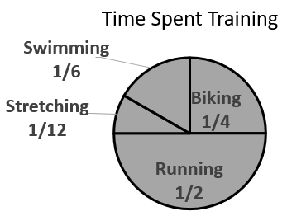
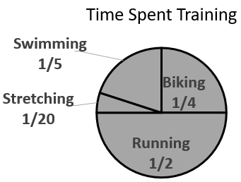
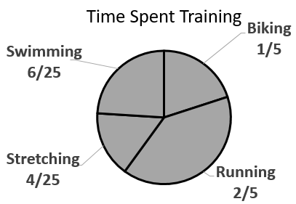
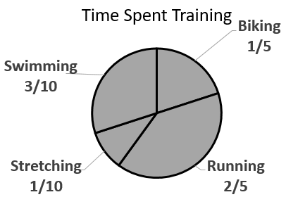
Suggested Practice with Representing Data in a Circle Graph (6.10a) 2 of 2
A
B
C
D

Slide 54
Answer to Practice with Representing Data in a Circle Graph (6.10a)
A
B
Common error: combining all of the activities to form one whole (1 hour).
C
D

Slide 55
Proportional Relationships
SOL 6.12
The student will
represent a proportional relationship between two quantities, including those arising from practical situations;
determine the unit rate of a proportional relationship and use it to find a missing value in a ratio table;
determine whether a proportional relationship exists between two quantities; and
make connections between and among representations of a proportional relationship between two quantities using verbal descriptions, ratio tables, and graphs.

Slide 56
Proportional Relationships and Unit Rates
Students would benefit from additional practice with representing proportional relationships and determining unit rates.
Common errors on SOL test items include:
reversing the order of the ratio of the relationship;
using only two sets of data values in a ratio table to determine an unknown value in a proportional relationship; and
omitting the ordered pair (0, 0) when describing or identifying a proportional relationship from a table or a graph.

Slide 57
Connections Among Representations
Students would benefit from additional practice with making connections among different representations of a proportional relationship.
Common errors on SOL test items include:
using an additive pattern to determine if a proportional relationship exists between the quantities in a ratio table.
(Note: The Grade 6 curriculum framework references that a proportional relationship includes pairs of values where a constant exists that can be multiplied by the measure of one quantity to get the measure of the other quantity for every ratio pair.)

Slide 58
Suggested Practice #1 with Representing Proportional Relationships (6.12a)
The ratio of 4 to 2.5 represents the relationship of y to x. Which table of values best represents this proportional relationship?
A B
C D
x | y
6 | 7
8.5 | 10
14 | 15.5
x | y
5 | 8
12.5 | 20
20 | 32
x | y
7.5 | 6
10 | 8.5
15.5 | 14
x | y
8 | 5
20 | 12.5
32 | 20

Slide 59
Answer to Practice #1 with Representing Proportional Relationships (6.12a)
The ratio of 4 to 2.5 represents the relationship of y to x. Which table of values best represents this proportional relationship?
A B
C D
x | y
6 | 7
8.5 | 10
14 | 15.5
x | y
5 | 8
12.5 | 20
20 | 32
x | y
7.5 | 6
10 | 8.5
15.5 | 14
x | y
8 | 5
20 | 12.5
32 | 20
Common error: reversed the order of the relationship

Slide 60
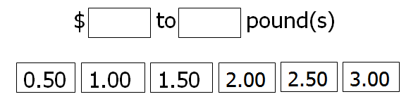
Suggested Practice #2 with Representing Proportional Relationships (6.12a)
The table shows the proportional relationship between the weight, in pounds, and the cost, in dollars, of cherries.
What is the ratio of the cost to the weight of these cherries?
Weight and Cost of Cherries
Weight (pounds) | 2.00 | 5.00 | 6.00 | 9.00
Cost (dollars) | 5.00 | 12.50 | 15.00 | 22.50

Slide 61
Answer to Practice #2 with Representing Proportional Relationships (6.12a)
The table shows the proportional relationship between the weight, in pounds, and the cost, in dollar, of cherries.
What is the ratio of the cost to the weight of these cherries?
Weight and Cost of Cherries
Weight (pounds) | 2.00 | 5.00 | 6.00 | 9.00
Cost (dollars) | 5.00 | 12.50 | 15.00 | 22.50
Common error: placing 1.00 first and 2.50 second
2.50
1.00

Slide 62
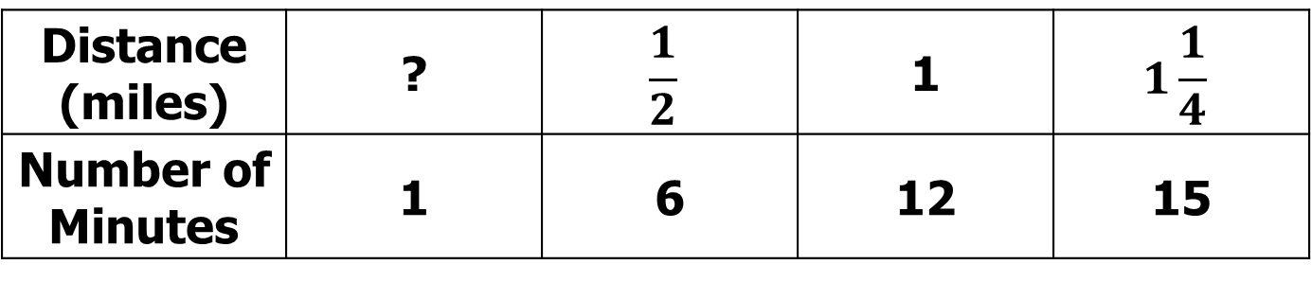
Suggested Practice with Unit Rates of a Proportional Relationship (6.12b) 1 of 2
Use this table for the next practice item.
Distance Ryan Walked His Dog
Distance (miles) | ? | $$\frac{1}{2}$$ | 1 | $$1\frac{1}{4}$$
Number of Minutes | 1 | 6 | 12 | 15

Slide 63
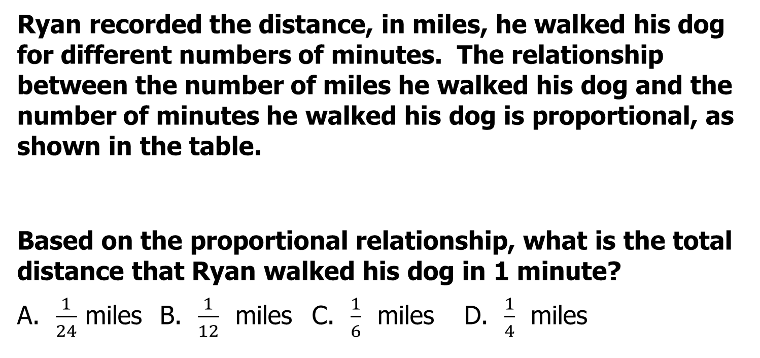
Suggested Practice with Unit Rates of a Proportional Relationship (6.12b) 2 of 2
Ryan recorded the distance, in miles, he walked his dog for different numbers of minutes. The relationship between the number of miles he walked his dog and the number of minutes he walked his dog is proportional, as shown in the table.
Based on the proportional relationship, what is the total distance that Ryan walked his dog in 1 minute?
A. $\frac{1}{24}$ miles B. $\frac{1}{12}$ miles C. $\frac{1}{6}$ miles D. $\frac{1}{4}$ miles

Slide 64
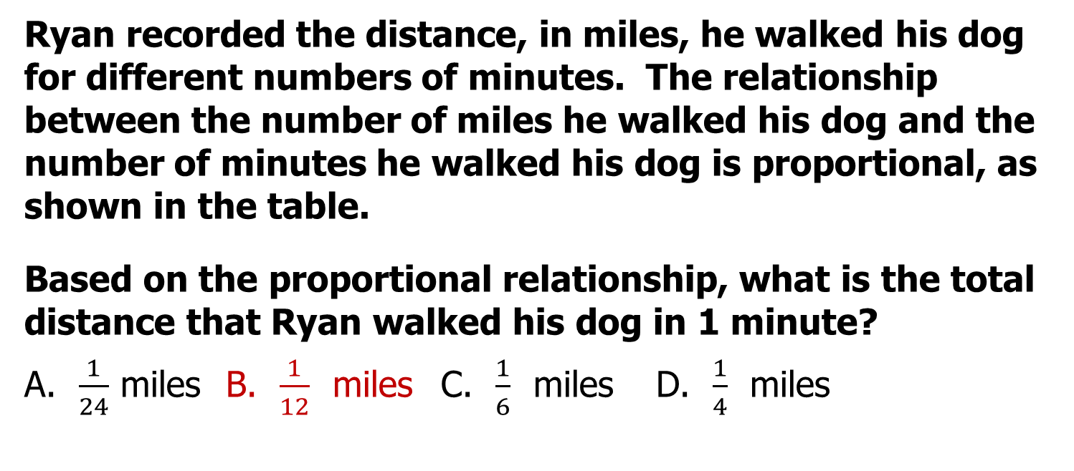
Answer to Practice with Unit Rates of a Proportional Relationship (6.12b)
Ryan recorded the distance, in miles, he walked his dog for different numbers of minutes. The relationship between the number of miles he walked his dog and the number of minutes he walked his dog is proportional, as shown in the table.
Based on the proportional relationship, what is the total distance that Ryan walked his dog in 1 minute?
A. $\frac{1}{24}$ miles B. $\frac{1}{12}$ miles C. $\frac{1}{6}$ miles D. $\frac{1}{4}$ miles
Common error: Working backwards to obtain $\frac{1}{4}$ .

Slide 65
Suggested Practice #1 with Determining Whether a Proportional Relationship Exists (6.12c) (1 of 2)
Use this table of values for the next item.
x | 3 | 6 | 9
y | 12 | 24 | 36

Slide 66
Suggested Practice #1 with Determining Whether a Proportional Relationship Exists (6.12c) (2 of 2)
The relationship between the x-values and y-values is-
A. proportional, because the x-values from left to right increase by three in each column
B. proportional, because the y-values from left to right increase by twelve in each column
C. proportional, because the y-value is four times the corresponding x-value in each column
D. proportional, because the y-value divided by the corresponding x-value is not the same value in each column

Slide 67
Answer to Practice #1 with Determining Whether a Proportional Relationship Exists (6.12c)
The relationship between the x-values and y-values is-
A. proportional, because the x-values from left to right increase by three
B. proportional, because the y-values from left to right increase by twelve
C. proportional, because the y-value is four times the corresponding x-value
D. proportional, because the y-value divided by the corresponding x-value is not the same value
Common error: used an additive relationship to justify the ratio table was proportional (option A and option B)

Slide 68
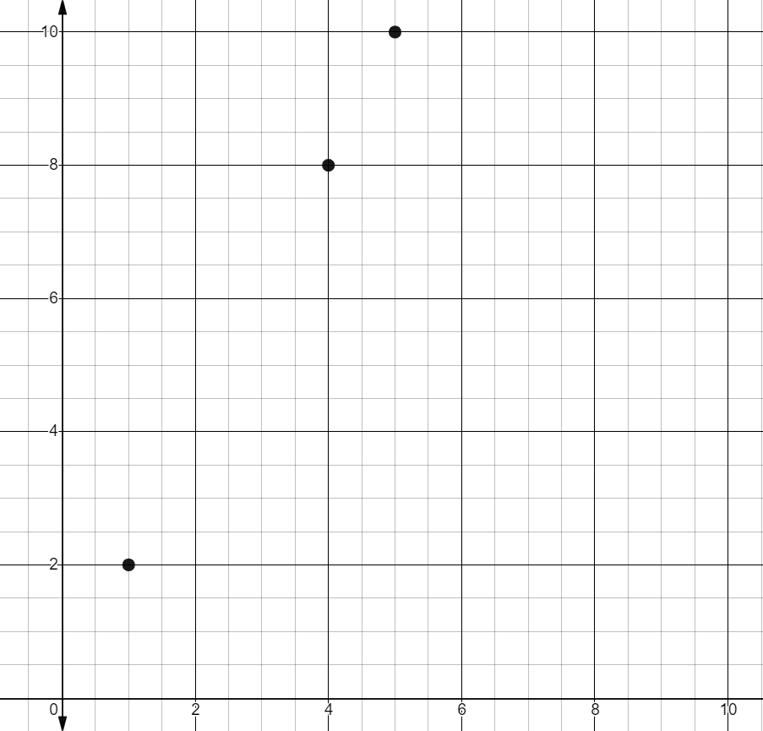
Suggested Practice #2 with Determining Whether a Proportional Relationship Exists (6.12c)
The graph represents a proportional relationship between x and y.
Choose all the ordered pairs that could be included in this proportional relationship.
(0, 0)
(1, 1)
(2, 4)
(3, 6)
(3, 7)

Slide 69
Answer to Practice #2 with Determining Whether a Proportional Relationship Exists (6.12c)
The graph represents a proportional relationship between x and y.
Choose all the ordered pairs that could be included in this proportional relationship.
Common error: not including (0, 0) in the relationship
(0, 0)
(1, 1)
(2, 4)
(3, 6)
(3, 7)

Slide 70
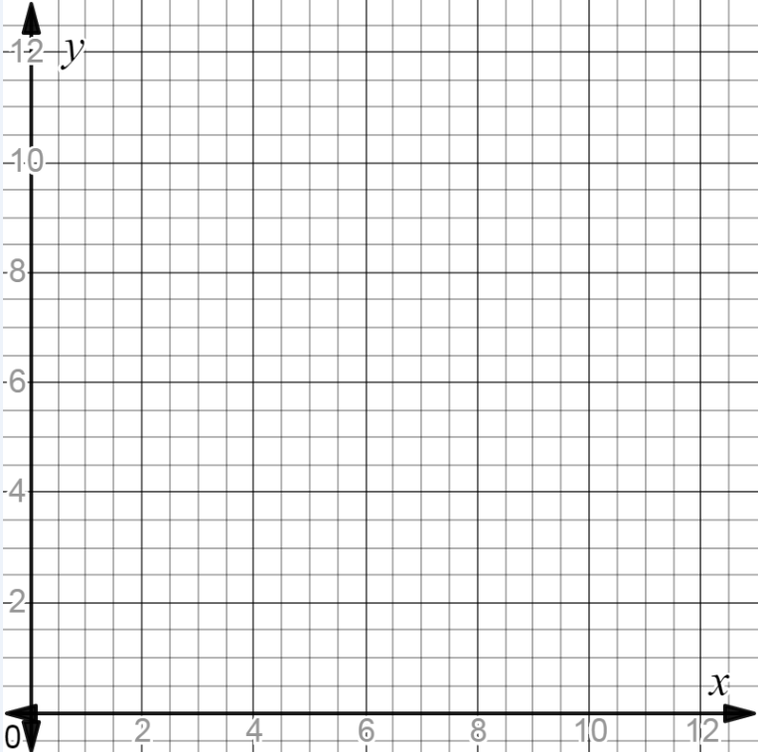
Suggested Practice #1 with Connections Among Representations (6.12d)
The table represents a proportional relationship between the x- and y-values.
Plot three points on the graph to represent the same proportional relationship as shown in the table. All points must have integer coordinates.
x | 12 | 16 | 18 | 22
y | 18 | 24 | 27 | 33

Slide 71
Answer to Practice #1 with Connections Among Representations (6.12d)
The table represents a proportional relationship between the x- and y-values.
Plot three points on the graph to represent the same proportional relationship as shown in the table. All points must have integer coordinates.
x | 12 | 16 | 18 | 22
y | 18 | 24 | 27 | 33
Any three of the following ordered pairs are correct. (0, 0), (2, 3), (4, 6), (6, 9), and (8, 12)

Slide 72
Suggested Practice #2 with Connections Among Representations (6.12d) (1 of 2)
Use this table for the next item.
Number of Pizzas Purchased | Total Cost (dollars)
4 | 34.00
7 | 59.50
12 | 102.00

Slide 73
Suggested Practice #2 with Connections Among Representations (6.12d) (2 of 2)
A restaurant sells pizzas. The total cost in dollars, y, of the pizzas is based on the number of pizzas purchased, x, as shown in the table.
Choose a situation that represents the same proportional relationship as shown in the table.
The total cost of 6 pizzas is $48.50.
The total cost of 9 pizzas is $67.50.
C. The total cost of 10 pizzas is $80.50.
D. The total cost of 11 pizzas is $93.50.

Slide 74
Answer to Practice #2 with Connections Among Representations (6.12d)
A restaurant sells pizzas. The total cost in dollars, y, of the pizzas is based on the number of pizzas purchased, x, as shown in the table.
Choose a situation that represents the same proportional relationship as shown in the table.
The total cost of 6 pizzas is $48.50.
The total cost of 9 pizzas is $67.50.
C. The total cost of 10 pizzas is $80.50.
D. The total cost of 11 pizzas is $93.50.
Common error: used a relationship of 8.05 and cost 80.50

Slide 75
Linear Inequalities
SOL 6.14
The student will
a) represent a practical situation with a linear inequality in one variable; and
b) solve one-step linear inequalities in one variable, involving addition or subtraction, and graph the solution on a number line.

Slide 76
Linear Inequalities (6.14)
Students would benefit from additional practice with identifying solutions of linear inequalities.
Common errors on SOL test items include:
using the value of where the inequality graph begins as a solution for a less than or greater than inequality.

Slide 77

Suggested Practice with Identifying Numerical Values of a Solution Set (6.14)
The graph represents all solutions to an inequality.
Which values are solutions of the inequality shown on the graph?
A. -1 and 1
B. -9 and 1
C. 3 and 5
D. -9 and -3

Slide 78
Answer to Practice with Identifying Numerical Values of a Solution Set (6.14)
The graph represents all solutions to an inequality.
Which values are solutions of the inequality shown on the graph?
A. -1 and 1
B. -9 and 1
C. 3 and 5
D. -9 and -3
Common error: used the value of where the graphical solution begins as a solution.

Slide 79
Practice Items
This concludes the student performance information for the Spring 2019 Grade 6 Mathematics SOL test.
Additional information on accessing practice items and the Guided Practice Suggestions can be found on the Virginia Department of Education website.

Slide 80
Contact Information
For questions regarding assessment, please contact student_assessment@doe.virginia.gov
For questions regarding instruction, please contact vdoe.mathematics@doe.virginia.gov

