Slide 1
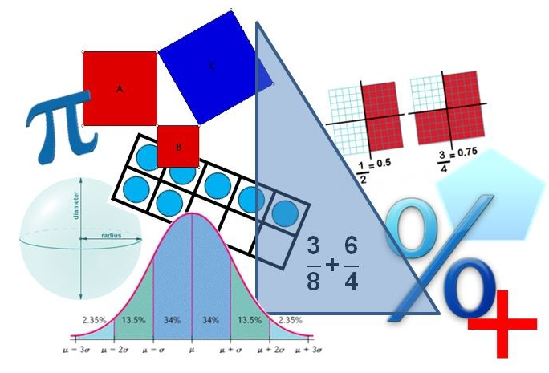
Student Performance Analysis Spring 2019
Grade 5
Mathematics Standards of Learning

Slide 2
Student Performance Analysis Spring 2019 (1 of 3)
Statewide results for the spring 2019 mathematics tests based on the 2016 Mathematics Standards of Learning (SOL) have been analyzed to determine specific content that may have challenged students. In order to support preparation of students for the Grade 5 Mathematics test, this PowerPoint presentation has been developed to provide examples of SOL content identified by this analysis.

Slide 3
Student Performance Analysis Spring 2019 (2 of 3)
It should be noted that these items are not SOL test questions and are not meant to mimic SOL test questions. Instead, they are intended to provide mathematics educators with further insight into the concepts that challenged students statewide.

Slide 4
Student Performance Analysis Spring 2019 (3 of 3)
It is important to keep the content of this statewide analysis in perspective. The information provided here should be used as supplemental information.
Instructional focus should remain on the standards as a whole, with school- or division-level data being used as the focal guiding resource to help improve instruction.

Slide 5
Using Decimals
SOL 5.5
The student will
estimate and determine the product and quotient of two numbers involving decimals; and
create and solve single-step and multistep practical problems involving addition, subtraction, and multiplication of decimals, and create and solve single-step practical problems involving division of decimals.

Slide 6
Practical Problems with Decimals (5.5b)
Students need additional practice solving multistep practical problems with decimals.
Common errors include:
determining the answer to one part of a multistep problem, but not completing all steps; and
using an incorrect operation (example: addition instead of subtraction).

Slide 7
Suggested Practice #1 with Multistep Problems with Decimals (5.5b)
Jeremy ran 1.4 miles each day for eight days. Amelia ran 2.1 miles each day for eight days.
What is the difference in the total distance Amelia and Jeremy ran in these eight days?
0.7 mile
3.5 miles
5.6 miles
28 miles

Slide 8
Answer to Practice #1 with Multistep Problems with Decimals (5.5b)
Jeremy ran 1.4 miles each day for eight days. Amelia ran 2.1 miles each day for eight days.
What is the difference in the total distance Amelia and Jeremy ran in these eight days?
0.7 mile
3.5 miles
5.6 miles
28 miles
Common error: finding the difference in the number of miles run in one day.

Slide 9
Suggested Practice #2 with Multistep Problems with Decimals (5.5b)
Billy’s puppy weighs 8.6 kilograms (kg). Myra’s puppy weighs 3.5 times as much as Billy’s puppy. What is the combined weight of these two puppies?
12.1 kg
30.1 kg
36.3 kg
38.7 kg

Slide 10
Answer to Practice #2 with Multistep Problems with Decimals (5.5b)
Billy’s puppy weighs 8.6 kilograms (kg). Myra’s puppy weighs 3.5 times as much as Billy’s puppy. What is the combined weight of these two puppies?
12.1 kg
30.1 kg
36.3 kg
38.7 kg
Common error: when the problem involves a comparison, some students add the numbers given instead of using the comparison to find the unknown number and then solving.

Slide 11
Practical Problems with Fractions
SOL 5.6
The student will
solve single-step and multistep practical problems involving addition and subtraction with fractions and mixed numbers; and
solve single-step practical problems involving multiplication of a whole number, limited to 12 or less, and a proper fraction, with models.

Slide 12
Practical Problems with Fractions (5.6a)
Students need additional practice solving practical problems involving fractions, particularly when regrouping is required.
Common errors include:
determining the answer to one part of a multistep problem, but not completing all steps;
using an incorrect operation; and
subtracting the numerator of the first fraction from the numerator of the second fraction rather than regrouping to subtract.

Slide 13
Suggested Practice #1 with Practical Problems with Fractions (5.6a)
Mallory had 2 full bags of beads to make necklaces and bracelets. She used $1\frac{3}{8}$ bag of beads to make the necklaces and $\frac{1}{3}$ of a bag of beads to make the bracelets.
What fraction of the bag of beads was left after she made these necklaces and bracelets?
$\frac{7}{24}$ C. 1$\frac{7}{24}$
B. $\frac{17}{24}$ D. 1$\frac{17}{24}$

Slide 14
Answer to Practice #1 with Practical Problems with Fractions (5.6a)
Mallory had 2 full bags of beads to make necklaces and bracelets. She used $1\frac{3}{8}$ bag of beads to make the necklaces and $\frac{1}{3}$ of a bag of beads to make the bracelets.
What fraction of the bag of beads was left after she made these necklaces and bracelets?
$\frac{7}{24}$ C. 1$\frac{7}{24}$
B. $\frac{17}{24}$ D. 1$\frac{17}{24}$
Common error: adding the two given fractions and not subtracting from 2.

Slide 15
Suggested Practice #2 with Practical Problems with Fractions (5.6a)
Josh is making a recipe that uses 1$\frac{3}{4}$ cup of water and 2$\frac{1}{8}$ cups of milk. What is the difference, in cups, in the amount of milk and the amount of water used in this recipe?
1$\frac{5}{8}$ C. $\frac{1}{2}$
1$\frac{1}{2}$ D. $\frac{3}{8}$

Slide 16
Answer to Practice #2 with Practical Problems with Fractions (5.6a)
Josh is making a recipe that uses 1$\frac{3}{4}$ cup of water and 2$\frac{1}{8}$ cups of milk. What is the difference, in cups, in the amount of milk and the amount of water used in this recipe?
1$\frac{5}{8}$ C. $\frac{1}{2}$
1$\frac{1}{2}$ D. $\frac{3}{8}$
Common error: subtracting 2-1=1, then 3-1=2 (the numerators), and then 8-4=4 (the denominators) to get 1$\frac{2}{4}$or 1$\frac{1}{2}$.

Slide 17
Practical Problems with Fractions (5.6b)
Students need additional practice solving practical problems using models to multiply a whole number and a proper fraction, particularly when they are identifying the result of the multiplication.
Common errors on SOL test items vary. Students would benefit from additional practice with models.

Slide 18
Suggested Practice #1 with Practical Problems with Fractions (5.6b)
Melvin has 6 dogs. Each dog eats $\frac{1}{3}$ can of dog food each morning. This model represents 1 can of dog food.
Which model represents the total number of cans of dog food eaten each morning?
A. B.
C. D.

Slide 19
Answer to Practice #1 with Practical Problems with Fractions (5.6b)
Melvin has 6 dogs. Each dog eats $\frac{1}{3}$ can of dog food each morning. This model represents 1 can of dog food.
Which model represents the total number of cans of dog food eaten each morning?
A. B.
C. D.

Slide 20
Equivalent Measures in the Metric System
SOL 5.9
The student will
given the equivalent measure of one unit, identify equivalent measurements within the metric system; and
solve practical problems involving length, mass, and liquid volume using metric units.

Slide 21
Finding Equivalent Measures (5.9a)
Students need additional practice finding equivalent measures when more than one calculation is required.
Common errors on SOL test items vary but suggest students have difficulty when the options are very similar and when they must fill in the answer.

Slide 22
Suggested Practice #1 with Finding Equivalent Measures (5.9a)
Ethan has some materials for a project. He has 5.62 meters of rope and 562 milliliters of paint.
He knows: 1 meter = 100 centimeters
1 liter = 1000 milliliters
Find the equivalent measurements.
5.62 meters = centimeter(s)
562 milliliters = liter(s)
0.0562 0.562 5.62 562 5,620 56,200

Slide 23
Answer to Practice #1 with Finding Equivalent Measures (5.9a)
Ethan has some materials for a project. He has 5.62 meters of rope and 562 milliliters of paint.
He knows: 1 meter = 100 centimeters
1 liter = 1000 milliliters
Find the equivalent measurements.
5.62 meters = 562 centimeter(s)
562 milliliters = 0.562 liter(s)
0.0562 0.562 5.62 562 5,620 56,200
Common error:
Using the inverse operation to get 0.0562 centimeter and 56,200 liters.

Slide 24
Suggested Practice #2 with Finding Equivalent Measures (5.9a)
Maurice has 1.5 liters of lemonade in one pitcher and 98 milliliters of lemonade in another pitcher.
1 liter = 1000 milliliters
How many milliliters of lemonade does he have altogether?
1.598 milliliters
99.5 milliliters
995 milliliters
1598 milliliters

Slide 25
Answer to Practice #2 with Finding Equivalent Measures (5.9a)
Maurice has 1.5 liters of lemonade in one pitcher and 98 milliliters of lemonade in another pitcher.
1 liter = 1000 milliliters
How many milliliters of lemonade does he have altogether?
1.598 milliliters
99.5 milliliters
995 milliliters
1598 milliliters
Common errors on SOL test items include selecting the equivalent answer in liters (1.598) and adding 98 and 1.5 to get 99.5.

Slide 26
Angles of Triangles
SOL 5.13
The student will
classify triangles as right, acute, or obtuse and equilateral, scalene, or isosceles; and
investigate the sum of the interior angles in a triangle and determine an unknown angle measure.

Slide 27
Finding Unknown Angle Measures of Triangles (5.13b)
Students need additional practice using models to prove that the sum of the interior angles of a triangle is 180 degrees, and using that relationship to determine an unknown angle measure in a triangle.
Common errors include calculating the missing angle as the sum of the two given angles, calculating the missing angle as the difference of the two given angles, and setting the sum of the three angles equal to 100 or 200 degrees instead of 180.

Slide 28
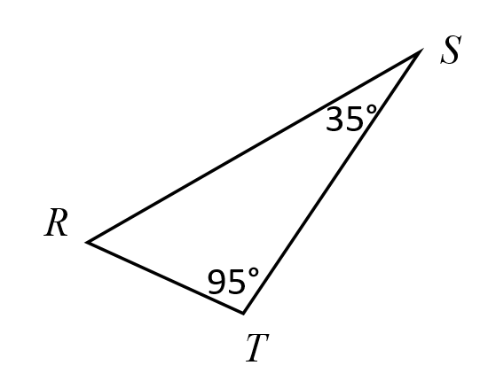
Suggested Practice #1 with Angles of Triangles (5.13b)
Two angle measures of a triangle are shown.
What is the measure of $∠$R?
130° C. 60°
70 ° D. 50°

Slide 29
Answer to Practice #1 with Angles of Triangles (5.13b)
Two angle measures of a triangle are shown.
What is the measure of $∠$R?
130° C. 60°
70 ° D. 50°
Common error: Selecting the sum or difference of the two given angle measures.

Slide 30
Representing and Interpreting Data
SOL 5.16
The student, given a practical problem, will
represent data in line plots and stem-and-leaf plots;
interpret data represented in line plots and stem-and-leaf plots; and
compare data represented in a line plot to the same data represented in a stem-and-leaf plot.

Slide 31
Comparing Data (5.16c)
Students need additional practice comparing data represented in a line plot and data represented in a stem and leaf plot.

Slide 32
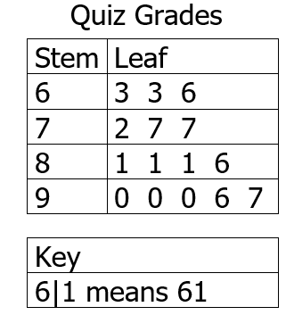
Suggested Practice with Comparing Plots (5.16c)
Mr. Fox recorded the grades 16 students earned on a quiz. He thought he recorded the same data on the stem-and-leaf plot and the line plot.
Which data point did Mr. Fox forget to record on the stem-and-leaf plot?
Each x represents one quiz grade.

Slide 33
Answer to Practice with Comparing Plots (5.16c)
Mr. Fox recorded the grades 16 students earned on a quiz. He thought he recorded the same data on the stem-and-leaf plot and the line plot.
Which data point did Mr. Fox forget to record on the stem-and-leaf plot?
84
Each x represents one quiz grade.

Slide 34
Mean, Median, Mode, and Range
SOL 5.17
The student, given a practical context, will
describe mean, median, and mode as measures of center;
describe mean as fair share;
describe the range of a set of data as a measure of spread; and
determine the mean, median, mode, and range of a set of data.

Slide 35
Finding a Range (5.17c)
Students need additional practice finding the range of a set of data when the data is presented in a format other than a list or table.
Common errors on SOL test items involve confusion between the highest possible number (score, grade, etc.) that could be attained in a data set versus the greatest value contained in the data set.

Slide 36
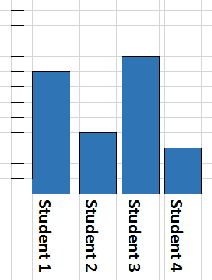
Suggested Practice #1 with Finding a Range (5.17c)
Four students threw balls at a target. Each student threw 10 balls at the target. The bar graph shows the number of times each student hit the target with a ball.
Balls Hitting Target
10
9
8
7
6
5
4
3
What is the range in the number of balls that hit the target?
3 B. 6
C. 7 D. 9
2
1
0

Slide 37
Answer to Practice #1 with Finding a Range (5.17c)
Four students threw balls at a target. Each student threw 10 balls at the target. The bar graph shows the number of times each student hit the target with a ball.
Balls Hitting Target
10
9
8
7
6
5
4
3
What is the range in the number of balls that hit the target?
3 B. 6
C. 7 D. 9
2
1
0
Common error

Slide 38
Suggested Practice #2 with Finding Range (5.17c)
Five students took a quiz. The quiz was worth 100 points. The scores on the quiz for 4 of the students is shown. The spread on the quiz scores was 22.
88 86 94 74
The score for the fifth student was either or

Slide 39
Answer to Practice #2 with Finding Range (5.17c)
Five students took a quiz. The quiz was worth 100 points. The scores on the quiz for 4 of the students is shown. The spread on the quiz scores was 22.
88 86 94 74
The score for the fifth student was either 72 or 96
Common errors include subtracting 22 from 100 to get 78, subtracting 22 from 88 to get 66, or not realizing that 94 might not be the highest score.

Slide 40
Expressions and Equations with Variables
SOL 5.19
The student will
investigate and describe the concept of variable;
write an equation to represent a given mathematical relationship, using a variable;
use an expression with a variable to represent a given verbal expression involving one operation; and
create a problem situation based on a given equation, using a single variable and one operation.

Slide 41
Writing Expressions with Variables (5.19c)
Students need additional practice writing expressions with variables to represent a given verbal expression.
Common errors include:
reversing the order when writing an expression that involves subtraction; and
reversing the order when writing an expression that involves division.

Slide 42
Suggested Practice #1 with Writing Expressions (5.19c)
Which expression can be used to represent this phrase?
11 less than a number, $m$
$11−m$ B. $\frac{11}{m}$
C. $\frac{m}{11}$ D. $m−11$

Slide 43
Answer to Practice #1 with Writing Expressions (5.19c)
Which expression can be used to represent this phrase?
11 less than a number, $m$
$11−m$ B. $\frac{11}{m}$
C. $\frac{m}{11}$ D. $m−11$
Common error

Slide 44
Suggested Practice #2 with Writing Expressions (5.19c)
Harold has 300 marbles and $c$ boxes to display them. He will put an equal number of marbles in each box.
Create an expression to represent the number of marbles in each box.
+ – $×$ $÷$ $c$ 300

Slide 45
Answer to Practice #2 with Writing Expressions (5.19c)
Harold has 300 marbles and $c$ boxes to display them. He will put an equal number of marbles in each box.
Create an expression to represent the number of marbles in each box.
300 $÷$ $c$
+ – $×$ $÷$ $c$ 300
Common error:
$c$ $÷$ 300

Slide 46
Suggested Practice #3 with Writing Expressions (5.19c)
Ann has 45 crayons. Milo has $n$ fewer crayons than Ann.
Create an expression to represent the number of crayons Milo has.
+ – $× ÷ n$45

Slide 47
Answer to Practice #3 with Writing Expressions (5.19c)
Ann has 45 crayons. Milo has $n$ fewer crayons than Ann.
Create an expression to represent the number of crayons Milo has.
45 – $n$
+ – $× ÷ n$45
Common error: $n$ – 45

Slide 48
Practice Items
This concludes the student performance information for the spring 2019 Grade 5 SOL test.
Additional information on accessing practice items and the Guided Practice Suggestions can be found on the Virginia Department of Education website.

Slide 49
Contact Information
For questions regarding assessment, please contact student_assessment@doe.virginia.gov
For questions regarding instruction, please contact vdoe.mathematics@doe.virginia.gov

