Slide 1
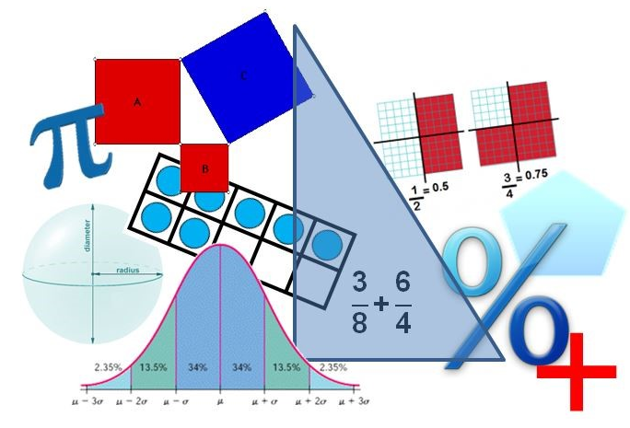
Student Performance Analysis
Spring 2019
Algebra II
Mathematics Standards of Learning

Slide 2
Student Performance Analysis Spring 2019 (1 of 3)
Statewide results for the spring 2019 mathematics tests based on the 2016 Mathematics Standards of Learning (SOL) have been analyzed to determine specific content that may have challenged students. In order to support preparation of students for the Algebra II test, this PowerPoint presentation has been developed to provide examples of SOL content identified by this analysis.

Slide 3
Student Performance Analysis Spring 2019 (2 of 3)
It should be noted that these items are not SOL test questions and are not meant to mimic SOL test questions. Instead, they are intended to provide mathematics educators with further insight into the concepts that challenged students statewide.

Slide 4
Student Performance Analysis Spring 2019 (3 of 3)
It is important to keep the content of this statewide analysis in perspective. The information provided here should be used as supplemental information.
Instructional focus should remain on the standards as a whole, with school- or division-level data being used as the focal guiding resource to help improve instruction.

Slide 5
Rational Algebraic Expressions
SOL AII.1
The student will
add, subtract, multiply, divide, and simplify rational algebraic expressions;
add subtract, multiply, divide, and simplify radical expressions containing rational numbers and variables, and expressions containing rational exponents; and
factor polynomials completely in one or two variables.

Slide 6
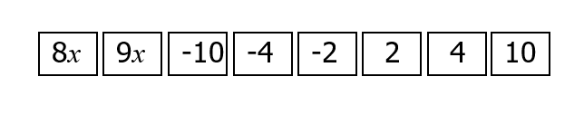
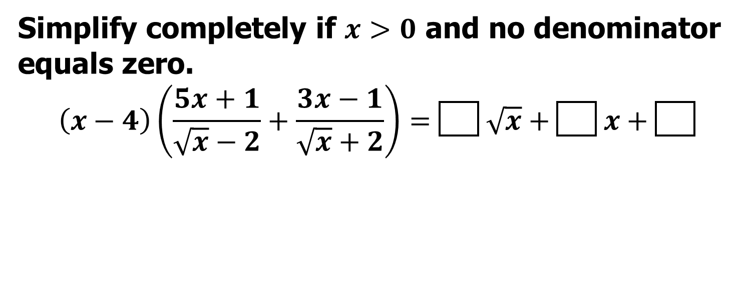
Suggested Practice for Simplifying Rational Expressions (AII.1b)
Simplify completely if $x>0$ and no denominator equals zero.
$$\left(x−4\right)\left(\frac{5x+1}{\sqrt{x}−2}+\frac{3x−1}{\sqrt{x}+2}\right)=\boxed{} \sqrt{x}+\boxed{} x+\boxed{}$$

Slide 7
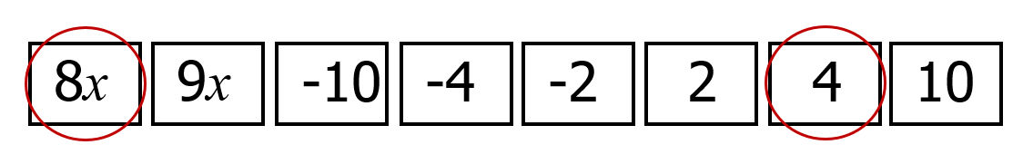

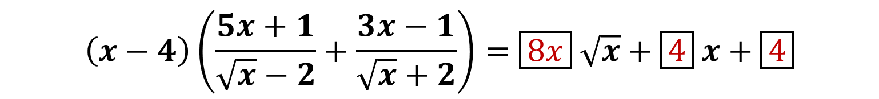
Answer to Practice for Simplifying Rational Expressions (AII.1b)
Simplify completely if $x>0$ and no denominator equals zero.
$$\left(x−4\right)\left(\frac{5x+1}{\sqrt{x}−2}+\frac{3x−1}{\sqrt{x}+2}\right)=\boxed{8x} \sqrt{x}+\boxed{4} x+\boxed{4}$$
Common errors include incorrectly multiplying expressions containing radicals and combining unlike terms.

Slide 8
Equations with Radical Expressions
SOL AII.3
The student will solve
absolute value linear equations and inequalities;
quadratic equations over the set of complex numbers;
equations containing rational algebraic expressions; and
equations containing radical expressions.

Slide 9
Solving Equations Containing Radical Expressions (AII.3d)
Students need additional practice solving equations containing radical expressions graphically.
Common errors on SOL test items include not recognizing the graphs of functions. This may suggest a lack of experience verifying algebraic solutions with a graphing utility.

Slide 10
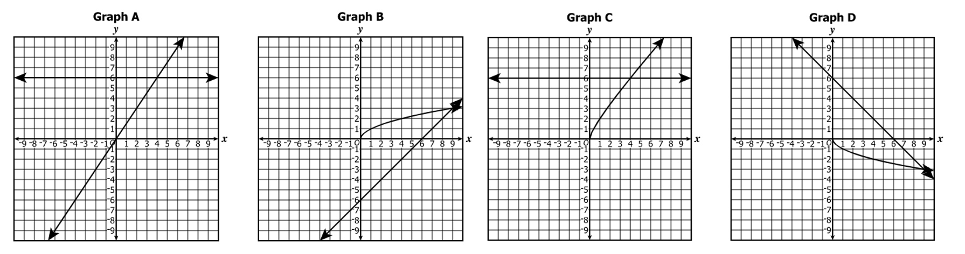
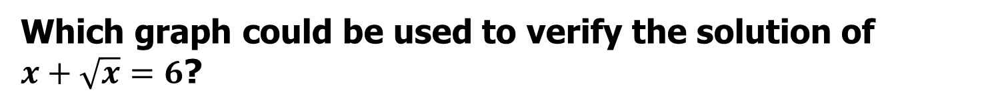
Suggested Practice #1 with Solving Equations Containing Radical Expressions (AII.3d)
Which graph could be used to verify the solution of $x+\sqrt{x}=6$?

Slide 11
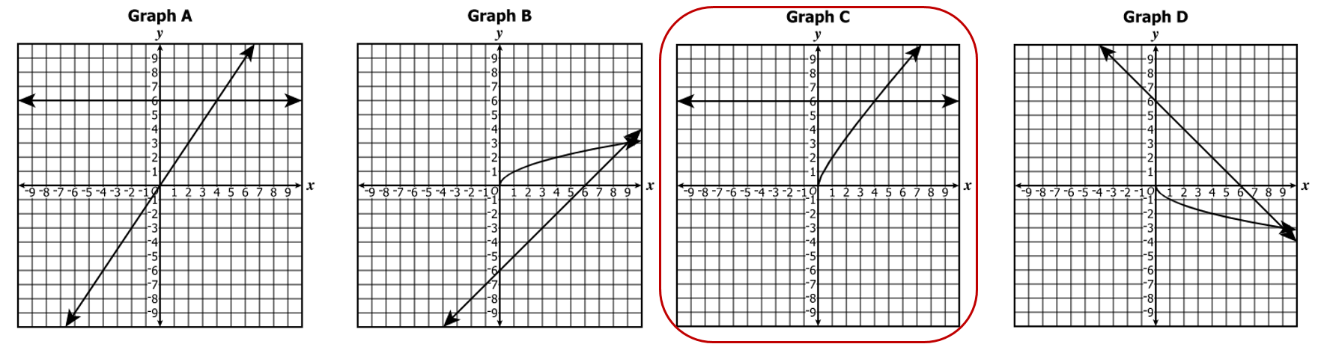
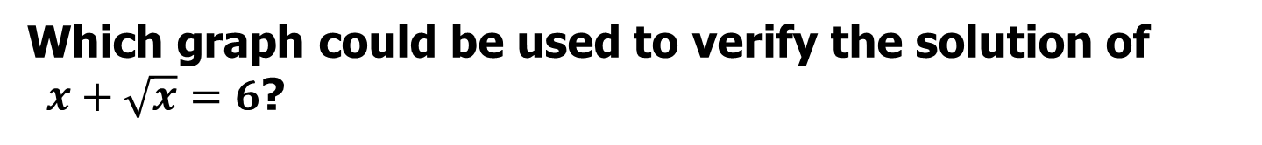
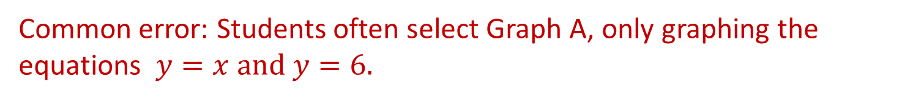
Answer to Practice #1 with Solving Equations Containing Radical Expressions (AII.3d)
Which graph could be used to verify the solution of $x+\sqrt{x}=6$?
Common error: Students often select Graph A, only graphing the equations $y=x and y=6.$

Slide 12
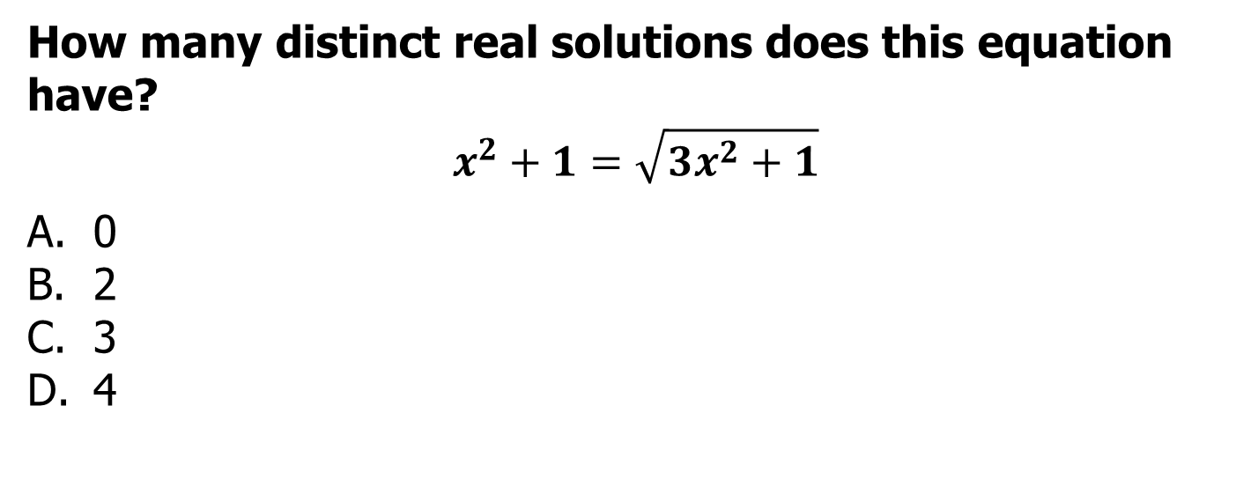
Suggested Practice #2 with Solving Equations Containing Radical Expressions (AII.3d)
How many distinct real solutions does this equation have?
$$x^{2}+1=\sqrt{3x^{2}+1}$$
0
2
3
4

Slide 13
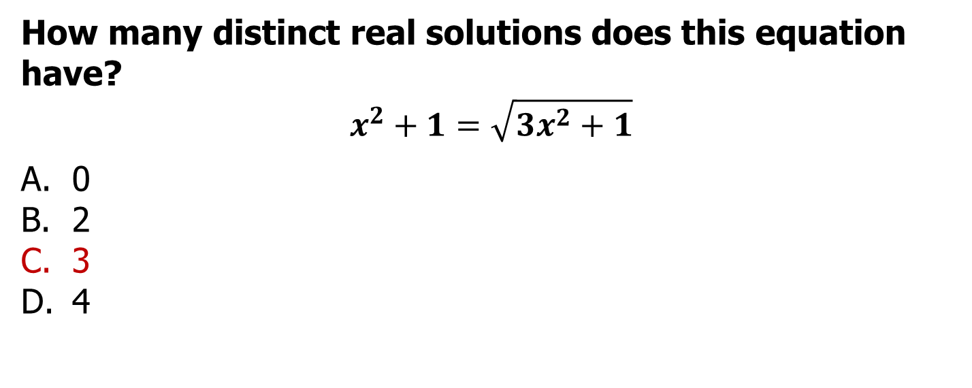
Answer to Practice #2 with Solving Equations Containing Radical Expressions (AII.3d)
How many distinct real solutions does this equation have?
$$x^{2}+1=\sqrt{3x^{2}+1}$$
0
2
3
4
Common error on SOL test items: Students graph the equation as written in implicit form and see only two solutions. When verifying solutions on a calculator, students should be aware of limitations that may occur with graphing utilities.

Slide 14
Function Families – Shapes and Transformations
SOL AII.6
For absolute value, square root, cube root, rational, polynomial, exponential, and logarithmic functions, the student will
recognize the general shape of function families; and
use knowledge of transformations to convert between equations and the corresponding graphs of functions.

Slide 15
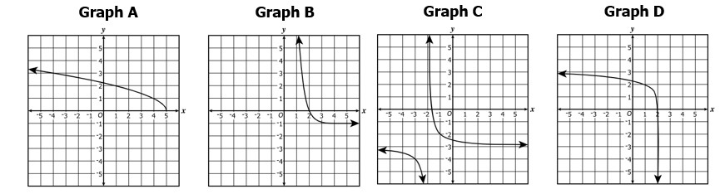
Suggested Practice #1 with Function Families (AII.6)
Which graph appears to belong to the family of rational functions?

Slide 16
Answer to Practice #1 with Function Families (AII.6)
Which graph appears to belong to the family of rational functions?

Slide 17
Function Families – Characteristics (1 of 2)
SOL AII.7
The student will investigate and analyze linear, quadratic, absolute value, square root, cube root, rational, polynomial, exponential, and logarithmic function families algebraically and graphically. Key concepts include
domain, range, and continuity;
intervals in which a function is increasing or decreasing;
extrema;
zeros;
intercepts;

Slide 18
Function Families – Characteristics (2 of 2)
SOL AII.7 cont.
Key concepts include
f) values of a function for elements in its domain;
g) connections between and among multiple representations of functions using verbal descriptions, tables, equations, and graphs;
h) end behavior;
i) vertical and horizontal asymptotes;
j) inverse of a function; and
k) composition of functions, algebraically and graphically.

Slide 19
Maxima and Minima (AII.7c)
Students need additional practice identifying the location and value of maxima and minima of a function for a given domain.
Common errors are generally made when students are asked to select the interval that includes the point. Students typically select the interval where the function is increasing or decreasing, but not necessarily the interval that includes the point representing the maxima or minima.

Slide 20
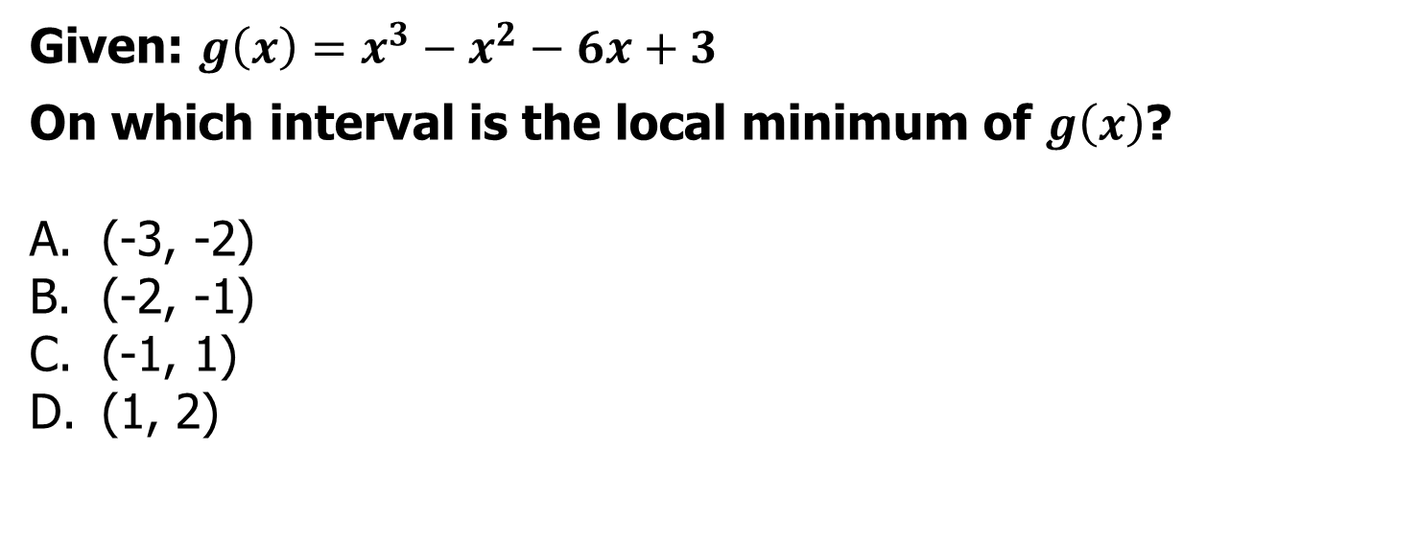
Suggested Practice with Maxima and Minima (AII.7c)
Given: $g\left(x\right)=x^{3}−x^{2}−6x+3$
On which interval is the local minimum of $g\left(x\right)$?
(-3, -2)
(-2, -1)
(-1, 1)
(1, 2)

Slide 21
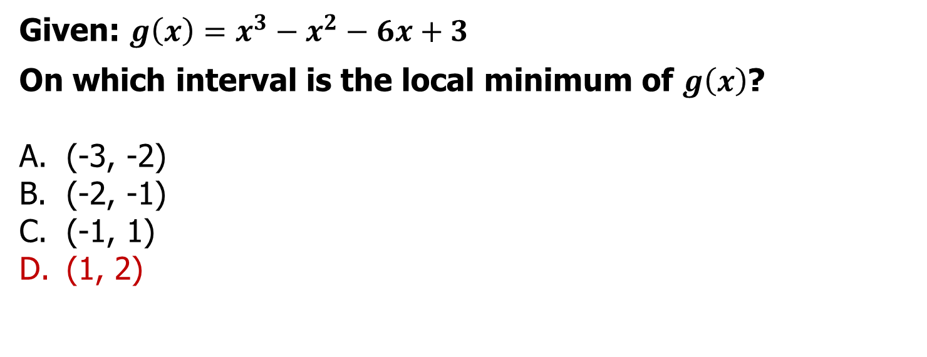
Answer to Practice with Maxima and Minima (AII.7c)
Given: $g\left(x\right)=x^{3}−x^{2}−6x+3$
On which interval is the local minimum of $g\left(x\right)$?
(-3, -2)
(-2, -1)
(-1, 1)
(1, 2)
A common error is for students to select (-1, 1) because the function is decreasing over the interval.

Slide 22
Multiple Representations of Functions (AII.7g)
Students need additional practice making connections between a verbal description of a function, particularly a practical situation, and the graph, table, or equation that represents the same situation.

Slide 23
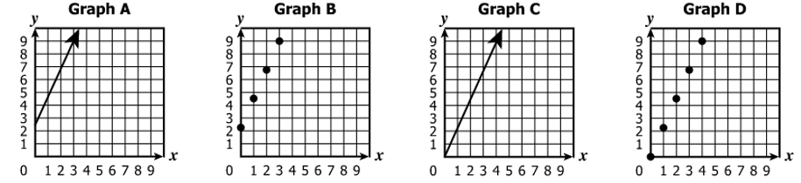
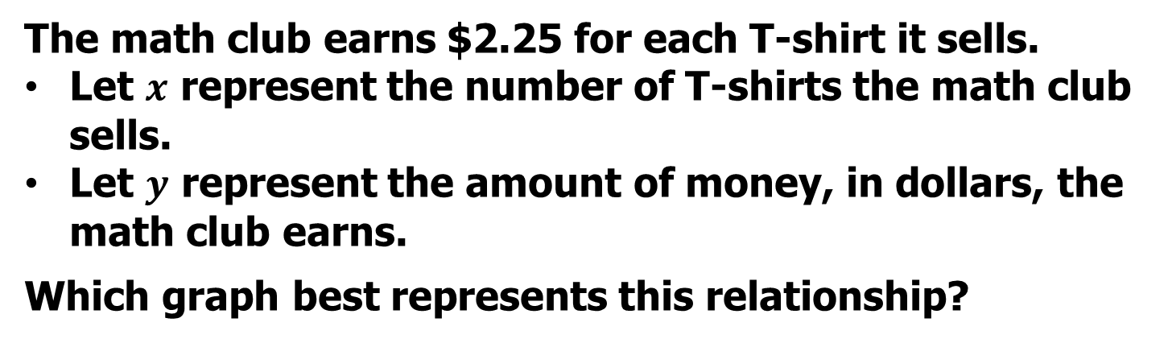
Suggested Practice with Functions (AII.7g)
The math club earns $2.25 for each T-shirt it sells.
Let $x$ represent the number of T-shirts the math club sells.
Let $y$ represent the amount of money, in dollars, the math club earns.
Which graph best represents this relationship?

Slide 24
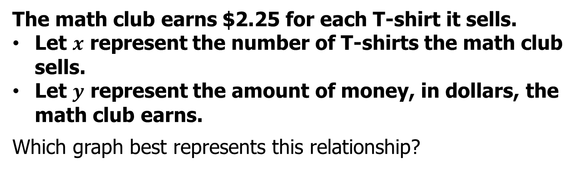
Answer to Practice with Functions (AII.7g)
The math club earns $2.25 for each T-shirt it sells.
Let $x$ represent the number of T-shirts the math club sells.
Let $y$ represent the amount of money, in dollars, the math club earns.
Which graph best represents this relationship?
Common error: starting at $2.25 for 0 shirts

Slide 25
Asymptotes (AII.7i)
Students need additional practice finding vertical and horizontal asymptotes.
Common errors on SOL test items include:
confusing the horizontal asymptote with the vertical asymptote; and
not factoring the denominator prior to identifying the asymptotes.

Slide 26
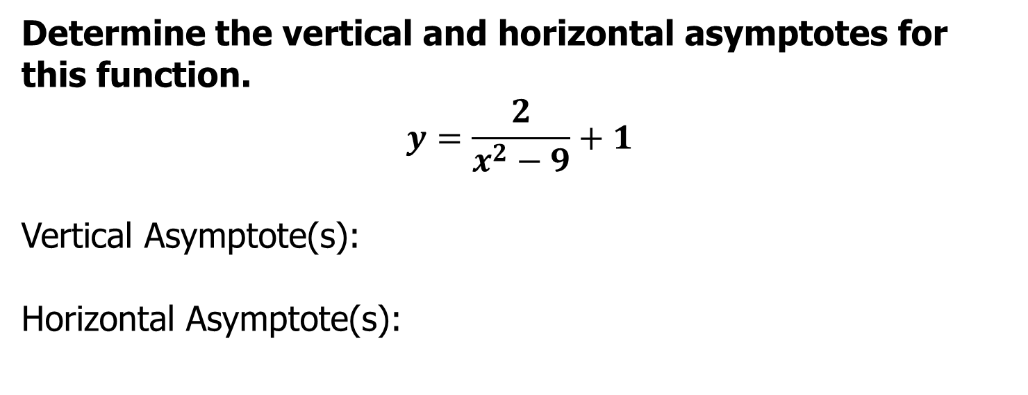
Suggested Practice with Asymptotes (AII.7i)
Determine the vertical and horizontal asymptotes for this function.
$$y=\frac{2}{x^{2}−9}+1$$
Vertical Asymptote(s):
Horizontal Asymptote(s):

Slide 27
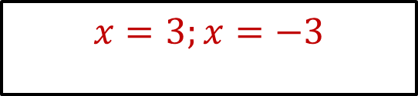
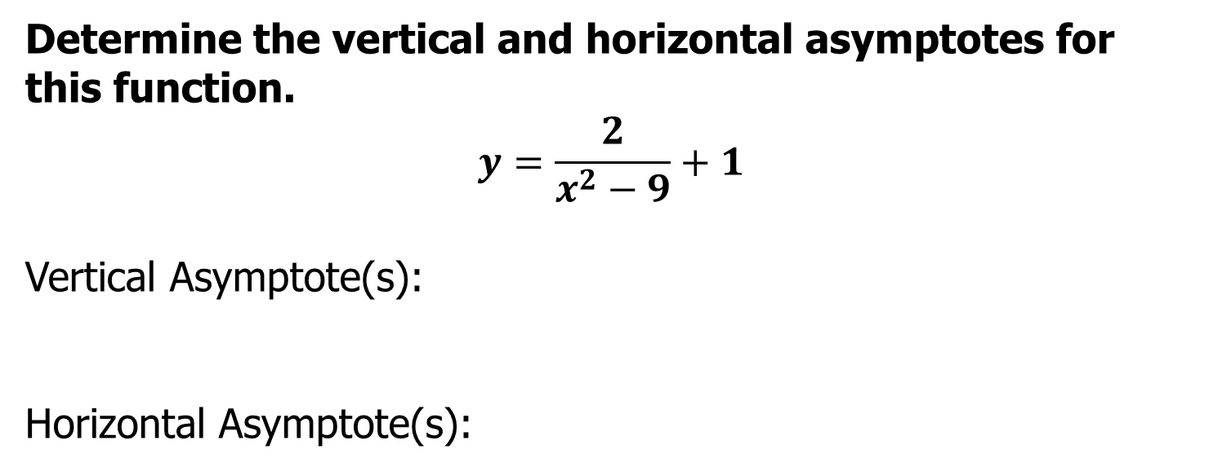

Answer to Practice with Asymptotes (AII.7i)
Determine the vertical and horizontal asymptotes for this function.
$$y=\frac{2}{x^{2}−9}+1$$
Vertical Asymptote(s):
Horizontal Asymptote(s):
$$x=3;x=−3$$
$$y=1$$

Slide 28
Variation
SOL AII.10
The student will represent and solve problems, including practical problems, involving inverse variation, joint variation, and a combination of direct and inverse variations.

Slide 29
Practical Problems with Variation (AII.10)
Students need additional practice solving practical problems that involve concepts of variation.
Common errors on SOL test items occur when students confuse joint variation and inverse variation.

Slide 30
Suggested Practice with Variation (AII.10)
The volume of a cone varies jointly with the square of the radius of the base and the height of the cone. The volume of a cone with a radius of 3 cm and a height of 2 cm is 18.85 cm³.
What is the volume, rounded to the nearest tenth, of a cone with a radius of 2 cm and a height of 3 cm?
What is the height of a cone, rounded to the nearest tenth, with a volume of 31.4 cm³ and a radius of 1 cm?

Slide 31
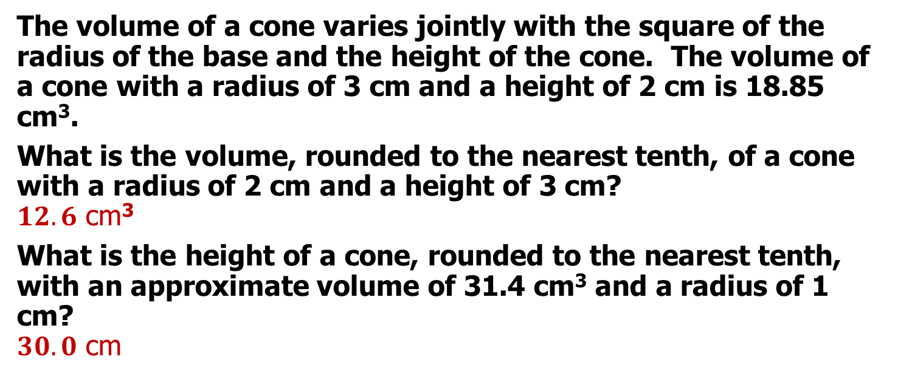
Answer to Practice with Variation (AII.10)
The volume of a cone varies jointly with the square of the radius of the base and the height of the cone. The volume of a cone with a radius of 3 cm and a height of 2 cm is 18.85 cm³.
What is the volume, rounded to the nearest tenth, of a cone with a radius of 2 cm and a height of 3 cm?
$12.6$ cm³
What is the height of a cone, rounded to the nearest tenth, with an approximate volume of 31.4 cm³ and a radius of 1 cm?
$30.0$ cm

Slide 32
Normal Distribution
SOL AII.11
The student will
identify and describe properties of a normal distribution;
interpret and compare z-scores for normally distributed data; and
apply properties of normal distributions to determine probabilities associated with areas under the standard normal curve.

Slide 33
Suggested Practice with Normal Distributions (AII.11)
The weights of chocolate bars at a candy factory are normally distributed with a mean of 2.2 ounces and a standard deviation of 0.08 ounce. Select each statement that must be true.
84% of the candy bars weigh more than 2.28 ounces
The median weight is 2.2 ounces.
50% of the candy bars weigh at most 2.2 ounces
The modal weight is 2.28 ounces.

Slide 34
Answer to Practice with Normal Distributions (AII.11)
The weights of chocolate bars at a candy factory are normally distributed with a mean of 2.2 ounces and a standard deviation of 0.08 ounce. Select each statement that must be true.
84% of the candy bars weigh more than 2.28 ounces
The median weight is 2.2 ounces.
50% of the candy bars weigh at most 2.2 ounces
The modal weight is 2.28 ounces.

Slide 35
Practice Items
This concludes the student performance information for the spring 2019 Algebra II SOL test.
Additional information on accessing practice items and the Guided Practice Suggestions can be found on the Virginia Department of Education website.

Slide 36
Contact Information
For questions regarding assessment, please contact student_assessment@doe.virginia.gov
For questions regarding instruction, please contact vdoe.mathematics@doe.virginia.gov

