Slide 1
Supporting Instruction and Deeper Learning through Balanced Assessment
May 29, 2019: Abingdon, VA
May 30, 2019: Staunton, VA
June 10, 2019: Charlottesville, VA
June 11, 2019: Chesapeake, VA

Slide 2
Today’s Agenda
Welcome
Overview and Goals for the Day
10:00-10:15 Break
Balanced Assessment Plans for Deeper Learning
12:00-12:45 Lunch
Creating Balanced Assessment Plans
Highlights from School Divisions
2:30-2:45 Break
Division Planning Time
Each Division Shares Out/ Next Steps
Reflection/ Evaluation

Slide 3
Welcome
School Divisions here today
Virginia Department of Education (VDOE) staff here today
  Department for Learning
  Department of Student Assessment and ESEA Programs

Slide 4
Virginia is for Learners
Information about this initiative from Shelley Loving-Ryder, Assistant Superintendent, Department of Student Assessment and ESEA Programs

Slide 5
Background
2014: General Assembly eliminated Standards of Learning (SOL) tests in five areas:
  Grade 3 History
  Grade 3 Science
  Grade 5 Writing
  United States History to 1865
  United States History: 1865 to the Present

Slide 6
Requirements from 2014 General Assembly Actions
School divisions are required to teach the content in each of these courses and measure student achievement with local alternative assessments.
School divisions must certify annually that they have provided instruction and administered an alternative assessment, consistent with Board of Education guidelines, to students in grades and subject areas that no longer have a corresponding SOL test.

Slide 7
First Steps: Guidelines
Guidelines for Local Alternative Assessments for 2014-2015
  Adopted by Virginia Board of Education (BOE) in September, 2014
  Encouraged the use of assessments that may be used by teachers to improve their instruction
  Provided flexibility for implementation

Slide 8
2016: Determining Readiness
School divisions used the Framework for Local Alternative Assessment Implementation
  Determine progress in implementing performance assessments
  Identify next steps
  Complete survey to share results of self-assessment with Virginia Department of Education

Slide 9
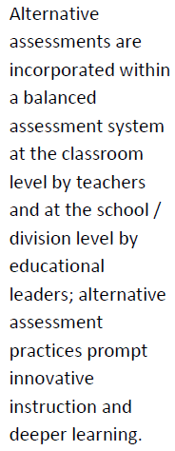
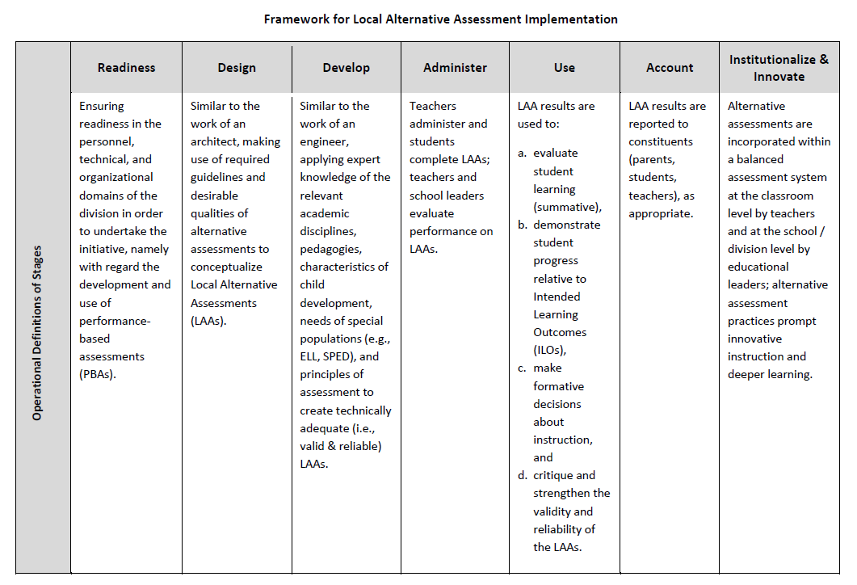
Framework for Local Alternative Assessment Implementation

Slide 10
Updated Guidelines from BOE: Highlights
October, 2016
  School divisions are expected to demonstrate progress in moving toward the use of performance assessments.

Slide 11
BOE Guidelines – Local Alternative Assessments (1 of 3)
2018-2019 through 2019-2020
  Adopted by Virginia Board of Education (BOE) January 24, 2019
  Provides guidance for local alternative assessment in non-verified credit courses in which Standards of Learning tests were eliminated by the General Assembly in 2014
  Guidelines for Local Alternative Assessments for 2018-2019 through 2019-2020 (Word) Please note that these guidelines have been replaced. Visit the Performance Assessments & Local Alternative Assessments webpage for current guidance.

Slide 12
BOE Guidelines – Local Alternative Assessments (2 of 3)
2018-2019 through 2019-2020
  School divisions are expected to continue to use the Virginia Quality Criteria Tool to ensure that students have access to quality tasks.
  School divisions will continue using the common rubrics developed by VDOE with performance assessment in classrooms where an SOL test has been replaced (Grade 3 Science, Grade 3 History, Grade 5 Writing, United States History to 1865, and United States History: 1865 to the Present).

Slide 13
BOE Guidelines – Local Alternative Assessments (3 of 3)
2018-2019 through 2019-2020
  School divisions are expected to prepare Balanced Assessment Plans for each of the five replaced SOL assessments
    Indicates types of assessments used to measure the content and skills addressed in the grade level/course
    May include a variety of assessment types but must include some performance assessments

Slide 14
Balanced Assessment Plans
for Deeper Learning

Slide 15
Shared Resource Folder https://tinyurl.com/va-balanced-assessments

Slide 16
Balanced Assessment System
(1 of 2)
Combination of assessments that form a comprehensive measure of student learning
Includes a variety of assessment types that are matched to the content being assessed and the purpose of the assessment data (including the need to meet accountability measures)
Adapted from: VDOE Assessment Literacy Glossary

Slide 17
Balanced Assessment System
(2 of 2)
Allows opportunities to measure student achievement and growth based on content standards, specific learning goals, and the 5 C’s (critical thinking, creative thinking, collaboration, communication, and citizenship)
The data gathered provide meaningful information that supports and guides classroom instruction.
Adapted from: VDOE Assessment Literacy Glossary

Slide 18
Why Balanced Assessment?
“The fact is that assessments may be useful for one purpose but worthless for other important instructional purposes. Education leaders now understand that a variety of measures are needed to accommodate a variety of goals. The challenge for schools is designing a balanced assessment system using the strengths of summative, interim, and formative assessments to address instructional, accountability, and learning needs.”
Tracy A. Huebner, What Research Says About... / Balanced Assessment Educational Leadership

Slide 19
Examine Current Research – Balanced Assessment to Support Deeper Learning

Slide 20
What Research Says About … Balanced Assessment
Read the article independently.
  Find a sentence that was meaningful to you that captures the core idea of the text.
  Find a phrase that moved, engaged, or provoked you.
  Find a word that captured your attention or struck you as powerful.

Slide 21
What Research Says About … Sharing Your Thoughts
As a group, discuss and record your choices.
Begin by sharing your words, then phrases, then sentences.
Explain why you made the selections you did.
Looking at your group’s collective choices of words, phrases, and sentences, reflect on the conversation by identifying:
  What themes emerge?
  What implications or predictions can be drawn?
  What aspects of the text were not captured in your choices?

Slide 22
What Research Says About … Balanced Assessment (2 of 2)
School staff must be willing to:
  Evaluate assessments in terms of the value they bring to student learning and instructional practice
  Question whether an assessment actually improves instruction
  Observe how assessments influence the way teachers converse with one another about teaching and learning

Slide 23
“Education leaders now understand that a variety of measures are needed to accommodate a variety of goals. The challenge for schools is designing a balanced assessment system using the strengths of summative, interim, and formative assessments to address instructional, accountability, and learning needs.”
Tracy A. Huebner, What Research Says About... / Balanced Assessment Educational Leadership

Slide 24
  Types of Assessment and Purpose and Instructional Use of Assessment

Slide 25
Deliberate and Purposeful Assessment
  Provide timely, actionable feedback
  Embedded in instruction
  Aligned to standards and learning goals
  Elicit student demonstration of complex knowledge
  Accurately measure student achievement
  Equitable – accessible and fair
  Transparent – to students and parents
  Multiple measures used

Slide 26
Types of Assessment
  Diagnostic Assessment
  Formative Assessment
  Summative Assessment

Slide 27
Diagnostic Assessment
  Assessment that determines student areas of strength and academic need prior to instruction
  Assessment “before” learning

Slide 28
Formative Assessment
A process or assessment designed to intentionally collect information about the nature or degree of student learning during instruction, providing feedback to teachers and students and allowing for teachers and students to make instructional decisions (adjustments and modifications)
Assessment “for” learning

Slide 29
Summative Assessment
Used to evaluate student learning, skill acquisition, and academic achievement at the conclusion of a unit, project, course, semester, program, or school year
Typically, summative assessments are comprehensive and representative of a set of knowledge and skills, and associated with high-stakes decisions (e.g., a grade in a course, promotion to another level, verification of a course credit).
Assessment “of” learning

Slide 30
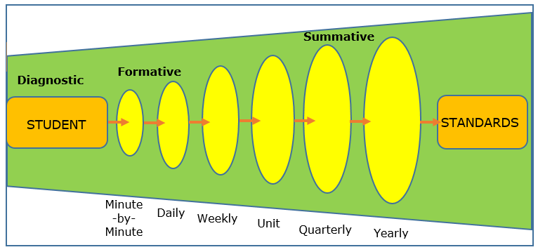
Assessment Grain Size
Adapted from California Department of Education
Talk to a shoulder partner about this graphic. Is there anything you might change about the graphic?
Does this align to your understanding of assessment?

Slide 31
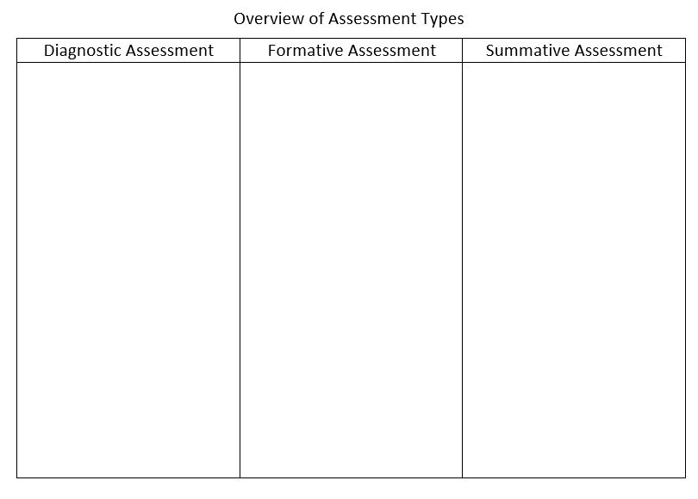
Table Top Activity
What are the differences between assessment types in a balanced assessment system?

Slide 32
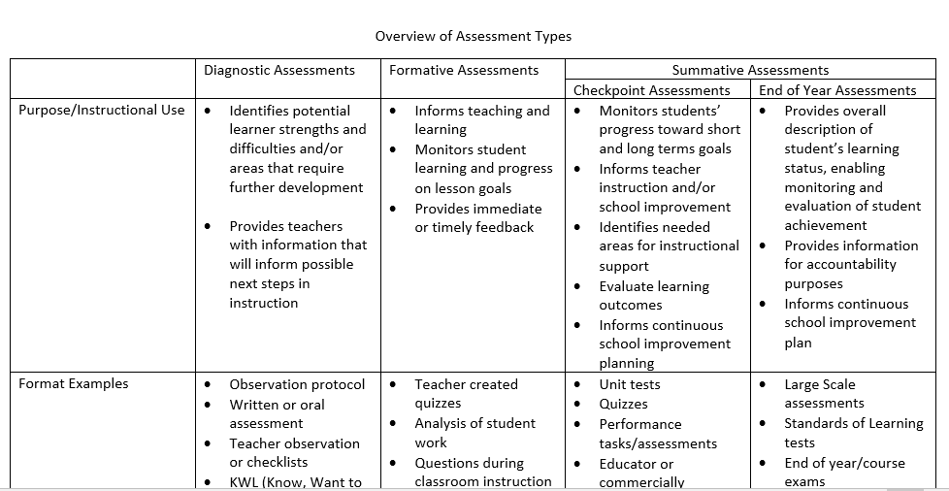
Overview of Assessment Types

Slide 33

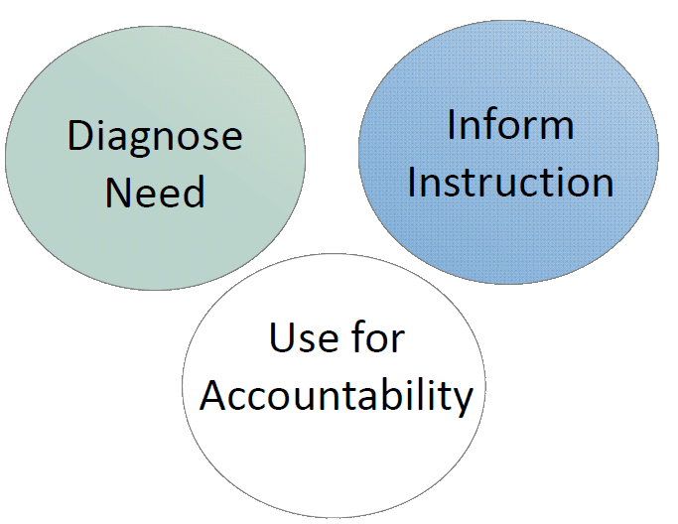
Examining Assessment Practices
Consider the assessments that you administer in your division or at your school.
Are the purposes clear?
Are the results used for the intended purpose?
Turn and talk to a shoulder partner

Slide 34
The Role of Performance Assessment
When is it appropriate to use performance assessment versus other forms of assessment (e.g., multiple choice, portfolio, etc.)?
Why should performance assessment be part of a balanced assessment system?

Slide 35
Setting the Stage for a Balanced Assessment System
Know what’s in place:
Identify high quality assessments that maximize instructional goals
Think about how each assessment contributes to the balance of the whole assessment system
Highlight assessments that provide results useful to teachers and students
Identify and eliminate gaps and redundancies

Slide 36
Taking Stock of Your Assessment Program
Think about your division assessment program.
What value do your assessments bring to student learning and instructional practice?
What is being assessed?
When is each assessment administered?
How is the evidence from each assessment used to support instruction?

Slide 37
  Balanced Assessment Plans – Informing Instruction

Slide 38
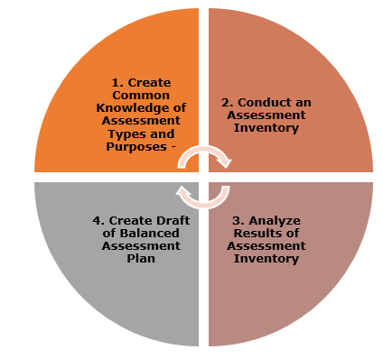
Developing a Balanced Assessment Plan

Slide 39
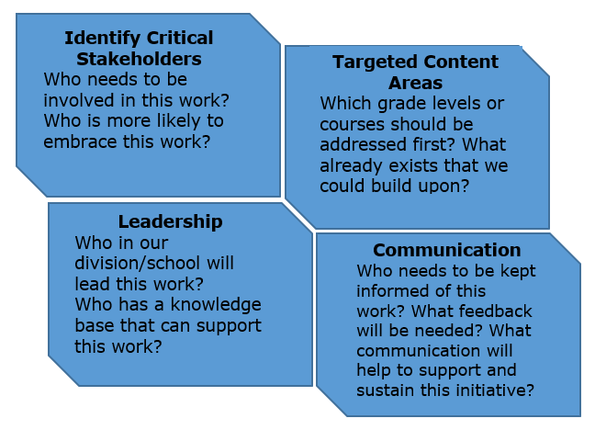
Considerations

Slide 40
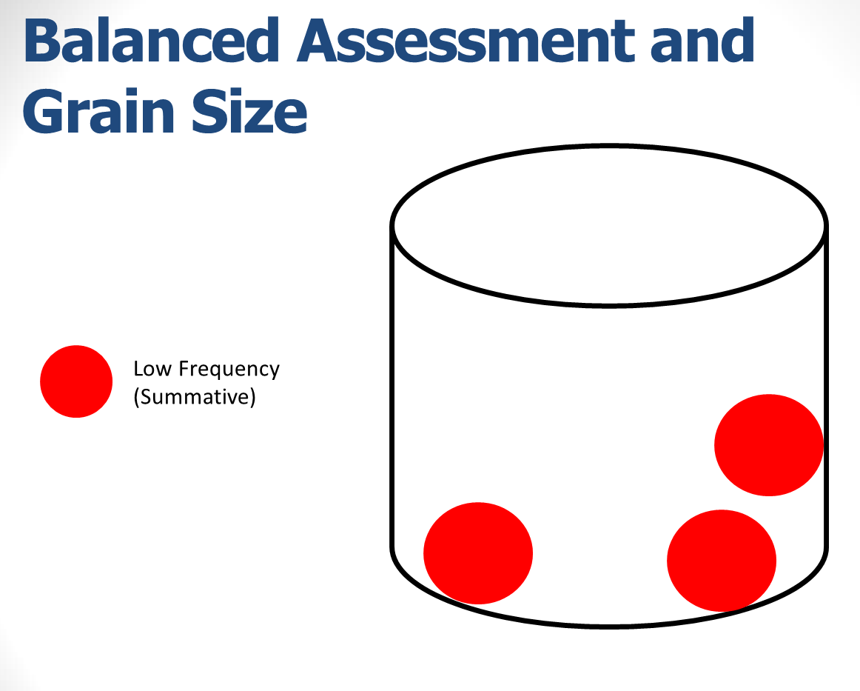
Balanced Assessment and
Grain Size (1 of 3)

Slide 41
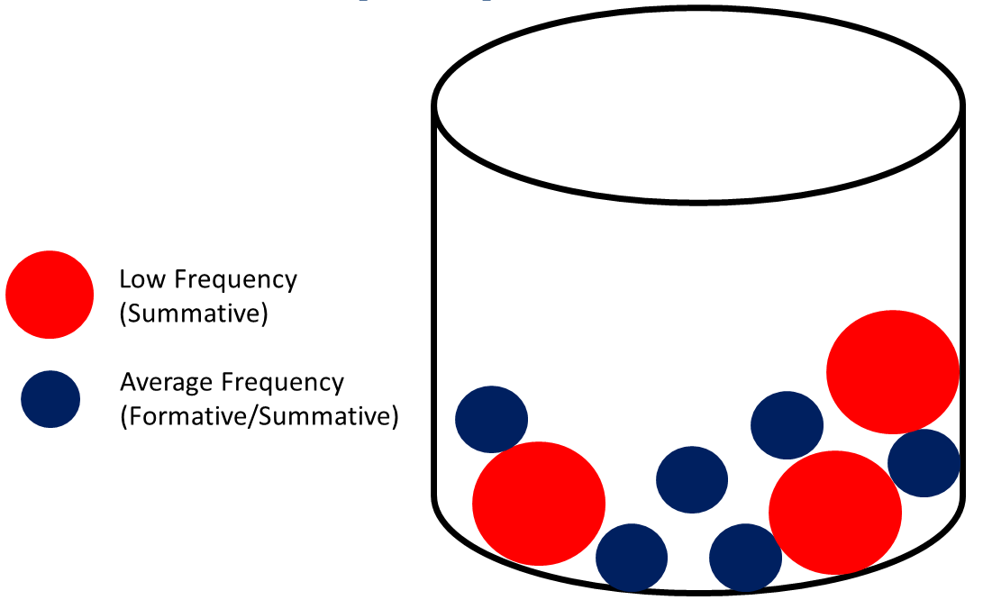
Balanced Assessment and
Grain Size (2 of 3)

Slide 42
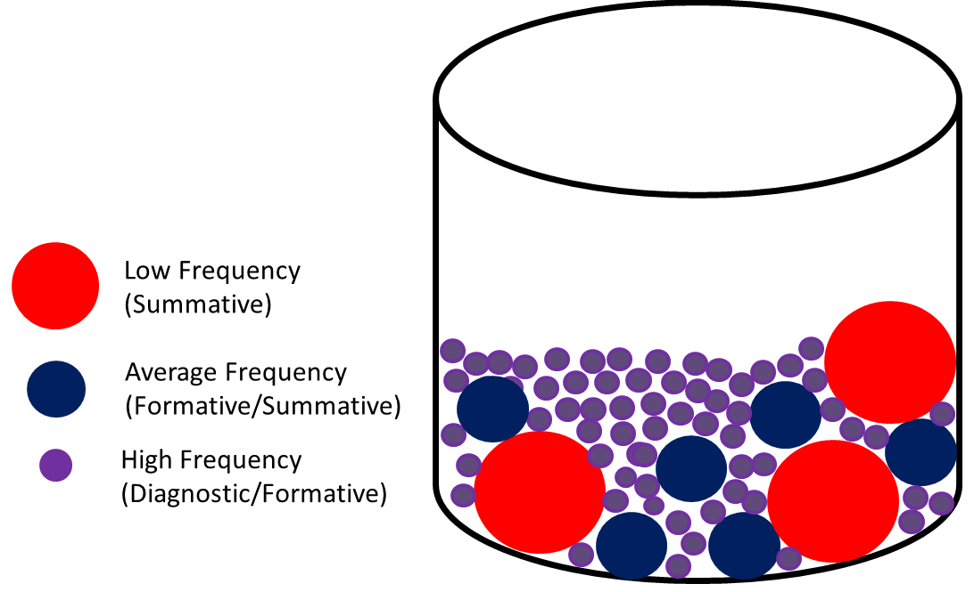
Balanced Assessment and
Grain Size (3 of 3)

Slide 43
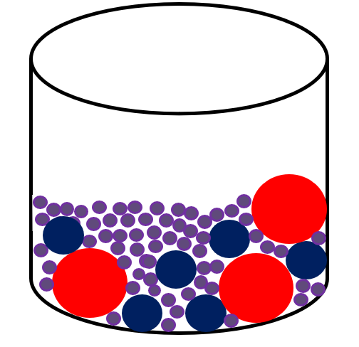
Connect the Dots…….
Compare and contrast these representations of grain size.
Discuss how these representations might impact the creation of a balanced assessment plan.

Slide 44
Local Alternative Assessments and Balanced Assessment Plans
Required for the five grade levels/courses with eliminated SOL Assessments
Reflects the use of a variety of assessment types, including performance assessment
Must exist at a division level and may also exist at a school level
Address all grade level/course content Standards of Learning

Slide 45
Balanced Assessment Plan (1 of 2)
Structures to Consider –
  Grain sizes of assessments being considered
  Time frame of instructional period to be addressed

Slide 46
Balanced Assessment Plan (2 of 2)
Attributes –
  Specify discipline and grade level/course
  Describe each assessment
    Specify alignment to standards/content
    Address the purpose(s) of each assessment
    Identify type(s) of assessment
    Describe how results will be used
  Determine time frame for assessment implementation

Slide 47
  Activity: Examining Additional Research

Slide 48
Examining Additional Research
  Each card has an excerpt from current research.
  Read the excerpt on your card.
  During lunch, share a summary of your excerpt and what resonated with you with your table.
  After lunch, each table will share a theme that emerged during your discussion and the implications for your work.

Slide 49
Conducting an
Assessment Inventory

Slide 50
Assessment Inventory
Captures information about the assessments administered to students in the division.
The assessment inventory tool is intended to guide divisions in looking across assessments to inform their recommendations and decisions regarding the creation of a balanced assessment system.

Slide 51
Using an Assessment Inventory
Division level teams will review the Assessment Inventory.
Using the division assessment information and other support materials that you brought to begin thinking about a balanced assessment plan for one of removed SOL test content areas.
Use the Assessment Inventory tool to guide decisions regarding your plan.
Be prepared to pair up with another division to share your work and provide feedback.

Slide 52
Division Pair-Up/ Check-In
Discuss how this tool might support analyzing the assessments being administered in your division.
Share any insights or discuss what other information may be needed to create a balanced assessment plan.

Slide 53
Assessment Inventory Scenario 1
TWO ASSESSMENTS USED FOR SIMILAR PURPOSES:
For the past five years, schools in Harbor County Public Schools have been administering two different vendor-developed reading assessments for all students in grades 3–5. Each assessment yields similar information on student performance. Harbor County Public Schools’ assessment leadership team has identified redundancy and is trying to determine which assessment should continue.
Adapted from Achieve Assessment Inventory Training: Assessment Scenarios

Slide 54
Scenario 1: Questions to Consider
What are the instructional and assessment implications if you continue to use vendor-developed reading assessments?
What criteria might you use to determine which assessment will be continued or eliminated?
What other factors or data may be useful or considered when making this decision?
Adapted from Achieve Assessment Inventory Training: Assessment Scenarios

Slide 55
Assessment Inventory Scenario 2
TEACHER-DEVELOPED, DIVISION-WIDE ASSESSMENTS NOT ALIGNED TO CURRENT STANDARDS:
Ten years ago, City Public Schools developed division-wide common performance assessments in science and social studies for grades 3–8. These performance assessments are given three times a year to all students. Internal studies showed that they support best practices during classroom instruction and help to increase student achievement on ALL grade 5 and grade 8 statewide summative assessments.
Adapted from Achieve Assessment Inventory Training: Assessment Scenarios

Slide 56
Scenario 2: Continued
Three years ago, the Board of Education approved new content standards and new statewide summative assessments. The previous performance assessments are no longer aligned to current standards.
Adapted from Achieve Assessment Inventory Training: Assessment Scenarios

Slide 57
Scenario 2: Questions to Consider
What are the instructional and assessment implications if you continue to use the current performance assessments?
How would you approach the process of developing options to address this situation?
Who would be involved, and what role(s) would they play?
Adapted from Achieve Assessment Inventory Training: Assessment Scenarios

Slide 58
Assessment Inventory Scenario 3
VENDOR-DEVELOPED ASSESSMENTS NOT ALIGNED TO CURRENT STANDARDS AND USE FOR INSTRUCTION IS UNCLEAR:
Western County Public Schools is at the end of a two-year contract with a testing vendor. In an effort to measure student growth, Western County Public Schools administers an assessment to all students twice a year in English and Mathematics.
Adapted from Achieve Assessment Inventory Training: Assessment Scenarios

Slide 59
Scenario 3: Continued
However, initial feedback from teacher focus groups suggests that teachers may not be confident that the assessments have strong alignment to the content standards; they are unclear how to use the results to inform instruction and unaware of the intended use of the assessment. You learn that several neighboring divisions are getting similar feedback from teachers.
Adapted from Achieve Assessment Inventory Training: Assessment Scenarios

Slide 60
Scenario 3: Questions to Consider
What are the instructional and assessment implications if you continue to use the current vendor-created assessments?
What steps might your assessment leadership team take in order to select a more effective product?
Adapted from Achieve Assessment Inventory Training: Assessment Scenarios

Slide 61
Assessment Inventory Scenario 4
NO ASSESSMENTS IDENTIFIED FOR ELIMINATION OR ADJUSTMENT:
The East Forest Public Schools launched a process to analyze the array of assessments administered throughout the year for K-3. With the new initiatives approved by the local school board, the school division’s ability to eliminate assessments is very limited. The assessment leadership team’s initial feedback signals that there has been an outcry from parents about the volume of testing for K-3 students.
Adapted from Achieve Assessment Inventory Training: Assessment Scenarios

Slide 62
Scenario 4: Questions to Consider
What are the instructional and assessment implications if you continue to ALL of the K–3 assessments?
What would you recommend the superintendent consider as a next step?
Adapted from Achieve Assessment Inventory Training: Assessment Scenarios

Slide 63
School Division Highlights:
Moving toward Balanced Assessment

Slide 64
Presentations from
School Divisions
Please note that some links in these presentations provided by school divisions in 2019 may no longer work. Contact the school division if you have questions about its presentation.
Tazewell County Public Schools
Roanoke City Public Schools
Frederick County Public Schools
Charlottesville City Public Schools
Chesterfield County Public Schools
Cumberland County Public Schools
Rockingham County Public Schools
Chesapeake City Public Schools

Slide 65
Questions for School Divisions
(1 of 2)
What were the conditions that led to the decision to begin moving toward a more balanced assessment approach?
What were the conditions that enabled these changes?
Who were key players in the design of these changes/ in your division's balanced assessment plan and its launch?

Slide 66
Questions for School Divisions
(2 of 2)
What previous work in your school division contributed to interest in this innovation throughout your division?
What early indicators, feedback and data have been used to see if this approach to assessment is yielding the intended results? What do you see as the next step toward a balanced assessment plan for your school division?
Identify system barriers that will need to be dealt with for there to be room for this innovation in other school divisions.

Slide 67
Developing Balanced
Assessment Plans
No specific format is required.
Consider if you have documents that can be adjusted to reflect assessment decisions.
Assessment inventory results should inform development.
Can be developed for any content area, but must be developed for all content areas/ courses requiring local alternative assessments
Evidence of opportunities for students to demonstrate acquisition of 5 C’s is encouraged.

Slide 68
Samples
Samples, if needed, have been shared here:
https://tinyurl.com/va-balanced-assessments

Slide 69
Current Status: Balanced Assessment Plans
Does your division or school currently have a published assessment plan?
If so, how is it structured and what are the attributes of the plan?
How are the results of your assessments informing instruction?
To what degree does it represent a good balance of assessments?

Slide 70
Each Division: Share Out
What are your findings from the assessment inventory? What more do you need to know?
Do other division personnel/ stakeholders need to be involved as you develop/ modify your plan?
What process will you use to develop/modify your division’s balanced assessment plan?
How will you put your plan into action? Will this be a division-level plan? Will schools develop their own plans? Will the division develop a framework for schools to follow?
What are the next steps for your division’s balanced assessment plan?

Slide 71
One Minute for Reflection
Please take a minute to complete the reflection statements about today’s session independently.
Two important ideas about instruction and assessment from this session are…
I still have questions about…

Slide 72
Related VDOE Support
Performance Assessment Modules for Professional Development – coming fall 2019
Deeper Learning Conference – English Institute September- October 2019
Deeper Learning Conference – History and Social Science Institute
September- October 2019
Deeper Learning Conference – Mathematics Institute October-November 2019
Deeper Learning Conference – Science Institute October-November 2019

Slide 73
Next Steps
Complete your division’s Balanced Assessment Plan for 2019-2020 by October 25, 2019.
Attend an optional follow-up webinar:
  Thursday, October 10, 2019 at 4:00 pm OR
  Friday, October 11, 2019 at 7:30 am
Respond to upcoming needs assessment survey. These results will be used to plan professional development for winter 2020.

Slide 74
Questions?
Questions about Balanced Assessment Plans should be directed to: Student_Assessment@doe.virginia.gov
(804)225-2102

