Slide 1
Performance Assessment Assurances:
Next Steps for Leading Deeper Learning in Virginia
Day 2: Secondary Breakout
Facilitators:
Christonya Brown, Virginia Department of Education
Ruth Wei, Envision Learning Partners

Slide 2
Introductions
Name
School, Division
Your professional role
Teaching area/grade level (past or present, if applicable)

Slide 3
Goals for Breakout Session
Day 2
Develop an understanding of Virginia Common Rubric in secondary history by applying it to score student work
Experience a scoring process that could be used with educators in local divisions
Notes:
Bring participants’ attention to the Agenda for Day 2 and the proceedings of the Breakout Group. Remind them the purpose of this session is not to calibrate them to become reliable scorers, but to demonstrate a process for using the common rubrics with student work that can be generalized with any content area rubric at the elementary/secondary level and across divisions.

Slide 4
Suggested Norms for Today
Be present and stay engaged
Devices used for today’s activities only, except at breaks
Challenge ideas, not people
Be mindful of air time and make space for others
Be incisive and honest
Be respectful of the work in front of us – it is the real work of real educators AND students in Virginia
Watch out for birdwalks
Other?

Slide 5
Logistics for Accessing Materials
Wireless Network Name:
Password:
Link to electronic versions of materials
Notes:
Provide wifi network name/password and link to Dropbox. Direct participants to appropriate folder (History, Day 1 Folder) and to download the three tasks that will be used today onto their own devices. Give time for participants to find the Dropbox folder and download the tasks.

Slide 6
Module 4: Introduction to Common Rubrics
What are the shifts in instruction and assessment design necessitated by the new Virginia common rubrics?
Notes:
Indicate that before we launch into using the rubrics, we want to recognize that the use of common rubrics in the state is and is not a new policy. It’s not new in that English language arts has always have a state writing rubric that is used on the state tests, and that has been adopted as part of assessment practice in ELA classes. However, it is new in that we have not had a common rubric in the assessment of either history or science competencies.
Also, we want to spend a bit of time reflecting on what might be the implications of adopting a set of common rubrics on assessment design and instruction at the local division level.

Slide 7
Table Talk: Implications for Classroom Assessment & Instruction
If the common rubrics represent the learning outcomes that are to be assessed across Virginia classrooms, what shifts will need to occur in how classroom assessments are designed?
What would it mean for classroom instruction?

Slide 8
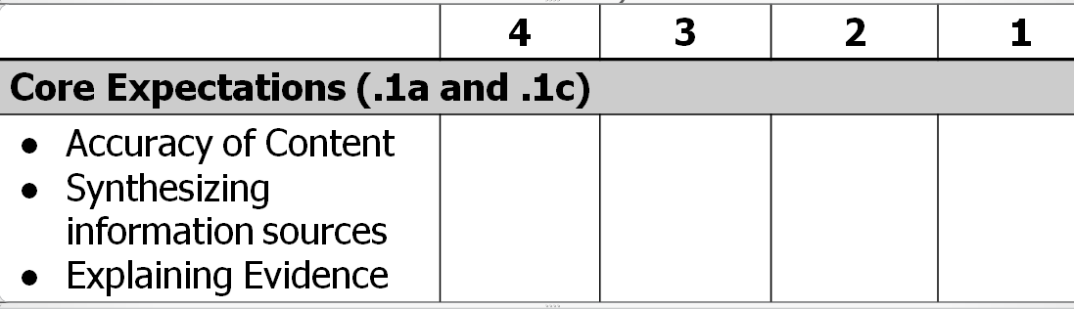
Secondary History-Social Science
Common Rubric for History and
Social Science Performance Assessments/Tasks
(Please see the electronic/paper copy of the full rubric for text within each cell of the rubric.)

Slide 9
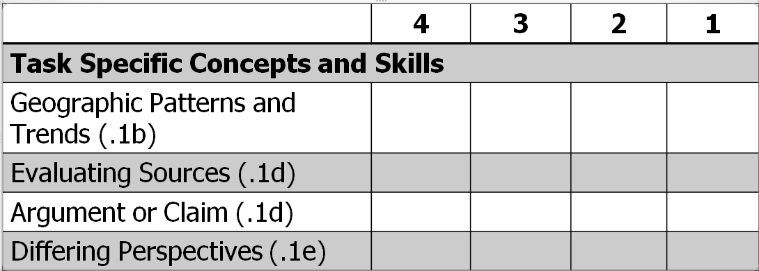
History-Social Science Rubric Continued
(Please see the electronic/paper copy of the full rubric for text within each cell of the rubric.)

Slide 10
A New Vision of Assessment in Virginia
Assessments that…
Demand students produce authentic work
Demand students apply specific disciplinary skill(s)
Focus on measuring specific disciplinary skill(s)

Slide 11
A New Vision of Instruction in Virginia
Instruction that…
Changes students’ role to a more active investigator
Names and teaches particular disciplinary skills
Engages students in big ideas and concepts
Requires students use facts not just recall them

Slide 12
Module 5: Understanding the Task through Students’ Eyes
Purpose: Understand the demands of a performance tasks and anticipate challenges students may have in responding to the task.
  Review the Performance Task: “Civil War Impacts”
  Use the tool: “Unpacking the Demands of a Performance Assessment”
Notes:
Introduce the purpose of this activity – which is to understand the cognitive and skill demands of the performance task and to anticipate possible challenges that students may have in responding to the task.
Indicate the resources they will need: Access to the Performance task that students responded to (should include student-facing prompt, teacher guide, and scoring rubric at the least); and the tool “Unpacking the Demands of a Performance Assessment”.

Slide 13
Unpacking the Demands of a Performance Assessment (1 of 2)
(15 min)
What do students need to know and be able to do to accomplish the task?
What language demands (function and form*) are embedded within the task?
What do you expect students to struggle with in this task?
Notes:
Introduce the questions that we will ask them to use to analyze the demands of the performance task
Make note of language demands as a special category and as even more salient than it is with multiple choice tests because of the language-rich nature of performance assessment. In many performance assessments, students must both access and process information and task-related resources that are language heavy, and they must respond in most cases using some form of language. We know this disproportionately affects students with disabilities and English Learners. This is the reason that we focus so much on language demands as a category in itself.
Go to the next slide to show examples of language demand types

Slide 14
* Language Demand Types
FUNCTION What students do with language as they engage with content and interact with others | FORM Language structures and vocabulary that are used to support language functions
Examples | Examples
Making claims | Paragraph organization
Expressing and supporting opinions | Language of science inquiry
Persuading | Timelines, tables, graphs
Analyzing | Quantitative representations
Defining | Comparison words
Notes:
Indicate that this table is also on the back of the Day 2 Handout: Unpacking the Demands of a Performance Assessment
These language demand types have to do both with how students take in language-based resources (e.g., the ability to interpret a timeline or an infographic) – FORM , as well as what they do with language in their academic work and in their everyday interactions with others –FUNCTION. In most cases, students will need to attend to both in creating a response to a performance assessment.

Slide 15
Unpacking the Demands of a Performance Assessment (2 of 2)
(15 min)
What do students need to know and be able to do to accomplish the task?
What language demands (function and form*) are embedded within the task?
What do you expect students to struggle with in this task?
Notes:
Indicate that participants now have about 10 minutes to unpack the demands of the performance assessment. When 5 minutes are left in Module 5, bring participants back together to share out some of the demands of the task, and where they expect students to struggle.

Slide 16
BREAK
(10:15 - 10:30)

Slide 17
Module 6: Analyze, Score, & Discuss Student Work
Part A – Skim & Rank-order Samples (15 min)
See Handouts: Student Samples 20, 21, 34, 47
Individually, read and sort/rank order them from highest to lowest
Compare notes with others at your table

Slide 18
Sample 34 & 47 Master Scores
 | 34 | 47
Core Expectations | 3 | 1+
Synthesizing information sources
Explaining Evidence
Accuracy of Content
Evaluating Sources | 1+ | N/O
Determining Causes or Effects | 3 | 1
What evidence supports these scores?
What questions do you have about the rubric?

Slide 19
Principles of Scoring Student Work
(Please see the electronic/paper copy of the Principles)
Know the rubric. It is your Constitution...
Trust evidence, not intuition...
Match evidence to language in the rubric...
Weigh evidence carefully; base judgments on the preponderance of evidence...
Know your biases; leave them at the door...
Notes:
Handout the Principles. Give participants time to skim it and think about which principles they will need to keep in mind. They could share this with an elbow partner [3 min]
Then take 2 minutes to highlight 2-3 principles that you think are particularly salient. E.g., Trust evidence, not intuition + Matching evidence to language in rubric; Isolate your judgment (no “double-dinging”); Resist seduction (“halo effect”). [2 min]

Slide 20
Principles of Scoring Student Work Continued
(Please see the electronic/paper copy of the Principles)
Focus on what the student does, not on what the student does not do...
Isolate your judgment: One poor element does not equal a low-quality student work sample...
Resist seduction...
Stick to the rubric...
Notes:
Handout the Principles. Give participants time to skim it and think about which principles they will need to keep in mind. They could share this with an elbow partner [3 min]
Then take 2 minutes to highlight 2-3 principles that you think are particularly salient. E.g., Trust evidence, not intuition + Matching evidence to language in rubric; Isolate your judgment (no “double-dinging”); Resist seduction (“halo effect”). [2 min]

Slide 21
Score Sample 21
Review & individually score Sample 21. (10 min)
When you have completed scoring, chart your scores on the blank Charting Paper.
Notes:
Direct participants to individually score Sample 21. (10 min max)

Slide 22
Example of Charting Scores
Notes:
Direct participants to chart their scores on the blank charting paper. They should do this by passing the blank paper around the table and individually charting their own scores. This ensures anonymity.

Slide 23
Discuss Sample 21
Make observations of the pattern of scores given on the samples. Note areas of agreement and disagreement.
Focus discussion on areas of disagreement.
Try to come to consensus on the scores. (10 min)
Notes:
Invite participants to discuss and share their scores with their table, trying to come to consensus on the scores. Using the Charting Paper for the samples they scored, they should note areas of agreement and disagreement and focus on discussing areas of disagreement. (10 min) Consensus does not mean 100% agreement, but that raters are getting closer to each other in how they would score.

Slide 24
Sample 21 Master Scores
 | 21
Core Expectations | 2.5
Synthesizing information sources
Explaining Evidence
Accuracy of Content
Evaluating Sources | N/O
Determining Causes or Effects | 2
Compare your group’s scores with the master scores
What questions do you have about the scores, evidence, or rubrics?
Notes:
HISTORY TEAM WILL NEED TO CUSTOMIZE THIS SLIDE FOR YOUR BREAKOUT [insert scores]
Share master scores for each sample
Ask participants to compare their group’s scores with the master scores and to generate questions about the scores, evidence or rubrics.

Slide 25
Score Sample 20
Review & individually score Sample 20. (10 min)
When you have completed scoring, chart your scores on the blank Charting Paper.
Notes:
Direct participants to individually score Sample 21. (10 min max)

Slide 26
Example of Charting Scores (cont.)
Notes:
Direct participants to chart their scores on the blank charting paper. They should do this by passing the blank paper around the table and individually charting their own scores. This ensures anonymity.

Slide 27
Discuss Sample 20
Make observations of the pattern of scores given on the samples. Note areas of agreement and disagreement.
Focus discussion on areas of disagreement.
Try to come to consensus on the scores. (10 min)
Notes:
Invite participants to discuss and share their scores with their table, trying to come to consensus on the scores. Using the Charting Paper for the samples they scored, they should note areas of agreement and disagreement and focus on discussing areas of disagreement. (10 min) Consensus does not mean 100% agreement, but that raters are getting closer to each other in how they would score.

Slide 28
Sample 20 Master Scores
 | 20
Core Expectations | 4
Synthesizing information sources
Explaining Evidence
Accuracy of Content
Evaluating Sources | 2
Determining Causes or Effects | 4
Compare your group’s scores with the master scores
What questions do you have about the scores, evidence, or rubrics?
Notes:
HISTORY TEAM WILL NEED TO CUSTOMIZE THIS SLIDE FOR YOUR BREAKOUT [insert scores]
Share master scores for each sample
Ask participants to compare their group’s scores with the master scores and to generate questions about the scores, evidence or rubrics.

Slide 29
INSTRUCTIONS FOR DIVISION TEAM TIME REFLECTION & PRODUCT

Slide 30
LUNCH – Team Time
12:30-1:15

Slide 31

The Why – Student Voices
Caleb
Elementary student from Henry County, VA
Listen to Caleb talk about testing

Slide 32

The Why – Student Voices
Fatima
Elementary student from Henry County, VA
Listen to Fatima talk about testing

Slide 33
Module 7: Reflect on What is Learned from Student Work
1. Task Revision Lens
How can evidence from student work be used to inform task (re)design work?
2. Instructional Implications Lens
How can evidence generated by high-quality performance assessment inform what teachers do next?
Notes:
Welcome everyone back from lunch.
Introduce the module by indicate that we will be debriefing and reflecting on the experience of looking at student work, and that this is a critical part of the process of using common rubrics. In fact, the participants are likely to have already begun thinking about these questions while they were engaged in the process of discussing the work samples with their colleagues.
We will be considering what we can learn from student work along two lines:
Task Revision Lens – Important because we know that tasks can always use improvement, and that the student work gives us the most telling evidence about whether a task is really eliciting the intendent evidence.
Instructional Implications Lens – It’s also important to consider what the student work provides evidence of in terms of the preparation they had prior to completing the performance task. We can sometimes see patterns of misunderstanding or weaknesses/strengths in student work that allow us to make inferences about the instruction that preceded the performance task.

Slide 34
Task Revision Lens
What disciplinary (content area) practices and/or understandings did the samples demonstrate?
What intended disciplinary practices and/or understandings were not evident in the samples?
What features of the task allowed students to demonstrate targeted disciplinary practices/understandings?
What are potential barriers for special populations in handling this task? OR What accessibility concerns do you have for the students you work with? For subgroups?
Notes:
Walk participants through analytic questions for this lens.
First ask participants to individually consider these questions and make notes about how the student work suggests revisions to the task they looked at today. [5 min]
Share out with table [5 min]
Then whole group share out [5 min]

Slide 35
Instructional Implications Lens
If the responses you reviewed had been from your own students, what would be your instructional next steps?
What kinds of learning supports and/or feedback do you think students need to support their success on this and future performance assessments?

Slide 36
Questions?
Notes:
Invite questions about the use of common rubrics and/or how these tools and protocols can be used, kinds of resources needed, kinds of preparation needed to facilitate a session like this.

Slide 37
Next…
Please reconvene in the whole group meeting space at 2:00 for Q&A with VDOE

Slide 38
Evaluation of Day 2
Link to survey, if applicable
THANK YOU FOR JOINING US!
Notes:
[Kim or other VA DOE Rep to facilitate]

