Slide 1
Performance Assessment Assurances: Next Steps for Leading Deeper Learning in Virginia Day 2: Opening
May 7-8, 2018 @Fredericksburg
May 10-11, 2018 @Staunton
June 4-5, 2018 @South Boston
June 7-8, 2018 @Abingdon

Slide 2
The Why – Student Voices
Aiden
Elementary student from Henry County, VA
Listen to Aiden

Slide 3
Welcome Back! Learning Outcomes for Today
Develop an understanding of Virginia Common Rubrics in secondary history and third grade science by applying them to scoring student work
Experience a scoring process that could be used with educators in local divisions
Learn about the concept of a “body of evidence” in English writing
Notes:
Kim Dockery to preview learning outcomes for today.

Slide 4
Body of Evidence
Kim Dockery, Christine Harris
Virginia DOE

Slide 5
Introduction to Common Rubrics
Envision Learning Partners

Slide 6
WHAT ARE DIFFERENT TYPES OF SCORING SYSTEMS?
Checklists
Point scoring systems
Scoring Rubrics
Notes:
[Envision Learning Partners]
There are several different types of scoring systems – checklists, point scoring systems, and rubrics. We believe Rubrics are the best choice and I’ll explain why in a minute.

Slide 7
Holistic Rubric Example
Literacy Design Collaborative - Persuasive Writing Rubric (Version 1)
See Day 2_Holistic Rubric Example
Notes:
[Envision Learning Partners]
This is a holistic rubric for scoring argumentative writing. As you can see, it describes the overall performance of a student’s essay. In this case, the score of “Not Yet” tells the students that she has not yet met the standard. But that student doesn’t know which of her skills were not up to snuff and where she hit the mark—the rubric does not identify specific strengths and weaknesses for students so that they know what aspects of their work need more focused attention. Holistic rubrics are useful and efficient for state standardized testing programs and other large-scale scoring, but they are less useful for supporting student and teaching learning because they do not provide feedback to students or teachers about particular strengths and weaknesses in the work.
DECIDE ABOUT ANNOTATION

Slide 8
COMMON ANALYTIC RUBRIC:
Literacy Design Collaborative - Argumentative Writing Rubric (Version 2)
See Day 2_Analytic Rubric Example
Notes:
[Envision Learning Partners]
In this example of analytic rubric, a student’s essay was scored along seven dimensions of performance. As you can see, on this rubric, this student’s scores varied along these seven dimensions.
A student receiving this scored rubric attached to his essay gets the message that that he’s done enough research and included enough detail in his essay, but to improve his score to Meets Expectations, he will need to work on his controlling idea, focus, organization, attention to English language conventions, and improve the accuracy of his content.
A teacher reviewing this scored rubric might realize that she will need to spend additional instructional time on developing controlling ideas, organization, and supporting students in editing and revising their writing.

Slide 9
LEARNING CENTERED DESIGN
Analytic rubrics provide specific feedback to students and teachers to inform revision
Notes:
[Envision Learning Partners]
From our learning-centered design perspective, rubrics should be analytic, so that students receive fine-grained feedback about their work and teachers receive more detailed information about what their students can do and where they need additional instruction.

Slide 10
COMMON ANALYTIC RUBRICS
September
November
February
May
1
(Not Yet)
1
(Not Yet)
2
(Approaches Expectations)
3
(Meets Expectations)

Slide 11
The Why – Student Voices Rubrics
Listen to
Student discussing rubrics (from CCE)

Slide 12
COMMON RUBRICS DISCIPLINARY TASK GENRES
Examples
ELA: Argumentative writing, Explanatory writing, Narrative writing, Research
Science: Investigation, Design, Research
Mathematics: Modeling, Problem Solving
History-Social Studies: Document-Based Questions, Research, Application of Concept
Notes:
[Envision Learning Partners]
Common rubrics are discipline-specific rubrics that are used with the most common genres of performance tasks within the discipline or field of study and are aligned to content standards . Task genres vary within disciplines. So for example, in English language arts, there are different writing purposes and types of writing tasks, some that involve students doing research and others than involve single-text responses. So you might have different common rubrics for each of those writing purposes.

Slide 13
Common Rubrics Other Task Genres Examples
Notes:
[Envision Learning Partners]
There are also certain task genres that are NOT necessarily discipline specific. Common rubrics for cross-disciplinary task genres, like different forms of oral communication, research, and technology integration can also be developed and used across a school.

Slide 14
COMMON RUBRICS, NOT TASK SPECIFIC
Support tracking student progress over time
Provide
consistency
for students
Provide a unifying language that builds professional community within and across schools
Notes:
[Envision Learning Partners]
SO…we advocate using common analytic rubrics.
Common analytic rubrics allow for tracking student progress on important dimensions over time and provide students with a consistent metric for thinking about the quality of their work. They communicate how students can reach the next level on any single dimension. Even when used within a single course, a common rubric can help students and teachers focus on the most important proficiencies all year long. When used across teachers and across a succession of courses within the grade span, a common rubric can provide a unifying language for students and teachers, and support opportunities for teacher collaboration, course articulation, and professional community. Common analytic Rubrics Support student and teacher learning and improvement .

Slide 15
Performance Task
Design Process
Scoring Rubrics
Performance Tasks
Performance Outcomes
Piloting
Scoring
Notes:
[Envision Learning Partners]
Developing Scoring Rubrics is a key step in the process of developing a performance assessment.
As this visual illustrates, we begin with the end in mind. We first consider – what performance outcomes do you want to measure? Performance outcomes are the key disciplinary understandings, practices, and skills that we want to develop and measure through the performance assessment. They may also include language goals, ways of thinking and doing in the disciplines, and other transferable college and career readiness skills.
Next, we consider what dimensions of performance will be examined in evaluating the quality of students’ performance? Contrary to what may be common practice – to develop a task first and then the rubrics – if we want to be clear about what we are measuring through a performance assessment and what kind of evidence will be needed to demonstrate that measurement goal, we need to first define the performance outcomes and the scoring dimensions. Then, we can determine what kind of evidence the performance task needs to elicit from students. This ensures alignment between the measurement goals and the performance task. The scoring rubrics serve as a kind of task design blueprint that provides the skeleton on which to build the substance of the performance task.
Last, in order to make sure that our scoring rubrics are useful and developmentally appropriate, we must use student work that results from piloting the task and scoring the student work to reflect on and refine the design of the scoring rubric, including the content of the scoring dimensions and the language used across scoring levels to match the developmental continuum represented in the student work. This iterative cycle is a key aspect of the designing high quality scoring rubrics and performance assessments.
We will talk more about the rubric development process later in this webinar.

Slide 16
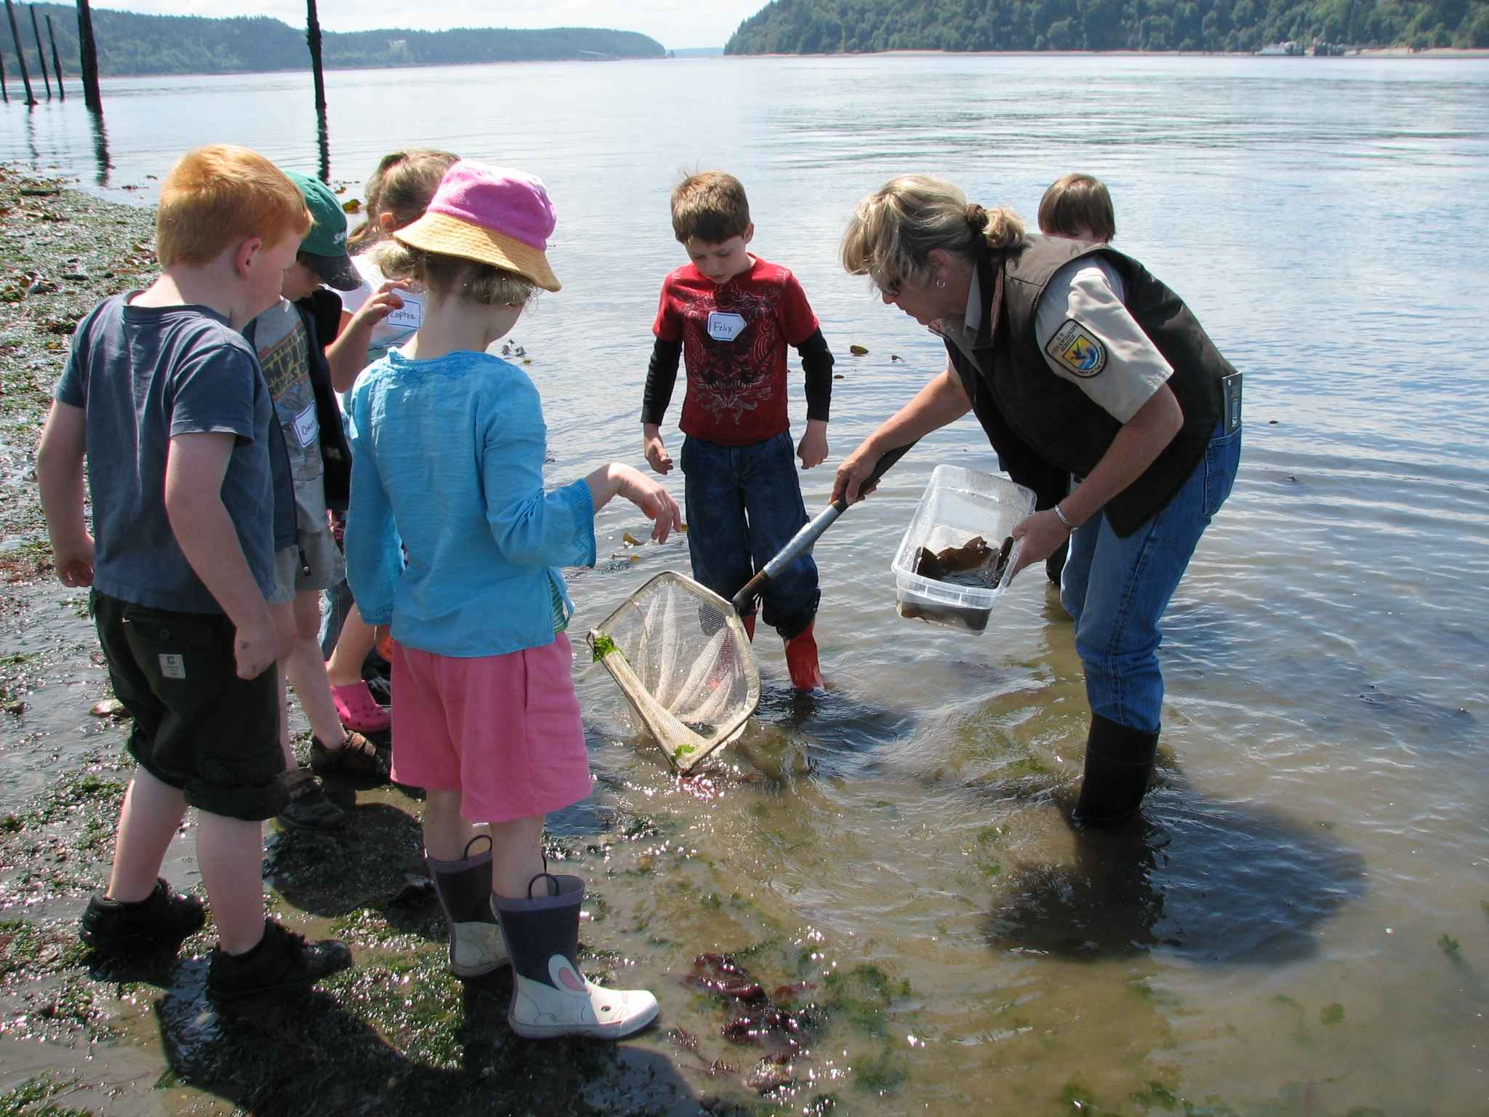
Virginia Elementary Science
Grade 3 Science Laboratory Investigation
Notes:
[Envision Learning Partners]
Intro to rubrics that we will be using today

Slide 17
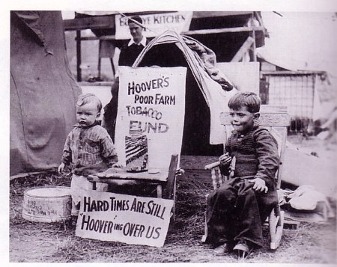
Virginia Secondary History-Social Science
History-Social Science
Standards of Learning
Skills Progression
Notes:
[Envision Learning Partners]
Intro to rubrics that we will be using today

Slide 18
Questions?

Slide 19
Logistics
Break-out Rooms (9:15 – 2:00)
Elementary [location]
Secondary [location]
Notes:
NEED TO ADD BREAKOUT ROOM NAMES

