Slide 1
Virtual Learning Professional Learning Series
VL Webinar 4: Virtual Learning in VA
Tuesday, May 24, 2022
3:00-4:00 p.m.

Slide 2




Presenters
Dr. Meg Foley
meg.foley@doe.virginia.gov
(804) 786-0877
Coordinator of Virtual Learning
Reginald Fox
reginald.fox@doe.virginia.gov
(804) 371-5663
Virtual Learning Specialist
Twitter: @VDOE_News
Facebook: @VDOENews
#VAis4Learners #EdEquityVA

Slide 3
Virtual Learning in Virginia
To provide school divisions, schools, staff, and stakeholders with information related to virtual learning in Virginia with emphasis on policies, procedures, professional development, and implementation of virtual programs.
  Recap from March 15th Webinar 3
  Accountability & Assessment
  Data Collection
  Reporting

Slide 4

Topics from March 15, 2022
  Guest Presenter: Maggie Clemmons
    Director of Licensure and School Leadership in the Department of Teacher Education & Licensure, VDOE
  What it means for School Divisions (IPAL)
  Accreditation – Teacher Licensure

Slide 5
Accountability & Assessment
The pupil performance standards for online courses or virtual school programs meet or exceed any applicable Virginia Board of Education Standards of Accreditation.
Any educational objectives and assessments used to measure pupil progress toward achieving pupil performance standards are in accordance with the Board’s Standards of Accreditation and all applicable state and federal laws.
Management and oversight of Virginia Standards of Learning test administration by school division and student participation rates in the Virginia Standards of Learning tests.
For compliance, student participation rates in early literacy assessments, or other types of standardized tests, including the names and types of assessments, grade levels, and participation rates.

Slide 6

Data & Reporting
Provide monitoring and reporting of student participation to ensure the highest level of progress.
Maintain student grade and assessment data.
Data and data management must meet state and federal reporting requirements, to include, but not limited to FERPA.
Transmit data electronically and appropriately while maintaining the highest level of confidentiality.
Collaborate with school divisions to ensure that student data is aligned with MOP data.

Slide 7

Guest Presenters:
Susan Williams, Director
Office of Data Services, VDOE
Dana Ratcliffe, MSC Specialist
Brittney Kanard, SRC Specialist
  Data Collection
  Reporting

Slide 8
MOP Reporting Requirements
Office of Data Services

Slide 9
Agenda
Reporting Timeline
Master Schedule Collection
Student Record Collection
Data Sharing
Contact Information

Slide 10
Reporting Timeline
Collection Name | Opens | Closes | “As Of” Date
Fall MSC | October 18th | January 31st | October 1st
EOY MSC | May 9th | August 12th | Last day of school (includes credit-bearing summer courses)
Fall SRC | October 1st | October 29th | October 1st
Spring SRC | April 1st | April 30th | March 31st
EOY SRC | May 15th | July 22nd | Last day of school
Summer SRC | August 1st | August 19th | Include students that graduate after the last day of school and before the first day of the next school year
*Contract divisions should provide a timeline to the MOP. It is imperative the data is reported to the division in a timely manner so the division can fulfill all other aspects of the complex collections on time.

Slide 11
Master Schedule Collection - MSC
What is the MSC?
  MSC is a data collection of individual student, course, and teacher information.
    The three components are linked to provide a view of the student’s academic experience and validate teacher licensure and endorsement data
Who is reported?
  Each teacher, administrator, pupil personnel staff and contracted vendors.
  Each students’ course enrollment in each section within their schedule.
Why is this required?
  To meet state and federal reporting requirements including Accreditation, ESSA, and the State Fiscal Stability Fund [Indicator (b)(1), Indicator (b)(2), Indicator (b)(3)]
Notes:
(b)(1)
Create a fully develop and implement a statewide longitudinal data system (SLDS)
(b)(2)
Provide student growth data on current students and students taught in the previous school year
(b)(3)
Provide teachers of reading/language arts and mathematics with reports of individual teacher impact on student achievement where the State administers assessments.

Slide 12

MSC - Guidelines
Divisions should provide a comprehensive list of data elements needed from the MOP.
  This includes B (teacher/IPAL–Fall only), C (courses), D (sections) and F (student) records.
  A complete list of reporting elements can be found on the MSC webpage.
MSC requires a record for every section where the student received at least 20 hours of instruction.
  If a student withdraws in October after 20 instructional hours in a class, MSC still requires a F record for that section.
MOP teachers must hold a valid VA teaching license.
  This is part of the MOP agreement approval by VDOE.

Slide 13
MSC - What is Required?
MOPs must provide all required teacher and staff data elements to include:
MOPs should work with the division in the use of course SCED codes.
  Use the VA Active SCED List found on the MSC website to report valid SCED codes for all courses being taught.
  The Section ID is an important data element that is used to connect the section to the course, teacher and students.
MSC requires a record for every section the student is scheduled to attend.
  Report any 2nd semester or quarter classes if available.
  The Final Grade and Credit Earned Flag are required on the EOY MSC.
Local Provider ID | Race and Ethnicity
VA Teaching License Number* | Gender
First Name | First Year Teacher Flag
Last Name | Total Years of Experience

Slide 14
Student Record Collection - SRC
What is the SRC?
  Collection of student enrollment, demographic, and program participation information.
Who is reported?
  One record is due for each student at each school where the student has at least one day of membership.
  Only full-time MOP students are flagged as such on the SRC.
    The division is still responsible for reporting both part-time and full-time MOP students.
  If a student withdraws in October, SRC still requires a record for the days enrolled for inactive students.
Why is this required?
  To comply with State and Federal reporting for financial and accountability purposes.
  With the increase in remote learning there is also an increased interest in outcomes for student served by MOPs

Slide 15
SRC - Enrollment and Attendance
Each record on the SRC contains an Entry Date and Entry Code. If a student leaves the program, an Exit Date and Exit Code are also required.
  The MOP must accurately track students who leave and/or re-enter the program.
  VDOE must be able to tell where a student is being served and for how long.
Attendance - accurate attendance is mandatory for every MOP student. Not every student is present every day.
  The resources linked below establish local authority to create a remote attendance policy and offer guidelines. The MOP must collaborate with the LEA in determining what is considered present.
    VA Code Law
    Recover, Redesign, Restart 2020 (page 59)
    Supts Memo 188-20

Slide 16
SRC - Demographics
All demographic data for MOP students must be reported when applicable
The LEA should provide a list to the MOP of required Data Elements.
  Demographic Data Elements include, but are not limited to:
Race | Ethnicity
Primary Disability Code | Gender
Economically Disadvantaged Flag | Immigrant Status
Military Connected Status | EL Services Code

Slide 17
SRC - Program Participation
Special program participation and graduation data must be reported when applicable.
The LEA should provide a list to the MOP of required Data Elements.
  Program Data Elements include, but are not limited to:
Gifted Code | International Baccalaureate Program Flag
CTE Finisher Code | Advanced Placement Code
Graduation Plan Code | Diploma Type

Slide 18
Data Sharing
MOPs must comply with all data agreements from the contracted division.
  This includes providing all reporting data elements needed for SRC and MSC collections.
MOPs are under the same guidelines for FERPA as the contracted division.
Secure communication protocols are required for sharing student data or other data elements that contains PII.

Slide 19
Contact Information
SRC Website
Brittney Kanard, Office of Data Services
Email - Brittney.Kanard@doe.virginia.gov
Phone - 804-225-3090
MSC Website
Dana Ratcliff, Office of Data Services
Email - Dana.Ratcliffe@doe.virginia.gov
Phone - 804-225-2827

Slide 20
What questions do you have about data collection and reporting?
Dr. Meg Foley
meg.foley@doe.virginia.gov
(804) 786-0877
Coordinator of Virtual Learning
Reginald Fox
reginald.fox@doe.virginia.gov
(804) 371-5663
Virtual Learning Specialist
Twitter: @VDOE_News
Facebook: @VDOENews
#VAis4Learners #EdEquityVA

Slide 21
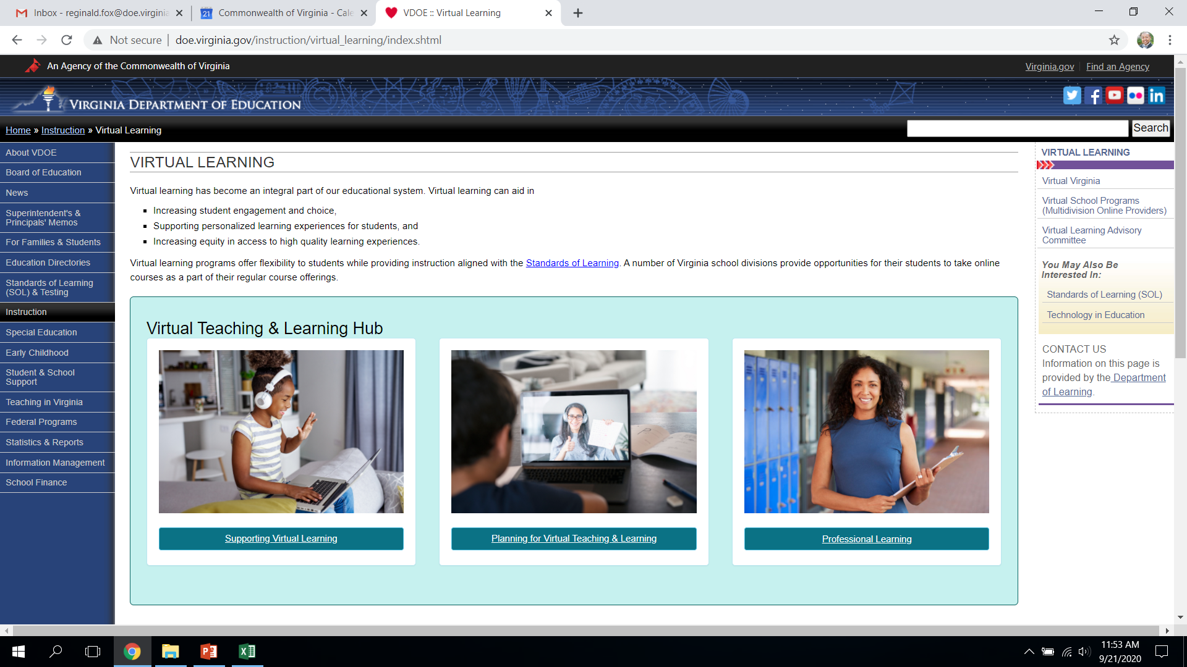
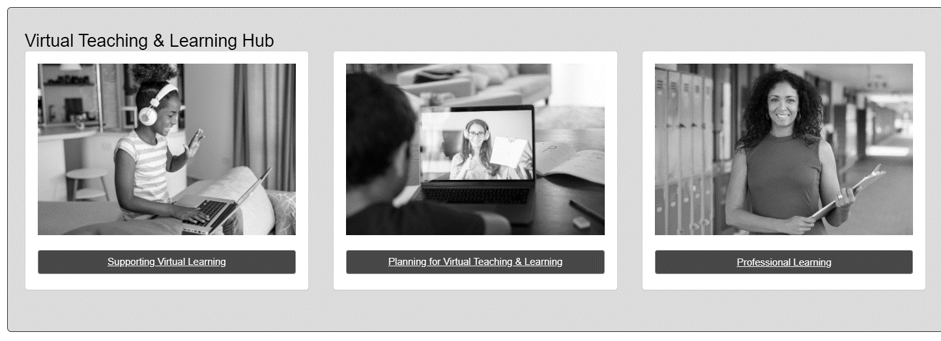
Professional Learning Community
Continue to expand our professional learning community in collaborating with school division staff and all of our virtual programs.

Slide 22
Thank you for participating!
Additional information may be found at Virtual Learning Professional Learning website.
VDOE Virtual Learning HUB
Dr. Meg Foley
meg.foley@doe.virginia.gov
(804) 786-0877
Coordinator of Virtual Learning
Reginald Fox
reginald.fox@doe.virginia.gov
(804) 371-5663
Virtual Learning Specialist

