Slide 1
Virtual Learning Professional Learning Series
VL Webinar 2: Virtual Learning in VA
Date – Wednesday, February 2, 2022
3:00-4:00 p.m.

Slide 2
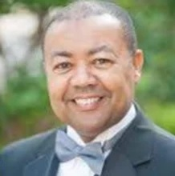



Presenters
Dr. Meg Foley
meg.foley@doe.virginia.gov
(804) 786-0877
Coordinator of Virtual Learning
Reginald Fox
reginald.fox@doe.virginia.gov
(804) 371-5663
Virtual Learning Specialist
Twitter: @VDOE_News
Facebook: @VDOENews
#VAis4Learners #EdEquityVA

Slide 3
Virtual Learning in Virginia
To provide school divisions, schools, staff, and stakeholders with information related to virtual learning in Virginia with emphasis on policies, procedures, professional development, and implementation of virtual programs.
  Follow-up from November 17th Meeting
  Enrollment in virtual courses
  Communication and support for virtual students
  Monitoring progress and reporting
  Teacher Licensure and staff roles

Slide 4

Topics from Nov. 17th
School division responsibilities
MOP responsibilities
Policies and procedures
Supporting student learning

Slide 5
Enrollment in virtual programs

Slide 6
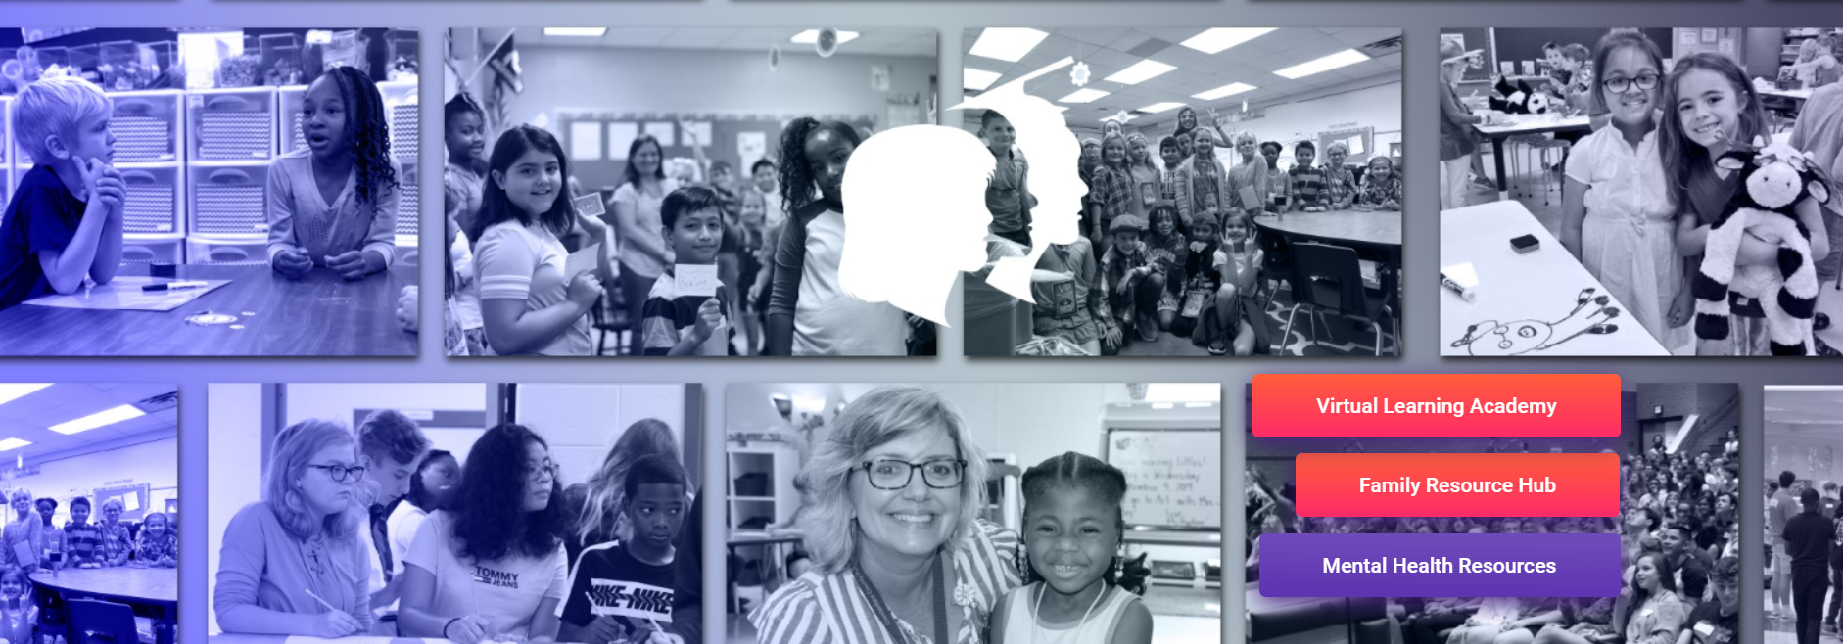
Enrolling in a “school division” virtual program
School divisions may have specific criteria for enrolling in virtual courses.
Students remain in their home school divisions.
ADM funding for students remains in home school division.
School divisions are responsible for instruction and required services for students with disabilities, 504 plans, EL, or providing other specialized services.
School divisions are responsible for calendar, attendance, and grades, monitoring student progress.

Slide 7
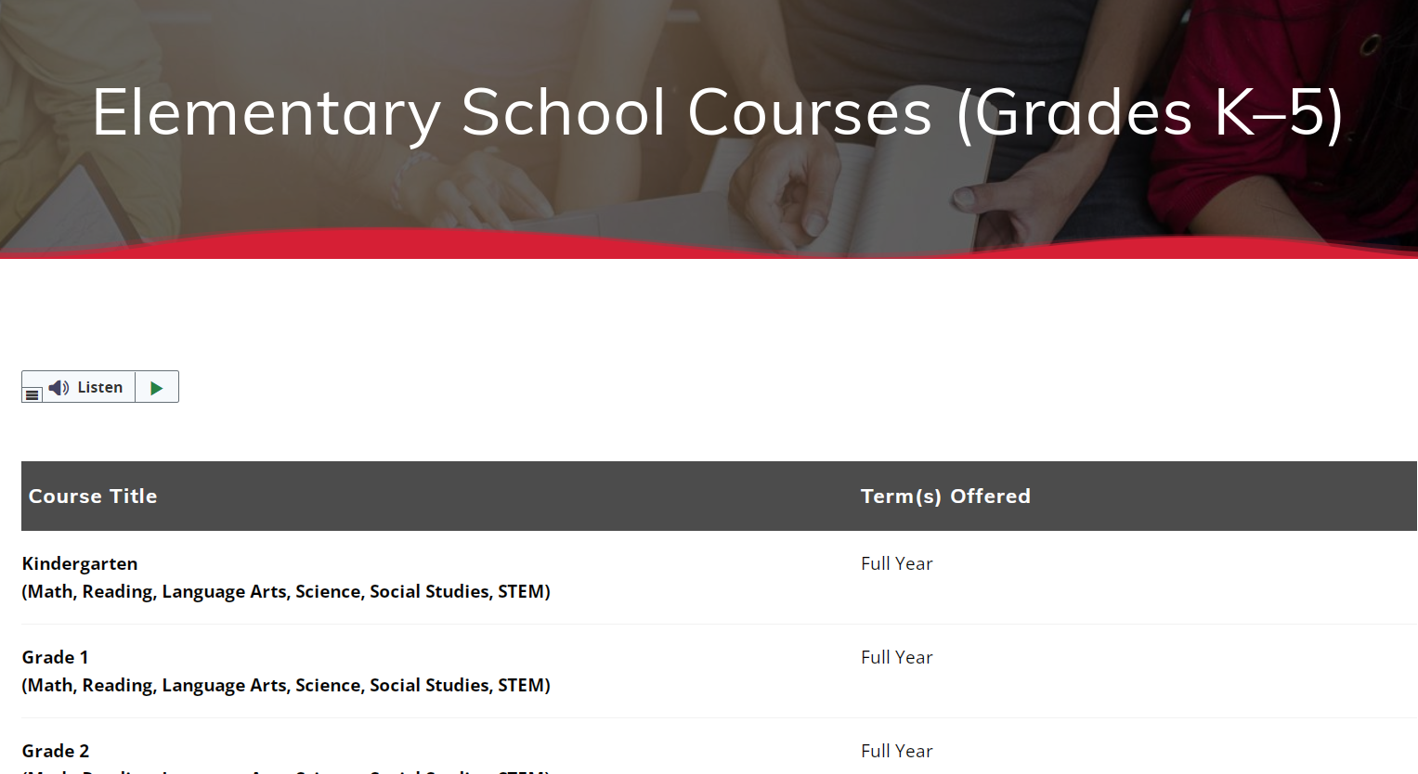
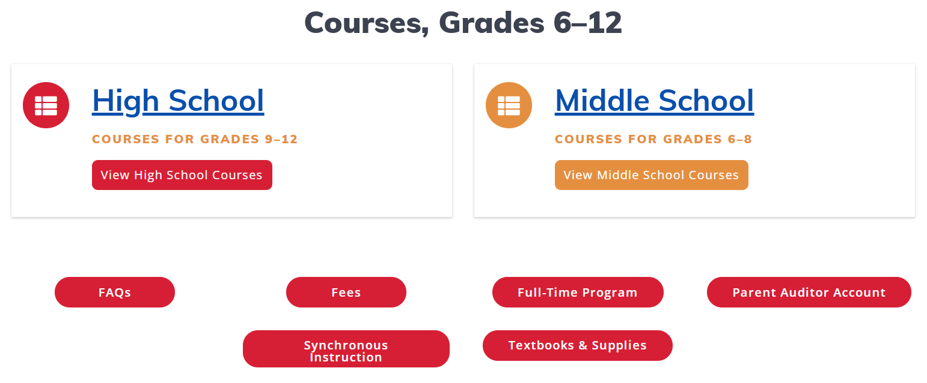
Enrolling in the Virtual VA program
School divisions may enroll students in virtual courses based on the Virtual VA enrollment process (part-time or full time).
Students remain in their home school divisions.
ADM funding for students remains in home school division. Tuition may apply depending on the enrollment requests.
School divisions are responsible for required services for students with disabilities, 504 plans, EL, or providing other specialized services.
Virtual VA will collaborate with school divisions to provide accommodations appropriately in the virtual setting.
School administrators, counselors, mentors, and parents have an important role in supporting students.

Slide 8
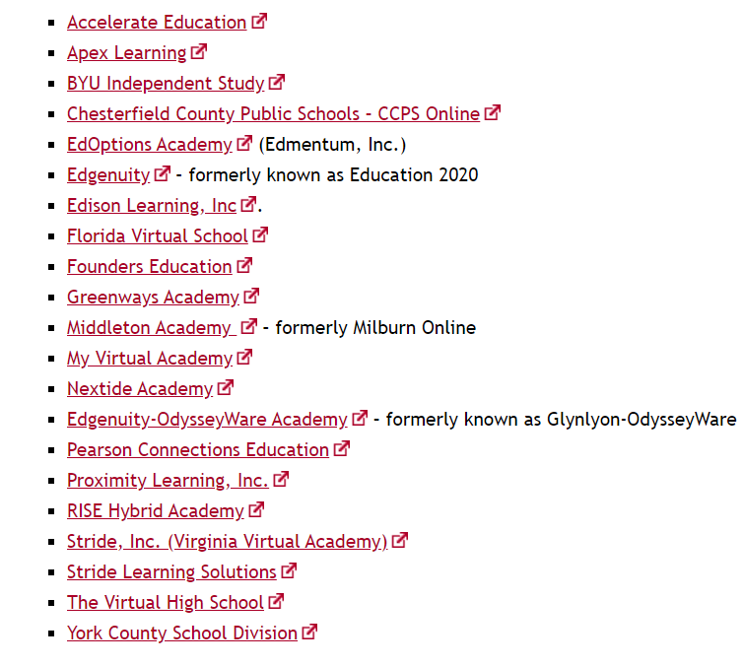
Enrollment in a Multidivision Online Provider program (MOP)
School divisions may enroll students in virtual courses through a contract with a MOP (part-time or full time).
Students may remain in their home school divisions.
ADM funding for students remains in home school division. Tuition is based on the contracted services.
School divisions are responsible for required services for students with disabilities, 504 plans, EL, or providing other specialized services.
School divisions should collaborate with MOP to meet accommodations appropriately in the virtual setting.
School administrators, counselors, mentors, and parents have an important role in supporting students.

Slide 9



Enrolling in a Full-time MOP program
Scenario
A group of students from Smith High School in Lake, VA have requested to attend a full time virtual program. Smith HS approves their participation with a MOP to take all virtual courses. The parents have agreed to have their students participate in this full time MOP full program. The MOP has contracted with Eagle County School Division in Mountain, VA. There are no academic records for the newly enrolled students. Some of the students previously at Smith HS are striving in the virtual setting, but other students are performing poorly and could use support. Two of the students have an IEP and should have accommodations.

Slide 10
MOP program & “transfer” students
Insight
Staff from the MOP, Smith HS, and Eagle County School Division should be communicating about enrollment, withdrawal and transfer of records.
The students are now enrolled in Eagle County School Division since the MOP has contracted with that division.
Eagle County School Division receives the ADM since the student has “transferred” as a full-time student and receiving instruction through the MOP.
There is no tuition involved in this scenario.
Eagle County School Division is responsible for providing required services for students enrolled, in collaboration with the MOP.
Students who are performing poorly in the virtual courses should receive support from the MOP online teacher, other appropriate MOP staff, and Eagle County School Division assigned staff.
Discussion
What information should have been communicated?
Where are the students actually enrolled?
Which school or division receives the ADM for the student?
Is there tuition involved?
Who is responsible for providing required services for students with disabilities, 504 plans, EL, or other specialized services?
Who is responsible for helping students who are performing poorly and need support?

Slide 11

Important Enrollment Tips
Communicate with all stakeholders
Ensure that stakeholders understand the “membership” of the student
Follow-up on transfer of academic records
Share IEP, 504 plan, and other important information that may require services
Inform stakeholders of the steps and action for supporting students who need help

Slide 12
Share examples of virtual enrollments that may have been unique or caused questions.
Dr. Meg Foley
meg.foley@doe.virginia.gov
(804) 786-0877
Coordinator of Virtual Learning
Reginald Fox
reginald.fox@doe.virginia.gov
(804) 371-5663
Virtual Learning Specialist
Twitter: @VDOE_News
Facebook: @VDOENews
#VAis4Learners #EdEquityVA

Slide 13
Communication and support for virtual students

Slide 14



Virtual Programs
Multidivision Online Providers (MOP)
As provided in § 22.1-212.23 et seq. , the Code of Virginia allows school divisions to offer online instruction to students using a private organization, educational institution or nonprofit virtual school organization that meets Board of Education approval criteria to operate as a MOP.
School Division Virtual Program
Parents may choose to enroll in an approved homeschool program, private school, or online private provider of virtual courses.
Virtual VA (VVA)
Virginia public school divisions & Virtual Virginia partner together to ensure learners have access and opportunity that complement those available in the physical school.

Slide 15

Communication =
Team means all stakeholders = communication as an expectation.
Use all forms of communication (phone, email, discussion forum, messaging).
Collaborate on student progress regularly.
We encourage parents to be engage in their child’s virtual learning.

Slide 16

Supporting Virtual Students
Ensure that the students has appropriate technology and materials.
Host orientation with “live” examples and components.
Be present both with asynchronous and synchronous instruction.
Monitor progress of all students throughout the grading term period.
Give timely feedback.

Slide 17

Supporting Virtual Students
Scenario
Jessica is enrolled in an online Biology class and is not performing well. Jessica is not completing all of the required assignments; however, Jessica is actively participating in discussions and “live sessions”. Jessica has an IEP with accommodations. Jessica’s parents are upset because her grades have dropped and is not getting any response from the teacher. Since Jessica’s grade average has dropped below 70%, she will be automatically withdrawn from the course and virtual program. If withdrawn, Jessica would have to return to her home school in a face-2-face class.

Slide 18

Supporting Virtual Students
What are the underlying issues in this scenario?
What questions would you ask and what steps would you have taken to help avoid having a student end up in this situation?
What action would you take to provide support to Jessica and her family?

Slide 19
Supporting Virtual Students
Scenario
Jessica is enrolled in an online Biology class and is not performing well. Jessica is not completing all of the required assignments; however, Jessica is actively participating in discussions and “live sessions”. Jessica has an IEP with accommodations. Jessica’s parents are upset because her grades have dropped and is not getting any response from the teacher. Since Jessica’s grade average has dropped below 70%, she will be automatically withdrawn from the course and virtual program. If withdrawn, Jessica would have to return to her home school in a face-2-face class.

Slide 20
What support systems do you have in place to ensure that students are successful?
Dr. Meg Foley
meg.foley@doe.virginia.gov
(804) 786-0877
Coordinator of Virtual Learning
Reginald Fox
reginald.fox@doe.virginia.gov
(804) 371-5663
Virtual Learning Specialist
Twitter: @VDOE_News
Facebook: @VDOENews
#VAis4Learners #EdEquityVA

Slide 21
Teacher Licensure & staff roles

Slide 22

Virtual Teachers in Virginia
A. Each school shall have at a minimum the staff as specified in the Standards of Quality with proper licenses and endorsements for the positions they hold.
B. The principal of each middle and secondary school shall be employed on a 12-month basis.
C. Each elementary, middle, and secondary school shall employ school counseling staff as prescribed by the Standards of Quality. School counseling shall be provided for students to ensure that a program of studies contributing to the student's academic achievement and meeting the graduation requirements specified in this chapter is being followed.
D. Each member of the school counseling staff in the counseling program for elementary, middle, and secondary schools shall spend at least 80% of his staff time during normal school hours in direct counseling of individual students or groups of students.
E. A middle school classroom teacher's standard load shall be based on teaching no more than the instructional day minus one planning period per day or the equivalent with no more than 150 students or 25 class periods per week. If a middle school classroom teacher teaches more than 150 students or 25 class periods per week, an appropriate contractual arrangement and compensation shall be provided.
F. The secondary classroom teacher's standard load shall be based on teaching no more than the instructional day minus one planning period per day or the equivalent with no more than 150 students or 25 class periods per week. If a secondary school classroom teacher teaches more than 150 students or 25 class periods per week, an appropriate contractual arrangement and compensation shall be provided.
G. Middle or secondary school teachers shall teach no more than 150 students per week; however, physical education and music teachers may teach 200 students per week. If a middle or secondary school physical education or music teacher teaches more than 200 students per week, an appropriate contractual arrangement and compensation shall be provided.
Standards of Accreditation – Code of Virginia
8VAC20-131-240.
Administrative and support staff; staffing requirements.

Slide 23

The Virtual Teacher
A Teacher of Record assigned to each course should be endorsed in the subject area.
Enrollment is reported based on the number of students assigned to the teacher of record.
Support staff assigned to virtual courses cannot reduce enrollment reported for the teacher of record.
The Teacher of Record and support staff are responsible for monitoring and communicating about the progress of students.
Paraeducators
Special education teachers
Teacher assistants
Support staff (required services)
Counselors
Administrators

Slide 24
What questions do you have about the teacher licensure, virtual staff, or support staff?
Dr. Meg Foley
meg.foley@doe.virginia.gov
(804) 786-0877
Coordinator of Virtual Learning
Reginald Fox
reginald.fox@doe.virginia.gov
(804) 371-5663
Virtual Learning Specialist
Twitter: @VDOE_News
Facebook: @VDOENews
#VAis4Learners #EdEquityVA

Slide 25
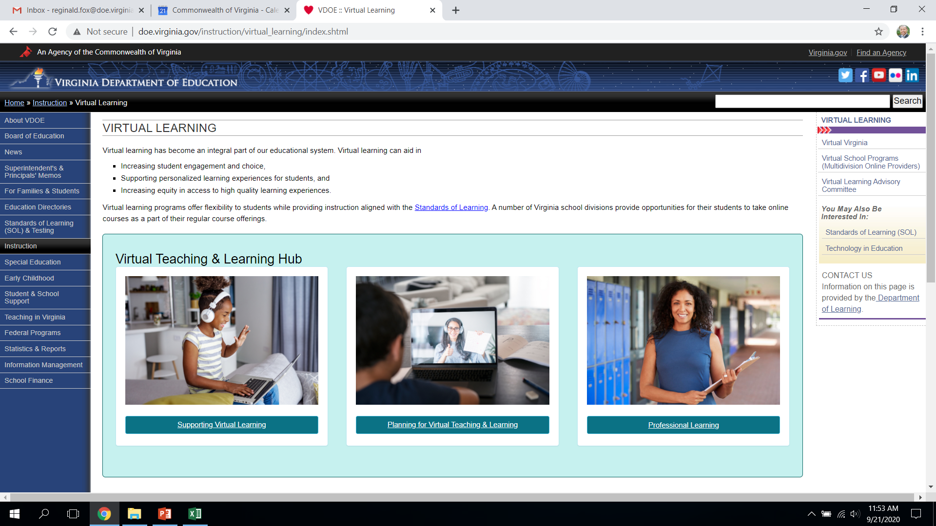
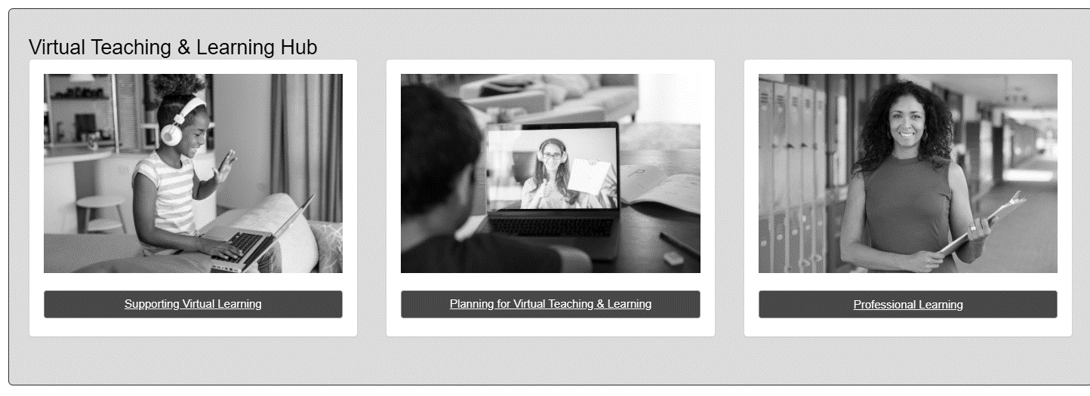
Professional Learning Community
Continue to expand our professional learning community in collaborating with school division staff and all of our virtual programs.

Slide 26
Thank you for participating!
Additional information may be found at Virtual Learning Professional Learning website.
https://www.doe.virginia.gov/instruction/virtual_learning/professional-learning/index.shtml
Dr. Meg Foley
meg.foley@doe.virginia.gov
(804) 786-0877
Coordinator of Virtual Learning
Reginald Fox
reginald.fox@doe.virginia.gov
(804) 371-5663
Virtual Learning Specialist

