Slide 1
Rising to the Rigor
of the
English Standards of Learning
Tracy Fair Robertson
English Coordinator

Slide 2

The Heart of the Matter
http://www.humanitiescommission.org /

Slide 3

Focus on Policy

Slide 4
Changes to SOA
Resulting from legislative changes made by the 2012 General Assembly
Accreditation Benchmarks change beginning with testing data for the 2012-2013 school year for ratings awarded in the 2013-2014 school year.
  Science and History and Social Science: 3rd grade pass rates increase from 50 percent to 70 percent.
  English: Pass rates for grades 6 through 12 increase from 70 percent to 75 percent.

Slide 5
Changes to SOA
Resulting from legislative changes made by the 2012 General Assembly
Diploma Changes - beginning with students entering ninth grade for the first time in 2013-2014
  A student must earn a board-approved career and technical education credential to graduate with a Standard Diploma.
  A student must successfully complete one virtual course, which may be non-credit bearing.
  The Modified Standard Diploma is folded into the Standard Diploma. Credit accommodations will be provided for students with disabilities.

Slide 6
Changes to SOA
Resulting from legislative changes made by the 2012 General Assembly
  The Standard Technical and Advanced Technical Diploma are eliminated.
  The Modified Standard Diploma is folded into the Standard Diploma. Credit accommodations will be provided for students with disabilities.
  Academic and Career Plan is required for all students beginning in middle school in the 2013-2104 school year.

Slide 7
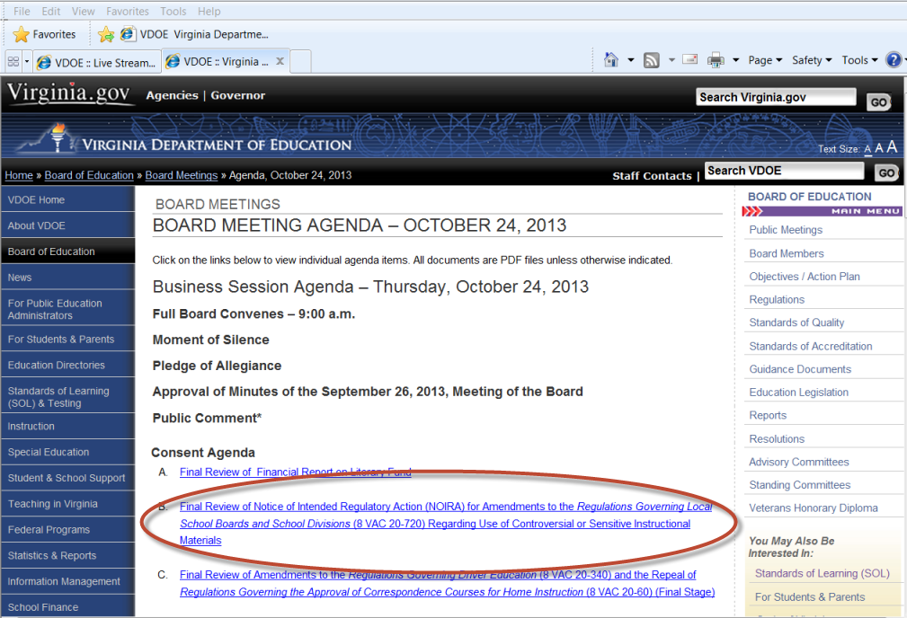
Board of Education

Slide 8
Proposed Changes to SOA
Additional language added regarding sensitive materials used in instruction:
The learning objectives developed in accordance with the provisions of 8 VAC 20-131-70 to be achieved at their child's grade level; or, in high school, a copy of the syllabus for each of their child's courses, including a notice to parents about any sensitive or sexually explicit materials that may be included in the course, the textbook, or any supplemental instructional materials; and a copy of the school division promotion, retention, and remediation policies.

Slide 9
Proposed Changes to SOA
Public comment will be taken at :
http://www.townhall.virginia.gov/index.cfm
The “sensitive materials” link does not currently appear. Check back and comment.

Slide 10
Secrets to Success with
English Instruction
Integration of all strands of English
  Vocabulary development
  Reading – fiction & nonfiction
  Writing – emphasis on expository, persuasive, analytical modes
      Emphasis on writing process
      Use of Writing Portfolios
      Peer revision /editing
      Regular writing conferences
  Research
  Media Literacy

Slide 11
Secrets to Success with
English Instruction
Emphasis of nonfiction reading strategies
Text- dependent questions
Text-based vocabulary study
Writing components in every lesson
Research components

Slide 12
Secrets to Success with
English Instruction
Incorporation of media literacy
Focus on building 21st century skills
Thinking-Enhanced-Items (TEI)
Use of SOL Resources
Project-based learning incorporates all strands of English SOL

Slide 13
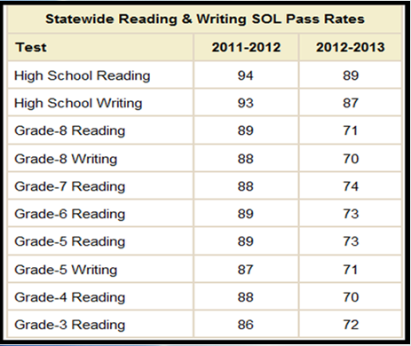
SOL Pass Rates

Slide 14
SOL Pass Rates
75% of students passed the SOL reading test for their grade
76 % passed their respective SOL writing test
Highest pass rates on EOC reading and writing
EOC Reading
  Students in 118 divisions achieved pass rates of 80 % or higher
  All divisions achieved pass rates of 70 % or higher
EOC Writing
  Students in 107 divisions achieved pass rates of 80% or higher
  128 divisions achieved pass rates of 70 % or higher

Slide 15
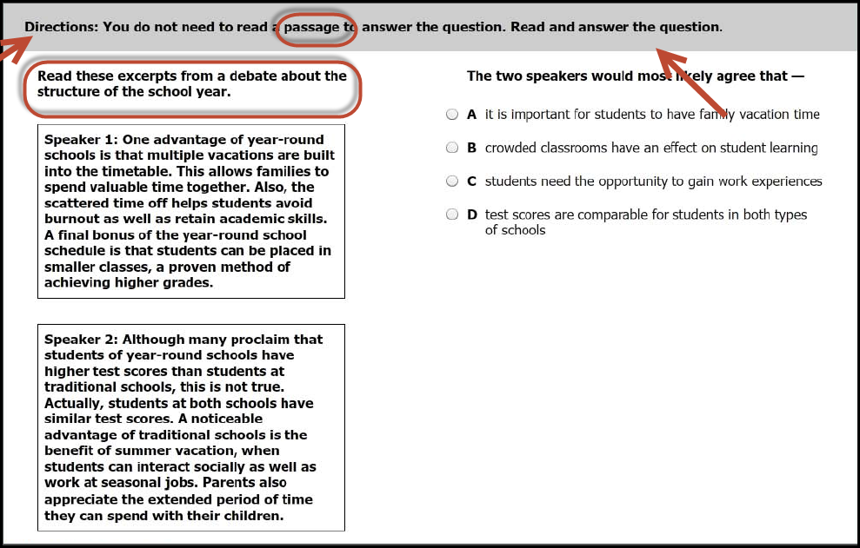
Assessment NEWS

Slide 16
Assessment NEWS
This item is only for high schools. ACT WorkKeys® Writing test will continue to be available as a substitute test for this school year. ACT will be discontinuing the WorkKeys Writing at some point. A committee of educators has reviewed the ACT WorkKeys Business Writing test as a potential substitute test for the SOL EOC Writing test. Their recommendation to include ACT WorkKeys Business Writing as a substitute test is expected to be submitted for initial review at the BOE November 21, 2013, meeting.
The Board is expected to vote on this issue at its January 16, 2014 meeting.

Slide 17
Assessment NEWS
VDOE is seeking nominations for educators to serve on the 2014 VMAST Reading item review committee.
12 members are needed for each of the committees:
VMAST Grades 3-4 Reading
VMAST Grades 5-6 Reading
VMAST Grades 7-8 Reading
VMAST End-of-Course Reading
The committee meetings will be on January 15, 2014, at the Hilton Richmond Hotel
Apply via ACAPS. Directions are available at: https://p1pe.doe.virginia.gov/acaps/

Slide 18
Lexiles
Beginning with the results of the fall 2013 SOL test administration, Lexile scores will be provided on SOL score reports.
Due to the proprietary calculations upon which Lexiles are based, the Lexile conversion tables have been made available to school divisions in SSWS.
Lexile measures are reported as either a numerical score of 5-1,600 followed by the letter L (e.g., 650L) or as BR (Beginning Reader). “Beginning Reader” is used for any student whose SOL test scale score corresponds to a Lexile measure of zero.

Slide 19

Focus on Reading

Slide 20
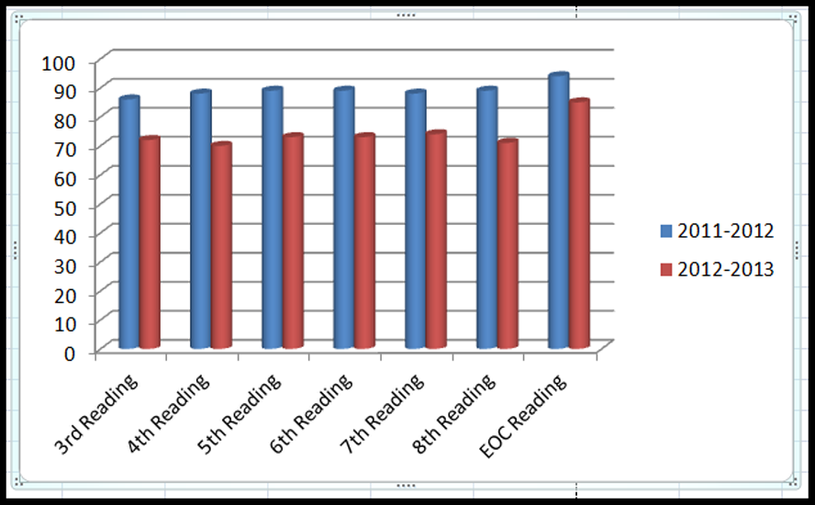
SOL Reading Scores

Slide 21
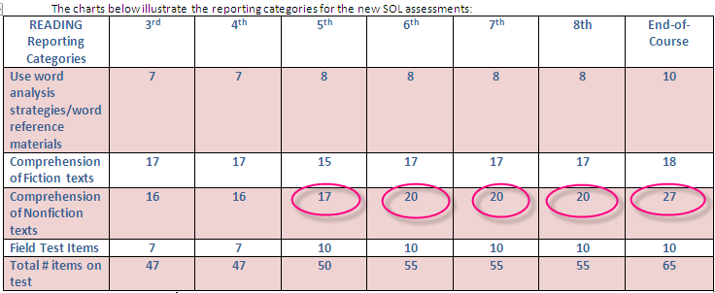
4-12 Reading Blueprints

Slide 22
Reading
Fiction and Nonfiction
Standards at each grade address reading fiction and nonfiction
Nonfiction emphasizes text structures and organizational patterns
Both emphasize making inferences and drawing conclusions based on explicit and implied information
Differentiate between fact and opinion

Slide 23
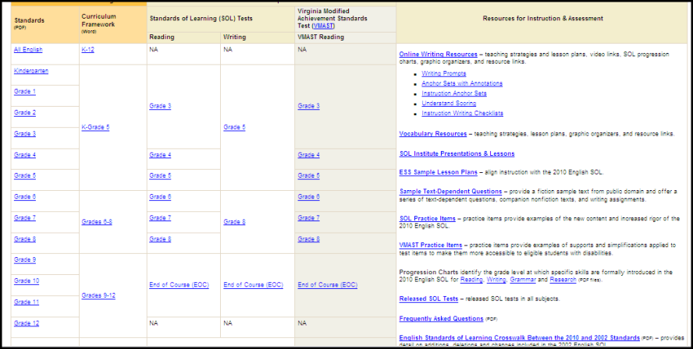
2010 English Standards of Learning
Web Page

Slide 24
Teach Nonfiction Text Features
Boldface
Italics
Color
Captions
Headings & Subheadings
Graphics

Slide 25
Teach Nonfiction Reading Strategies
Organizational Patterns
Chronological or Sequential
Comparison – Contrast
Cause – Effect
Problem – Solution
Generalization or Explanation
Enumeration or Listing
Concept – Definition
Process
Spatial Layout
Classification
Order of Importance
Question – Answer
Fact - Opinion

Slide 26
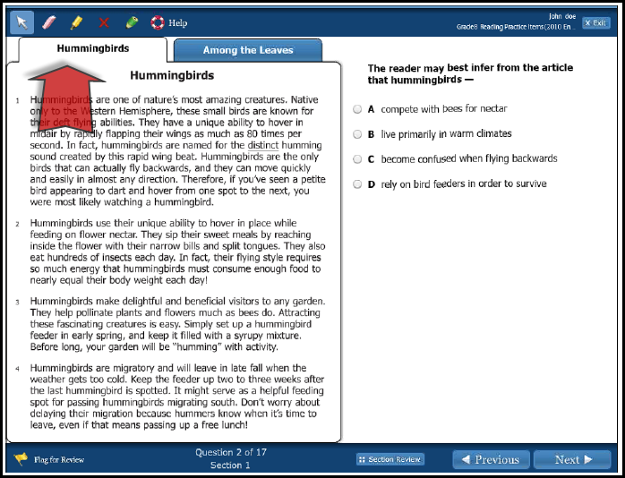
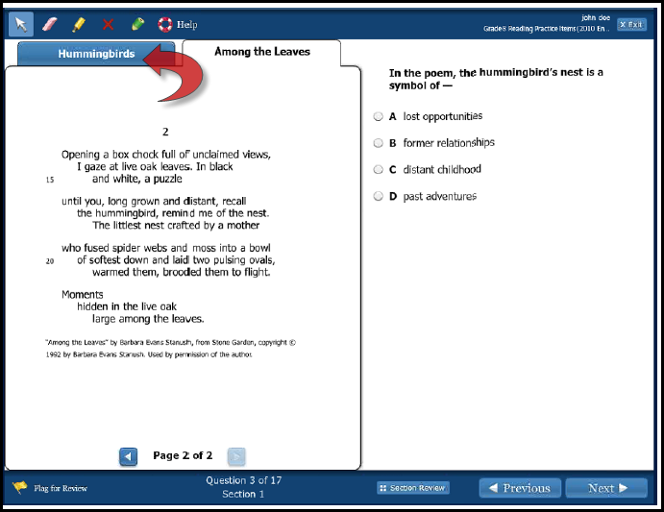
Paired Passages
Pair fiction & nonfiction passages
Tabbed passage demonstration on Sample SOL Item page
Grade 8 Assessment Sample
Paired passages will be on 6-8 & EOC SOL Reading Tests

Slide 27
Text-Dependent Question Samples
Text-Dependent Questions:
Do not ask students about their prior experience or feelings on a subject
Rely on explicit or implied information from the text

Slide 28
Text-Dependent Questioning
The Student Should Ask… | The Teacher Should Ask…
Am I going back to the text to find evidence to support my response(s)? Am I attempting to engage with the author and with what the author is trying to say? Am I becoming aware of when I no longer understand what I am reading, and what might be causing me difficulty? | Am I facilitating conversations with students that are dependent on the text? Am I asking questions that require students to find evidence in the text? Am I keeping students in the text? Am I reminding students to apply reading strategies when reading challenging texts?

Slide 29
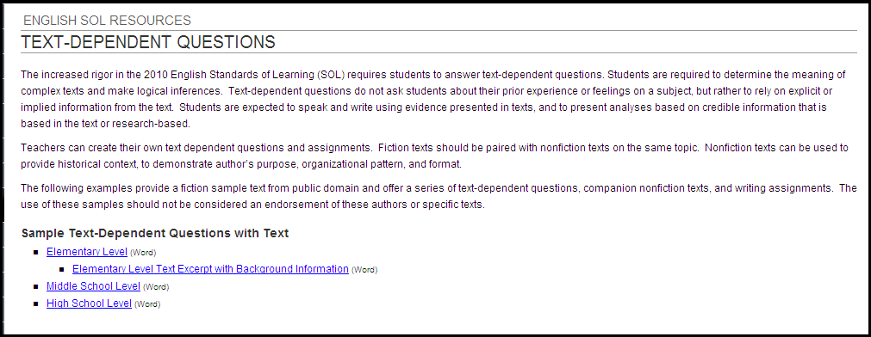
Text-Dependent Questions
Pair fiction passages with nonfiction
Ask text-dependent questions
Put content reading passages on assessments

Slide 30
Integrate Reading, Writing & Research
Text-Dependent Questions
Middle School- The Monkey’s Paw
One theme of The Monkey’s Paw revolves around greed. Read or watch the speech on greed from the movie Wall Street. Draw a Venn diagram to compare and contrast the ideas presented in the short story and the speech.
Research examples in history, life, or literature of people for whom greed or money gain caused them to change. Using the information from the research, write a persuasive essay supporting your opinion of whether money gain/greed is good or bad.

Slide 31
Integrate Reading and Writing
Text-Dependent Questions
High School – Occurrence at Owl Creek Bridge
Read the top 10 arguments on pro or con for the death penalty on Death Penalty ProCon.org Choose a position on the death penalty. Write a persuasive essay arguing your side. Support your opinion and provide counterarguments using facts and court cases from the information on this Web site.
Take on the role of Farquhar’s defense or prosecuting attorney. Research your case based on the text and facts listed on the death penalty pro/con Web site. Prepare and present your closing argument for the jury summarizing your case and arguing against your opponent.

Slide 32
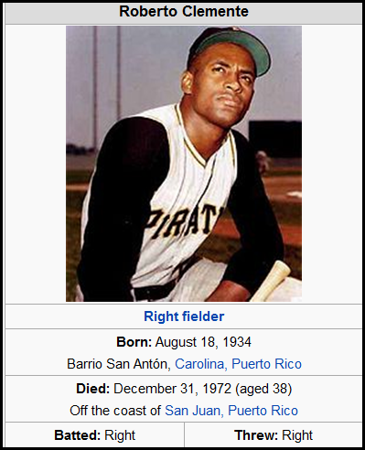
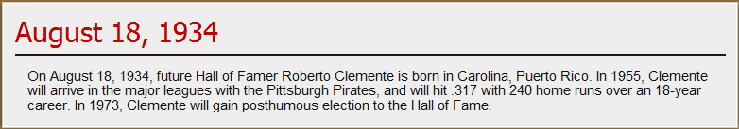
Practice with Text-dependent Questions
He had no money for a baseball bat, so he make one from a guava tree branch. His first glove he also o made, from the cloth of a coffee bean sack. His first baseball field was muddy and crowded with palm trees.
For batting practice, he used empty soup can and hit them farther than anyone else. Soup cans turned into softballs. Softballs turned into baseballs. Little League turned into minor league turned into winter league: professional league baseball in Puerto Rico.
http://baseballhall.org/search/node/Roberto%2520Clemente

Slide 33



Text-Dependent Questions
1. Poetry 2. Newspaper column 3. Informational government Web site

Slide 34
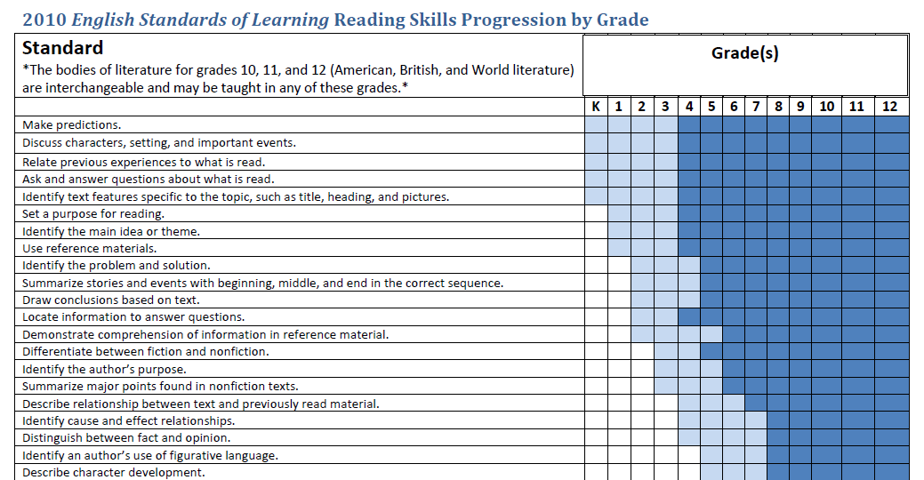
SOL Progression Chart:
Reading

Slide 35
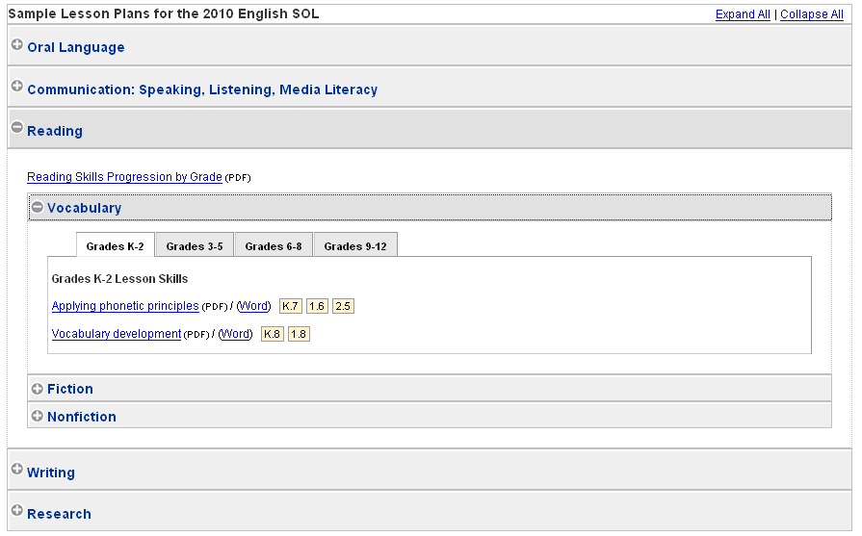
Enhanced Scope and Sequence

Slide 36
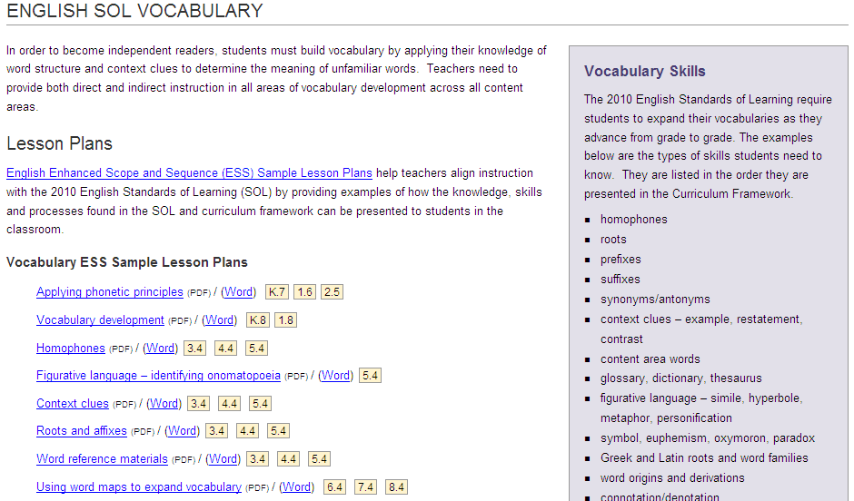
Vocabulary Web Page

Slide 37
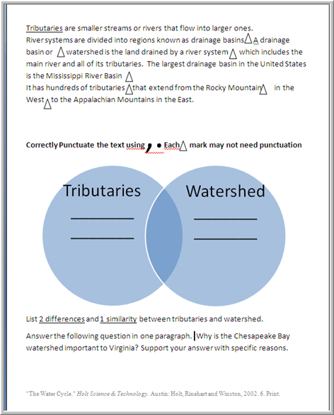
Use of Content Texts
Use content text books to create:
  nonfiction paired passages
  reading comprehension questions
  vocabulary questions
  usage/mechanics questions
  constructed response questions
Create TEI “thinking-enhanced questions”

Slide 38

Focus on Writing

Slide 39
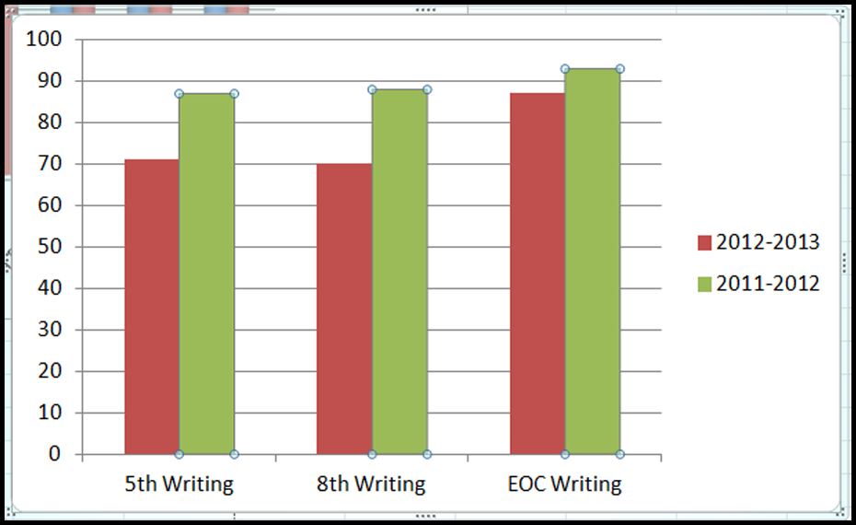
SOL Writing Scores

Slide 40
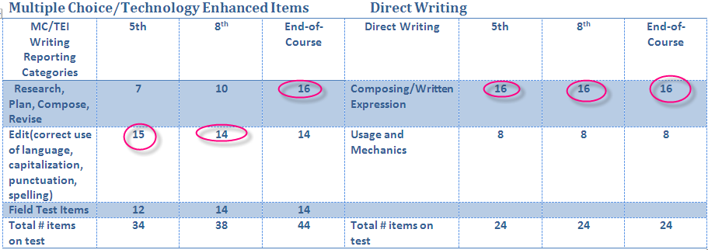
SOL Writing Blueprints

Slide 41
Writing Instruction
Teach Writing~ DO NOT Assign It!
Teaching writing is an expectation of EVERY grade, not only tested grades
Each grade has 2 Writing Standards:
  Composing & Revising
  Editing
Emphasize persuasive and analytical writing

Slide 42
Writing Instruction
Focus on purpose and audience
Teach peer revision/editing
  Putting students in groups is NOT teaching peer editing
  Do incorporate writing into every lesson
  Do use writing portfolios
  Do conference with students
  Don’t grade every writing assignment
  Don’t correct every U/M error in student papers

Slide 43
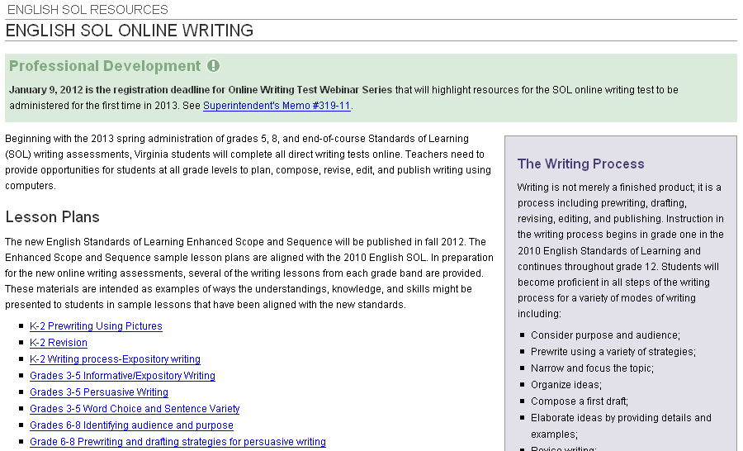
Online Writing Web Page

Slide 44
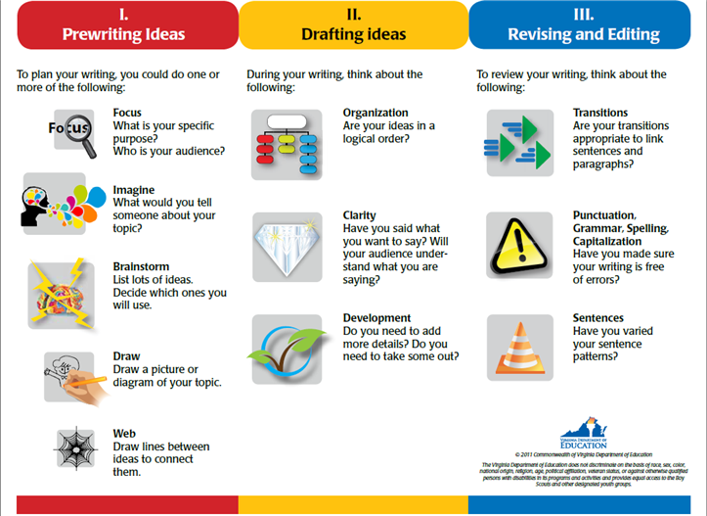
Writing Process

Slide 45
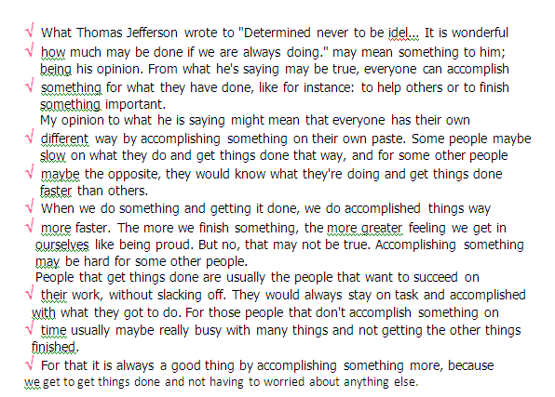
Writing Instruction

Slide 46
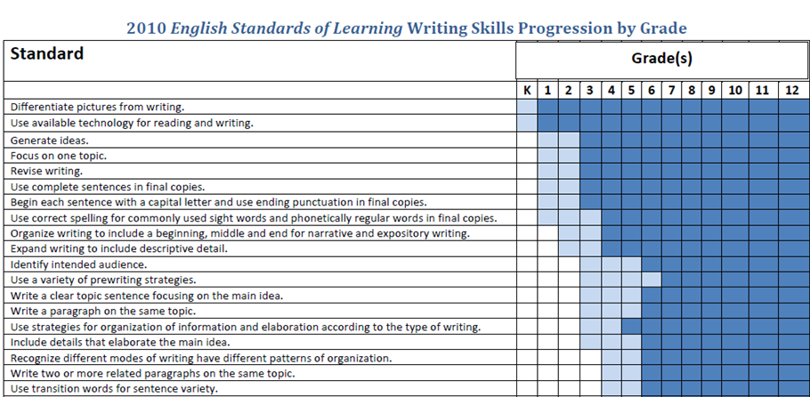
SOL Progression Charts
Writing

Slide 47
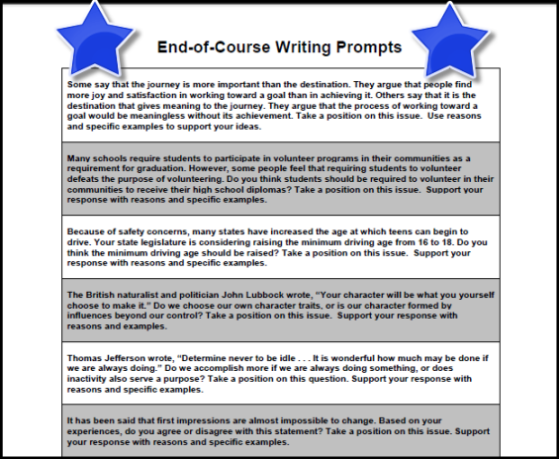
Writing Prompts Released

Slide 48
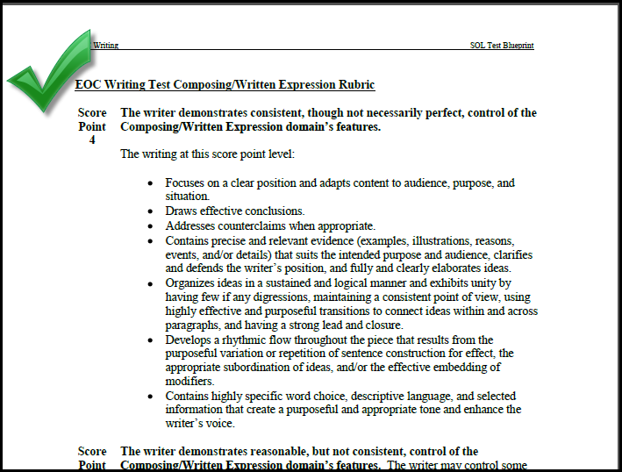
Writing Rubrics

Slide 49
Scoring with the SOL Writing Rubric
All student papers are read by two readers; their scores are added together
Composing/Written Expression score counts twice = 2/3
Usage/Mechanics score counts once = 1/3
If judges scores are more than 1 point apart, papers are read by a third judge

Slide 50
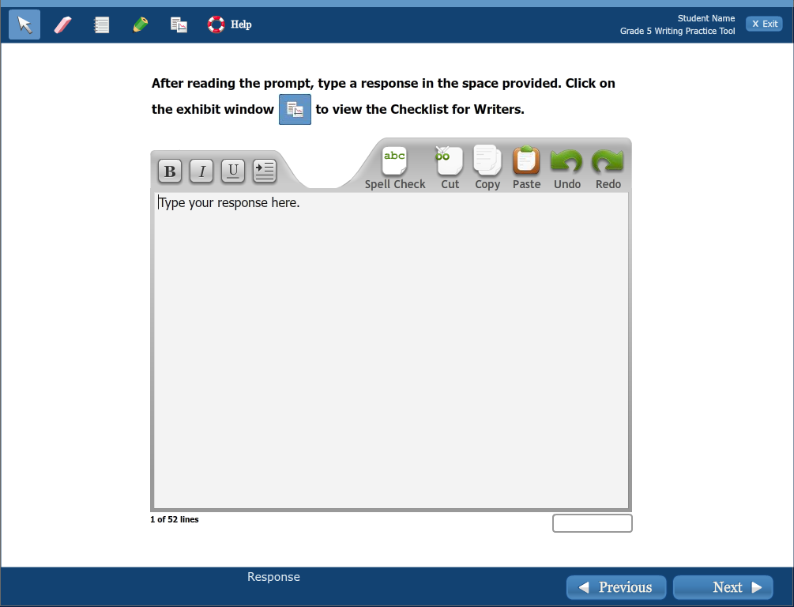
Online Writing Practice Tool
Typing Tools
Typing Tools
Current Line Location
Progress Bar

Slide 51
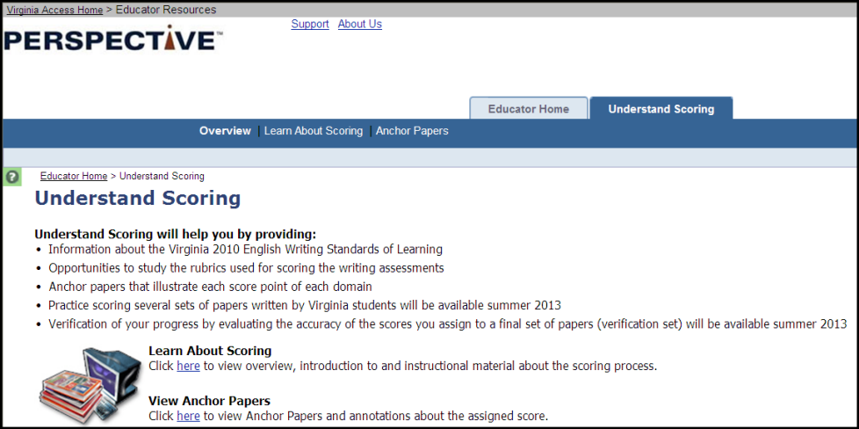
Understand Scoring

Slide 52
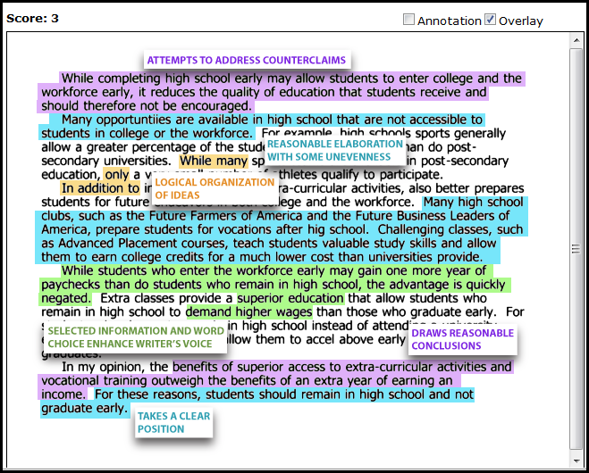
Understand Scoring
2 practice sets and 2 verifications sets now available
Use Keyword “Virginia” to create an account

Slide 53
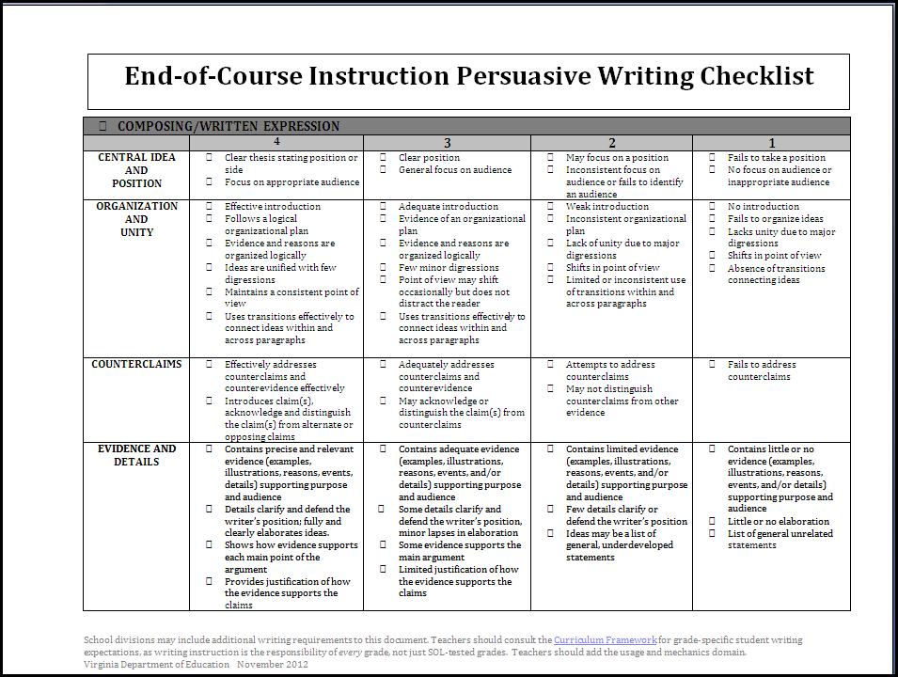
Instruction Writing Checklists

Slide 54
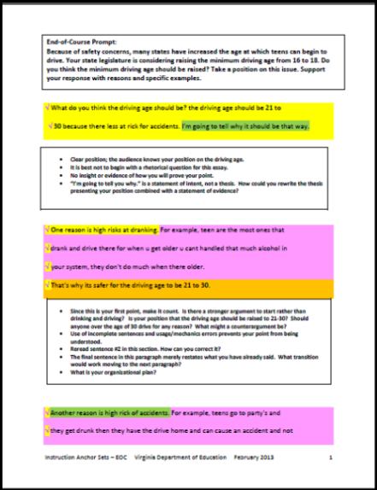
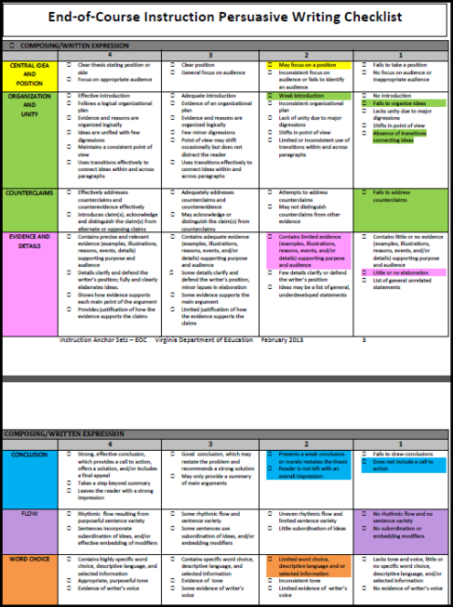
Instruction Anchor Sets

Slide 55
Writing to Learn
The reading journal
Generic and focused summaries
Annotations
Response papers
Synthesis papers
Discussion starter
Focused discussion
Learning log
Analyzing the process
Problem statement
Solving real problems
Pre-test warm-ups
Letters
What counts as a fact?
Believing and doubting
Analysis of events
Project notebooks
Writing journal
Freewriting & Focused Freewriting
Entry Slips/Exit Slips
Reader-Response Writing
Sentence/Passage Springboard
Writing Definitions to Empower the Student
Student-Formulated Questions
Summary
Group Writing Activities
Microthemes
Answer the Question!
Clarification/Review Letters
The National Writing Project
http://www.nwp.org/cs/public/print/resource_topic/teaching_writing

Slide 56


Persuasive Writing
The National Writing Project
http://nwp.org

Slide 57

Teacher Direct

Slide 58

Teacher Direct Library

Slide 59
2013-2014 SOL Testing Schedule
Fall Writing (EOC) – October 21- November 8
Fall- EOC Reading – December 2- February 28, 2014
Spring Writing – March 3-April 4, 2014
Spring – SOL Reading -April 14 - June 27

Slide 60

Create Your Legacy
http://www.youtube.com/watch?v=d3t-Rldgzc4

Slide 61

Contact Information
  Tracy Fair Robertson
English Coordinator
Tracy.Robertson@doe.virginia.gov
804-371-7585
Assessment Office
Student_assessment@doe.virginia.gov
804-225-2102
Virginia Department of Education

