Slide 1
School Counselors Taking the Lead
Virginia School Counseling Leadership Summit 2018
Notes:
Thank you! I am Liz Parker, Coordinator of School Counseling Programs in Williamsburg-James City County Public Schools and Chair of the Virginia School Counselor Association (VSCA) Board of Directors!
VSCA was founded 56 years ago and today, we have over 1,400 members throughout the state of VA (800 of which will be joining us in Hampton tomorrow for our largest annual conference to date!). We actively work with VA’s school counselors with a clear focus in mind: To Educate, Advocate, Collaborate and Empower.
Most recently, VSCA’s voice has been heard across the Commonwealth, as we have been working hand-in-hand with federal and state lawmakers, as well as educational leaders like yourselves, to communicate how schools counselors can directly impact student achievement, close achievement gaps, promote college and career readiness, and create safe, healthy, inclusive, and secure school environments.
I’d like to take a few minutes this morning to share the messages VSCA has been communicating, and will continue to communicate, to those in power who have the ability enact real change for Virginia’s students.

Slide 2
Notes:
First and foremost, VSCA continue to address why the use of the term “school counselor” over “guidance counselor” is critically important. While many of our legislatures and state leaders have had their own personal experiences with guidance counselors, we know the profession has drastically evolved in recent decades and the role of the school counselors has expanded in regards to education, training, and psycho-social and mental/behavioral health services available to students.

Slide 3
It’s more than a name change…
Guidance Counselor
School Counselor
Teachers inherited position or took limited number of additional classes for counseling certification
Hold a Master’s Degree or higher in Counseling (48-60 graduate credit hours)
Meet VA Board of Counseling’s degree requirements for Licensed Professional Counselors (LPC)
Exceed VA’s educational requirement of Qualified Mental Health Professionals (QMHP-C) working with children and adolescents
SB1117- Mandatory training in the recognition of mental health disorder and behavioral distress, including depression, trauma, violence, youth suicide, and substance abuse.
Notes:
Simply put…it is MUCH more than a name change.
VSCA is working to make sure that lawmakers and state leaders understand the amount of professional preparation and clinical experience now required to be a school counselor in the state of VA.
We are clearly communicating that VA’s School Counselors hold a Master’s Degree or higher in Counseling…
That the degree requirements to become a school counselor in Virginia meet the VA Board of Counseling degree requirements for Licensed Professional Counselors (LPCs)
And, importantly, that school counseling degree requirements FAR EXCEED the educational requirements of Qualified Mental Health Professionals working with children and adolescents- Those are often the folks who come in to our buildings to provide TDT programs to our students, while our much more credentialed and qualified school counselors are scheduling, coordinating tests, and often performing other administrative or non-counseling tasks.

Slide 4
It’s more than a name change…
Guidance Counselor
School Counselor
Vocational movement- Occupational assessment, employment services, assist students in planning for future employment or college
Provided a reactive service for some students
Pointed students in a productive direction and provide “quick fix” to problems
Academic Achievement, College & Career Readiness, Social/Emotional Development and Mental/Behavioral Health
Provides a comprehensive program, driven by data that includes 8 different delivery methods of counseling services to all students
Provides education, prevention, early identification, and intervention/crisis response services to all students
Notes:
Additionally, VSCA is working to educate those in leadership positions about what today’s comprehensive school counseling programs could and should look like. While today’s programs absolutely address academic and career development, they also place a much larger focus on Prevention by addressing communication and coping skills, mental health and wellness, suicide prevention, healthy relationships, and more.
Additionally, VSCA believes it is important to show those in leadership positions the connection between school counseling and school safety. Often policy makers are surprised to learn that:
School counselors are trained to identify early signs of depression, social isolation, aggressive and antisocial behaviors, which can be pre-determinants to a school shooter mindset.
They are also surprised to learn that schools are often the first place where mental health crises and needs of students are recognized and formally addressed
And that School counselors may be the only counseling professionals VA families have access to in their geographic region

Slide 5
Today’s students
1 in 4 children have been exposed to a traumatic event that can affect learning and/or behavior.
1 in 5 children from birth to 18 years has a diagnosable mental disorder.
Onset of mental illness may occur as early as 7-11 years old, and half begin by age 14
Suicide is the second leading cause of death for ages 10-24
Children who struggle with mental health may miss copious amounts of school, and their rates of suspension and expulsion are 3x higher than children without a mental health concern or illness.
Of school-aged children who receive any behavioral or mental health services, 70-80% of them receive them only at school.
Student’s unmet mental health needs pose barriers to development, learning, and compromise school safety.
Notes:
And as we know, the role of the school counselor has evolved because the needs of students have evolved.
These statistics illustrate the reality for many of today’s children and schools. VSCA works continuously to provide different professional development opportunities and trainings so that VA’s school counselors are equipped to provide interventions and services to students who are bringing with them much more than their backpack to school each day.

Slide 6
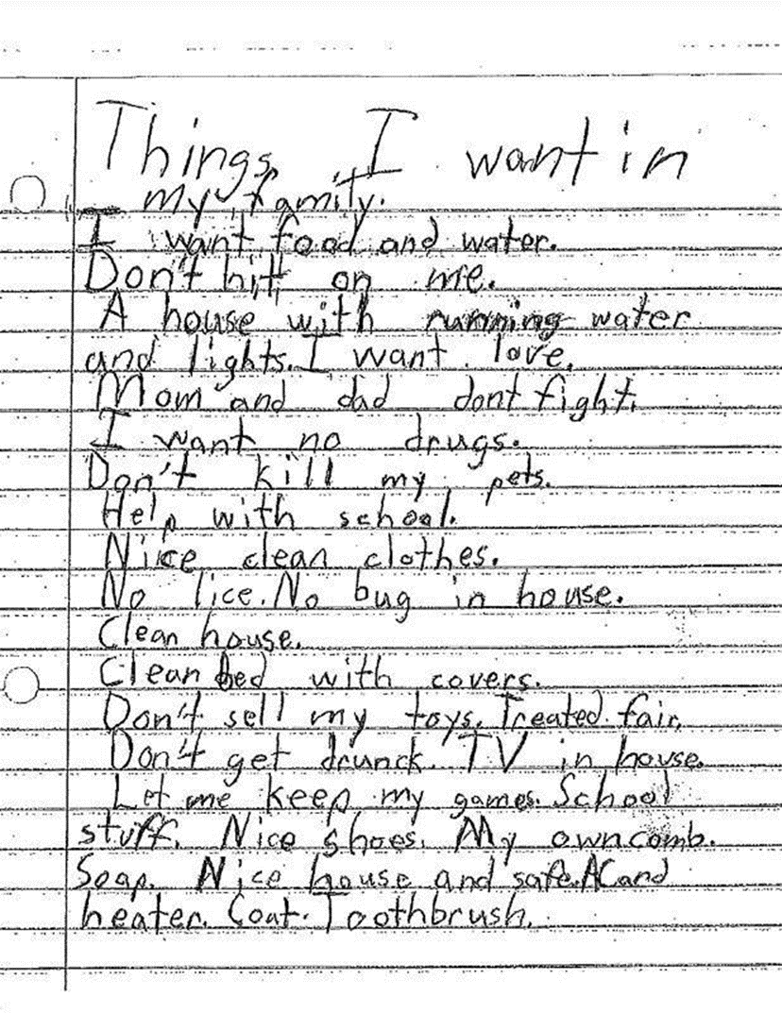
Notes:
We also work to humanize these statistics by providing opportunities for school counselors to share testimonials and experiences directly with lawmakers and state leaders.
One of these opportunities is our annual Legislative Day, which will take place on January 9th of this year and will be critically important as we work to encourage the full legislation to support recommendations specific to school counseling from the House Select Committee on School Safety and the Governor’s Children’s Cabinet Workgroup on Student Safety.

Slide 7
School Counseling Services
DIRECT COUNSEILNG
Counseling Curriculum
Small Group Counseling
Individual Counseling
Crisis Response
Individual Student Planning
Consultation
Collaboration
Referral
Notes:
Additionally, VSCA is using multiple pathways to clearly define for lawmakers and state leaders exactly what DIRECT COUNSELING SERVICES are, and what they are not.
Many don’t know that school counselors are trained to provide counseling services through these 8 different types of delivery methods- in fact, many students in divisions and districts across the state are only able to access one or two of these services as a result of the other duties and tasks that counselors are performing.
VSCA is working to clearly define these services because we know that, by providing direct services that include individual and small group counseling session, as well as teaching preventative, evidence-based classroom lessons dealing with conflict resolution, bullying prevention, self-regulation, personal responsibility, frustration tolerance and more, school counselors have the ability to significantly impact the lives of all students, including students who have become disengaged and disenfranchised.

Slide 8
School Counseling Get Results
Schools with lower school counselor to student ratios had statistically significant lower rates of student suspensions and fewer disciplinary incidents (Lapan, Whitcomb, & Aleman, 2012)
Students with access to school counselors and comprehensive school counseling programs are more likely to achieve academically and behaviorally; particularly students in high-poverty schools (Lapan, Gysbers, Bragg, & Pierce, 2012)
A comprehensive school counseling program in every elementary, middle, and high school is a necessary component of any effort directed at school safety (Nims, 2000)
Students in schools with more fully implemented school counseling programs had a more positive perception of school climate and safety within their school (Lapan, Gysbers, & Petroski, 2001).
School counselors can be catalysts for identifying students with depression and suicidal thoughts (Erickson & Abel, 2013)
Notes:
And we can prove it! This is just a very small sampling of the vast amount of research and empirical evidence that we share with legislatures, the media, and leaders in education that illustrates the effectiveness of school counseling interventions.

Slide 9
Increase student access to school counselors
Utilize school counseling staff appropriately
Notes:
Finally, VSCA is focused on communicating a clear and simple message to federal and state lawmakers as well as educational leaders this year.
Increasing student access to school counselors & utilizing school counseling staff appropriately allows students to receive academic and career development interventions along with psychosocial counseling and mental/behavioral health supports while ensuring that schools remain educational (rather than clinical) settings.

Slide 10
Recommendations
Standards of Quality Revision (§ 22.1-253.13:2. Standard 2. Instructional, administrative, and support personnel)
K. Local school boards shall employ one full-time equivalent school counselor position per 250 students, with no caseload being larger than 300 in grades kindergarten through 12.
Standards of Accreditation Revision (8VAC20-131-240. Administrative and Support Staff; Staffing Requirements)
D. The counseling program for elementary, middle, and secondary schools shall provide a minimum of 80% of the time for each member of the school counseling staff devoted to the delivery of direct counseling services to students.
Notes:
With all of that in mind, VSCA has made two very specific asks of state lawmakers and will continues to work with members of the General Assembly to prepare for the upcoming legislative session with these two recommendations in mind.
Specifically, we ask the GA to adopt proposals by the VBOE to amend VA SOQ’s and establish higher staffing standards for school counselors as indicated in the slide.
Both the American School Counselor Association and Virginia’s Board of Education recommend a 1:250 school counselor-to-student ratio, and the impact of such a ratio is widely addressed in research and studies and supported by empirical evidence. Virginia’s Board of Education reviewed the current Standards of Quality and presented this proposed revision to the Governor and General Assembly in 2017.
A recently released report by The Commonwealth Institute for Fiscal Analysis and the Legal Aide Justice Center found that staffing in VA’s schools falls far short of recommended benchmarks for school counselors. The number of school counselors has decreased significantly over the past decade and school counselor caseloads have increased nearly 30% on average, while for some that increase is significantly higher (2007-2008=300, 2015-2016=385).
Additionally, VSCA asks for a revision to the Standards of Accreditation that increase the percentage of time a school counselor is required to spend counseling students to 80% and clearly defines these as the delivery of direct counseling services to students.
Alarmingly, language in the current SOA requires that school counselors spend only a little more than half of their time counseling students (60%), which directly impedes student access to counseling services.
Of equal importance is the lack of a clearly defined role of the school counselor that emphasizes direct service to students. Without this, the role of the school counselor is often misunderstood or not properly recognized by local school divisions or school administrators, who often assign counselors administrative duties such as test coordination, scheduling, supervising classrooms or common areas, data entry, cafeteria and bus duty, etc.
With these two changes, we believe that Virginia’s school counselors could use their extensive training to best support the academic and career development, and social/emotional and mental health of all students. VSCA is shouting this message from the rooftops…

Slide 11
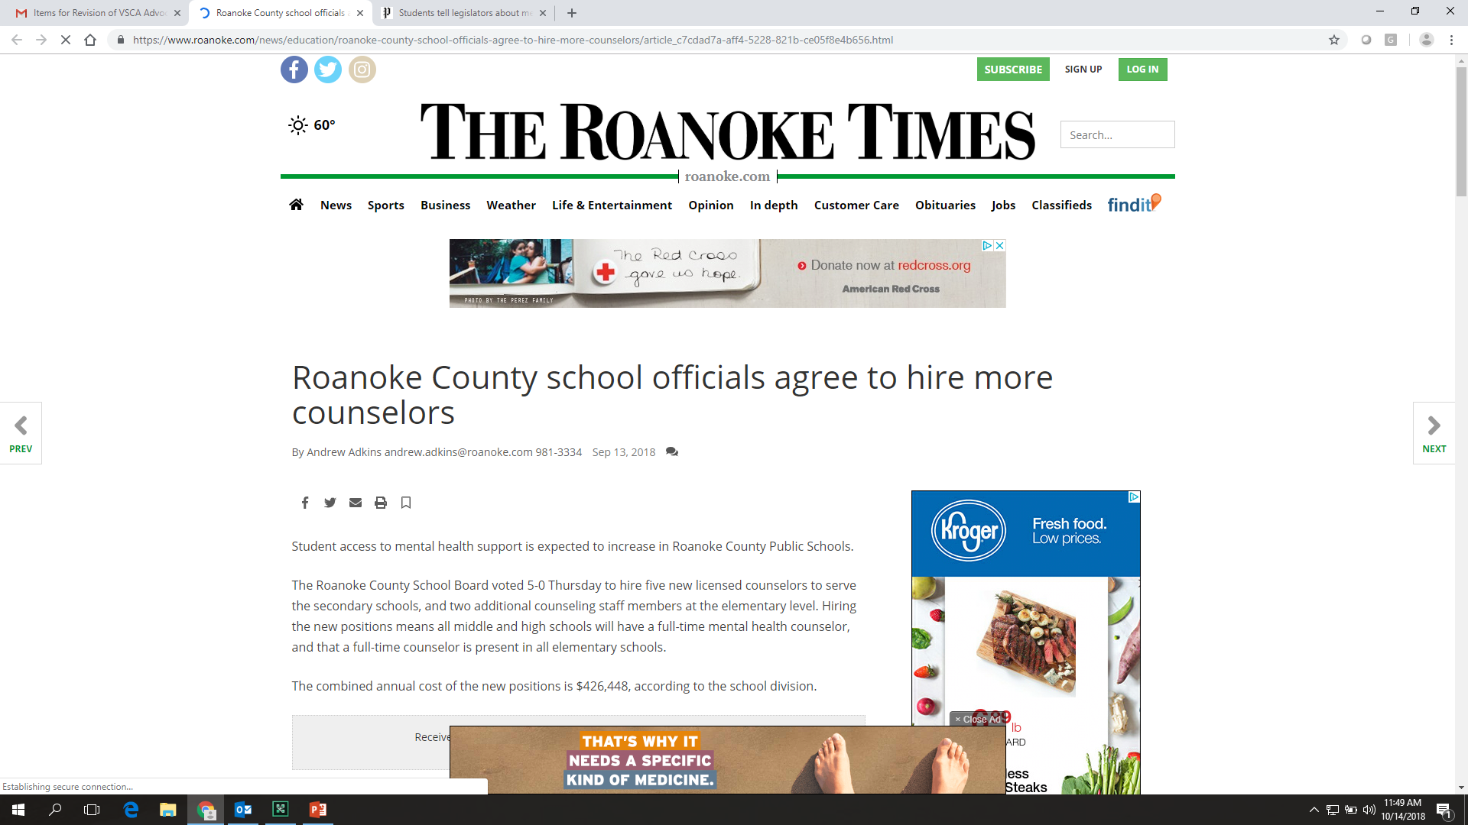
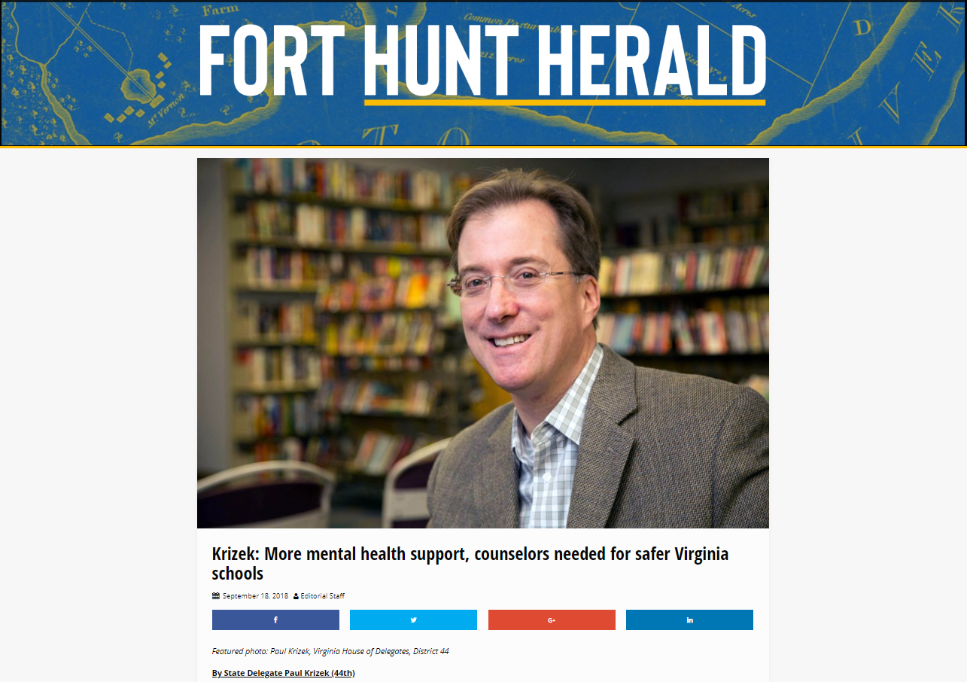
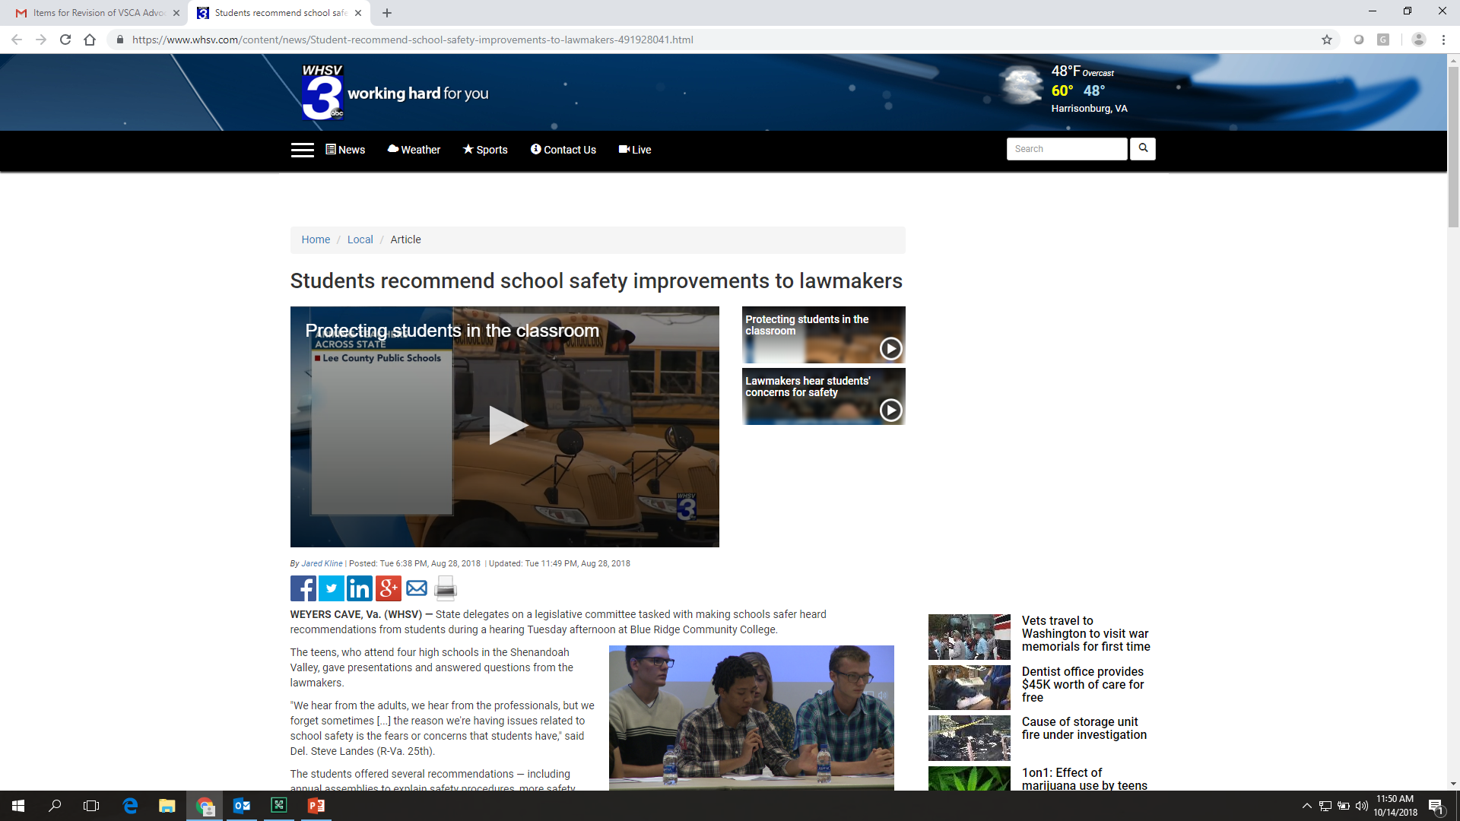
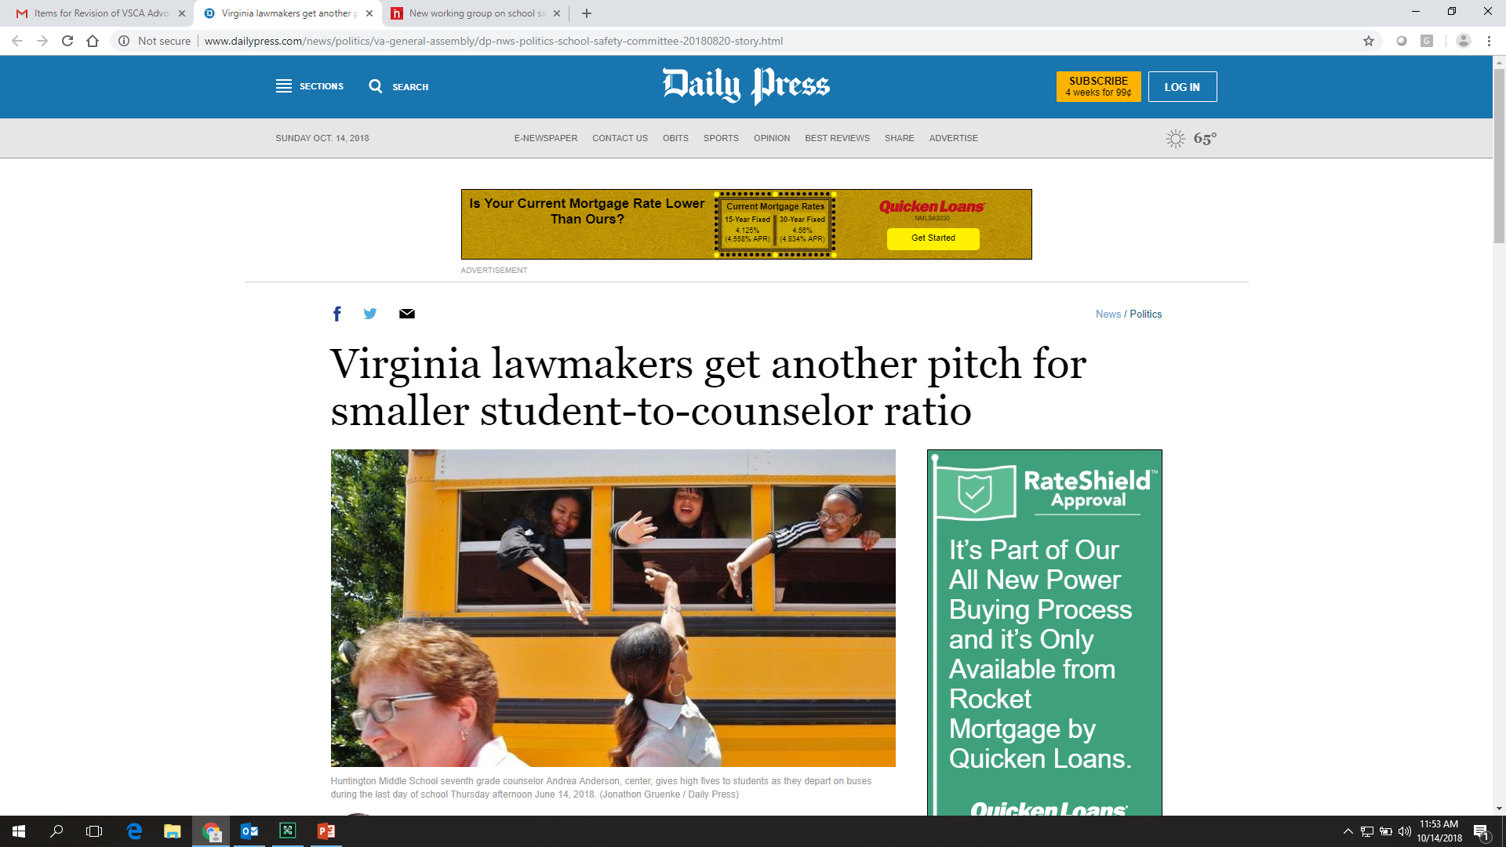
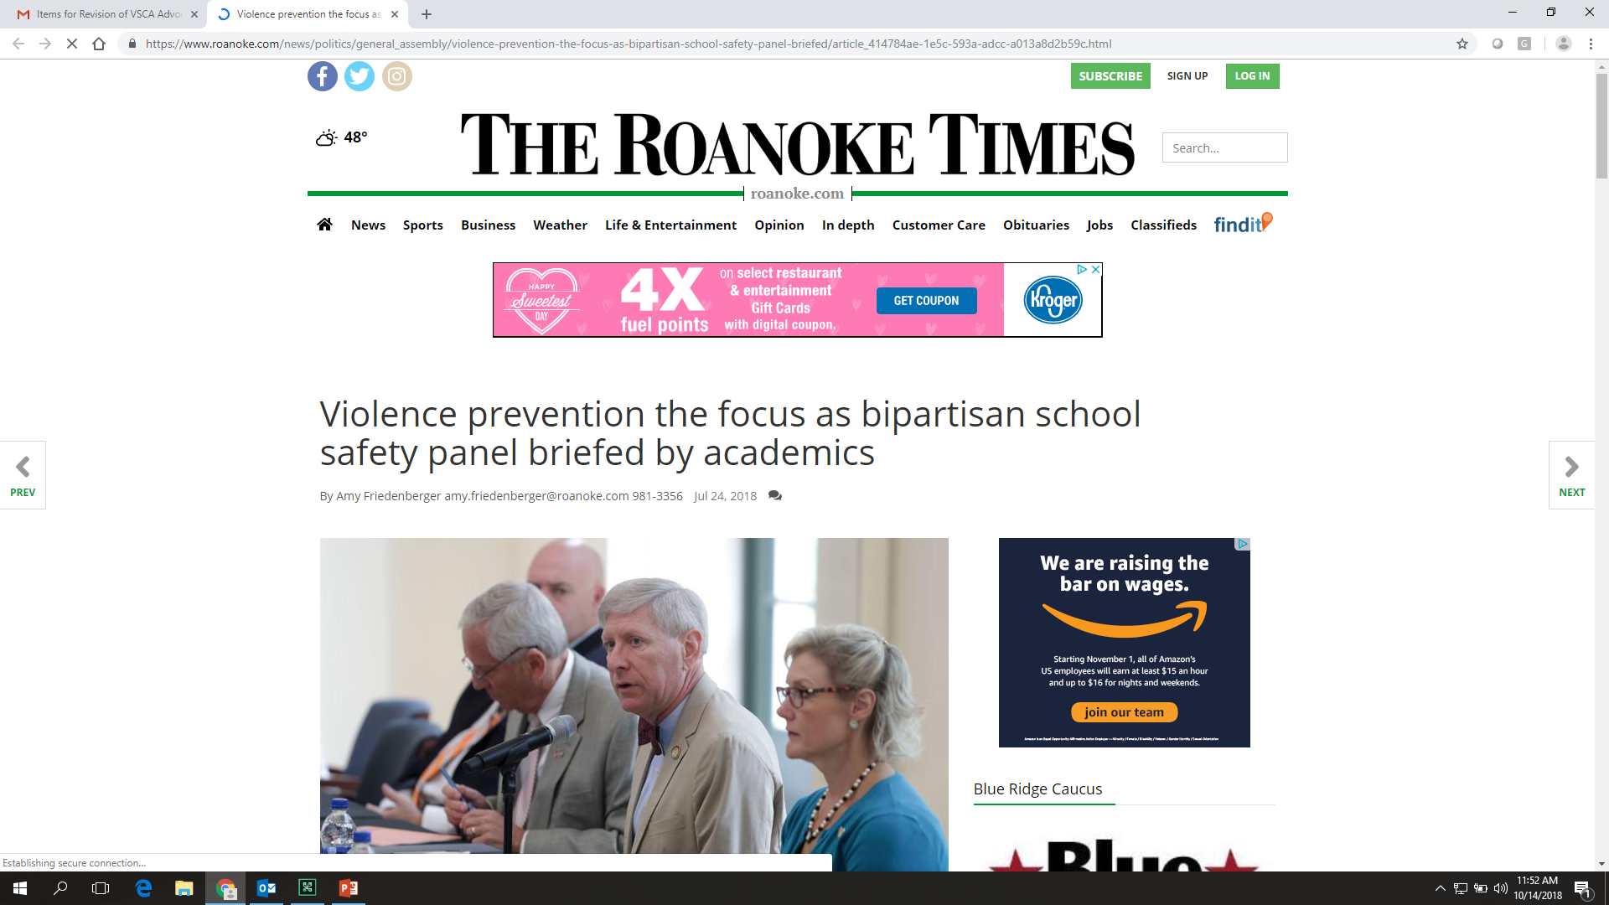
Notes:
And this year, people are listening! We have made significant progress in inserting school counseling into the many different conversations going on about education and school safety. We look forward to continuing to work collaboratively with the VDOE and state lawmakers to simply increase student access to school counseling services.
VSCA is thrilled to be a part of the important work happening here today. We believe that, together, we can continue to strengthen the voice of school counselor and provide students with the academic, career, and social/emotional support they need to experience success in school and in life. Thank you!

