Slide 1
Master Schedule Collection
2022-2023

Slide 2

Agenda
Reporting Regional Centers & Private Day Schools
New Data Element & Edits for 2022-23
Reporting Scenarios
Reporting Timeline

Slide 3
Regional Centers
Full and part-time Governor’s Schools, CTE, STEM and STEM-H programs will report MSC data to VDOE in the 2022-23 SY.
  Divisions are responsible for reporting all sections taught within their schools. Regional centers will only report sections taught by the regional center.
  If students are scheduled to classes taught by regional center teachers, the regional center must report MSC directly to VDOE.
Alternative Education and Special Education Centers will report MSC data to VDOE starting in the 2023-24 SY.
  Divisions are responsible for reporting students in alternative and special education centers for the 2022-23 SY.

Slide 4
Private Day Schools
Divisions are responsible for collecting and reporting private day school data.
  Divisions and private day schools should work together to develop a plan for collecting all MSC data needed for the Fall and EOY collections.
  Divisions should provide private day schools enough time to gather the data so reporting deadlines can be met.
Divisions may report zeros for the social security number of any unlicensed private day school teacher. Use 9 zeros and no dashes as the format 000000000
  Edits will exclude any records with a serving division of 600 or 999 from the IPAL and SEDF reports.
Direct private day school questions to Danielle Basham with the Office of Facilities and Family Engagement at Danielle.Basham@doe.virginia.gov

Slide 5
Private Day Schools should report all applicable data elements.
  Report students and teachers with 20 or more instructional hours in a section
    Private Day Schools need to develop a way to track teacher who provide 20 or more hours of instruction and students who receive 20 or more of instruction.
  Fall MSC requires a B record for all Private Day School teachers
    Teacher licensing information or Social Security Number should be reported if possible
    The Division Teaching, Administrative and Pupil Personnel Years 0f Experience data element should be reported as null and the First Year Teacher Flag as Y or N
  Report CTE courses with the correct SCED and minutes when applicable
  The Remote Course Indicator is required for any remote or virtual course
  A Final Grade and Credit Awarded must be reported for courses in grades 6 - 12
  Report Co-op, linking sections and Interdisciplinary Courses when applicable

Slide 6
New Data Element & Edits
Notes:
.

Slide 7
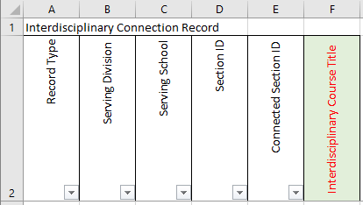
K Record
Interdisciplinary Course Title is a new data element
  The Interdisciplinary Course Title is defined at the local level to distinguish one course created from multiple SCED codes.
  Edit checks
    Must be 50 characters or less
    Must be alphanumeric
    Blanks are permitted

Slide 8
Edits
B Record (Teacher/IPAL)
  Only unlicensed private day school teachers are allowed to report the SSN data element with 9 zeros.
D Record (Sections)
  All sections must report a Teacher Role Code of 1/Teacher of Record or 5/Long Term Sub.
F Record (Student)
  Responsible Division data element.
    Required for all regional programs
    Required for all divisions serving a student outside of their attendance zone
    This will be mandatory for all divisions starting with the 2023-24 SY.
G Record (Administrators)
  The VA Assignment Code 7875 Speech/Language Impairment has been removed since this is reported on the PEC.

Slide 9
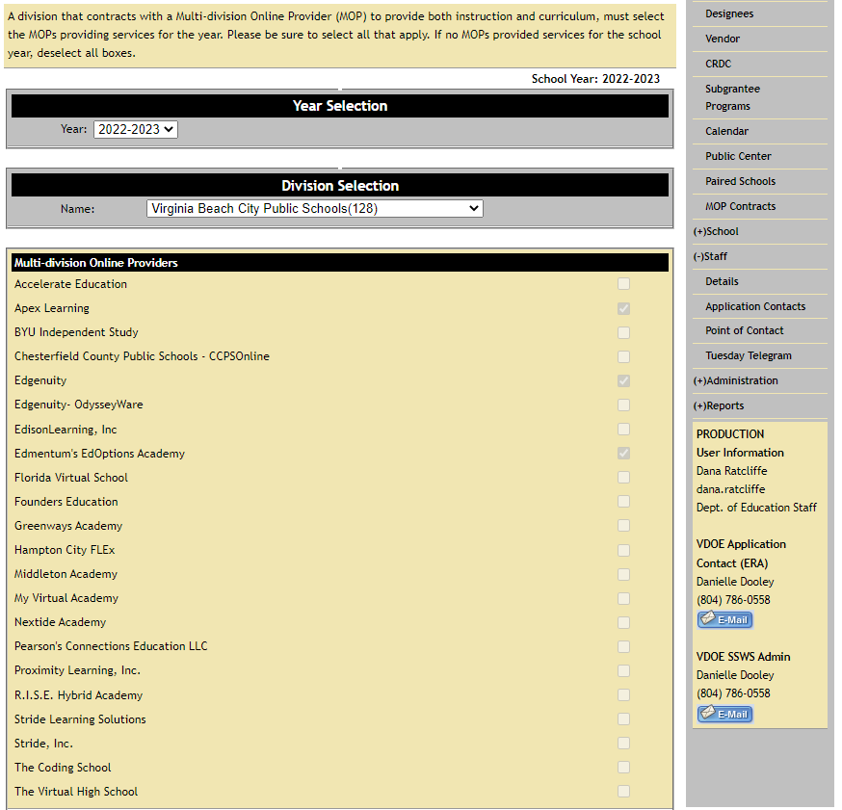
MOP Fatal Error - Division does not participate with the Approved Multi-Online Provider identified in the C Record
  The MOP ID reported in the C record must be consistent with the selected contracted MOPs in the Educational Registry Application (ERA).
  The fatal error is generated when a MOP ID reported doesn’t match the selection in ERA. The same is true for MOP IDs not reported but selected in ERA.

Slide 10
Reporting Scenarios

Slide 11
Scenario 1: Reporting classes with multiple teachers throughout the school year
Mrs. Smith is the teacher of record on Oct 1st for a yearlong Journalism I class at Elm HS (0999) in Monroe County (099), but had to resign after 2 month. Since this was a vacant position, Mr. Martin was hired as a long term sub for 3 months. The vacant position was filled by Mrs. Sarver who resigns for health reasons after providing classroom instruction for more than 20 hours. Mr. Hill is the teacher of record on the last day of school after being hired during the 2nd semester..
All 4 teachers should be reported on the EOY MSC since each provided more than 20 hours of classroom instruction.

Slide 12
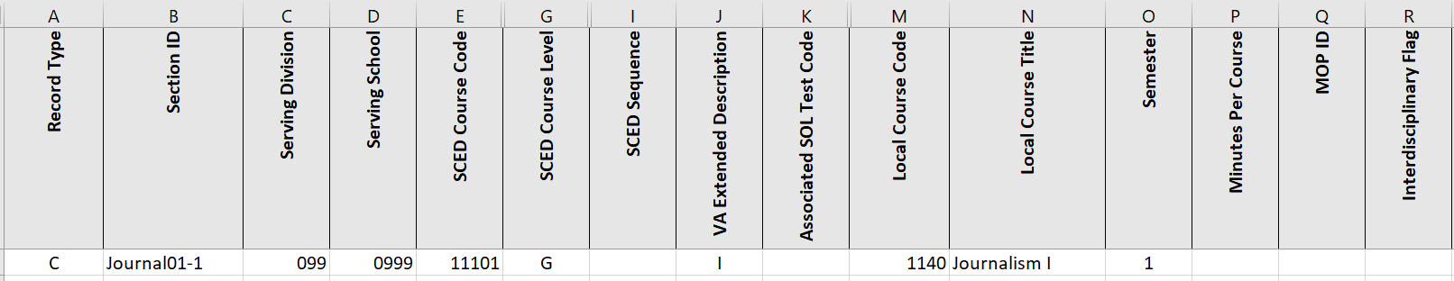
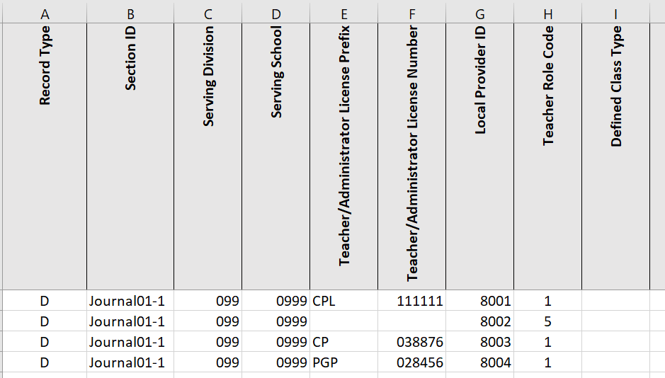
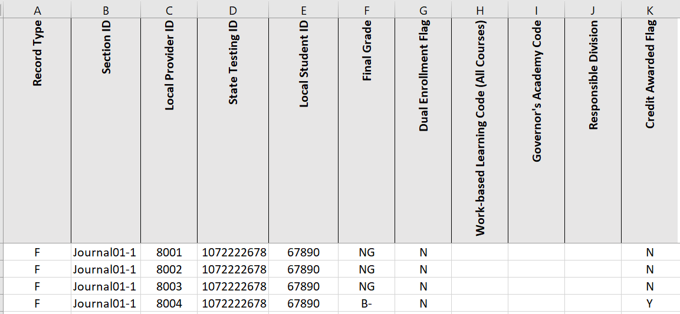
C Record
D Record
F Record

Slide 13
Scenario 2: Unlicensed Private Day School Teacher
Sally Baldwin is enrolled at Elm HS (0999) in Monroe County (099) but attends classes each day at Pathway School (0060), a Private Day School. Sally’s 1st period Computer Math class at Pathway School is taught by Mr. Graham who does not have a valid Va. teaching license.

Slide 14
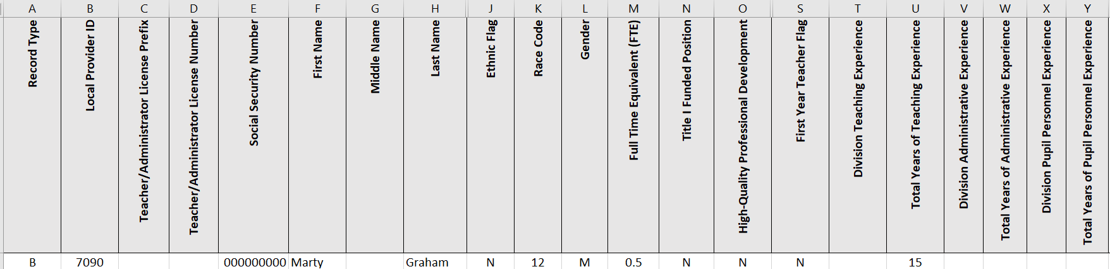
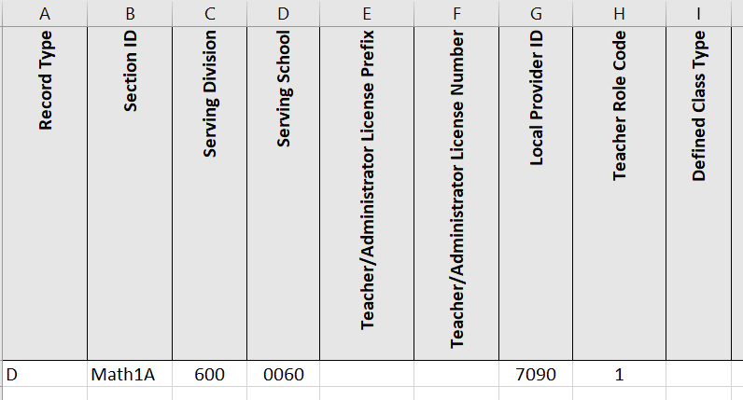
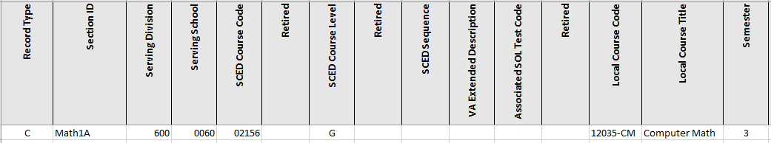
B Record
D Record
C Record

Slide 15
Scenario 3: Reporting a Student in a Partial Day Regional Center
William is transported each morning to Region 12 Governor’s School (0010) located in Hayward County (222) to attend a DE Oceanography class. After the class, William is transported back to Elm HS (0999) in Monroe County (099) to attend a Biology class.
William will be reported on 2 separate MSC file since he attends classes at the Region 12 Governor’s School and Elm HS.
The Region 12 Governor’s School will also need to report the Responsible Division in the F Record.

Slide 16
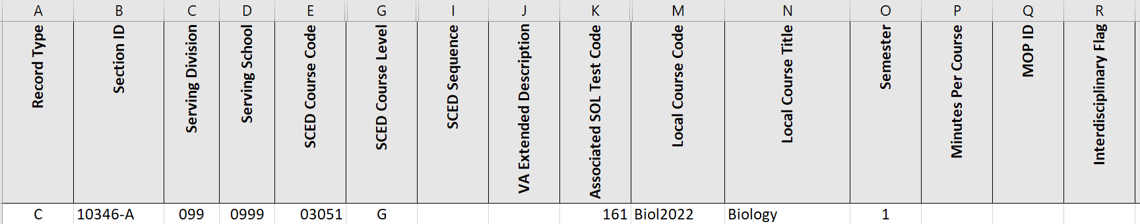
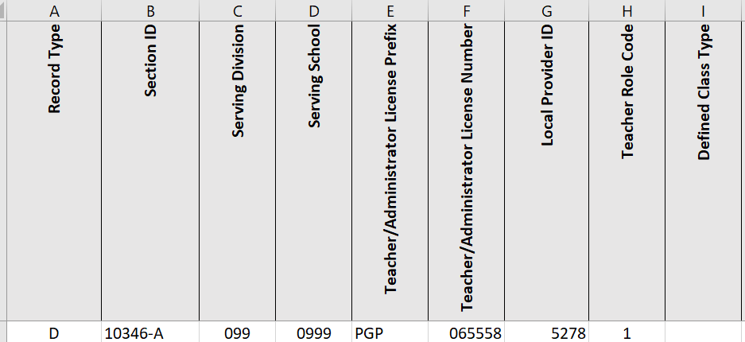
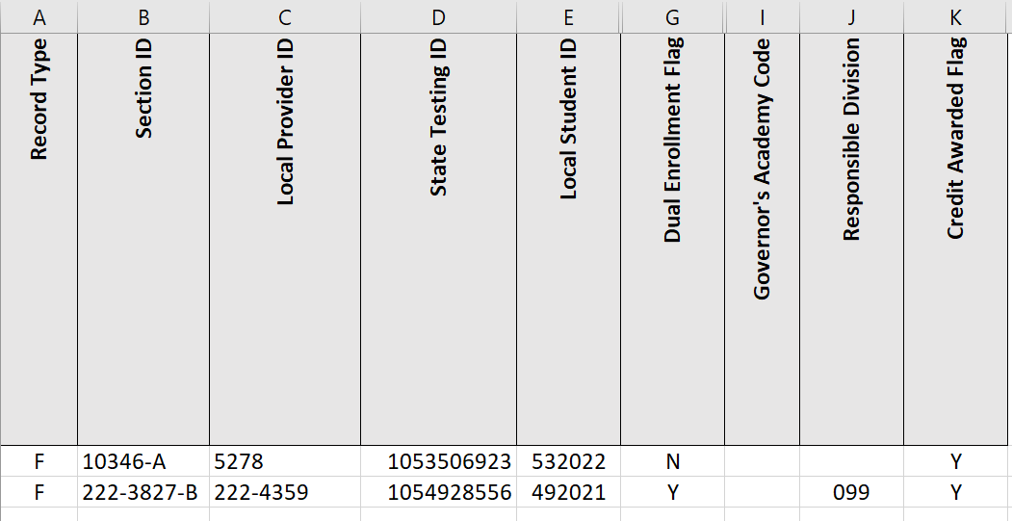
Monroe County Public Schools (099)
C Record
D Record
F Record

Slide 17
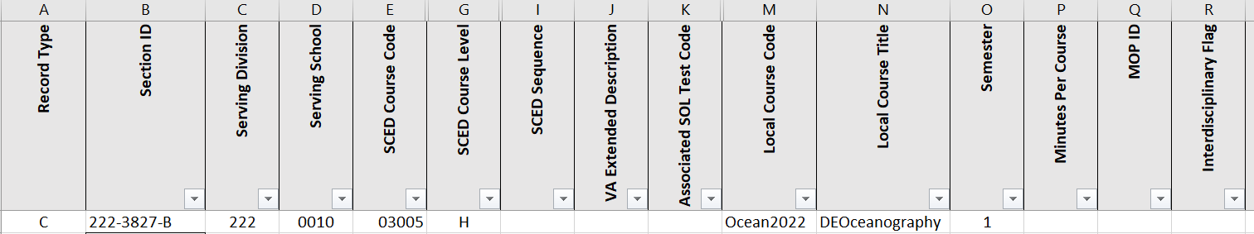
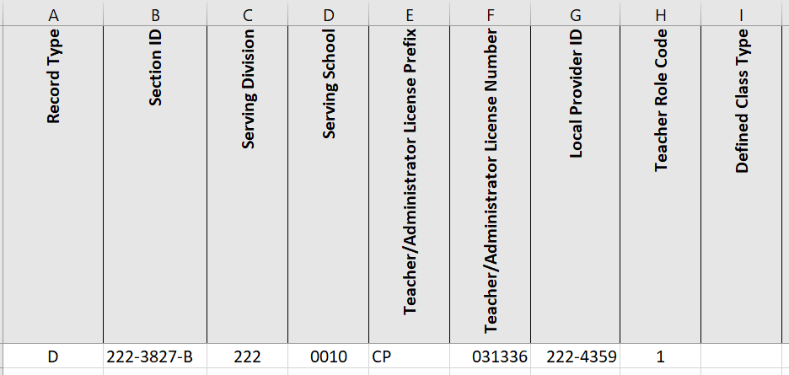
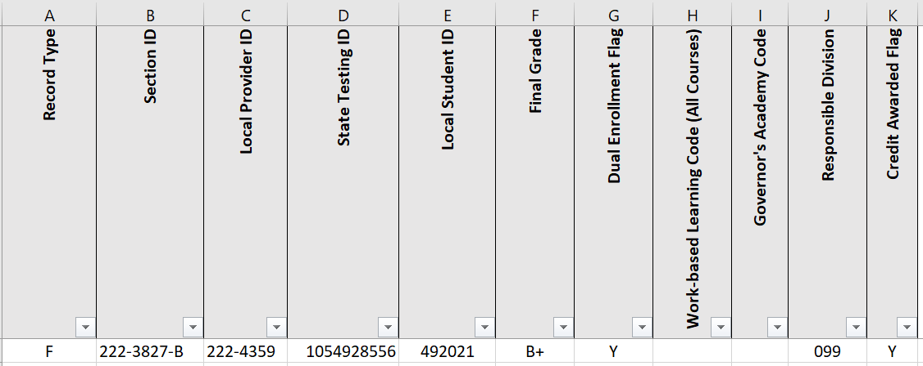
Region 12 Governor School (0010)
C Record
D Record
F Record

Slide 18
Scenario 4: A Student is Served by a Local Regional Center in Another Division
Michael attends a Political Science class each morning at Hayward STEM Academy (0060) in Hayward County (091). He is transported to Elm HS (0999) in Monroe County (099), the responsible division to attend the remaining class on his schedule.
Since the STEM Academy is located in Hayward County, the Political Science course should be included in Hayward County’s MSC along with reporting the Responsible Division. Monroe County will report classes taught within their schools by their teachers.

Slide 19
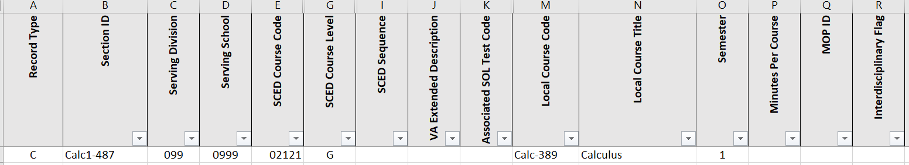
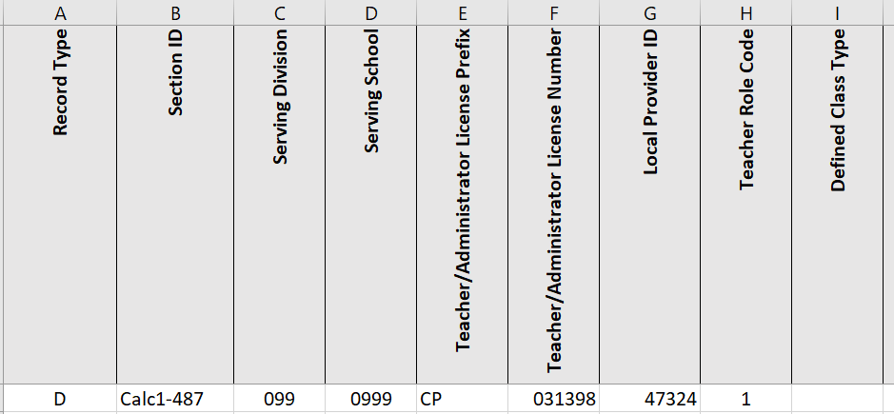
Elm HS (0999) in Monroe County (099)
C Record
D Record

Slide 20
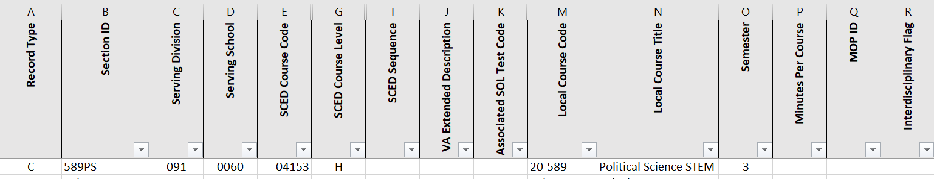
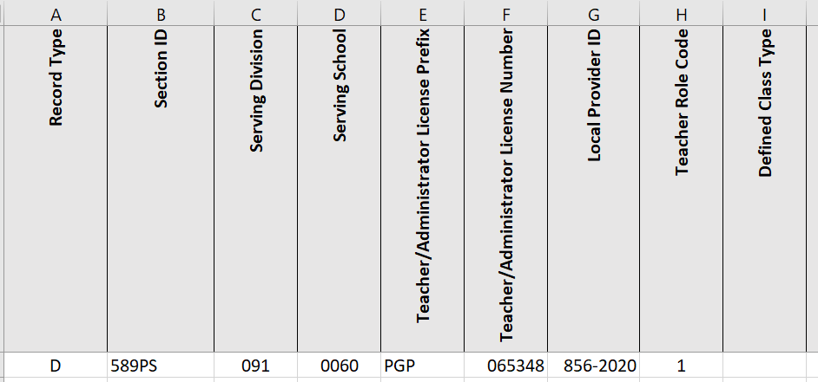
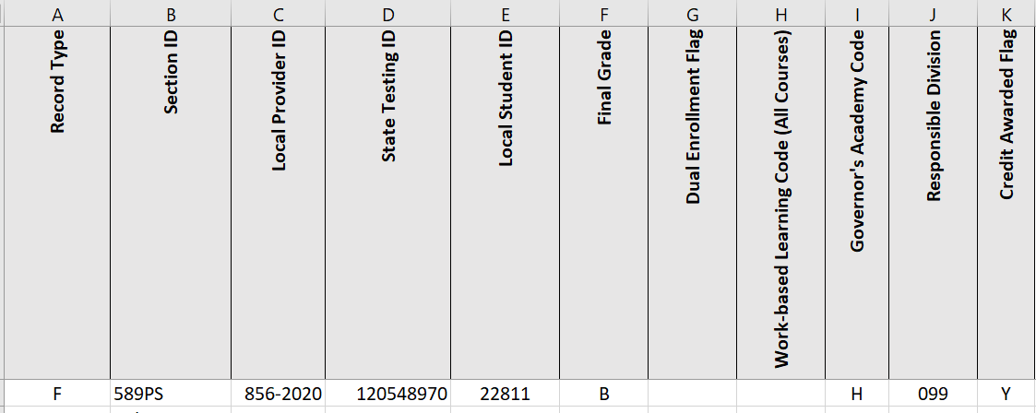
Hayward STEM Academy (0060) in Hayward County (091)
C Record
D Record
F Record

Slide 21
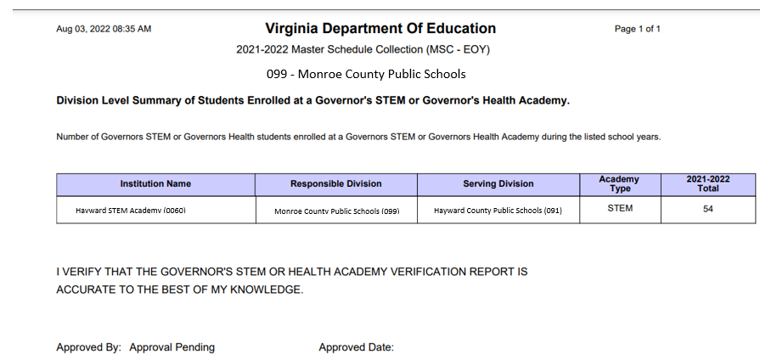
Sample CTE Verification Report

Slide 22
Reporting Timeline
Notes:
.

Slide 23
Fall MSC
Snapshot date of Oct 1st
    Report the student and teachers in a section on Oct 1st
Collection window opens Oct 17, 2022
Divisions must have a successful submission by Dec 7, 2022
    Divisions may continue to upload files after this date but a successful submission status must be maintained.
All Approvals and SDCA must be completed no later than Jan 30, 2023

Slide 24
End of Year
As of the last day of school and summer school courses (tentative dates)
  Report summer courses taken for credit at the secondary level
  Report summer courses taken for promotion in grades K-8
  Do not report summer remediation sessions
  Report students and teachers with 20 or more instructional hours in a section
Collection window opens May 10, 2023
Division must have a successful submission by July 17, 2023
All Local Approvals and SDCA must be completed no later than Aug 14, 2023
* Divisions are highly encouraged to meet the reporting deadlines since the MSC due dates are based on the accountability timelines and reporting requirements for other VDOE offices. The data is used for accreditation (CCCRI), CTE funding, teacher licensure, and MOP program monitoring.

Slide 25
MSC Webpage
  https://www.doe.virginia.gov/info_management/data_collection/master_schedule_collection/index.shtml
Dana Ratcliffe, Education Data Specialist
Phone: 804-225-2827
Email: Dana.Ratcliffe@doe.virginia.gov or
ResultsHelp@doe.virginia.gov
Carol Wells Bazzichi, Data Collection Manager
Email: Carol.WellBazzichi@doe.virginia.gov
Danielle Basham, Office of Facilities and Family Engagement (Private Day School questions)
danielle.basham@doe.virginia.gov

