Slide 1
Master Schedule Collection
Training: Reporting for Private Schools for Special Education Placement
Notes:
Todays webinar contains information Private Schools for Special Education Placement need for MSC reporting.
My name is Dana Ratcliffe, one of the Education Data Specialist in the Office of Data Services.
One of my job responsibilities is maintaining the Master Schedule Collection

Slide 2
Agenda
Background
MSC Reporting Rules
Data Collection/Gathering and Submission
Reporting Timeline
Resources
Contacts
Notes:
The agenda for this presentation is
To cover some of the background information for the MSC.
Reporting Rules
Collecting and submitting the data to the LEAs
Reporting timeline
Resources
And contact information
I’ll also review the Data File Template in detail at the end of the presentation.

Slide 3
Introduction and Background
What is the MSC?
Reporting Rules
Notes:
What is the MSC and what are the reporting rules

Slide 4
What is the Master Schedule Collection?
The Master Schedule Collection was implemented to consolidate and promote efficiency in processing multiple data collections.
It includes course, teacher and student data for publicly served and funded students.
The current MSC is comprised of 10 record types.
Some elements have been retired or are optional to report.
Retired and not required data elements should be included.
Notes:
The Master Schedule Collection was implemented to consolidate and promote efficiency in processing multiple data collections.
It includes course, teacher and student data for publicly served and funded students.
The current MSC is comprised of 10 record types
Some elements have been retired or are optional to report
If a data element is retired or not required it should still be included in the file. Division will need every element when the private school data is combined with the LEAs file.

Slide 5
Why private schools must report
HB1800 (Chapter 552)
The Department of Education shall collect and publish data annually from each private special education day school on: (i) the number of teachers who are not fully endorsed in the content that they are teaching; (ii) the number of teachers who have less than one year of classroom experience; (iii) the number of teachers who are provisionally licensed; (iv) the type of academic credentials attained by each teacher and in what subjects; (v) the number of career and technical education credentials conferred by each school on its graduating students in each of the three prior academic years; (vi) each school's accreditation status, including the accrediting body; and (vii) the number of incidents of restraint and seclusion occurring in each of the previous three academic years.
Notes:
According to the HB 1800 – chapter 552:
The Department of Education shall collect and publish data annually. A few items to be award of is
# 1: the number of teachers who are not fully endorsed in the content that they are teaching;
The reported course and licensure will identify teachers not endorsed in the content area.
# 2: the number of teachers who have less than one year of classroom experience;
The First Year Teacher flag will be used to report this
and #3: the number of teachers who are provisionally licensed;
The license number reported will identify the teachers with a provisional license.
It’s the responsibility of the LEA to report MSC data to VDOE but the private school must provide the data. The results should increase the accuracy of reported data for all students the LEA is responsible for.

Slide 6
Providing Data
Responsible Division A
VDOE
Private School for Special Ed Placement Staff
Secure transfer of Excel file template
Collaborative effort!
Responsible Division B
VDOE
Responsible Division C
VDOE
Notes:
In this diagram you can see:
The Private school will provide the data to the LEA using a secure file transfer method. SSWS Dropbox is a secure method that LEAs and private school have access to.
The LEA incorporates the data into the MSC file to be submitted to VDOE. The private school most likely has multiple schools requesting the data.
It requires time on the LEAs part to combine the data, submit a file, correct errors and complete the verification process.
Divisions need to set reasonable timelines since private schools work with multiple LEAs. Requesting a private school to provide data in 2 days isn’t a reasonable timeline.
Private schools must provide the required data elements to the LEA for reporting in a timely manner as well.

Slide 7
MSC Reporting Rules
Notes:
Let’s review some reporting rules

Slide 8
Overall
This should be a collaborative effort between the division and private schools for special education placement.
The MSC should represent the students’ complete academic experience for the year.
Fall MSC should include a snapshot on Oct 1st of teacher/student/course combinations.
The EOY MSC submission should include data as of the last day of school as well as summer school classes for high school credit or required for promotion in grades K-8.
While each collection may differ because of classes created during the year, all classes that appear in the Fall MSC should also appear in the EOY MSC.
Notes:
This should be a collaborative effort between the division and private schools for special education placement.
The MSC should represent the students’ complete academic experience for the year.
Fall MSC should include a snapshot on Oct 1st of teacher/student and course combinations.
The EOY MSC submission should include data as of the last day of school as well as summer school classes for high school credit or required for promotion in grades K-8.
Teachers who provide 20 or more hours of instruction and student who received 20 or more hours of instruction should be included on the EOY MSC.
Both the Fall and EOY MSC should contain classes for the entire school year. While each may differ because of classes created during the year, all classes that appear in the Fall MSC should also appear in the EOY MSC.

Slide 9
Teachers
The B Record (teacher demographics) is only reported on Fall and NOT EOY.
Long term subs should only be reported if they are filling a vacant position.
There must be a teacher of record or long term sub on each section.
Co-teachers may be added as additional staff.
Teachers that provided 20 or more hours of instruction should be included in the B record.
Notes:
The B Record contains teacher demographics and is only reported in the Fall and NOT EOY
Every required data element in the B Record must be completed
I will review the B record in detail at the end of the presentation and go over what’s required
This data is used to determine teacher endorsements and qualifications in early Spring
Teachers reported in private facilities will not be included in the LEAs IPAL report
Long term subs should only be reported if they are filling a vacant position
A positions is considered vacant if the LEA has advertised to fill the position. If a teacher is out on medical leave, the substitute in the class is not considered a long term sub for reporting reason since the teacher will be returning.
There must be a teacher of record or long term sub on each section. Co-teachers may be added as additional staff.
Teachers that provided 20 or more hours of instruction should be included in the B record.

Slide 10
Courses
Report each teacher associated with the class during the school year.
Courses are identified at VDOE by the SCED code in combination with the local section ID, so it is imperative to report the correct SCED.
SCED codes are a 5-digit Course Code that provides a basic structure for classifying course content.
Additional SCED elements and attributes such as the VA Extended Description provide descriptive information about each course.
Notes:
Courses
Report each teacher associated with the class during the school year.
Courses are identified at VDOE by the SCED code in combination with the local section ID, it’s important to report the correct SCED code.
SCED codes are a 5-digit Course Code that provides a basic structure for classifying course content.
Additional SCED elements and attributes such as the Va Extended Description provide descriptive information about each course.

Slide 11
Courses
NCES SCED Finder website https://nces.ed.gov/scedfinder/Home/Search?AspxAutoDetectCookieSupport=1
VA Active SCED List
Nation SCED Finder website
Notes:
The NCES SCED Finder website does not only lists Va active SCED codes but all national codes. The course description is outlines for each SCED.
Va Active SCED list:
In the example, 03 represents the subject code for science.
The Va Extended Description designates the code as being for Elem grade levels.
The Final Grade Flag indicates if a final grade must be reported on the EOY MSC.
A secondary course shouldn’t have a SCED code for an elementary course.
The National SCED finder websites lists the Code Title and Description for SCED 03151:

Slide 12
Sections
Report each teacher associated with the class during the school year.
For example: Mrs. Smith is the teacher of record on Oct 1st for a yearlong Journalism I class at Elm HS in Monroe County, but had to resign after 2 month. Mr. Hill is reported as the teacher of record on the last day of school for the Journalism I class.
Both teachers must be reported on the EOY MSC since each provided more than 20 hours of classroom instruction.
Special Education teachers associated with a course will require a Defined Class Type.
Special education teacher in a general education class
A self contained special education class.
Notes:
Sections
Report each teacher associated with the class during the school year.
Teachers that provided 20 or more hours of instruction should be reported.
The class might have 2 different teachers during the year. Each one must be reported.
For example:
Mrs. Smith is the teacher of record on Oct 1st for a yearlong Journalism I class at Elm HS in Monroe County, but had to resign after 2 month. Mr. Hill is reported as the teacher of record on the last day of school for the Journalism I class.
Both teachers must be reported on the EOY MSC since each provided more than 20 hours of classroom instruction.
A Special Education teacher associated with a course will require a Define Class Type.
This includes a special education teacher in a general education class and
A self contained special education class.
The Define Class Type should reflect the students the class is intended for and not the content.

Slide 13
Students
When reporting out-of-state students, this should only include students enrolled in a VA LEA, not students enrolled in a LEA from another state.
The Final Grade and Credit Awarded Flag is collected on the EOY MSC for grades 6-12.
Students who received 20 or more instructional hours in a class should be reported.
A student could have multiple F records for the same section depending on how many teachers are associated with the section.
Notes:
Students
When reporting out-of-state students, this should only include students enrolled in a VA LEA, not students enrolled in a LEA from another state.
The Final Grade and Credit Awarded Flag is collected on the EOY MSC for grades 6-12.
Students who received 20 or more instructional hours in a class should be reported.
A student could have multiple F records for the same section depending on how many teachers are associated with the section.
This goes back to the scenario where a teacher starts the school year in a class but resigns. Another teacher was hired to fill the vacant position.

Slide 14
Data Collection/Gathering and Submission Process
Notes:
Now lets look at the process of gather and submitting the data to the LEAs

Slide 15
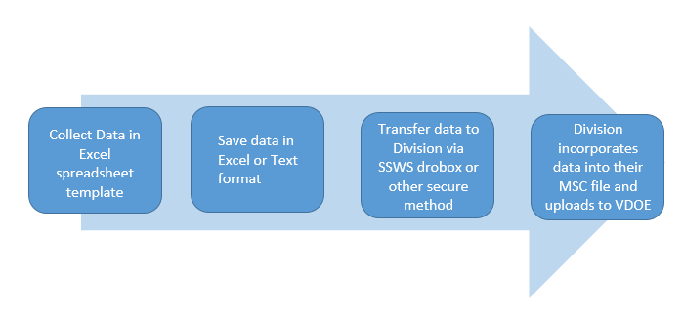
Data Flow
Notes:
The first step is to gather the data. The Excel Data File Template is a good resource.
The data should be saved in either Excel or Text format, depending on what the division has requested.
It’s easier for division to combine the private school data into the raw MSC file if it’s in Text format.
It’s important to use a file transfer method that is secure.
The division will incorporate the private schools data into the MSC file and upload it to VDOE.
A file might be uploaded multiple time depending on the number errors.

Slide 16
Data Collection
Record Types for the Fall MSC
MSC
Notes:
Fall MSC requires the
B record that contains the teacher demographics used with the IPAL report
C record that contains the course details
The D record shows the teacher and course connection
and the F record that shows the student, teacher and course connection.
The records are linked using the Section ID
There are some record types that might or might not need to be reported.
This include the
I record if 2 different CTE courses are taught during the same class period. The records need to be connected.
J record is for teachers who oversee students enrolled in a co-op course.
Report the K record if the course is designated as an interdisciplinary course. An interdisciplinary course is when a LEA combines 2 different courses together to form 1 course.
And the E record is used to report unlicensed teachers. This is also used to report vendors that might provide course content. An example could be a self paced type of course.
Since only private school teacher data is collected, the G record will not be reported. Normally this is used to report administrator or pupil personnel such as librarians or guidance.

Slide 17
Data Collection
Record Types for the End of Year MSC
B (Teacher Demographic)
Fall only
Notes:
End of year MSC requires
The C record that contains the course details
The D record shows the teacher and course connection
and the F record that shows the student, teacher and course connection.
The records are linked using the Section ID
The same condition applies for EOY as in the Fall for the optional records. The I, J, K and the E records should only be reported if needed.
Record G will not be collected on the end of year MSC and the B record will not be collected since teacher demographics is only needed in the fall.

Slide 18
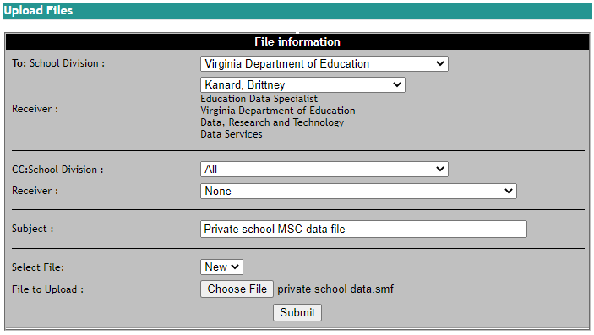
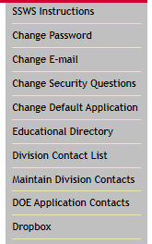
Submit Data
It’s important to use a file transfer system that is secure. One secure method is to use SSWS Dropbox.
Notes:
It’s important for private schools and LEAs to use a file transfer system that is secure. One option is to use the SSWS Dropbox since it’s a secure file transfer system offered by VDOE. Some staff in the LEAs and private schools have access to the dropbox. The person with access at the private school might be the same person gathering the data.
The dropbox link is found in the right side menu once logged into SSWS.
Select the division and person to transfer the file to.
Type in a subject and choose the file to upload.
The designated person will receive an email that a file has been shared using the dropbox.
Retrieve the file at the bottom of this same screen.

Slide 19
Reporting Timeline
Notes:
Reporting timeline

Slide 20
Fall MSC
Who is included?
Teachers and students enrolled in a course on Oct 1st
Reporting Timeline
Opens October 17, 2022
Successful submission December 7, 2022
LEAs may continue to submit files to make corrections but a successful submission must be maintained.
Closes January 30, 2023 (includes verification)
Notes:
Fall MSC:
Who is included?
Teachers and students enrolled in a course on Oct 1st
For the 2022-2023 school year:
The collection Opens October 17, 2022
A Successful submission is due December 7, 2022
LEAs may continue to submit files to make corrections but a successful submission must be maintained.
The fall MSC closes January 30, 2023. This includes all local approvals and the Superintendent’s verification.

Slide 21
EOY MSC
Who is included?
Teachers that provided at least 20 hours of instruction and students who received at least 20 hours of course content instruction
Reporting Timeline
Opens Mid-May
Successful submission Mid-July
LEAs may continue to submit files to make corrections but a successful submission must be maintained.
Closes Mid-August (includes verification)
Notes:
End of year MSC
Who is included?
Teachers that provided 20 or more hours of instruction and students who received 20 or more instructional hours of course content during the school year.
The EOY MSC opens Mid-May
A Successful submission is due Mid-July
And the collection closes Mid-August. This includes all local approvals and the Superintendent’s verification.

Slide 22
Resources
Notes:
What resources are available?

Slide 23
Resources
The MSC web page contains all current documentation:
Specifications for Completing the Master Schedule Collection
Details every data element, contains data edits, and reporting rules.
Data Elements
Excel and PDF table containing the data elements, similar to the Specifications Document.
Data File Template
Follows the layout of the text file submitted.
VA Active SCED List
Valid SCED codes
Notes:
First there is the MSC web page. This contains current documentation such as the:
Specifications for Completing the MSC
This details each data element, any edits and valid codes.
Data Elements file
is very similar to the Specification document but in a different format.
This could be used as a quick reference guide
Data File Template
This follows the layout in a spreadsheet format, making it easier to enter data.
This is one resource LEAs use to resolve errors.
Va Active SCED List
This is a list of valid VA assigned SCED codes. Only SCED codes listed can be reported. Any other SCED is invalid. LEAs need to assist the private schools with assigning the correct SCED code.

Slide 24
Contact Information
Master Schedule Collection web site
https://doe.virginia.gov/info_management/data_collection/master_schedule_collection/index.shtml
Dana Ratcliffe, Education Data Specialist
MSC data element questions only
Email: Dana.Ratcliffe@doe.virginia.gov or
ResultsHelp@doe.virginia.gov Monitored: 7:30 am to 4:00 pm, Monday through Friday except for state holidays
Carol Wells Bazzichi, Data Collection Manager
Email: Carol.WellsBazzichi@doe.virginia.gov
Danielle Basham, Office of Facilities and Family Engagement
All Private Schools for Special Education Placement questions
Email: Danielle.Basham@doe.virginia.gov
Notes:
The URL for the MSC web page is on the screen
I can be reached at dana.Ratcliffe@doe.Virginia.gov for any questions pertaining to MSC data elements
ResultsHelp is also monitored from 7:30 to 4:00pm each day other then on state holidays.
You can also reach out to Carol Well Bazzichi who is the data collection manager
Contact Danielle Basham with the Office of Facilities and Family Engagement with private schools for special education placement questions.

